Slide 2
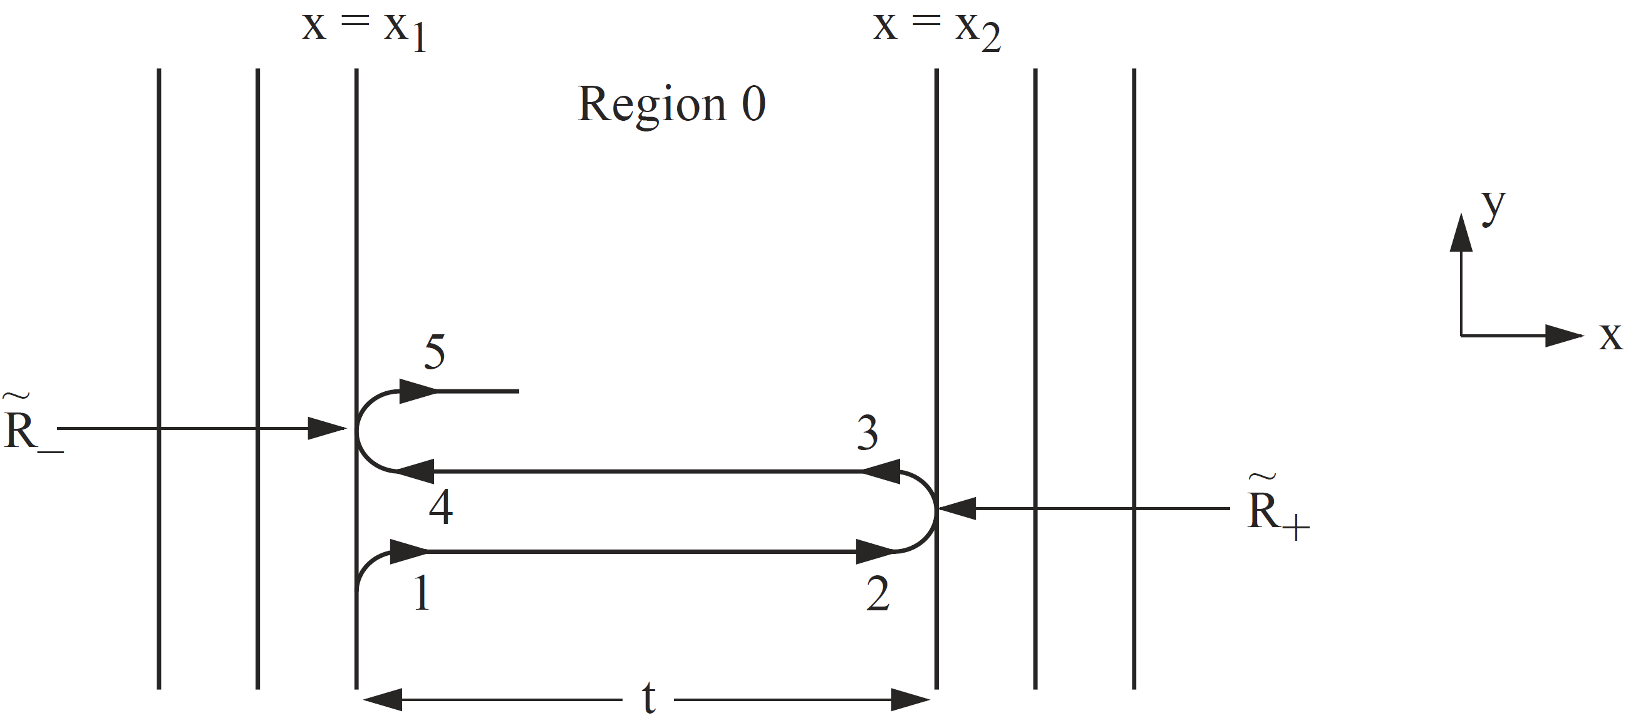

Slide 8
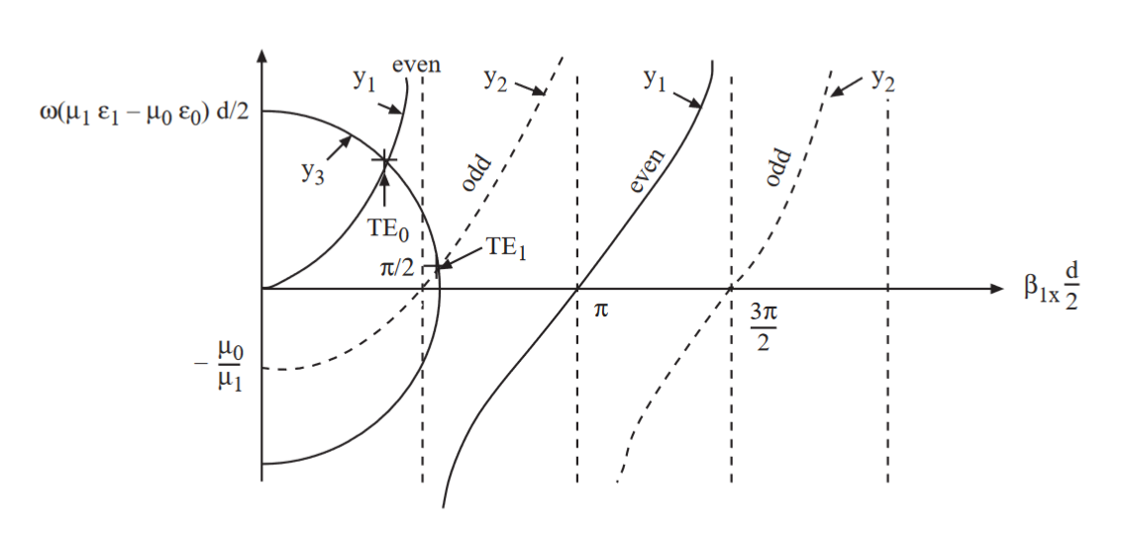

Slide 10
Courtesy of J.A. Kong

Slide 11
Courtesy of J.A. Kong

