Slide 12
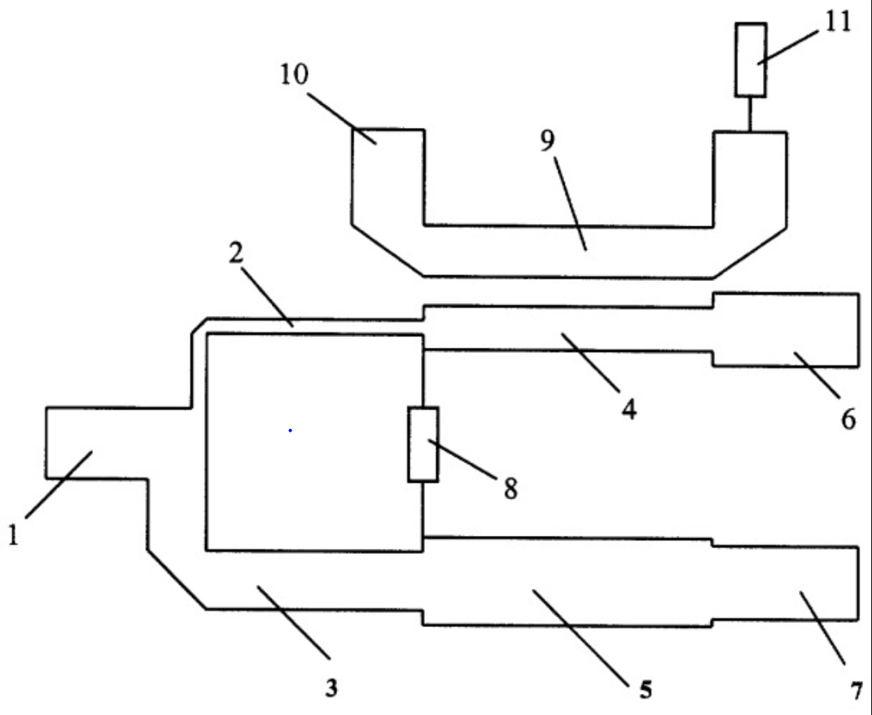
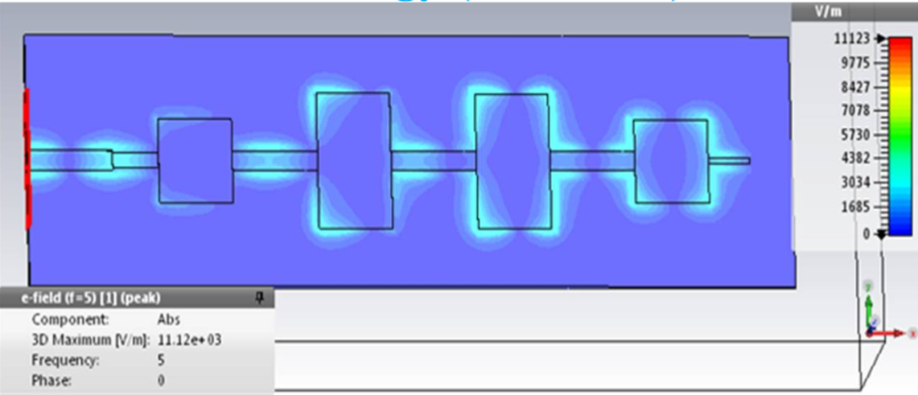

Slide 13
Microwave Integrated Circuit

Slide 14
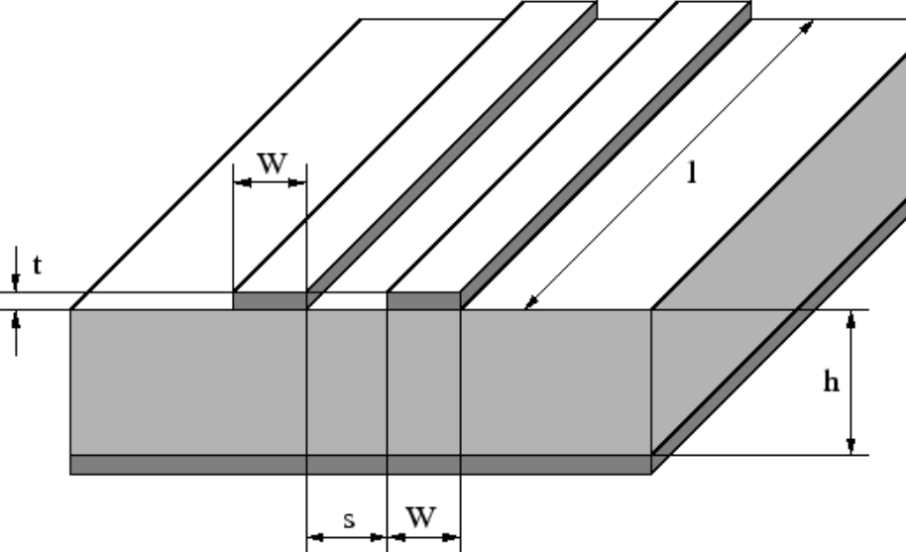
Microstrip Line Waveguide

Slide 17
