Slide 1
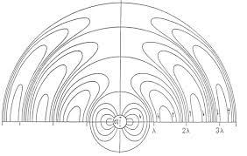
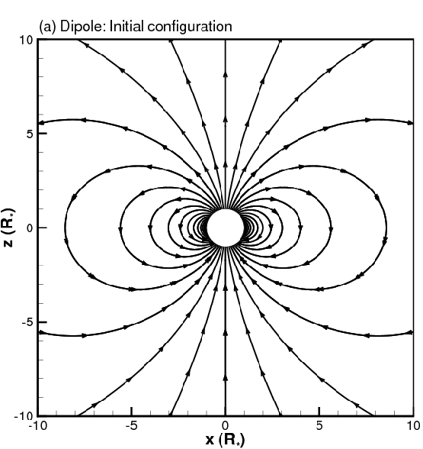
Scalar and Vector Potentials for Time-Harmonic Fields
Scalar and Vector Potentials for Statics, A Review
Scalar and Vector Potentials for Electrodynamics
More on Scalar and Vector Potentials
When is Static Electromagnetic Theory Valid?
Quasi-Static Electromagnetic Theory

Slide 10
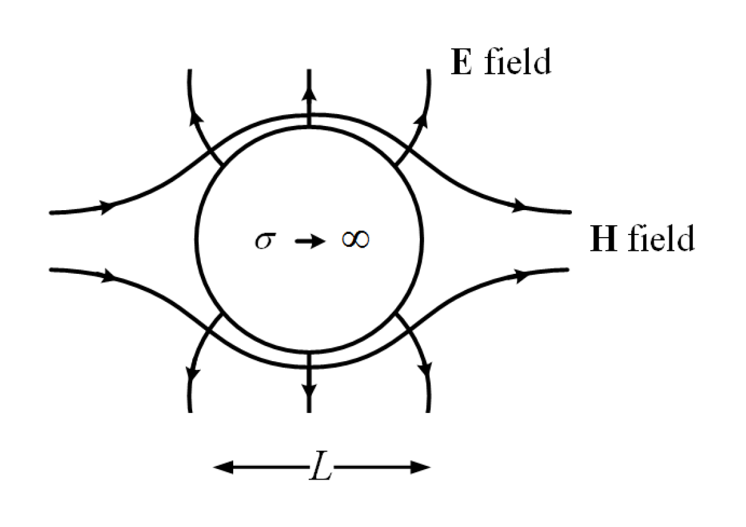

Slide 13
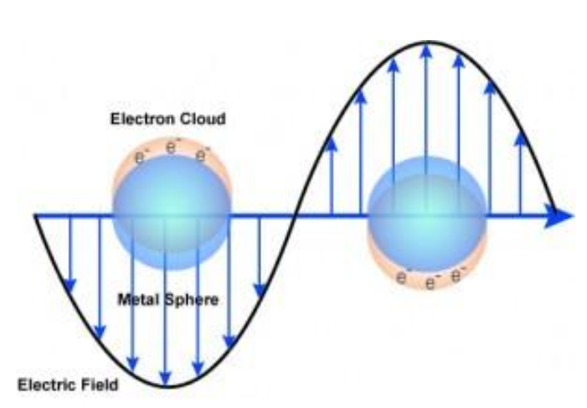

Slide 14
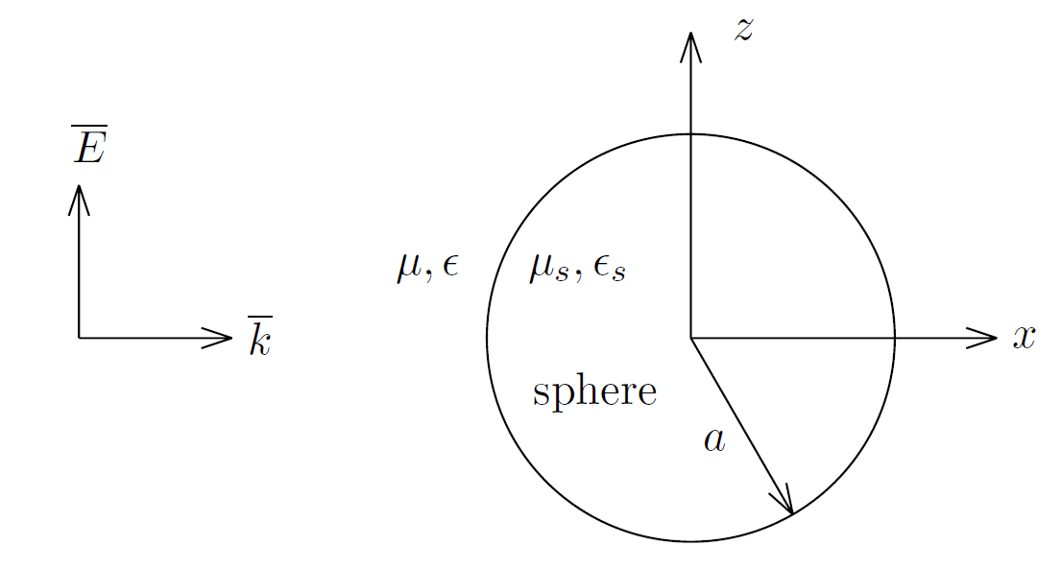
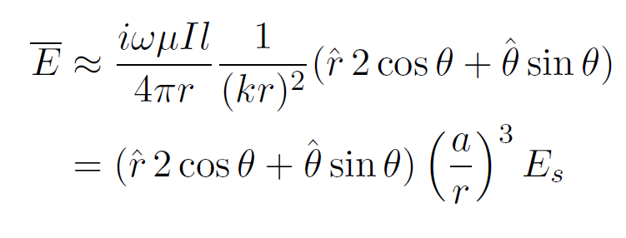

Slide 15
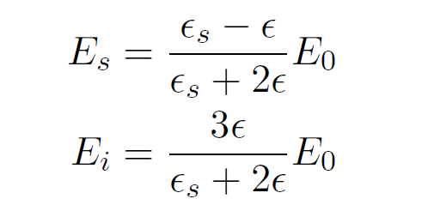

Slide 16
Circuit Theory Revisited 229
Circuit Theory Revisited
Kirchhoff Current Law
Kirchhoff Voltage Law
Inductor
Capacitance
Resistor

Slide 17
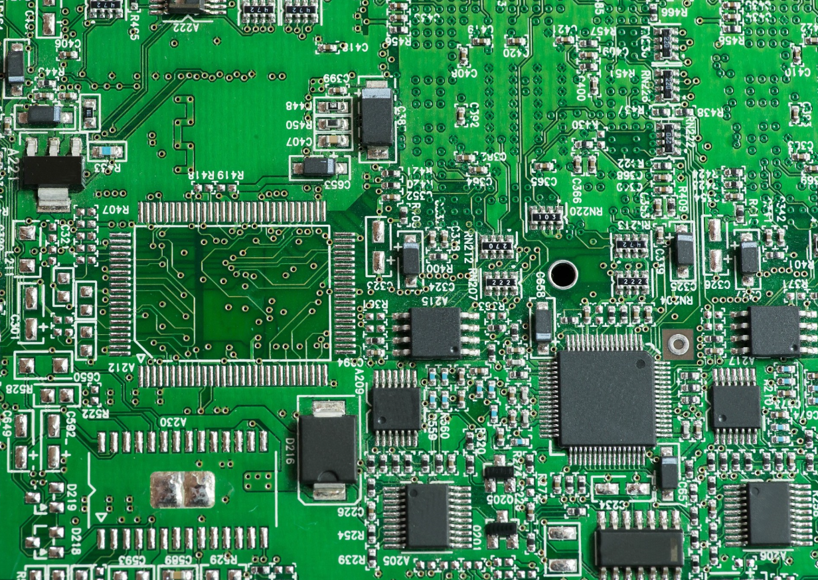

Slide 18
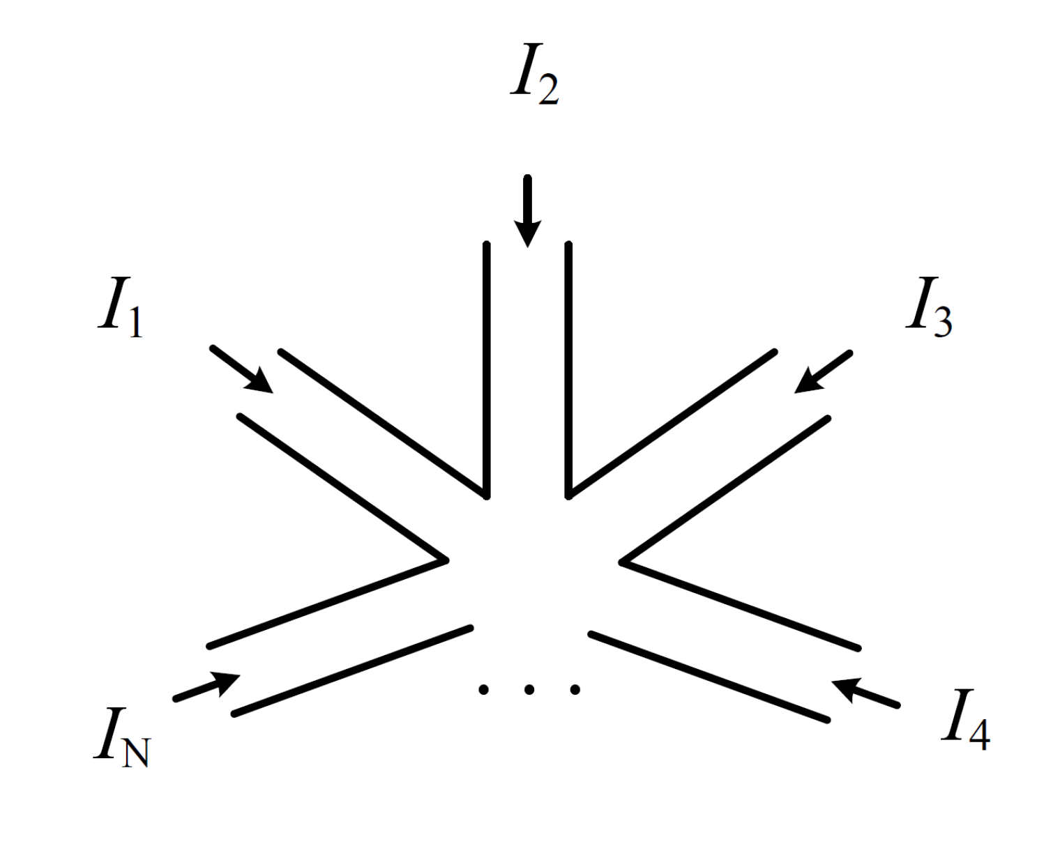

Slide 20
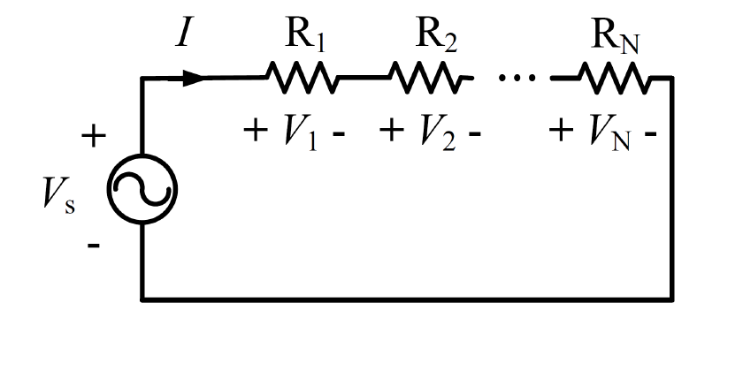

Slide 22
