Slide 1
Homomorphism of Waveguides and Transmission Lines
TE Case
TM Case
Mode Conversion

Slide 2
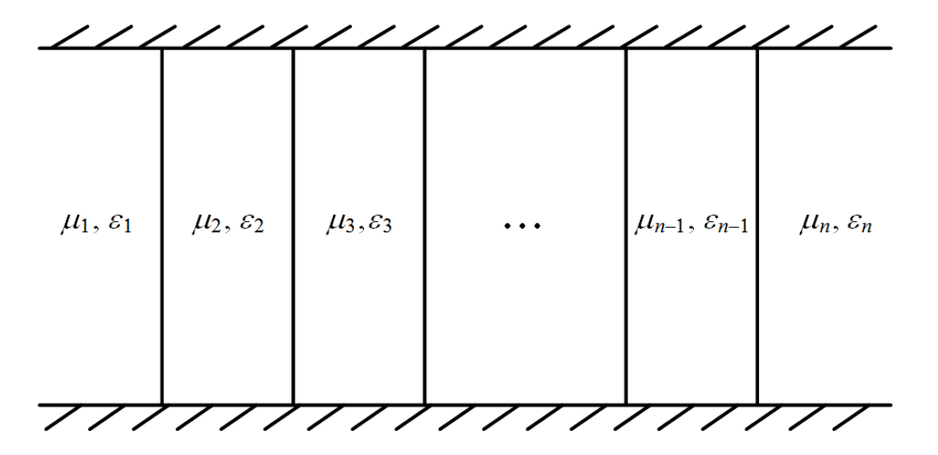

Slide 9
Resonators
Cavity Resonators
Transmission Line Model
Cylindrical Waveguide Resonators
Some Applications of Resonators
Filters
Electromagnetic
Frequency Sensor

Slide 10
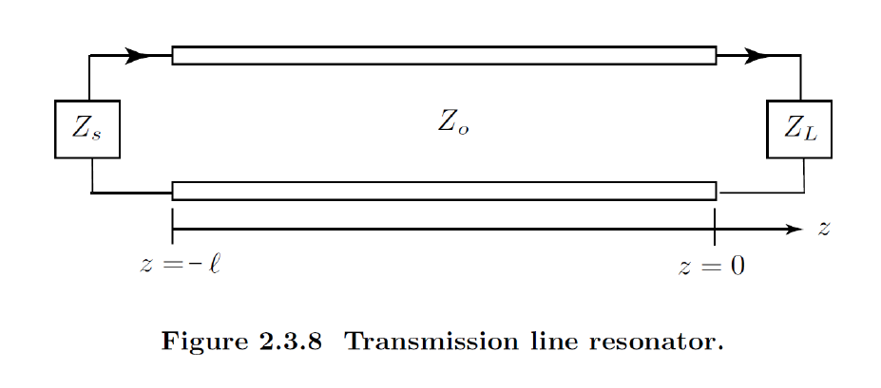

Slide 11
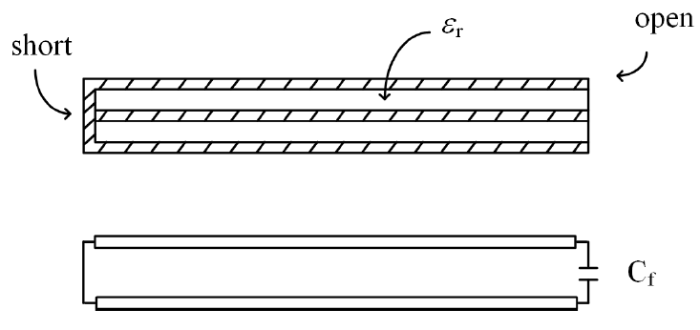

Slide 17
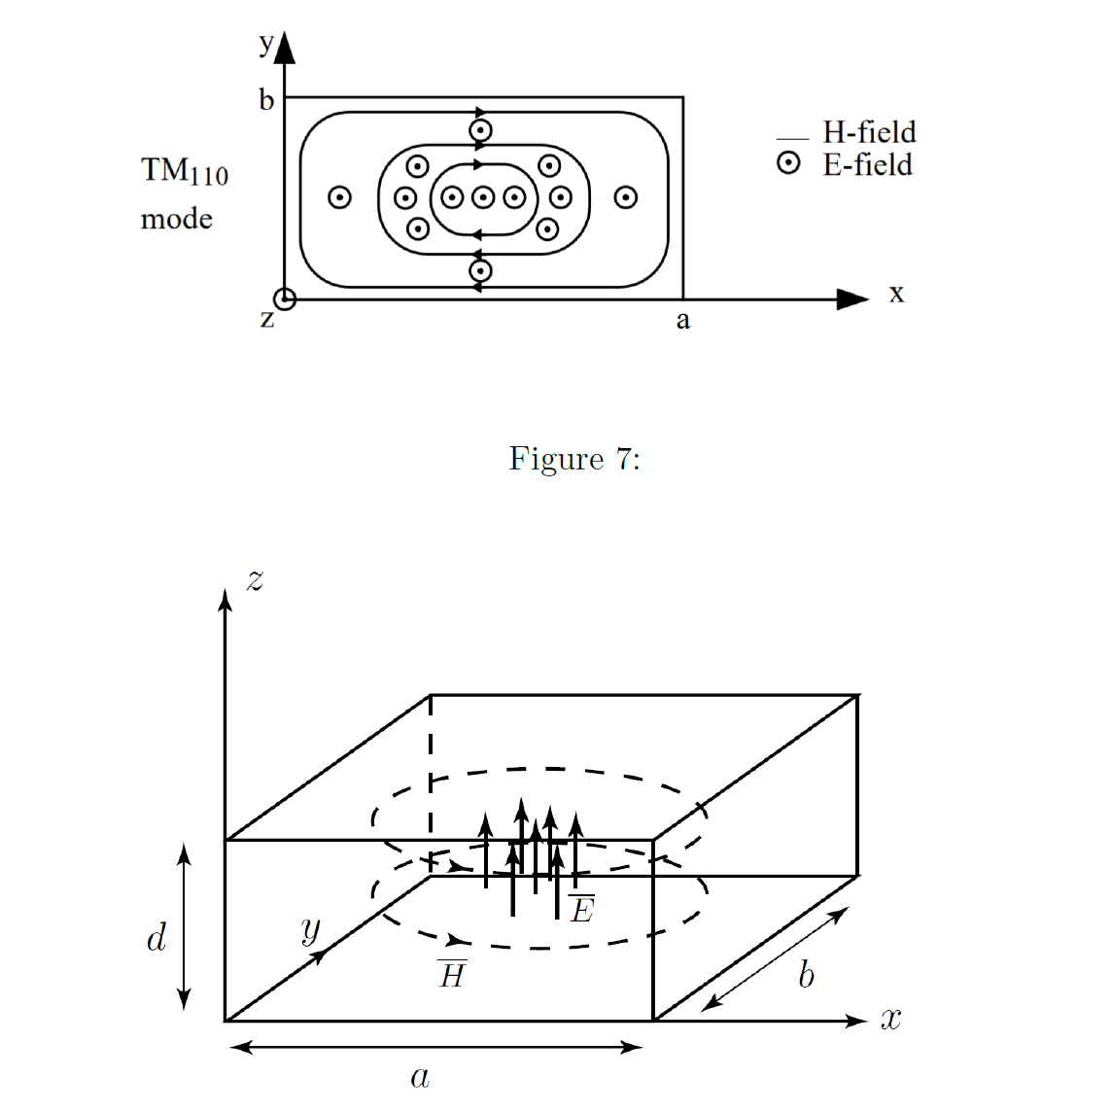

Slide 18
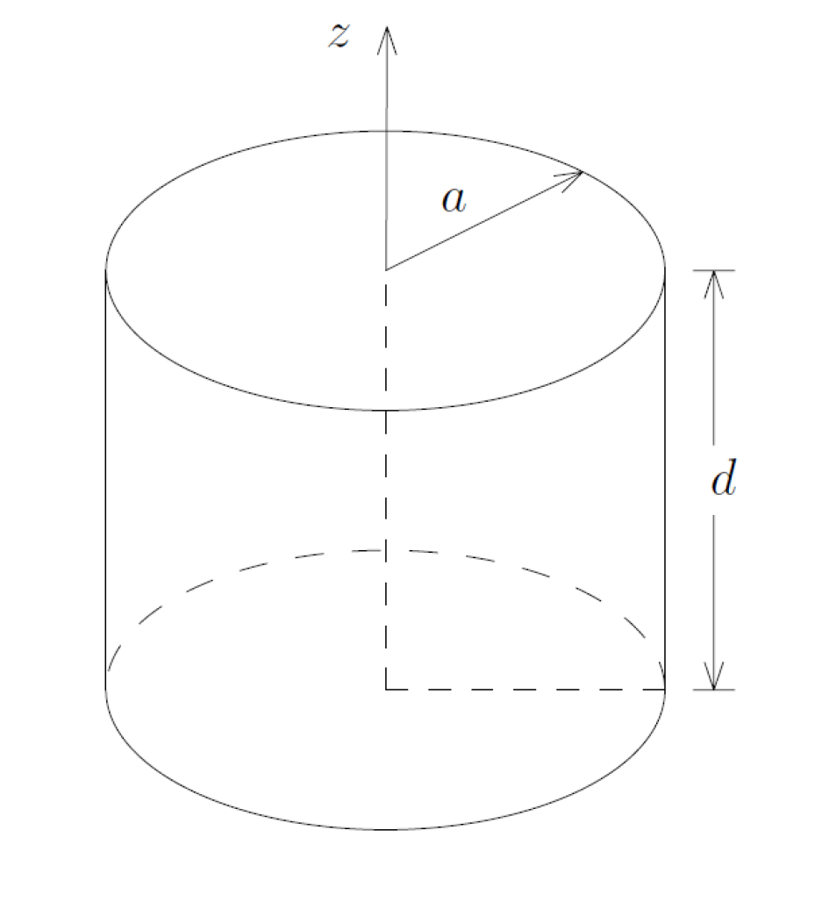

Slide 19
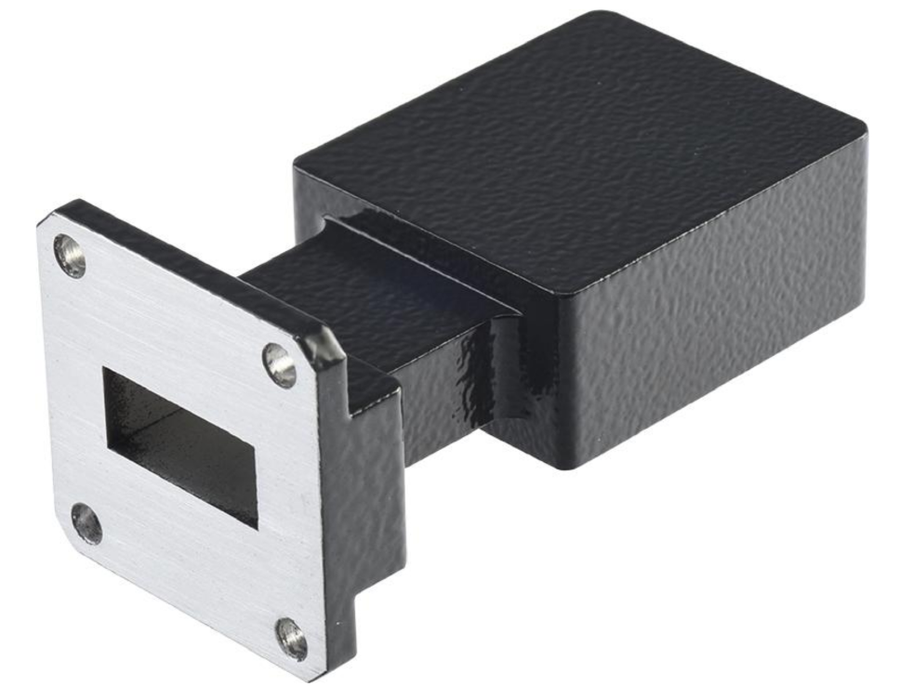

Slide 20
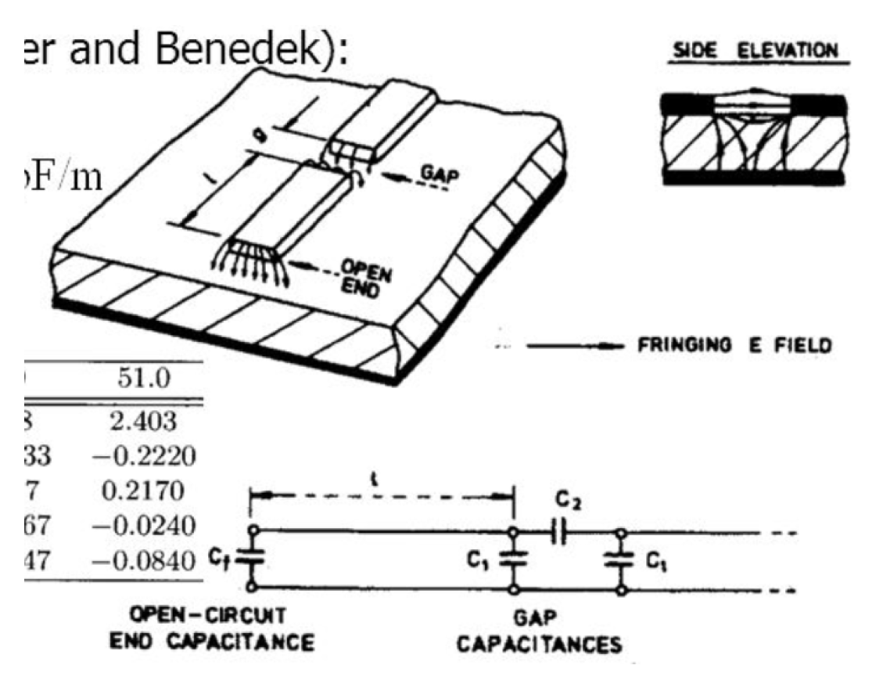

Slide 21
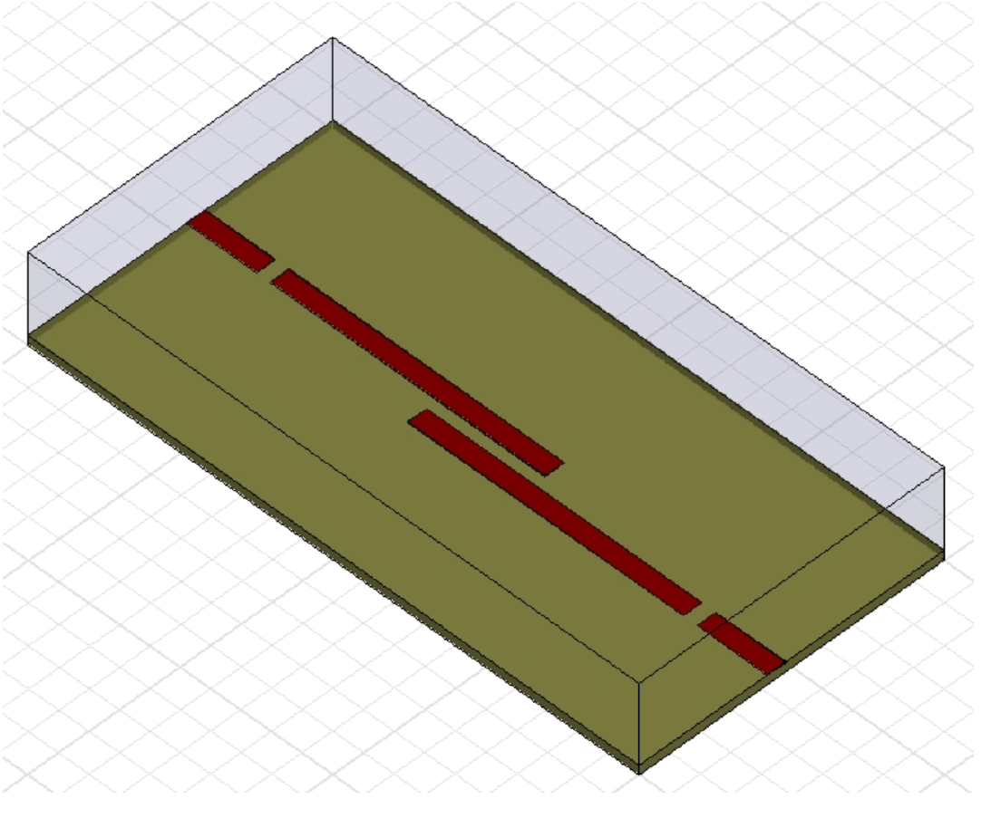

Slide 24
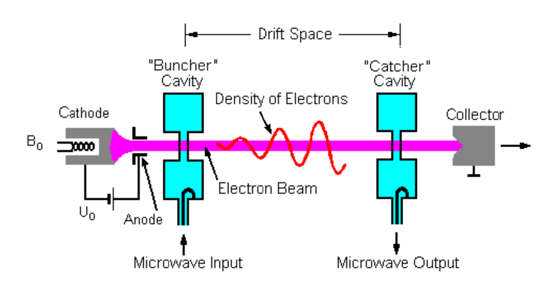

Slide 25
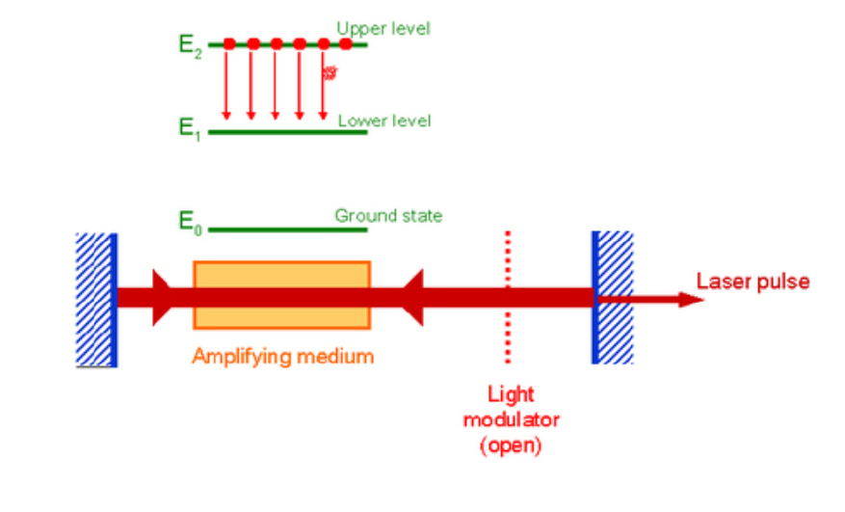

Slide 27
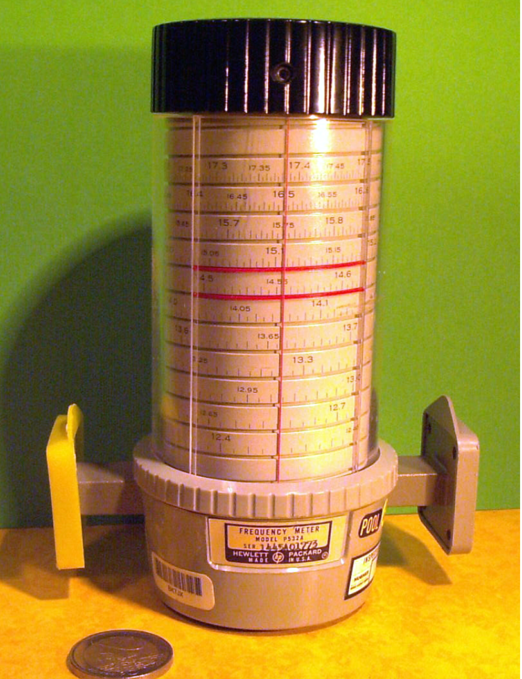

Slide 28
