Slide 1
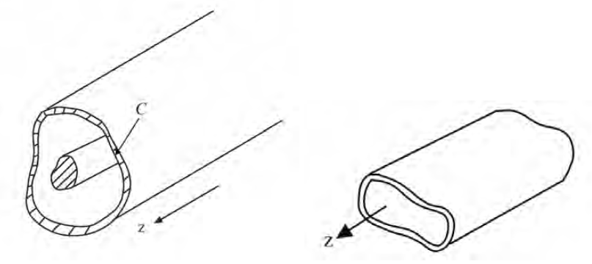
Hollow Metallic Waveguides: TE_{z} mode construction
where

Slide 2
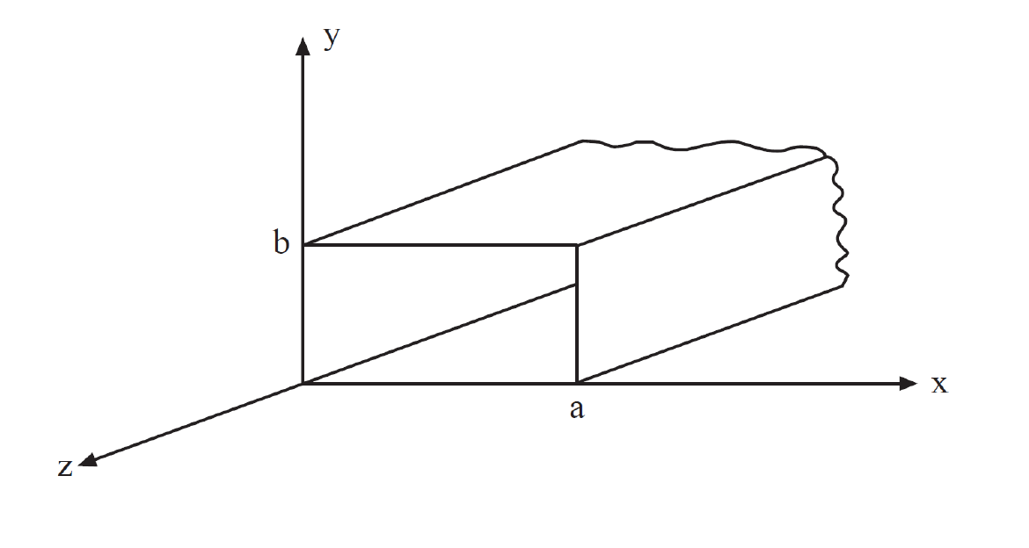
Rectangular Waveguides

Slide 4
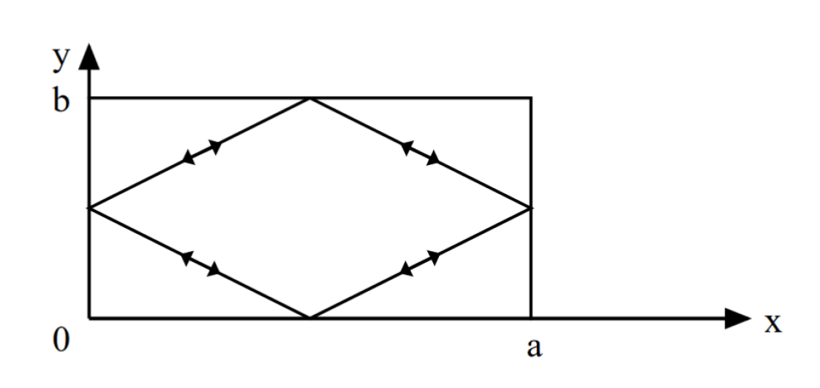
Bouncing wave picture

Slide 5
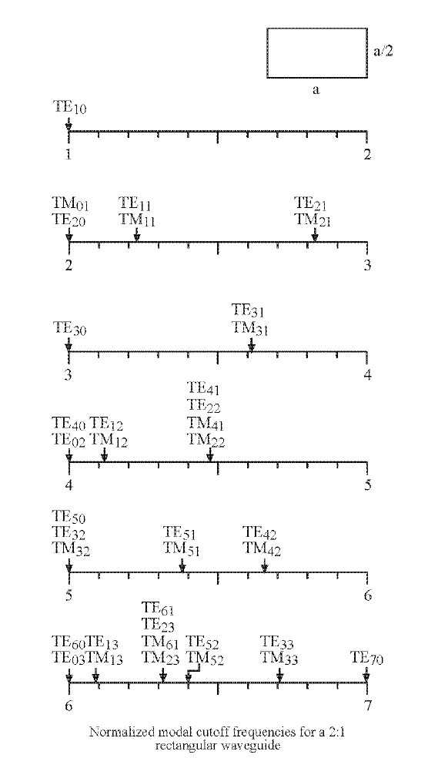
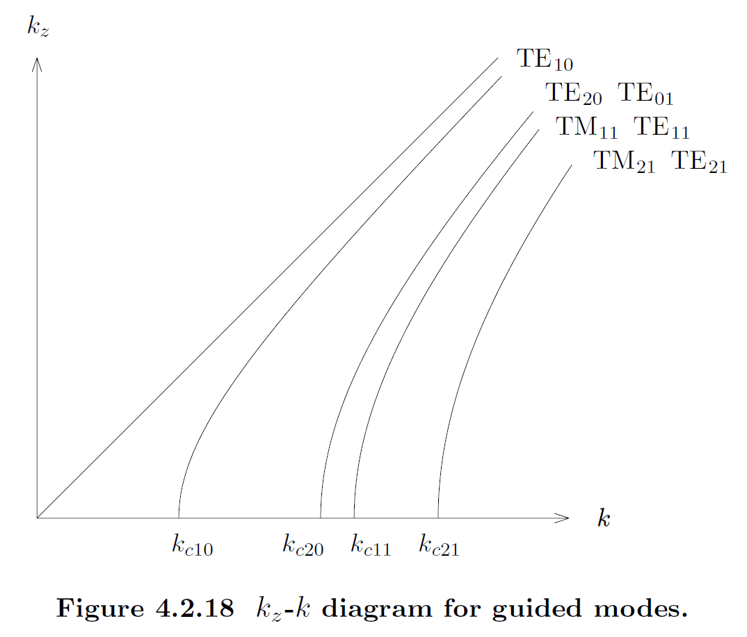

Slide 6
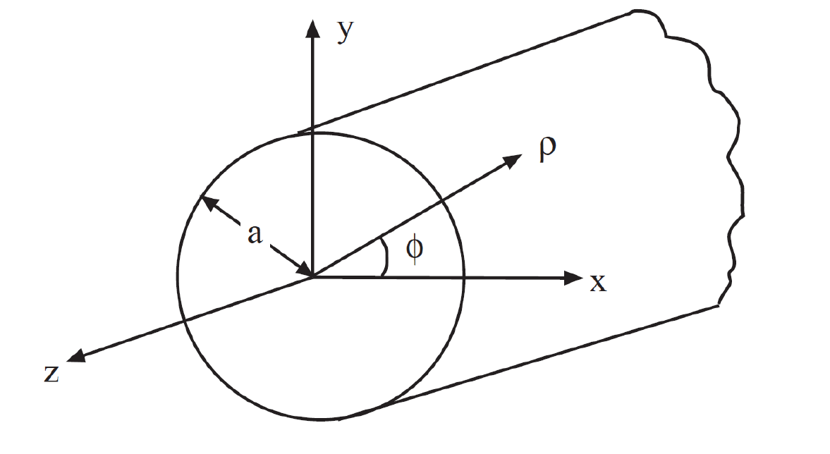
Circular Waveguides

Slide 7
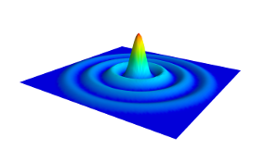
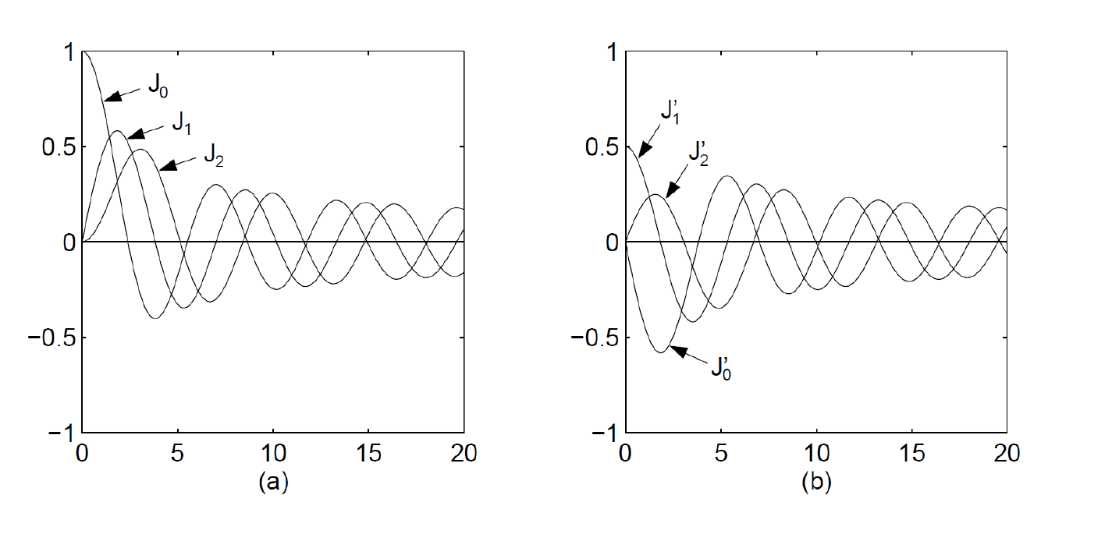
Bessel functions of the first kind and zeros

Slide 8
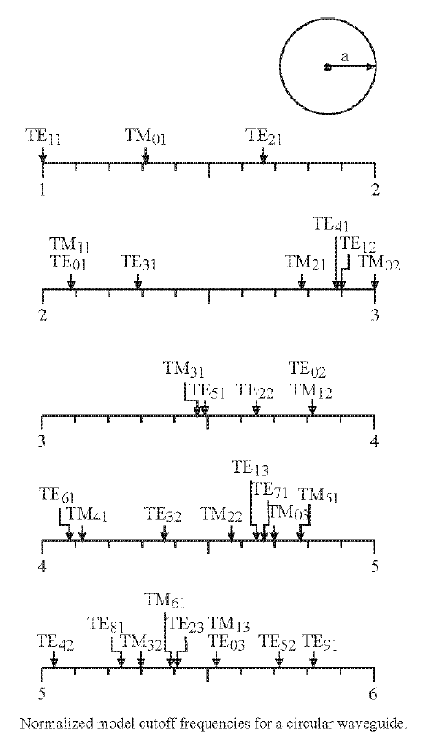
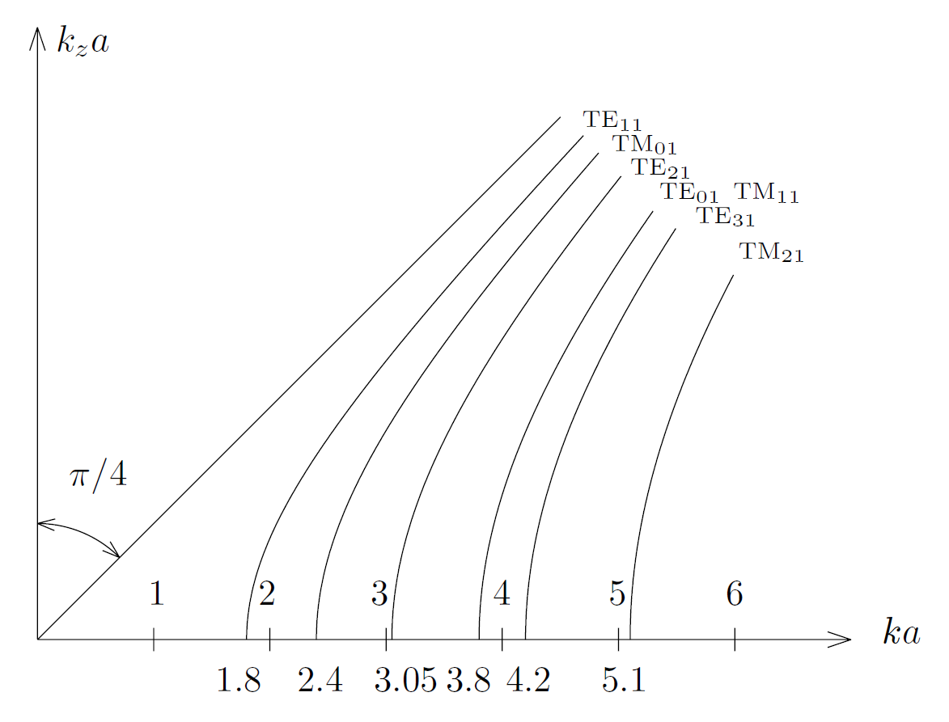

Slide 9
Field Configurations

Slide 10
Least Ohmic loss on a metallic wall via TE₀₁ mode

Slide 11
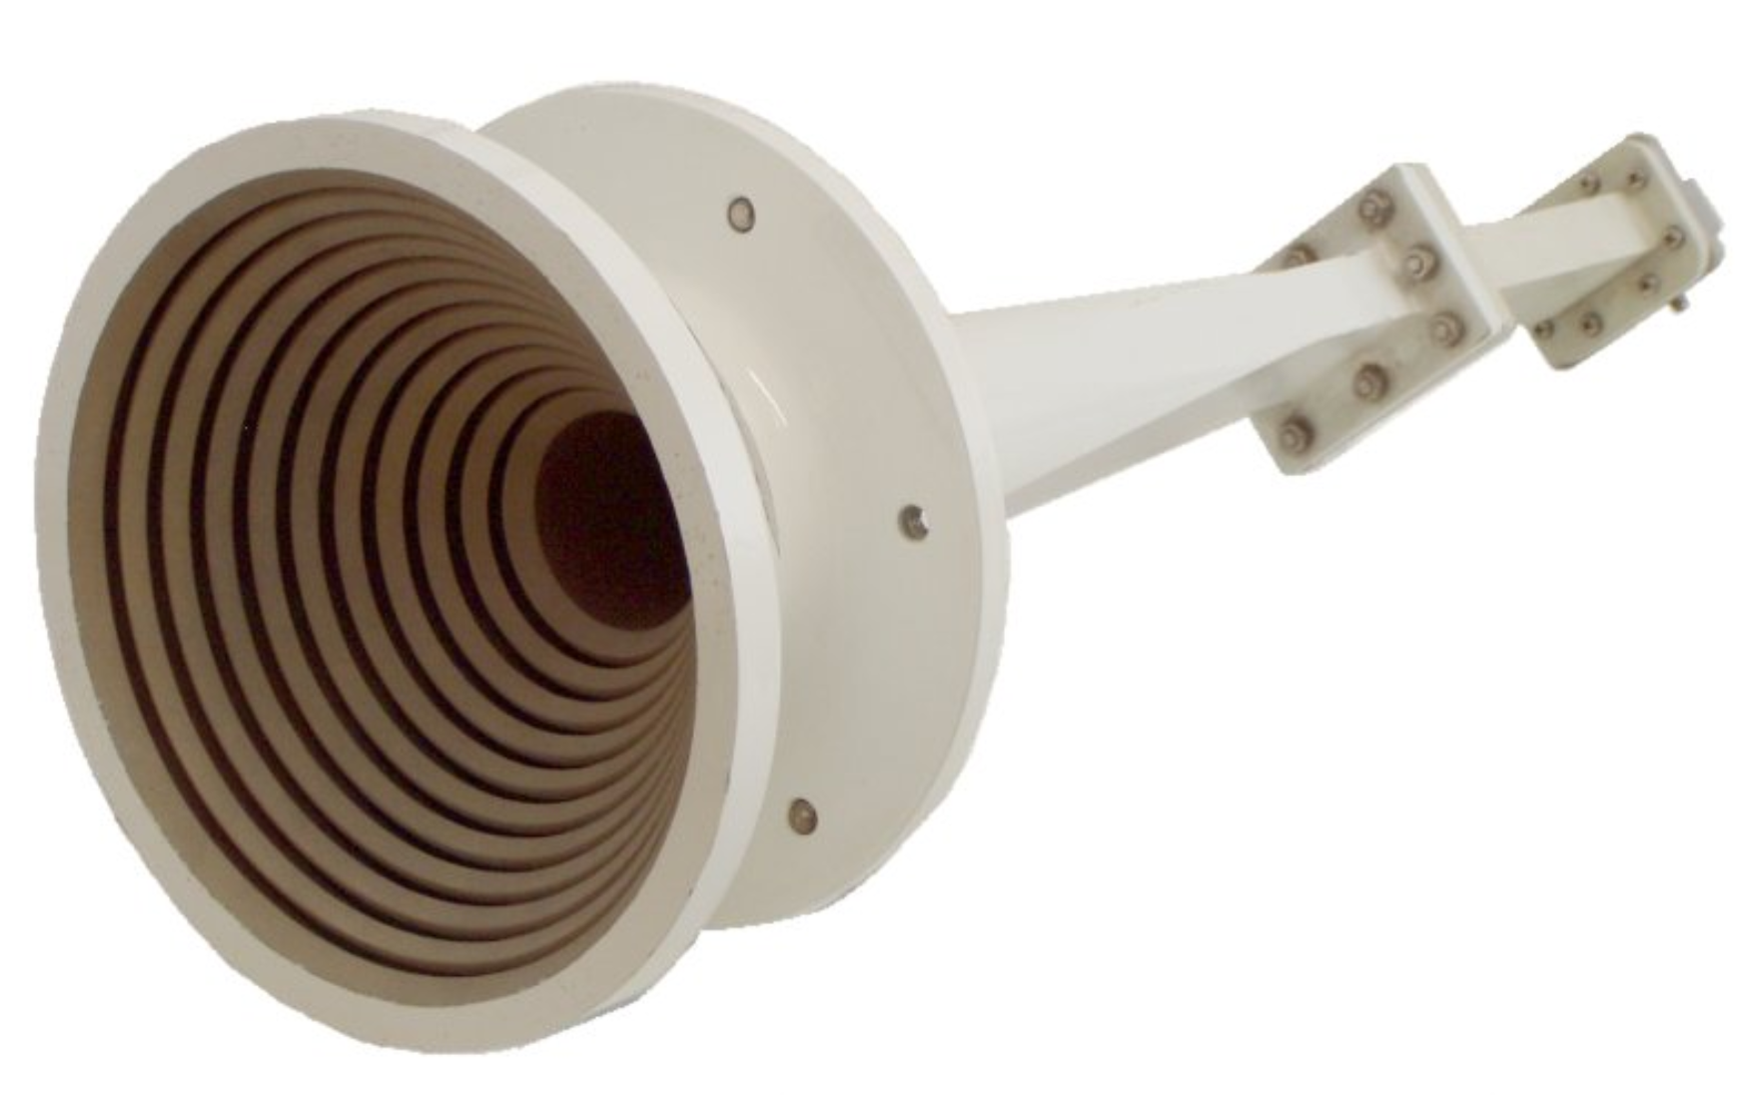

Slide 12
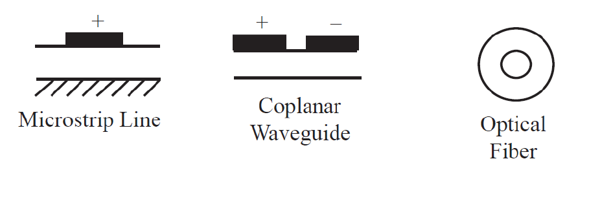
Quasi-TEM mode

