Slide 1
Dielectric Waveguides
Generalized Transverse Resonance Condition

Slide 2
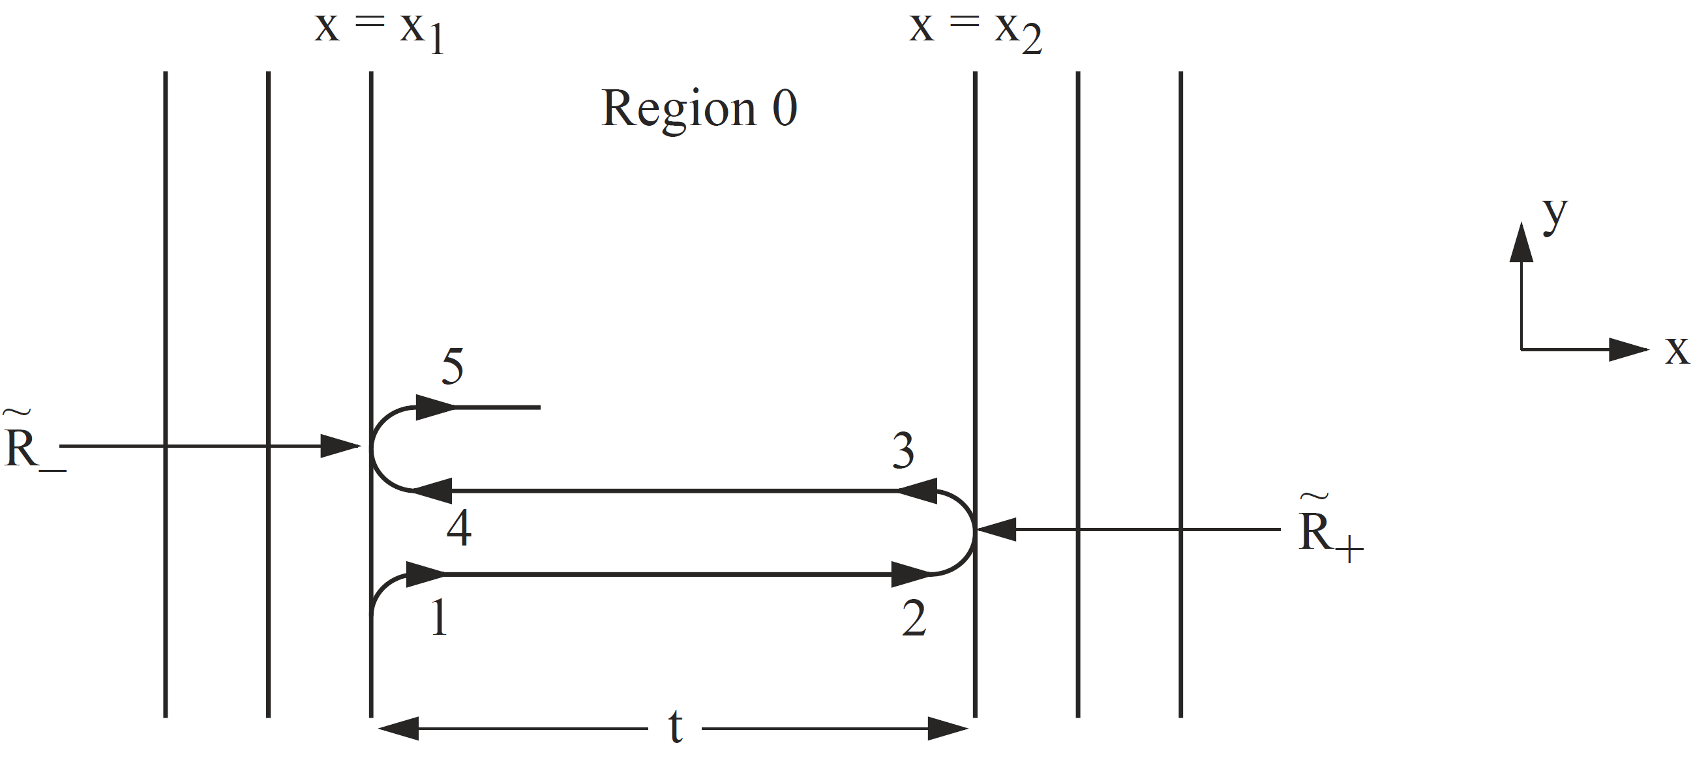

Slide 4
Dielectric Waveguide

Slide 7
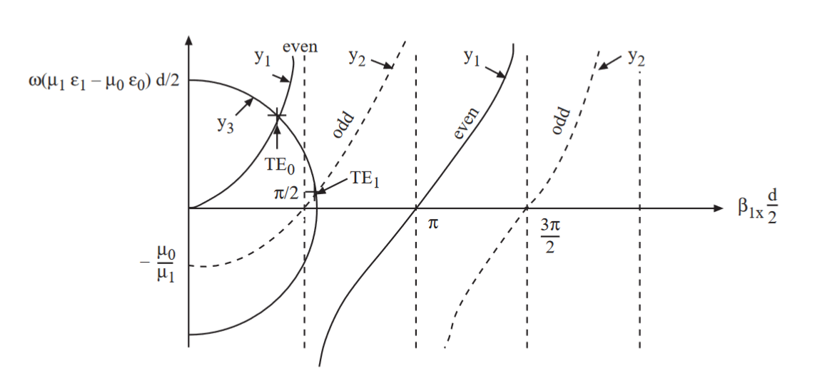

Slide 9
Courtesy of J.A. Kong

Slide 10
Courtesy of J.A. Kong

Slide 11
Hollow Waveguides

Slide 12
TE Case (Ez = 0, Hz = 0)
Absence of TEM Mode in a Hollow Waveguide
TM Case (Ez = 0, Hz = 0)

