Slide 1
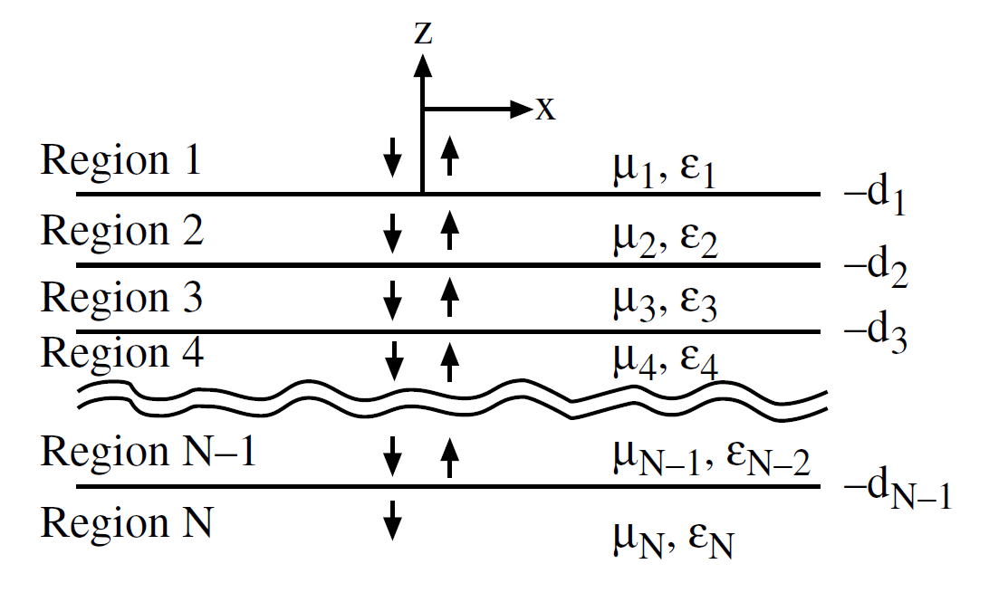
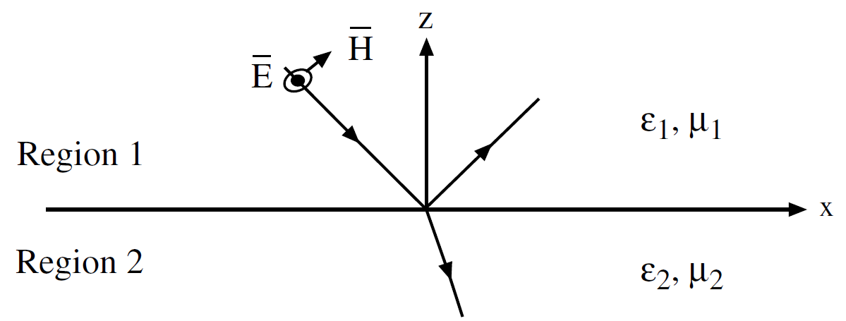
Waves in Layered Media
Generalized Reflection Coefficient for Layered Media

Slide 4
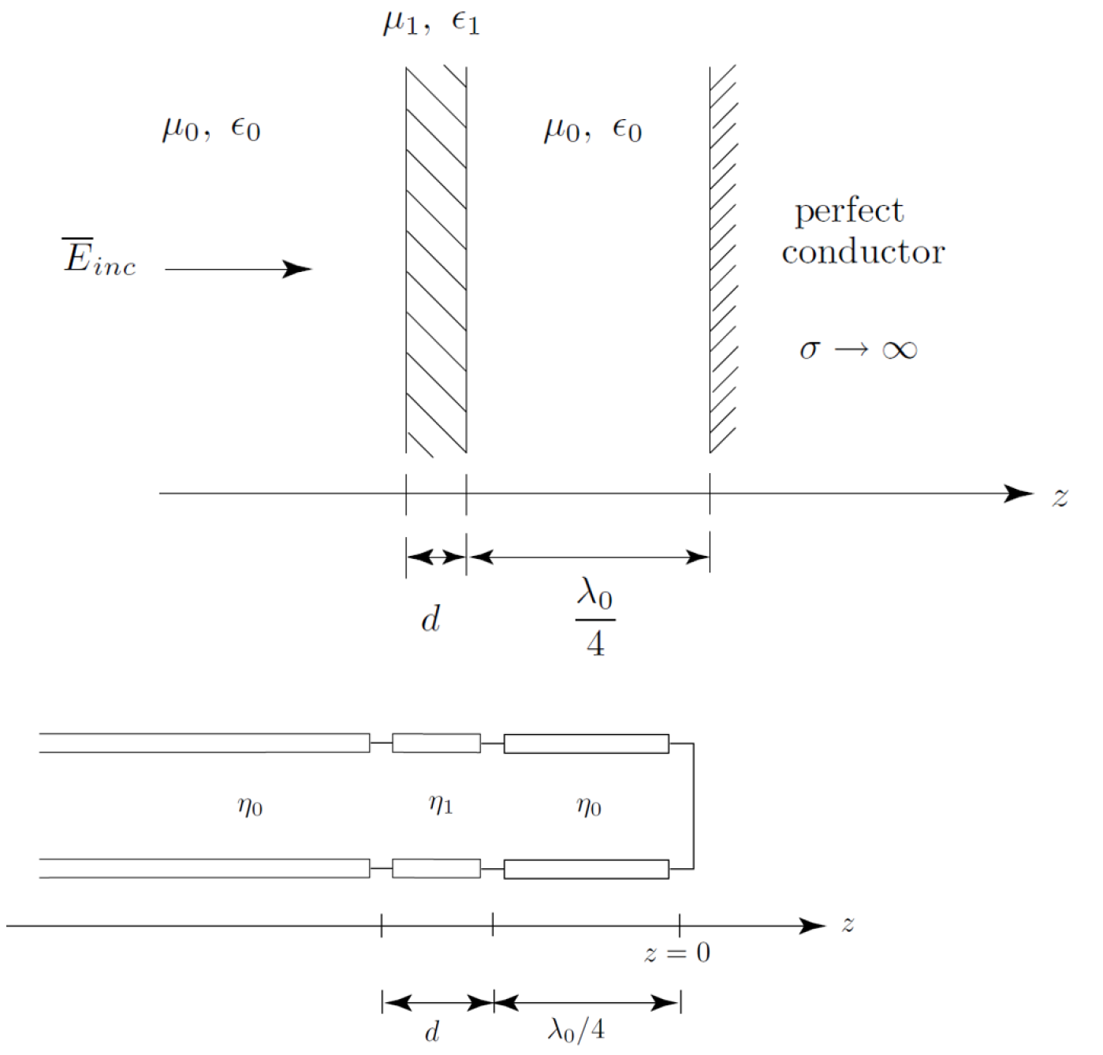

Slide 5
Phase Velocity and Group Velocity

Slide 13
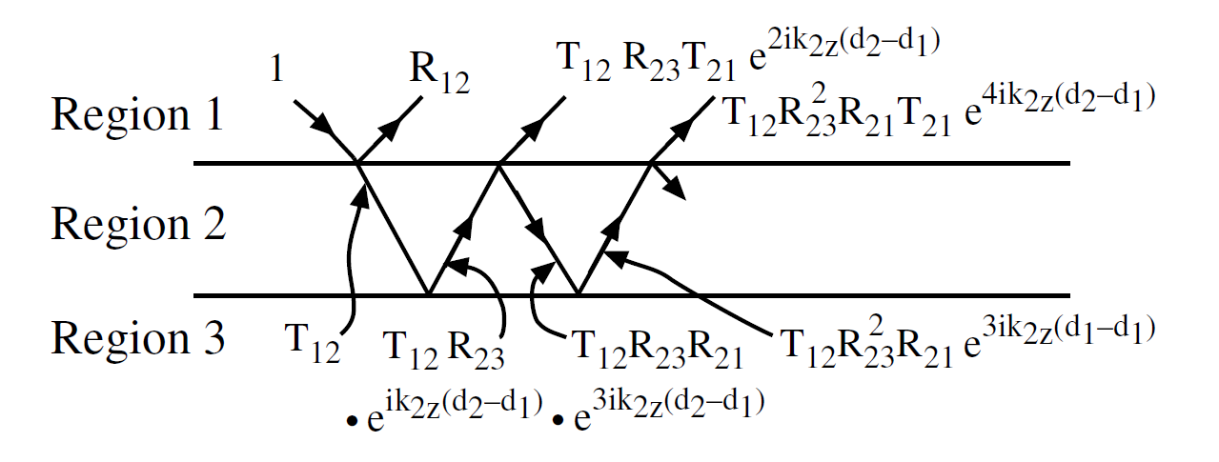
Wave Guidance in a Layered Media

