Slide 1
Interesting Physical Phenomena
Total Internal Reflection

Slide 6
Goos-Hanschen Shift

Slide 7
Thin-Film Waveguide

Slide 8
Optical Fiber Waveguide
Charles Kao, the father of
the optical fiber, was awarded the Nobel Prize in 2009.

Slide 9
More on Interesting Physical Phenomena
Brewster Angle

Slide 11
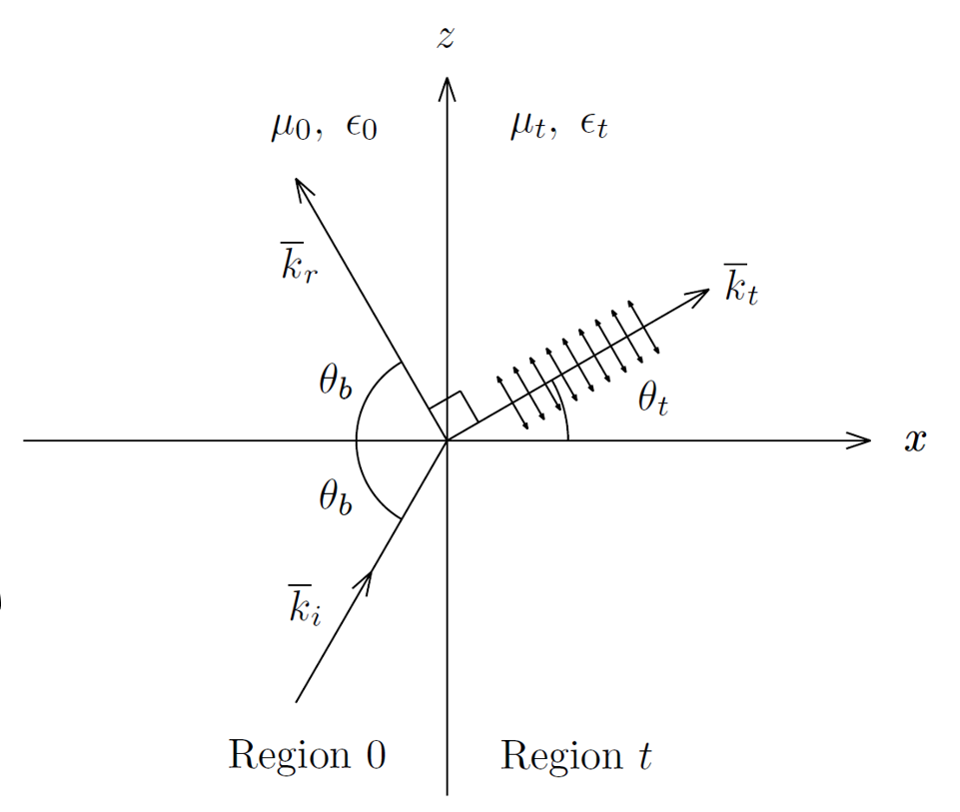

Slide 14
Surface Plasmon Polariton

Slide 17
Homomorphism of Uniform Plane Waves and Transmission Lines Equations

