Slide 1
VSWR (Voltage Standing Wave Ratio)

Slide 8
Multi-Junction Transmission Lines

Slide 9
Microwave Integrated Circuit

Slide 10
Single-Junction Transmission Lines

Slide 13
Two-Junction Transmission Lines

Slide 14
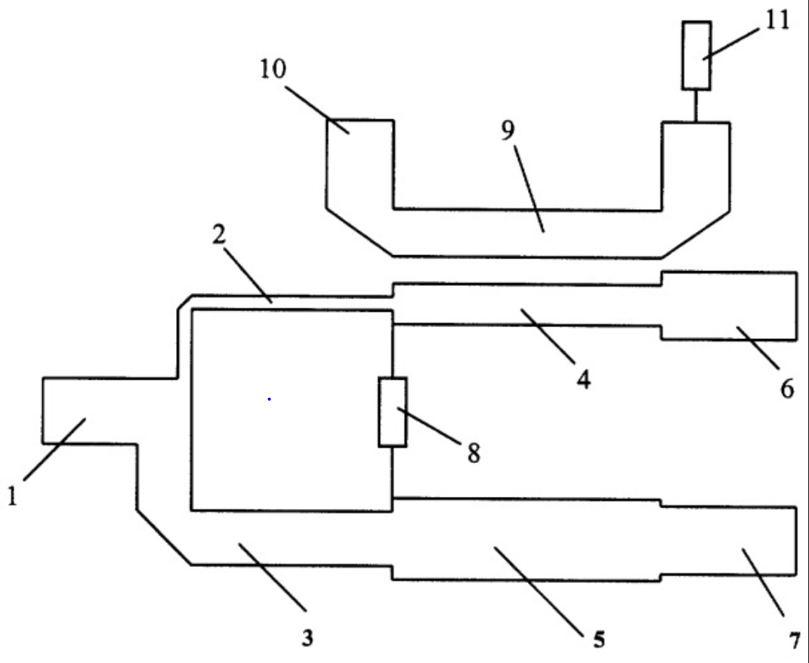
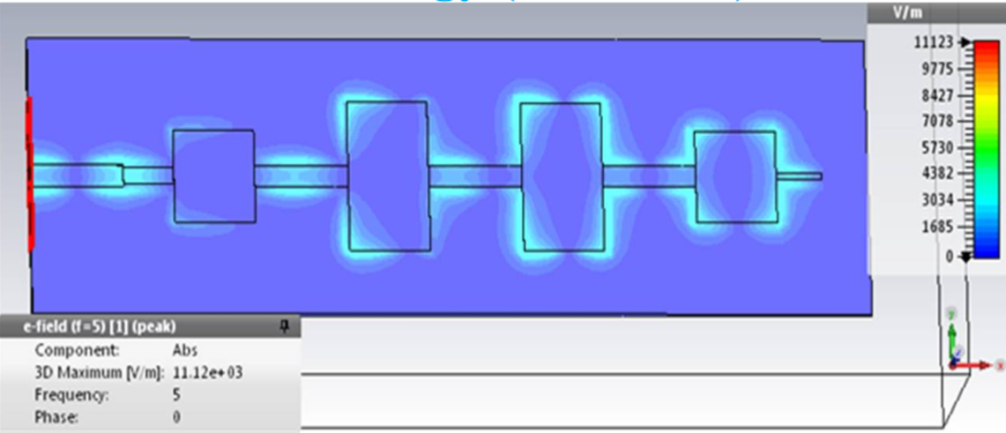

Slide 15
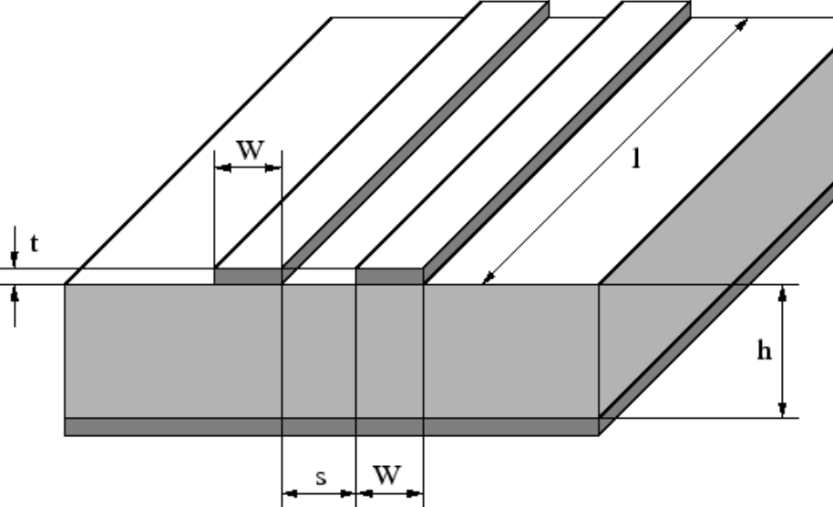
Microstrip Line Waveguide

Slide 16
Stray Capacitance and Inductance

Slide 17
Duality Principle

Slide 18
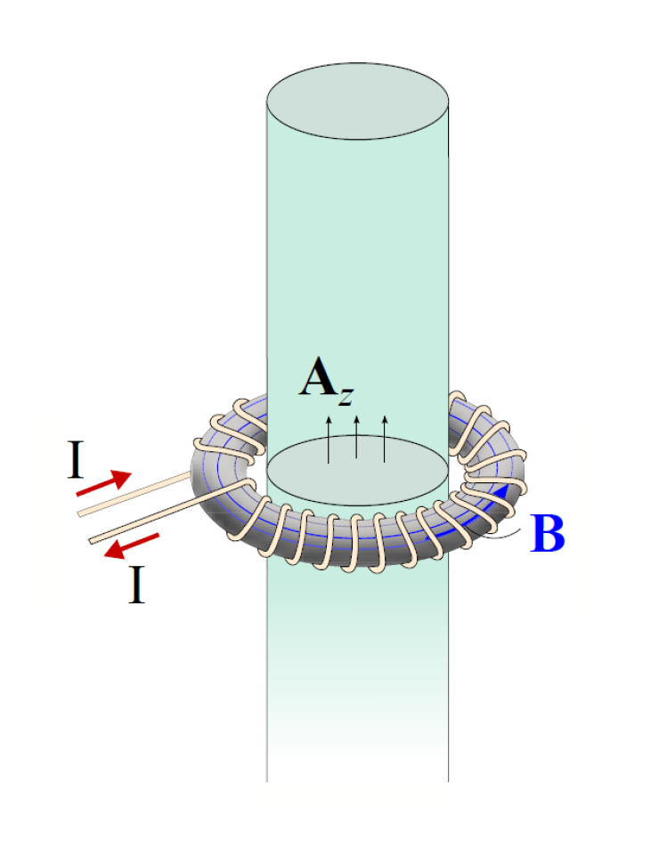
Fictitious Magnetic Currents

Slide 19
Reflection and Transmission|Single Interface Case
TE Polarization (Perpendicular or E Polarization)1

Slide 20
TM Polarization (Parallel or H Polarization)

