Slide 1
Transmission Lines

Slide 3
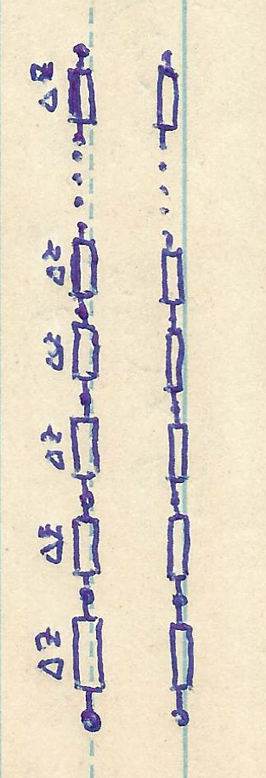

Slide 4
Telegrapher’s Equations

Slide 9
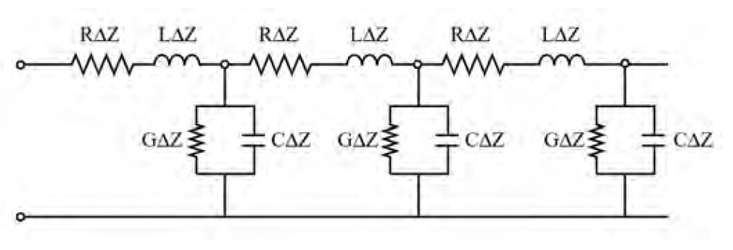
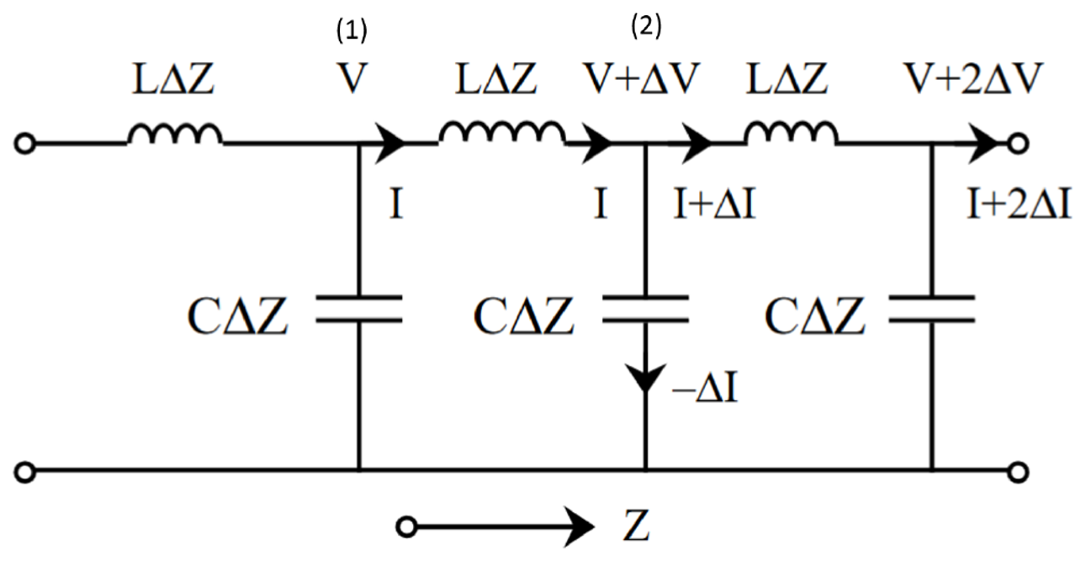
Same topology! Mathematical homomorpism.

Slide 11
More on Transmission Lines

