Slide 1
Lorentz Force Law
Drude-Lorentz-Sommerfeld Model
In

Slide 2
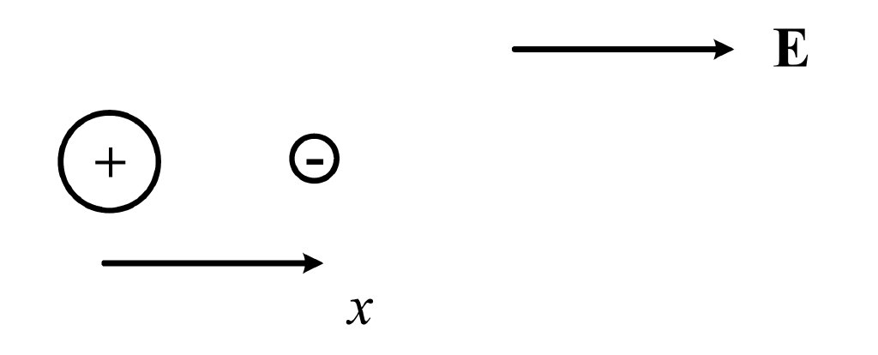

Slide 5
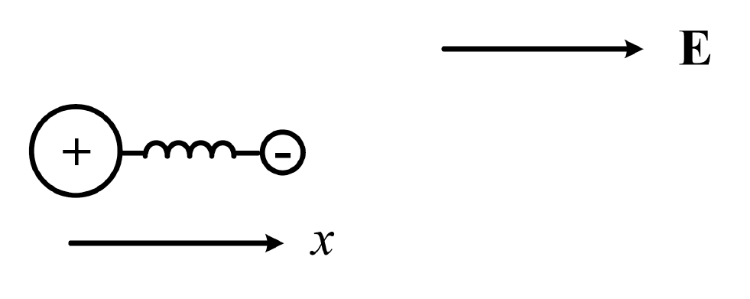

Slide 7
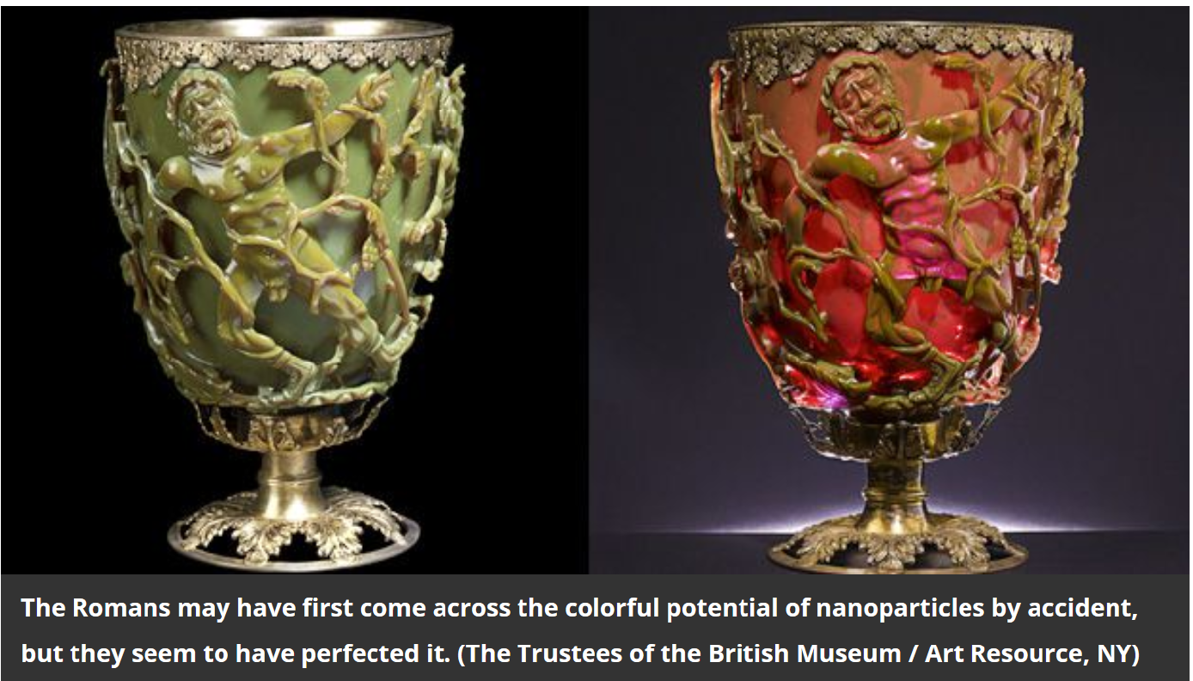

Slide 8
Gyrotropic Media

Slide 11
Wave Polarization

Slide 18
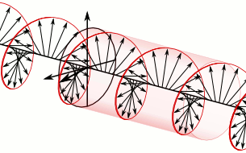
Put in display mode, and the animation will start.

