Slide 1


Slide 2
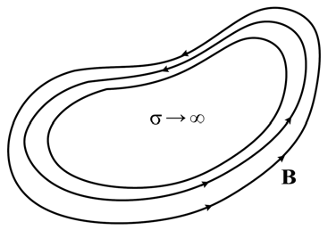
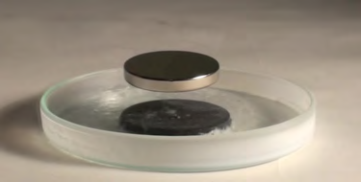






Slide 3



Instantaneous Poynting Theorem & Energy conservation

Slide 5




Slide 6





Phasor Technique

Slide 7


Complex Power & Poynting Vector

Slide 8




Slide 9



Slide 10





