Slide 1
39 Quantum Coherent State of Light 403
39.1 The Quantum Coherent State . . . . . . . . . . . . . . . . . . . . . . . . . . . 403
39.1.1 Quantum Harmonic Oscillator Revisited . . . . . . . . . . . . . . . . . 404
39.2 Some Words on Quantum Randomness and Quantum Observables . . . . . . 406
39.3 Derivation of the Coherent States . . . . . . . . . . . . . . . . . . . . . . . . . 407
39.3.1 Time Evolution of a Quantum State . . . . . . . . . . . . . . . . . . . 409
39.4 More on the Creation and Annihilation Operator . . . . . . . . . . . . . . . . 410
39.4.1 Connecting Quantum Pendulum to Electromagnetic Oscillator . . . . 412
39.5 Epilogue . . . . . . . . . . . . . . . . . . . . . . . . . . . . . . . . . . . . . . . 415

Slide 18
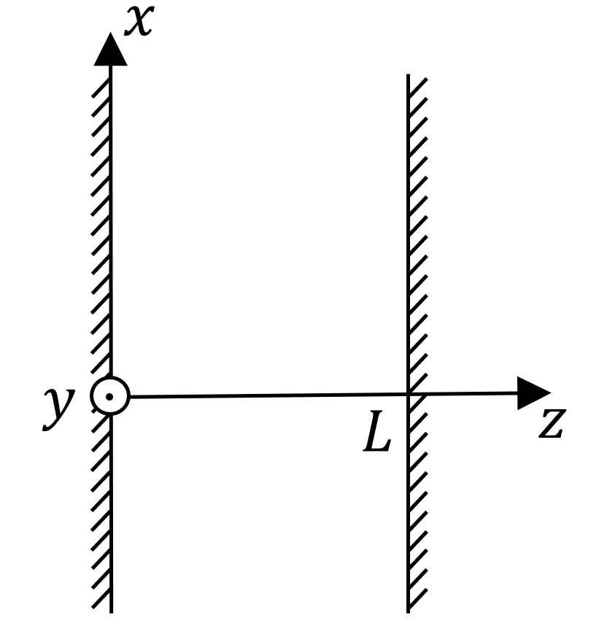

Slide 19
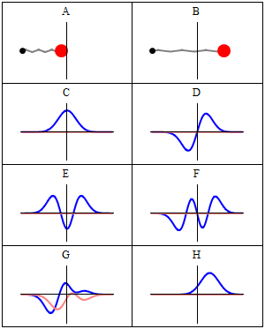
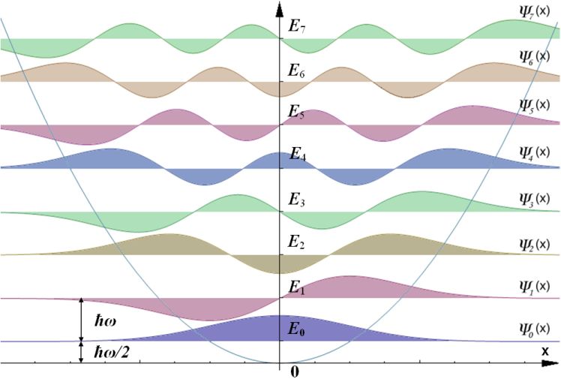
Electromagnetic Oscillation as a Quantum Pendulum
Courtesy of Wiki
Classical harmonic oscillator
Wave-Particle Duality
x²potential
Quantum harmonic oscillator
Photon-Number State
Quantum State Eigenequation
Wave mechanics
Zero point energy
Vacuum state
Potential Well
Notes:
二象性. 狀態。波動力學。真空；

Slide 20
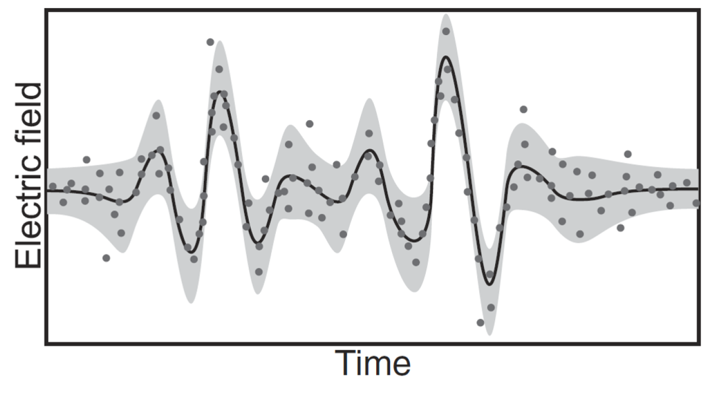

Slide 21
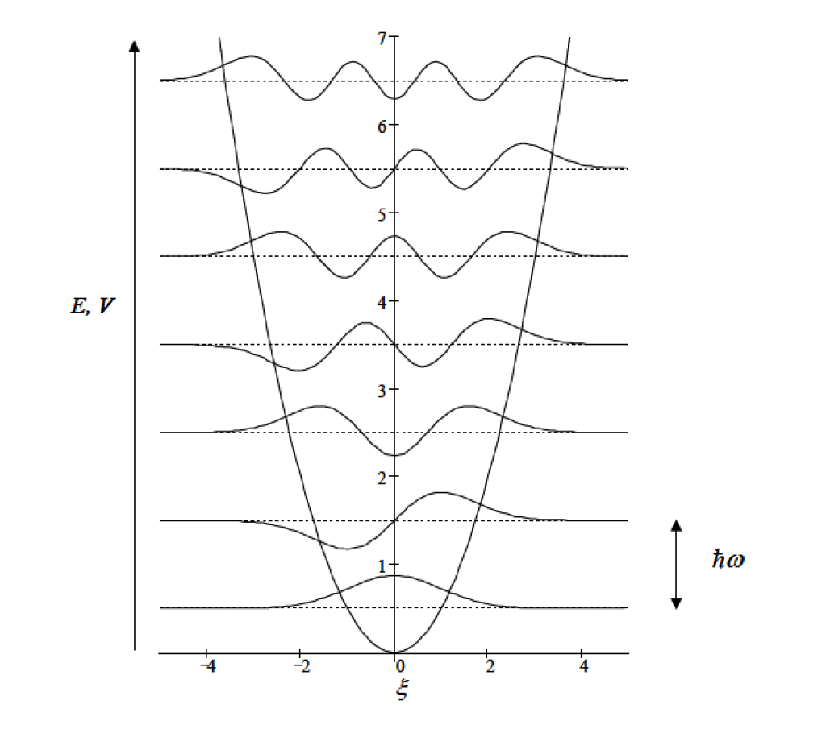
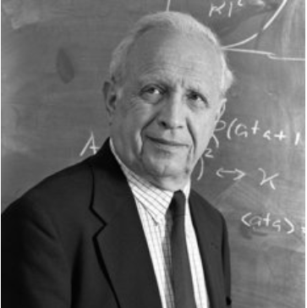
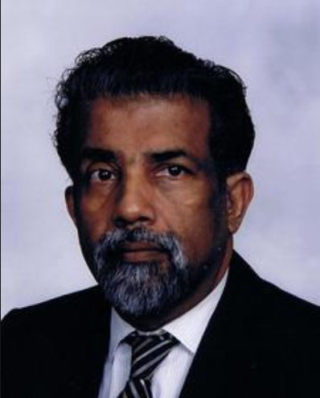
Photon Number State Revisited
The photon number states are non-classical states.
They are highly spread out and bizarre.
The expectation value of the position
x is zero.
The coherent state is needed.
Roy Glauber and George Sudharshan.
Roy Glauber won the Nobel Prize in 2005.
Notes:
光子数状态 極相似的, 它們分佈得很分散, 也很奇怪。希奇古怪的，不同尋常的。相干的，相參的。

Slide 22
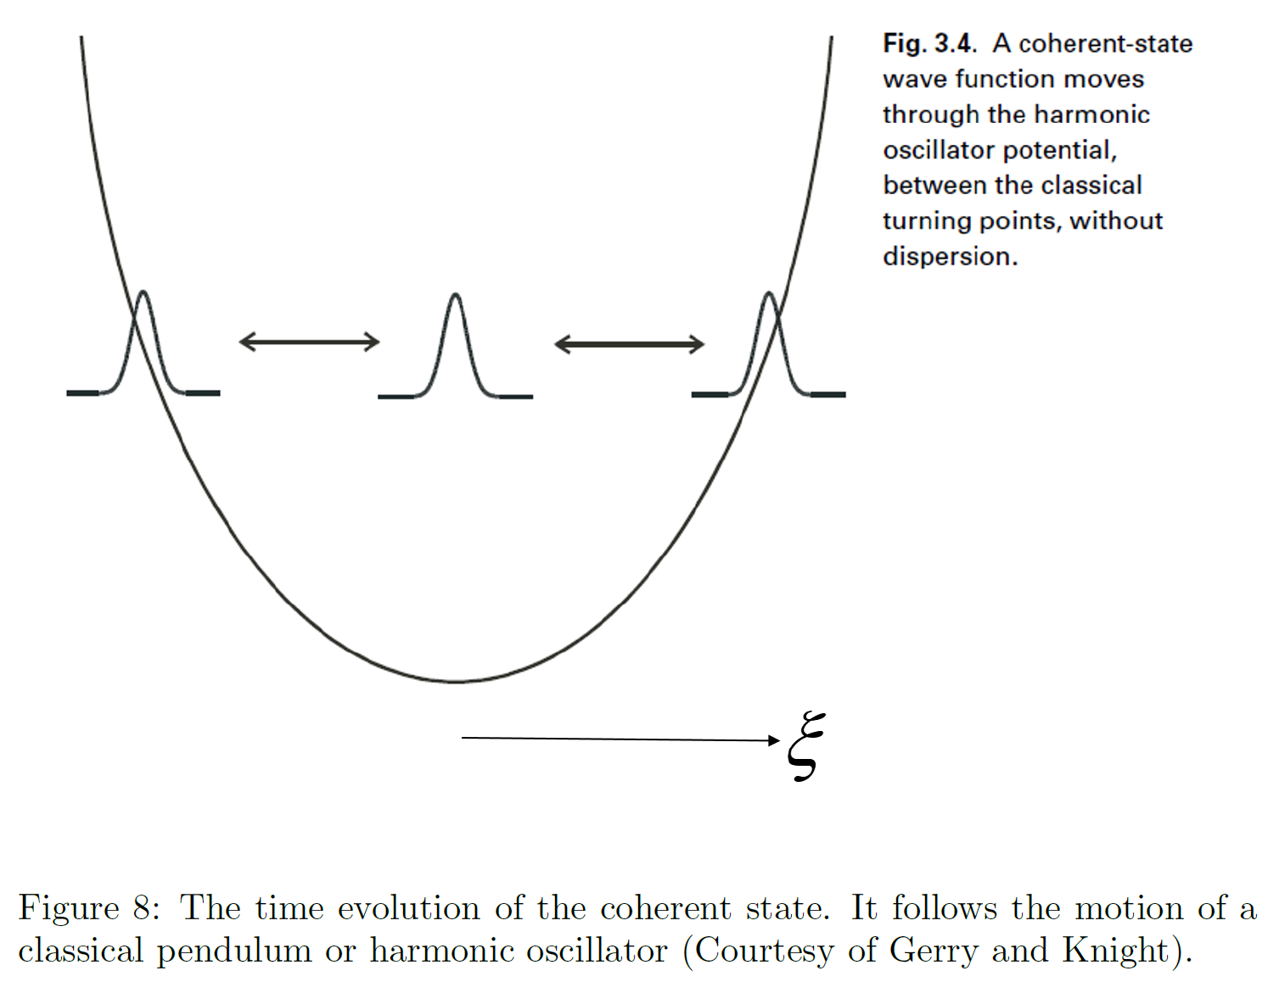

Slide 23
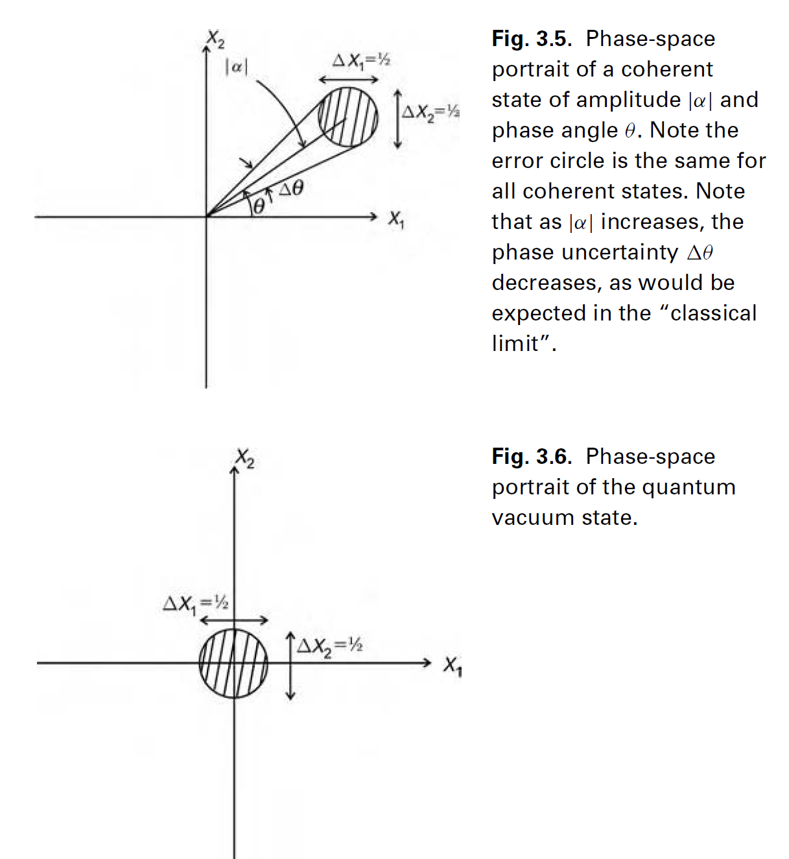
Another View of Coherent Light/Electromagnetic Field (Light)
Coherent State
Coherent State
Coherent state is a displaced vacuum state.
Quadrature and in phase components
Quantum noise
Vacuum State
--Ground State
Courtesy of Gerry and Knight
Notes:
相干狀態是一個移位的真空狀態。真空狀態--地面狀態

Slide 24
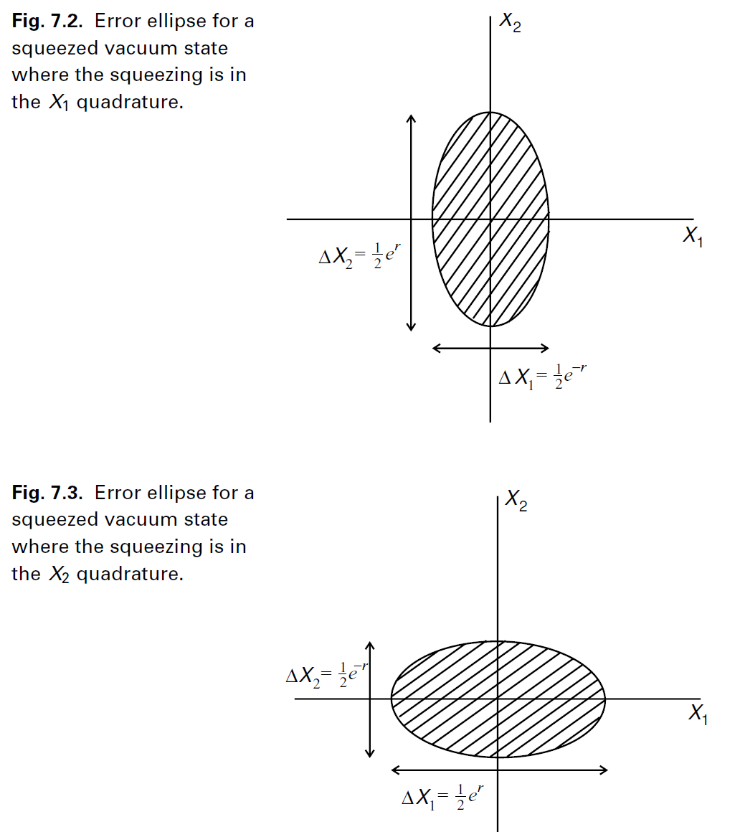
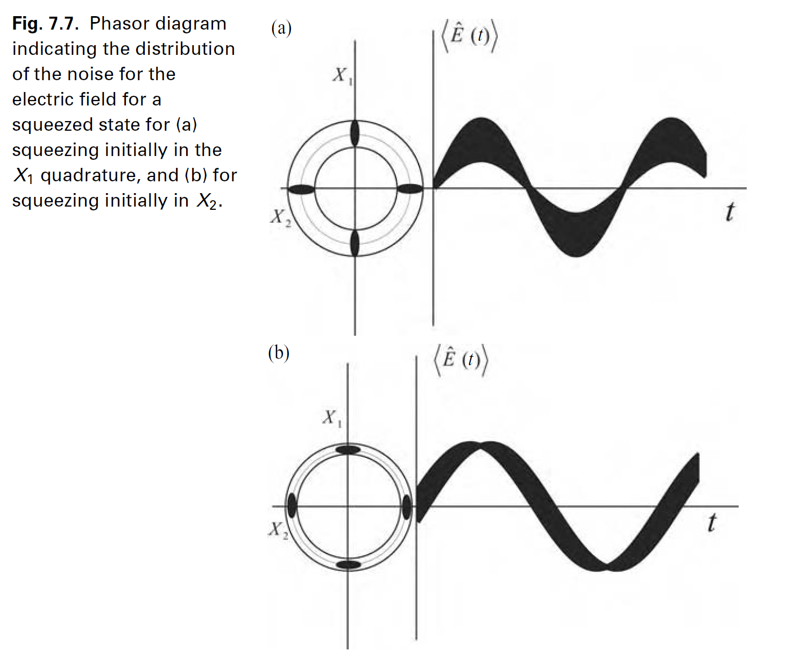
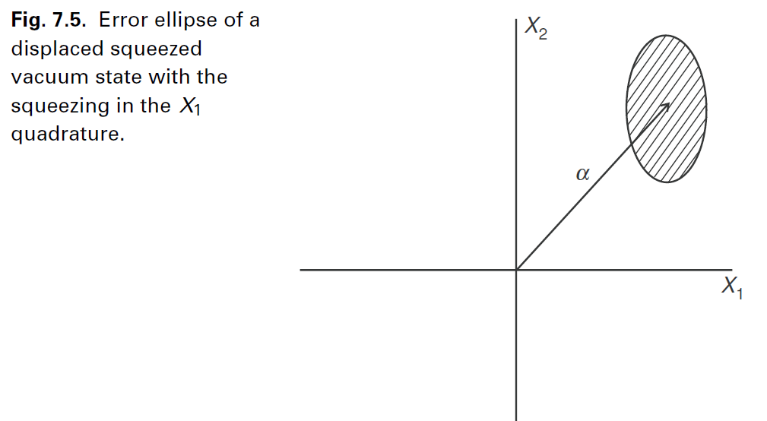
Squeezed Light—Non-Classical Light

Slide 25
