Slide 1
Quantum Theory of Light
Cross disciplinary research is difficult

Slide 2
38 Quantum Theory of Light 387
38.1 Historical Background on Quantum Theory . . . . . . . . . . . . . . . . . . . 387
38.2 Connecting Electromagnetic Oscillation to Simple Pendulum . . . . . . . . . 390
38.3 Hamiltonian Mechanics . . . . . . . . . . . . . . . . . . . . . . . . . . . . . . 394
38.4 Schrodinger Equation (1925) . . . . . . . . . . . . . . . . . . . . . . . . . . . 396
38.5 Some Quantum Interpretations{A Preview . . . . . . . . . . . . . . . . . . . . 399
38.5.1 Matrix or Operator Representations . . . . . . . . . . . . . . . . . . . 400
38.6 Bizarre Nature of the Photon Number States . . . . . . . . . . . . . . . . . . 401

Slide 3
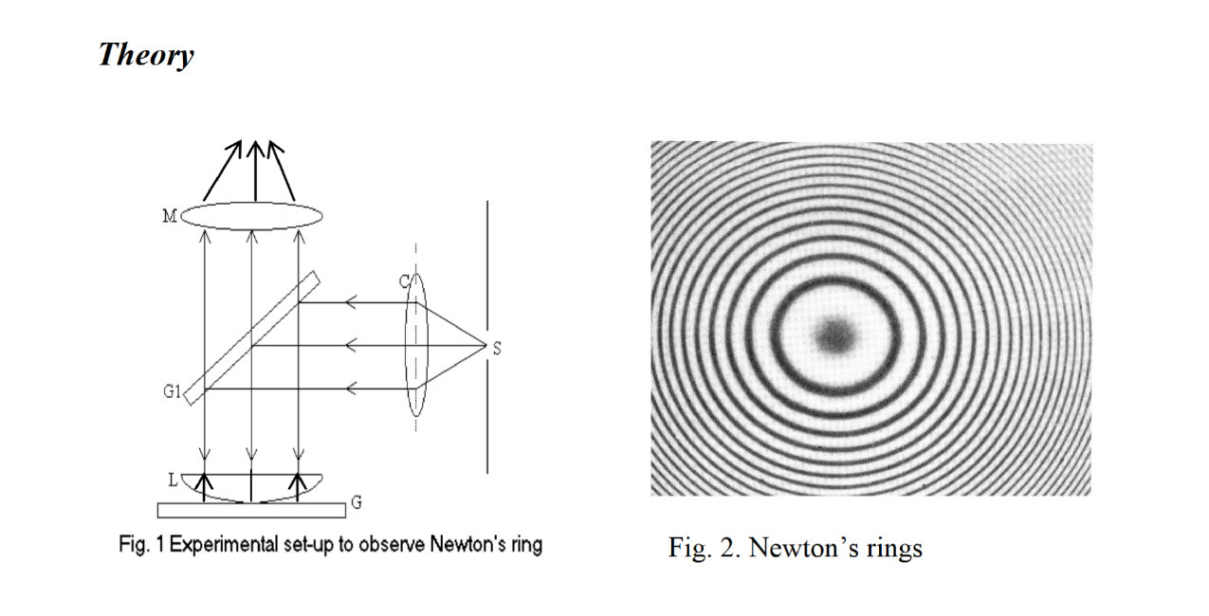

Slide 4
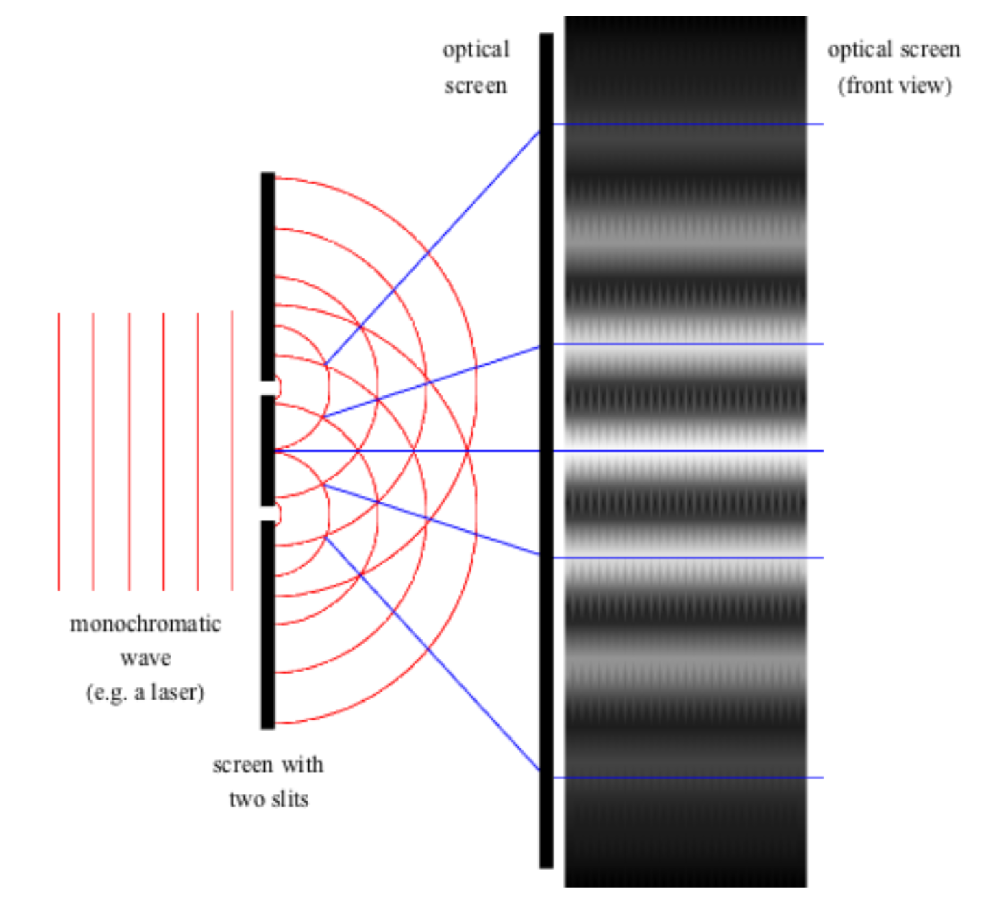

Slide 15
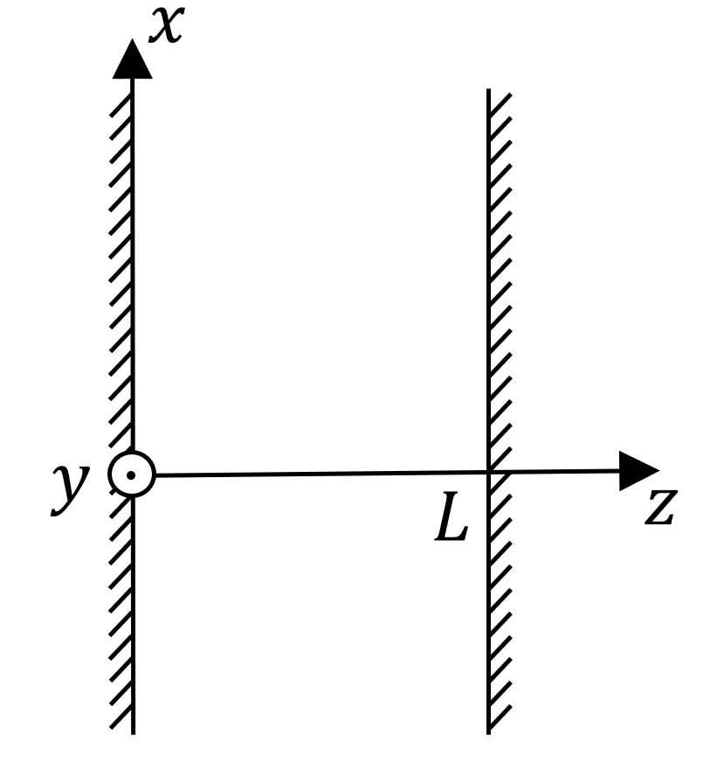

Slide 16
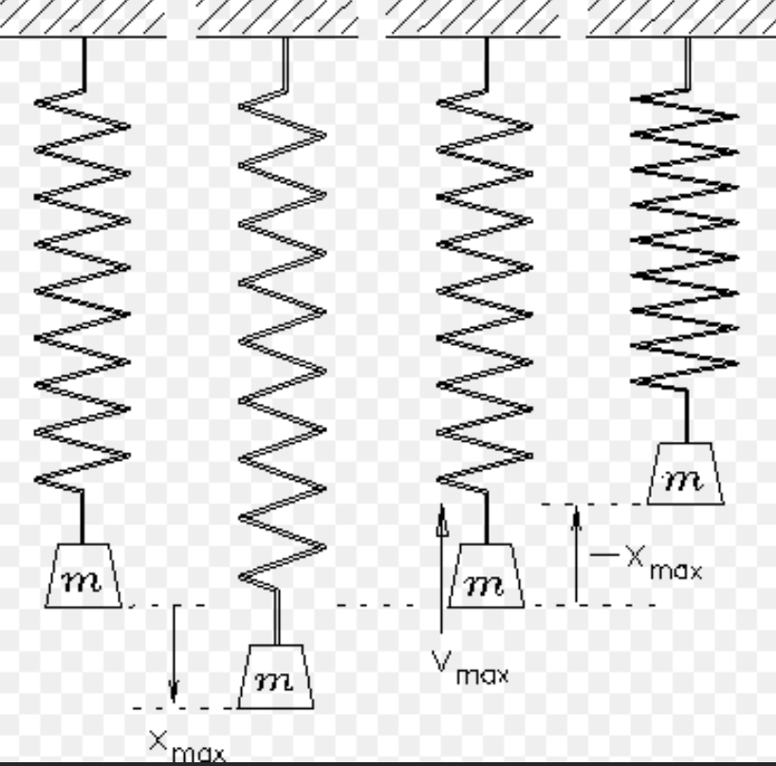
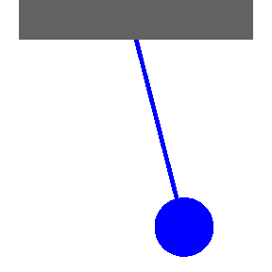
Electromagnetic Mode Oscillation
An electromagnetic mode oscillating is similar to a simple pendulum.
If we can connect a simple pendulm to a quantum pendulum, we can understand the quantization of electromagnetic field.
Notes:
電磁模式振盪類似于一個簡單的鐘擺; 如果我們能把一個簡單的鐘擺連接到量子擺, 我們就能理解電磁場的量子化。

Slide 17
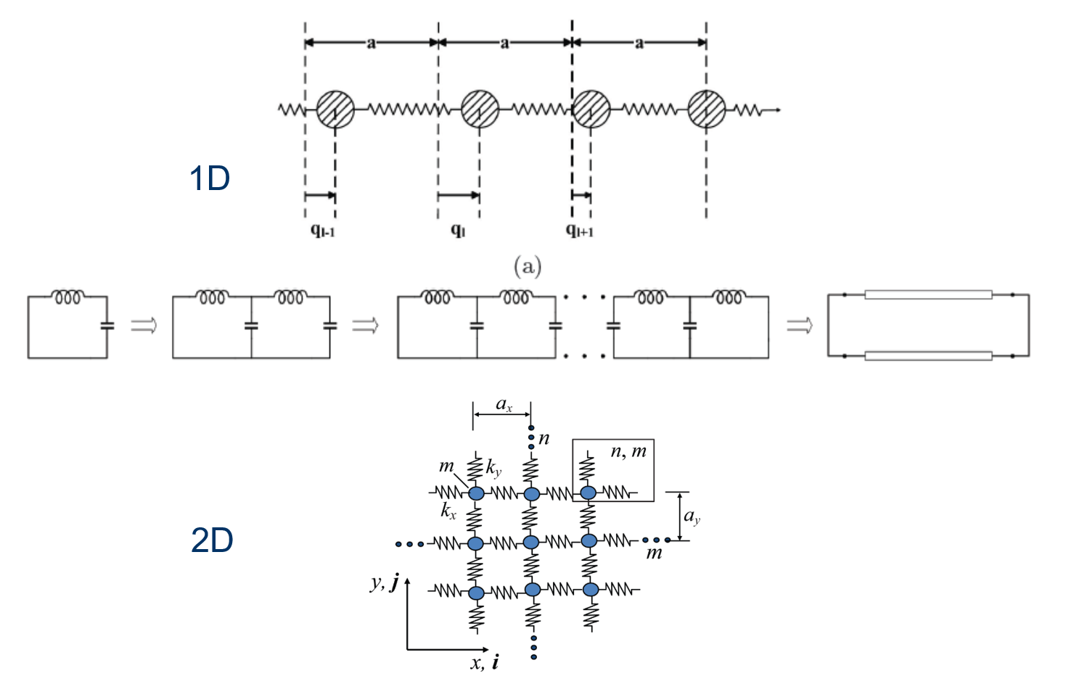

Slide 19
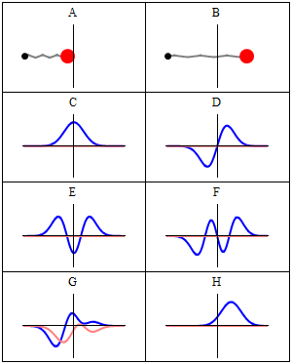
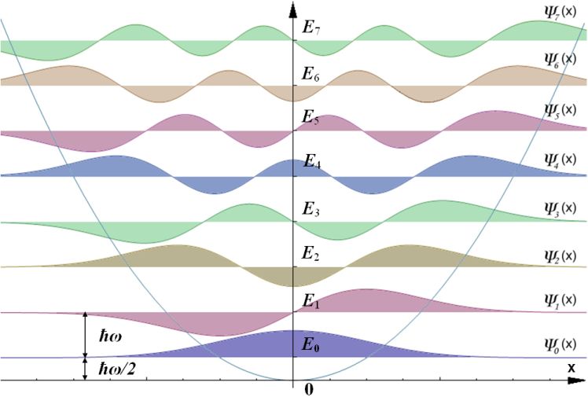
Electromagnetic Oscillation as a Quantum Pendulum
Courtesy of Wiki
Classical harmonic oscillator
Wave-Particle Duality
x²potential
Quantum harmonic oscillator
Photon-Number State
Quantum State Eigenequation
Wave mechanics
Zero point energy
Vacuum state
Potential Well
Notes:
二象性. 狀態。波動力學。真空；

Slide 20
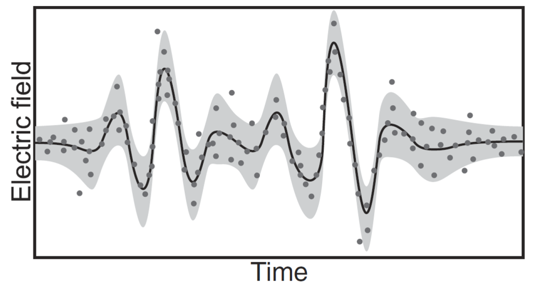

Slide 21
Electromagnetic Oscillation as a Quantum Pendulum
Courtesy of Wiki
Classical harmonic oscillator
Wave-Particle Duality
x²potential
Quantum harmonic oscillator
Photon-Number State
Quantum State Eigenequation
Wave mechanics
Zero point energy
Vacuum state
Potential Well
Notes:
二象性. 狀態。波動力學。真空；

Slide 23
39 Quantum Coherent State of Light 403
39.1 The Quantum Coherent State . . . . . . . . . . . . . . . . . . . . . . . . . . . 403
39.1.1 Quantum Harmonic Oscillator Revisited . . . . . . . . . . . . . . . . . 404
39.2 Some Words on Quantum Randomness and Quantum Observables . . . . . . 406
39.3 Derivation of the Coherent States . . . . . . . . . . . . . . . . . . . . . . . . . 407
39.3.1 Time Evolution of a Quantum State . . . . . . . . . . . . . . . . . . . 409
39.4 More on the Creation and Annihilation Operator . . . . . . . . . . . . . . . . 410
39.4.1 Connecting Quantum Pendulum to Electromagnetic Oscillator . . . . 412
39.5 Epilogue . . . . . . . . . . . . . . . . . . . . . . . . . . . . . . . . . . . . . . . 415

Slide 24
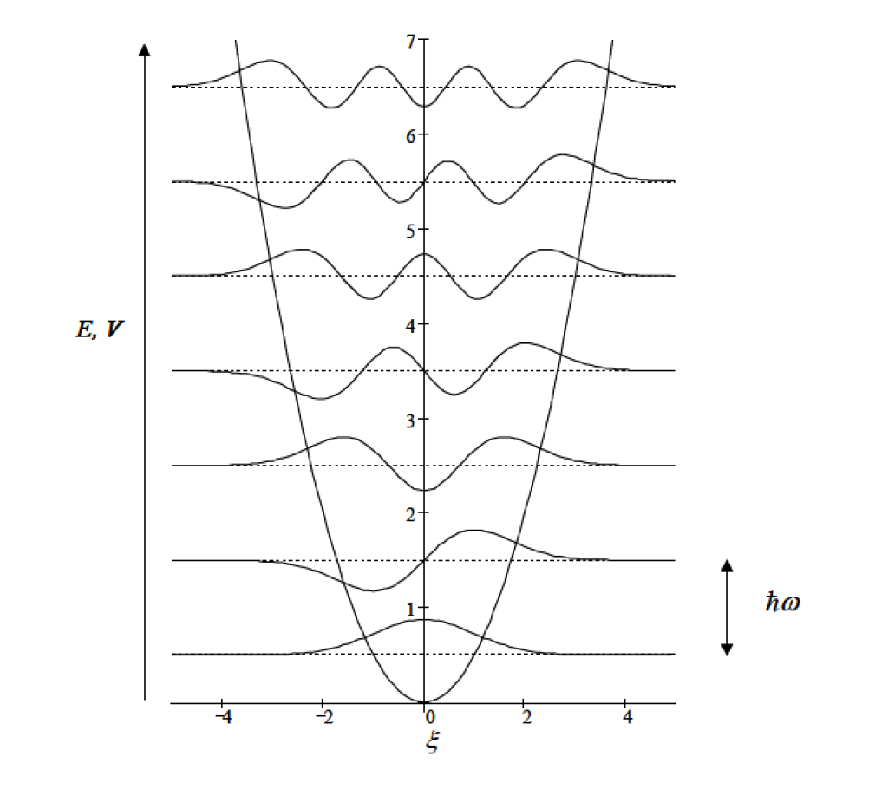
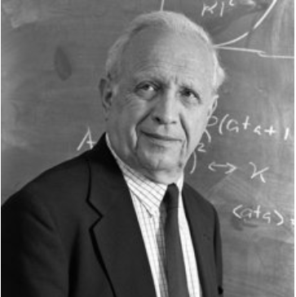
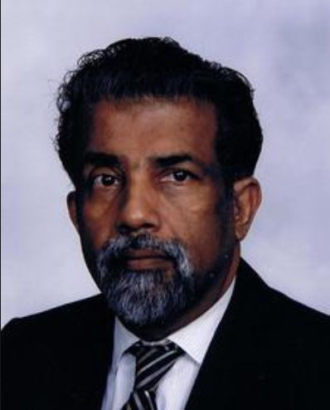
Photon Number State Revisited
The photon number states are non-classical states.
They are highly spread out and bizarre.
The expectation value of the position
x is zero.
The coherent state is needed.
Roy Glauber and George Sudharshan.
Roy Glauber won the Nobel Prize in 2005.
Notes:
光子数状态 極相似的, 它們分佈得很分散, 也很奇怪。希奇古怪的，不同尋常的。相干的，相參的。

Slide 25
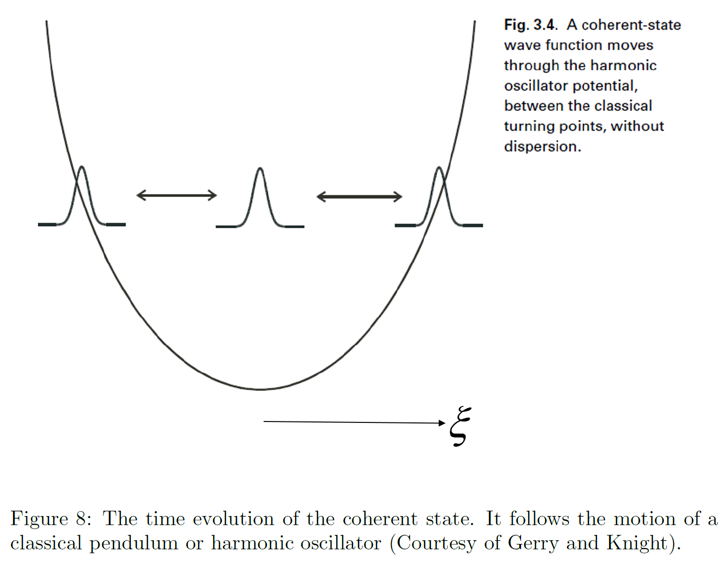

Slide 26
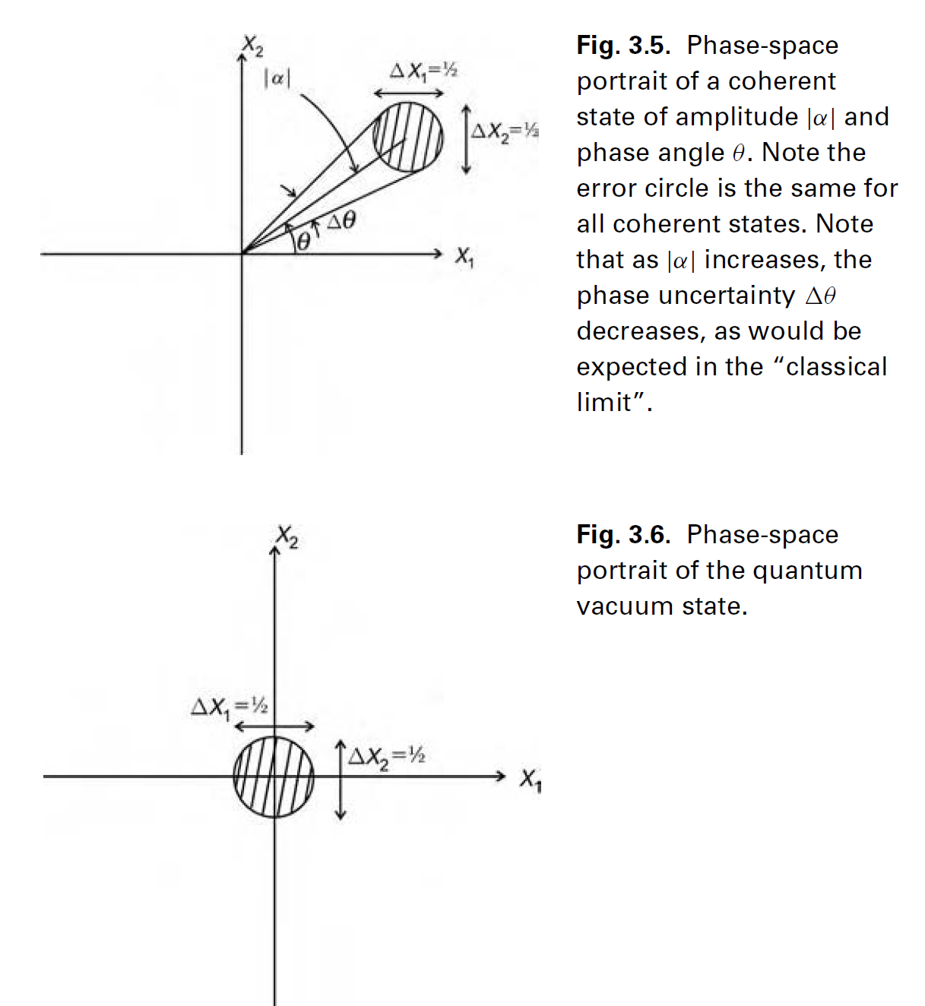
Another View of Coherent Light/Electromagnetic Field (Light)
Coherent State
Coherent State
Coherent state is a displaced vacuum state.
Quadrature and in phase components
Quantum noise
Vacuum State
--Ground State
Courtesy of Gerry and Knight
Notes:
相干狀態是一個移位的真空狀態。真空狀態--地面狀態

Slide 27
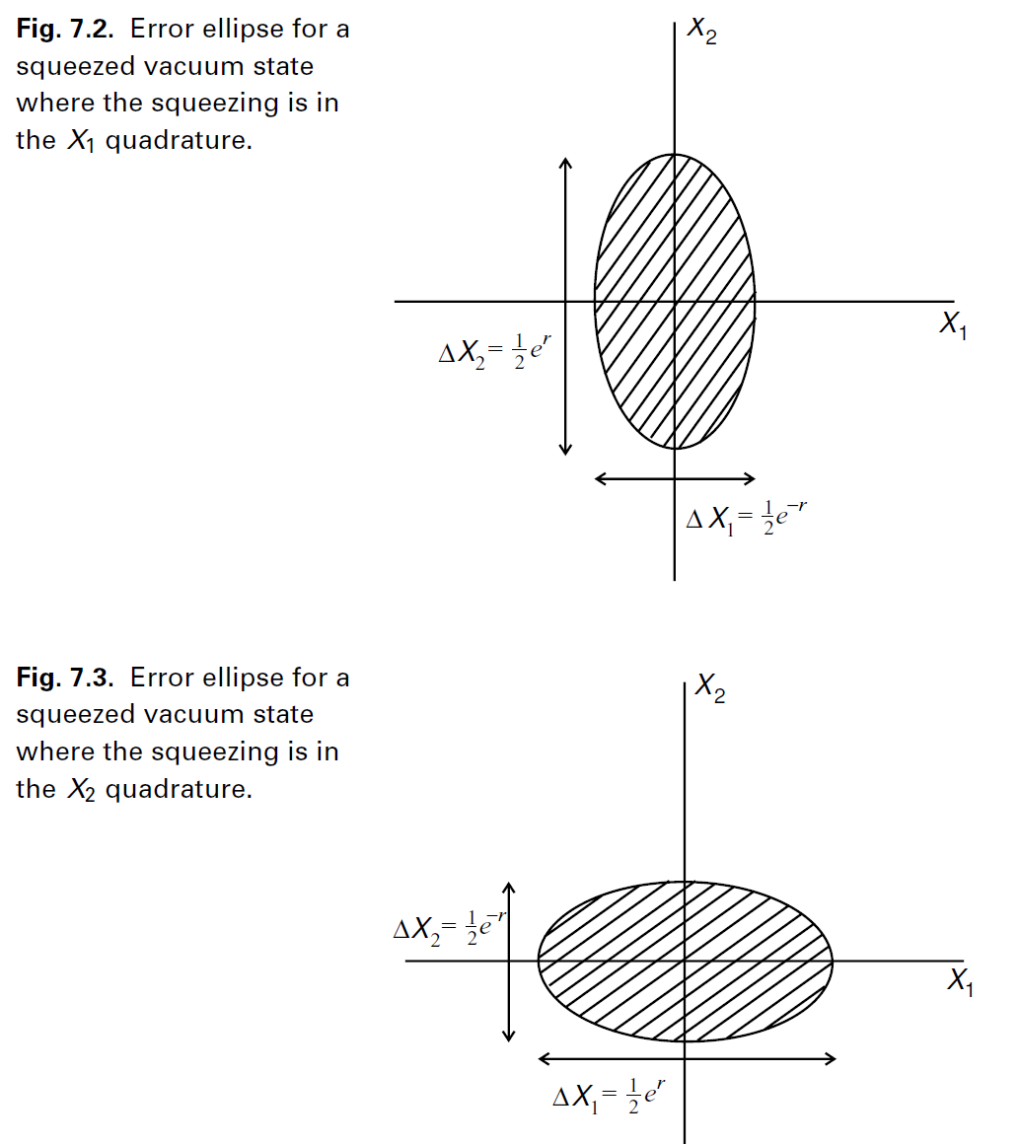
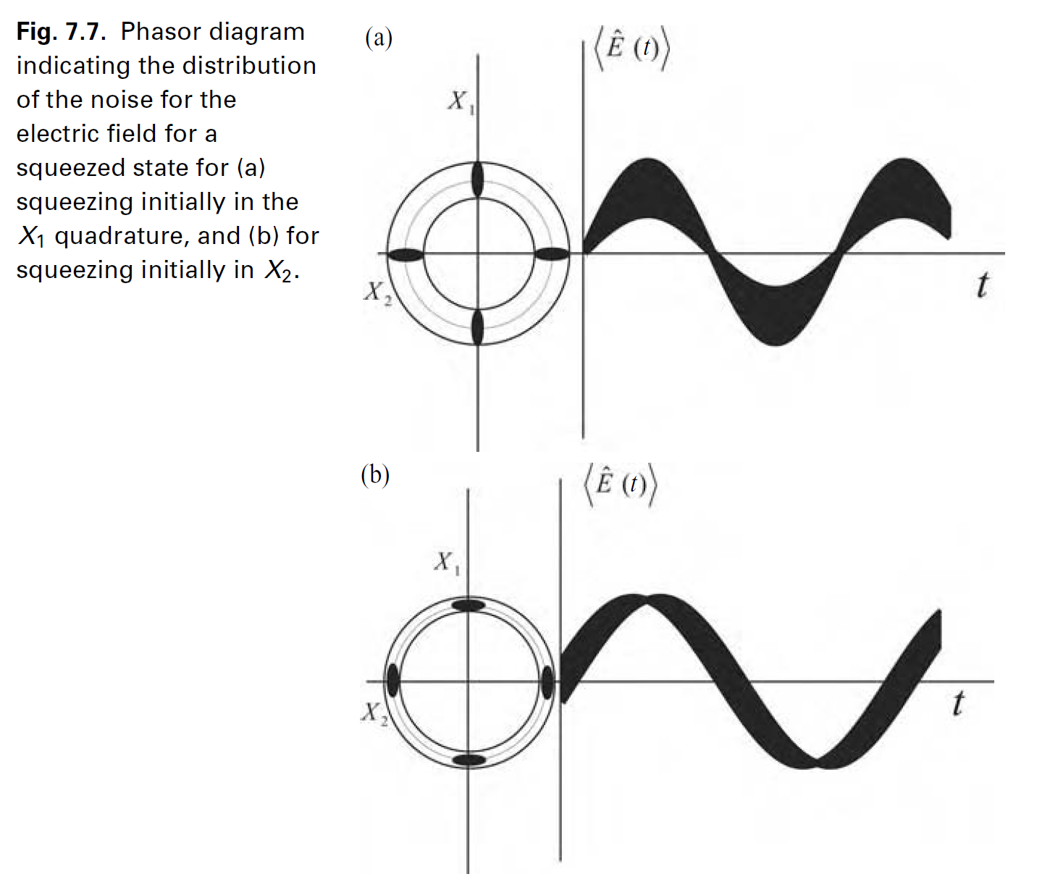
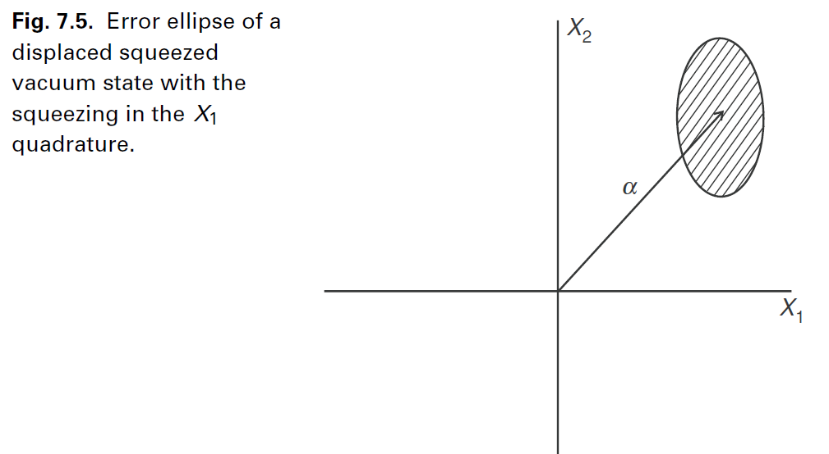
Squeezed Light—Non-Classical Light

Slide 28
