Slide 1
Shielding, Image Theory
32.1 Shielding
32.1.1 A Note on Electrostatic Shielding
32.1.2 Relaxation Time
32.2 Image Theory
32.2.1 Electric Charges and Electric Dipoles
32.2.2 Magnetic Charges and Magnetic Dipoles 32.2.3 Perfect Magnetic Conductor (PMC) Surfaces
32.2.4 Multiple Images
32.2.5 Some Special Cases

Slide 2
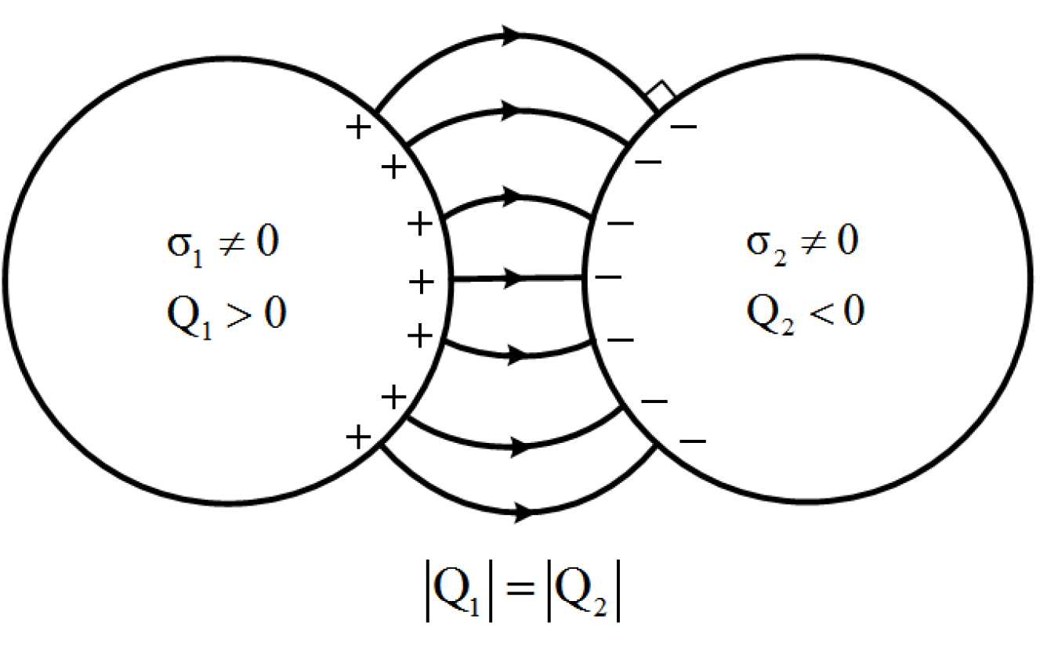
Conductor Shielding

Slide 3
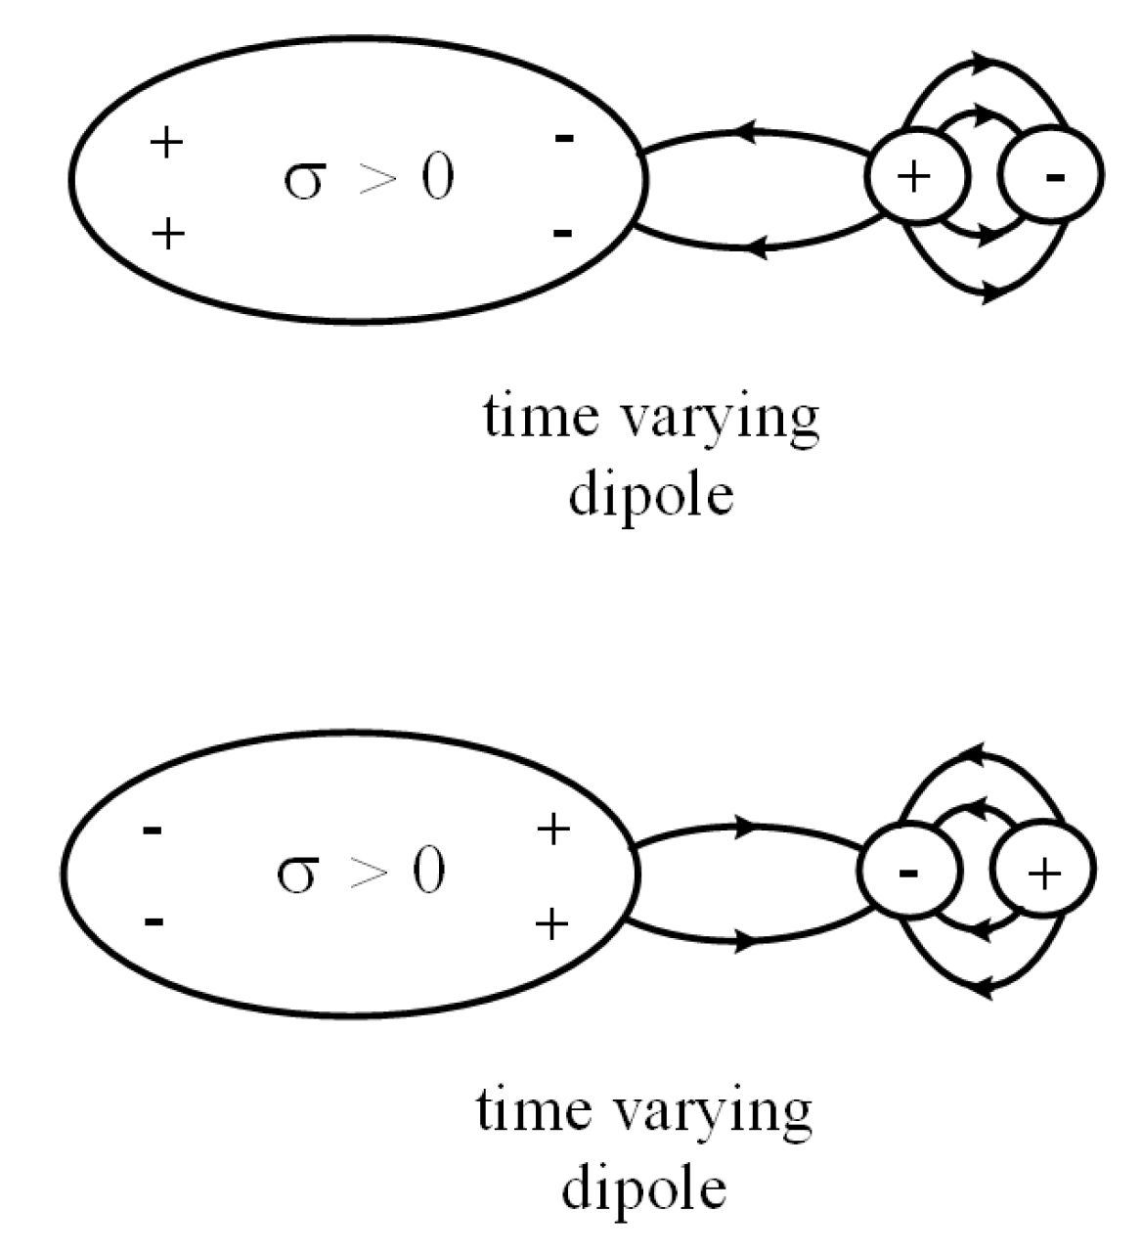
Relaxation Time in Shielding

Slide 4
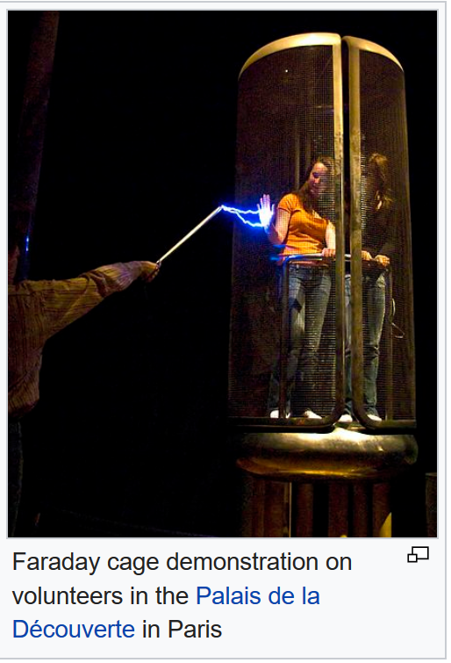

Slide 5
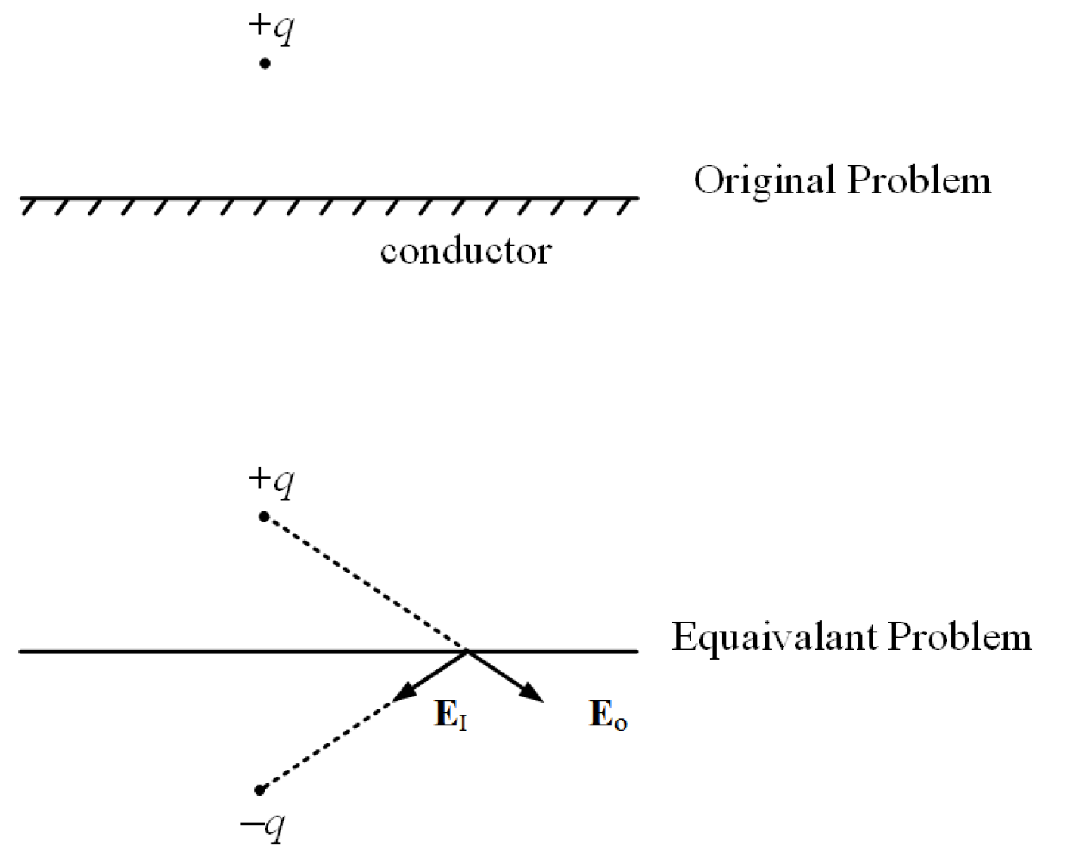

Slide 6
Image Theorem

Slide 7
Conductor Surface

Slide 8
Magnetic Monopole above PEC

Slide 10
Meissner Effect

Slide 12
PMC Surface—Mushroom Structure

Slide 13
PMC Surface

Slide 14
Image Theory for Sectors

Slide 15
Image Theory for a Sphere

Slide 18
33 High Frequency Solutions, Gaussian Beams
33.1 Tangent Plane Approximations
33.2 Fermat's Principle
33.2.1 Generalized Snell's Law
33.3 Gaussian Beam
33.3.1 Derivation of the Paraxial/Parabolic Wave Equation
33.3.2 Finding a Closed Form Solution
33.3.3 Other solutions

Slide 19
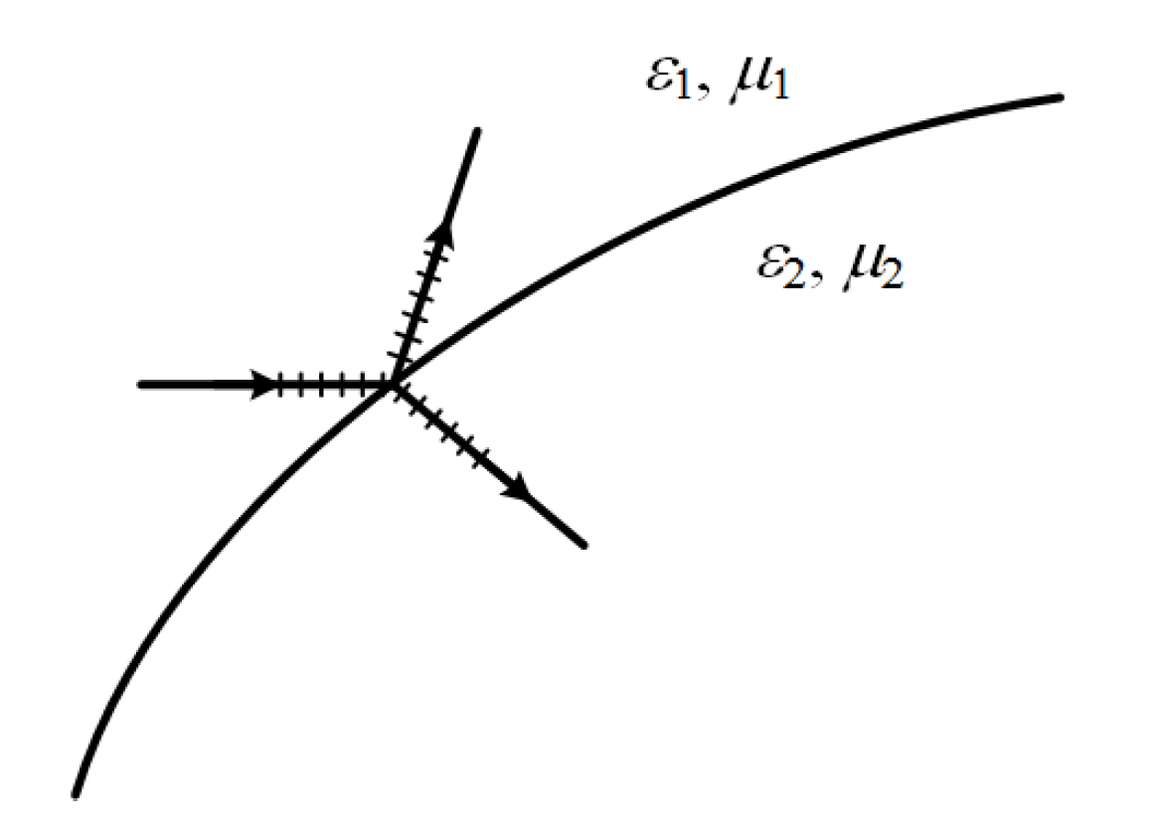
Tangent Plane Approximations

Slide 23
