Slide 1
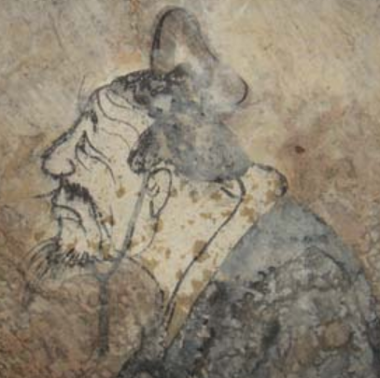

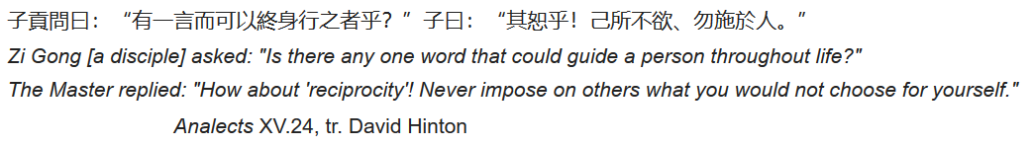

Slide 2





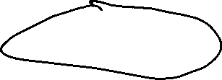
Reciprocity Theorem
Application to a Two-Port Network and Circuit Theory Voltage Sources in Electromagnetics
Hind Sight
Transmit and Receive Patterns of an Antennna

Slide 3
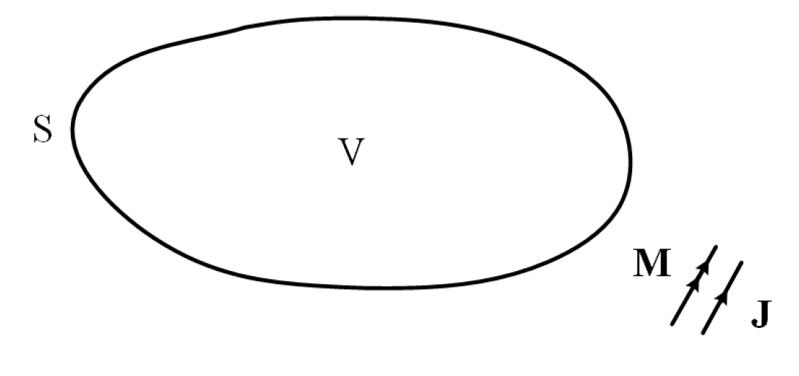

Slide 4
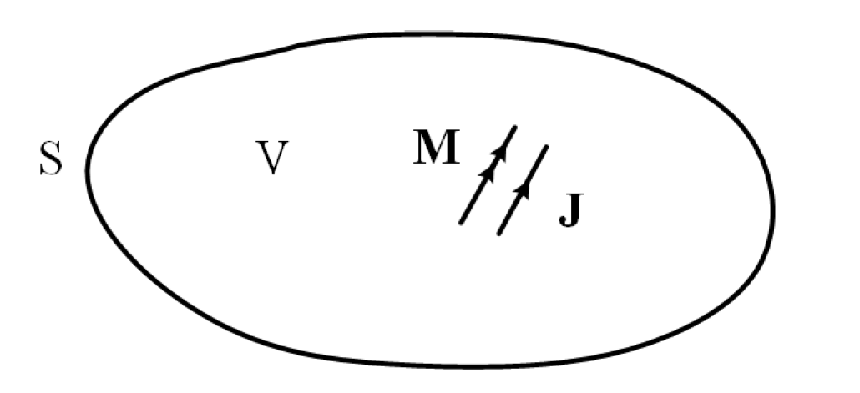



Slide 5


Slide 6
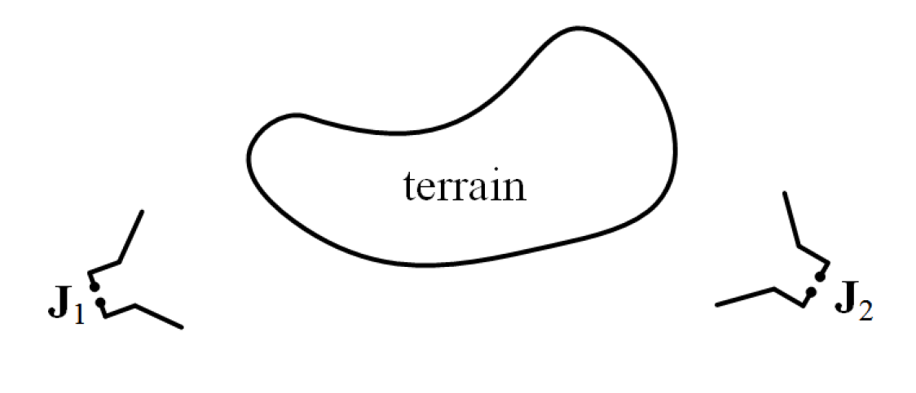





Slide 7
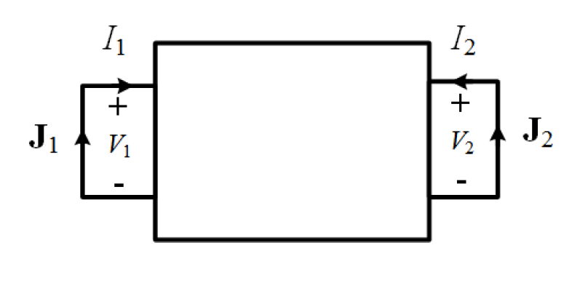




Slide 8




Slide 9









Slide 10
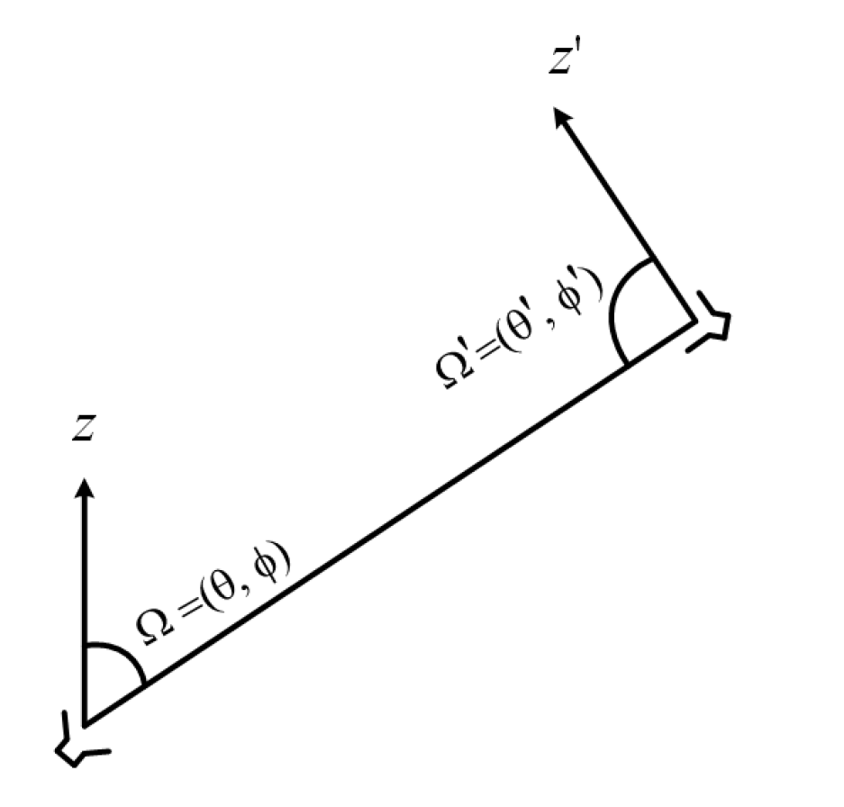








Slide 11

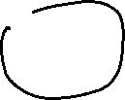



Slide 12
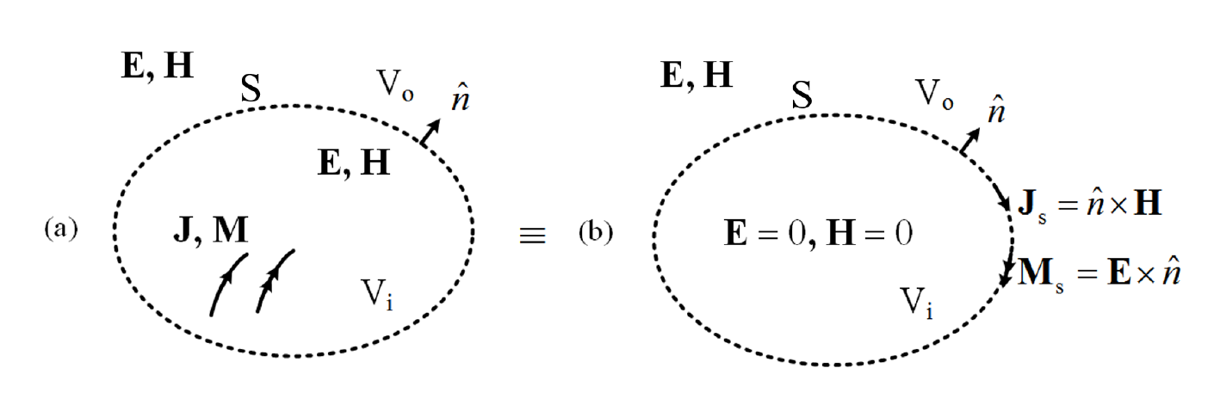


Equivalence Theorems or Equivalence Principles
Inside-Out Case
Outside-in Case
General Case
Electric Current on a PEC
Magnetic Current on a PMC
Huygens' Principle and Green's Theorem
Scalar Waves Case
Electromagnetic Waves Case

Slide 13
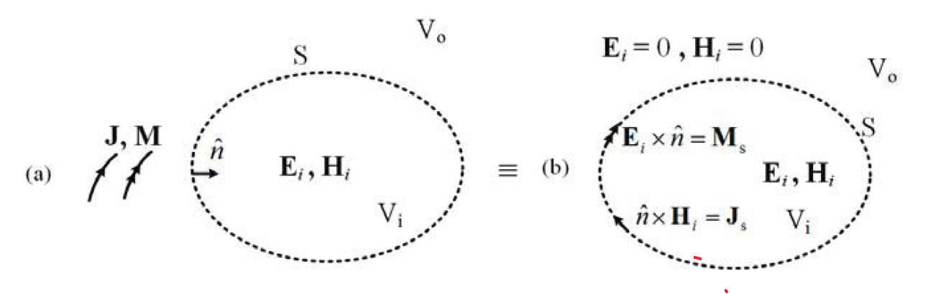


Slide 14
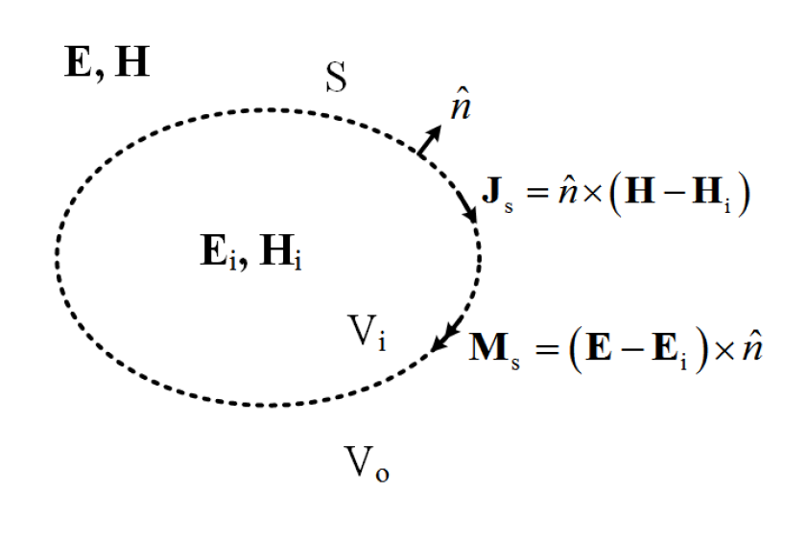


Slide 15
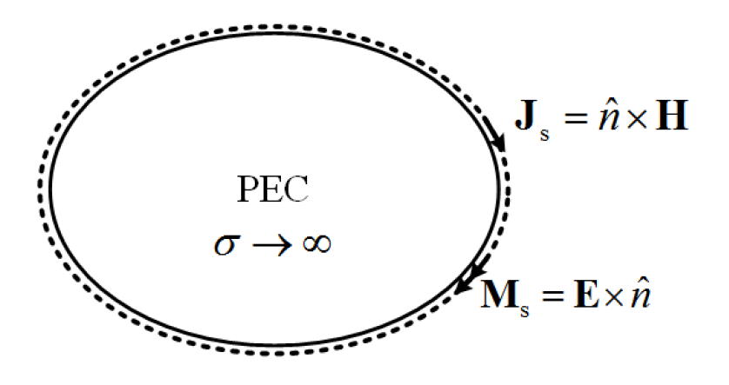




Slide 16




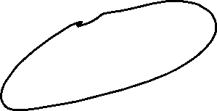

Slide 17
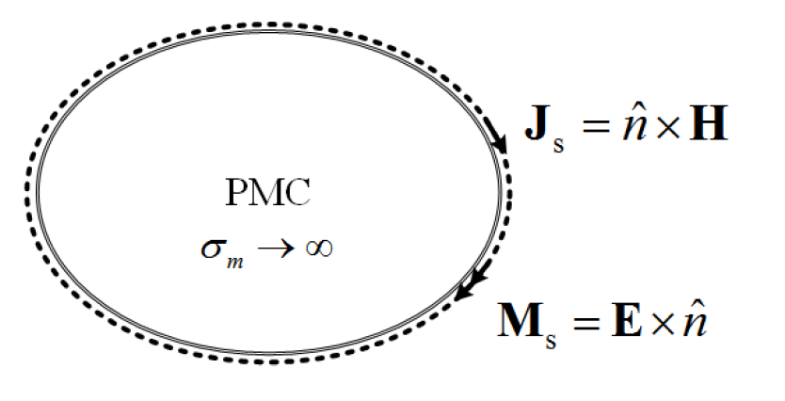




Slide 18
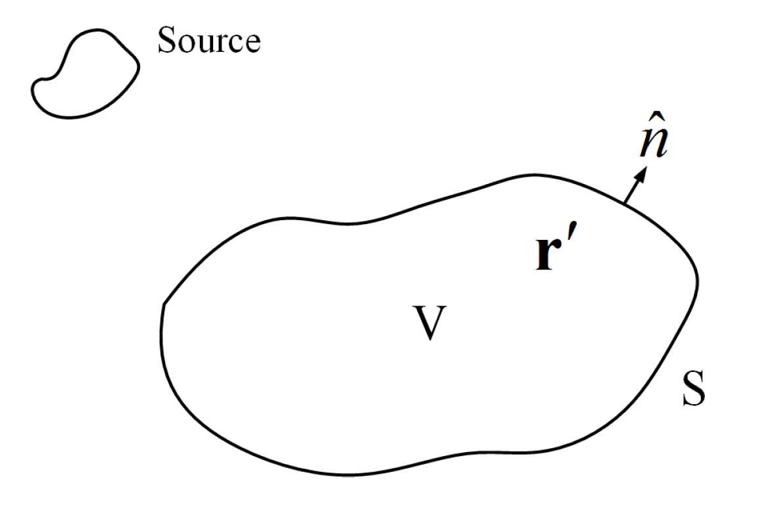




Slide 19






Slide 20
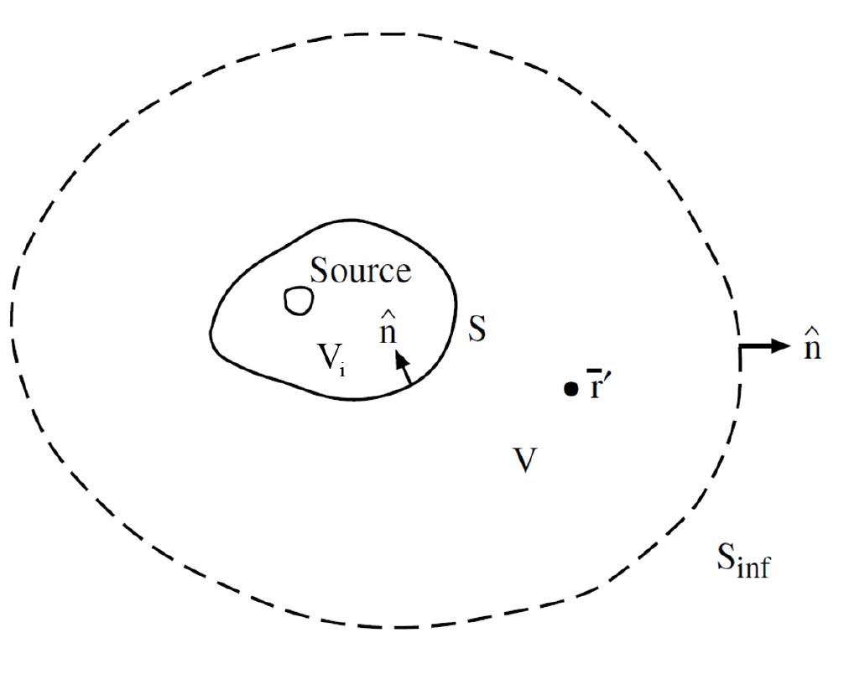

Slide 21
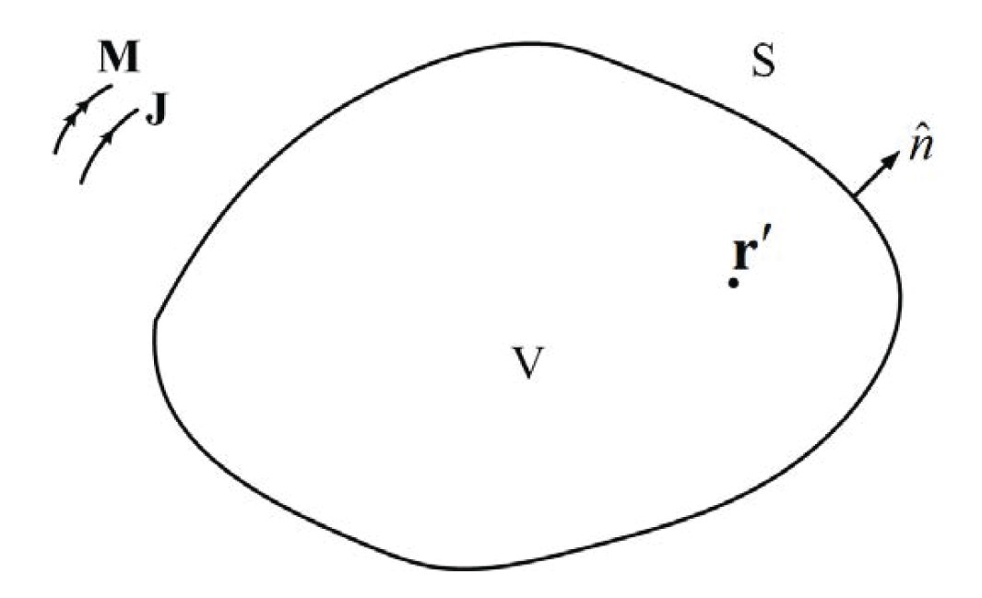


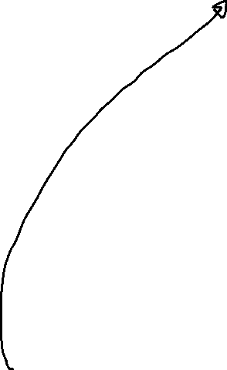




Slide 22









