Slide 1










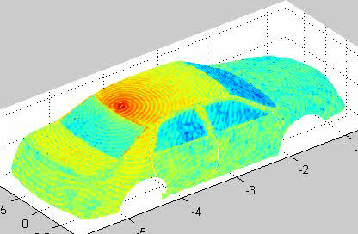
Animation of Current Distribution on Car (2005)
I.T. Chiang
A.J. Hesford
L.J. Jiang
M.K. Li
M.S. Tong
K. Pirapa
M. Delaquil
G. Sorenson
S. Ohnuki
J. Xiong
Antenna generates a circularly polarized field and current on rooftop of the car.
2 GHz antenna on a 4.25 m size car is equivalent to 100 GHz on a 8 cm board
Note also works by Zhen Peng and Z.P. Nie’s group.

Slide 2
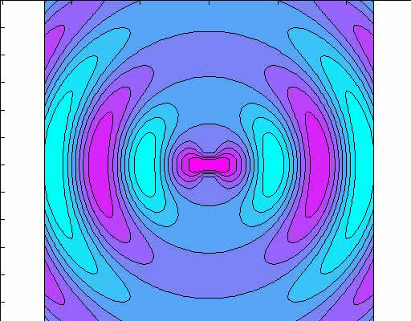
Time Domain Radiation of a Hertzian Dipole
J. Xiong

Slide 3
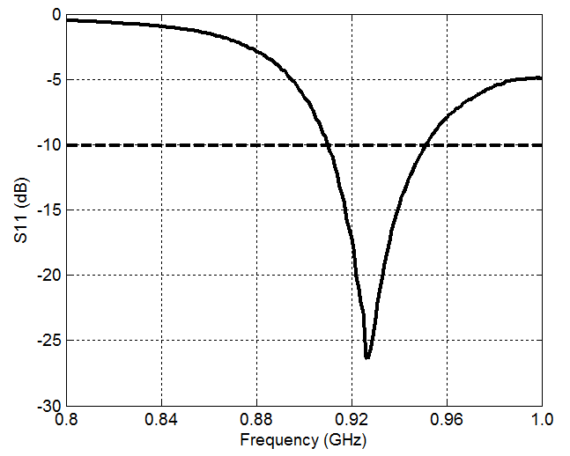
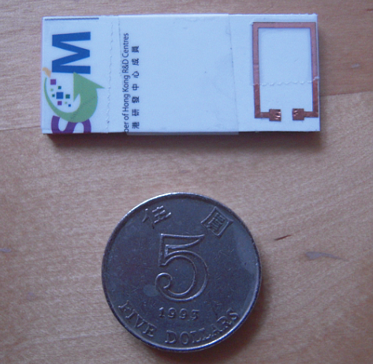
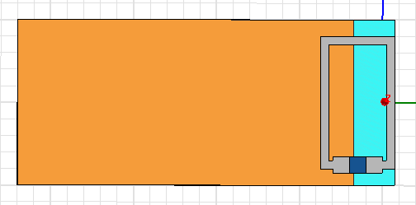
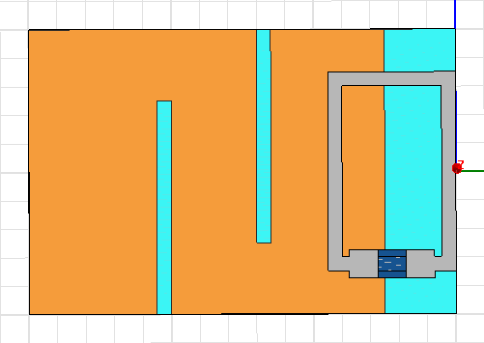
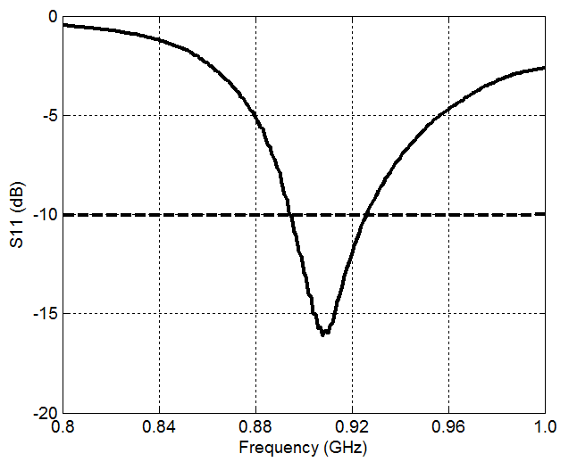
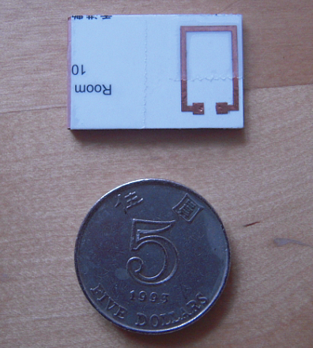
Size Reduction (YANG Peng, LI Yan, HUANG Jun, HE Shiquan, JIANG Lijun, Terry YE)
short
short
86*25*2mm
Read range:>5m
short
45*20*2mm
Read range:>2.5m
short
30*20*2mm
Read range:1m

Slide 4
Square Segmented Loop
See also: Daniel M. Dobkin, Steven M. Weigand and Nathan Iye, Microwave Journal, vol.50 , no. 6, 2007.
By CHEN Zhi Ning, from ASTAR, Singapore, 2009

Slide 5




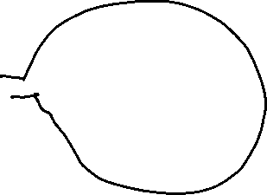

Slide 6
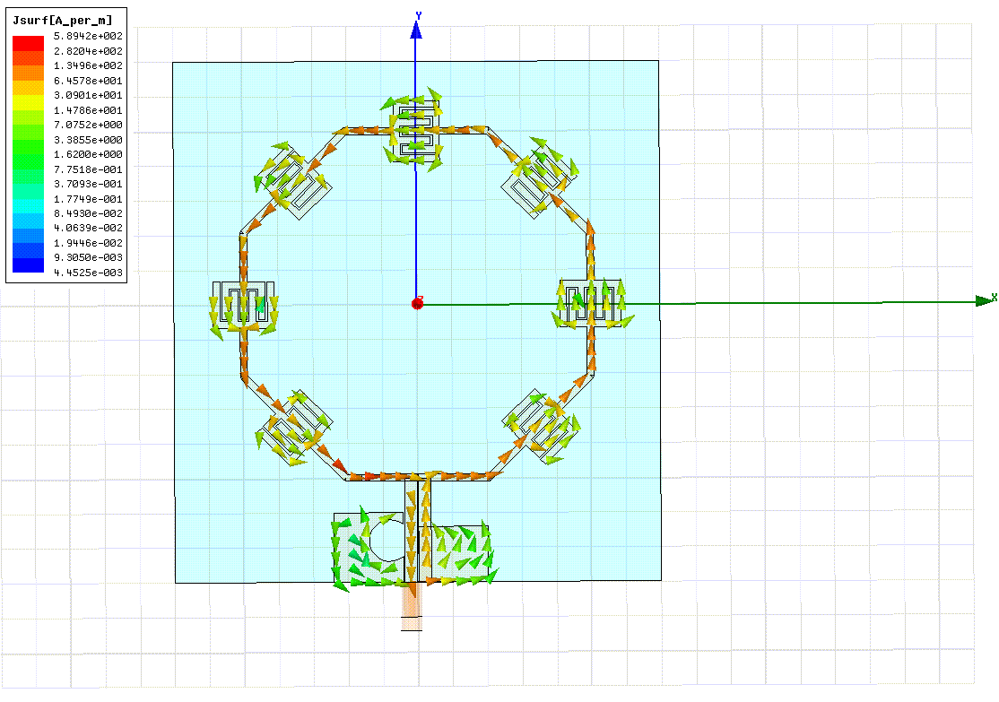
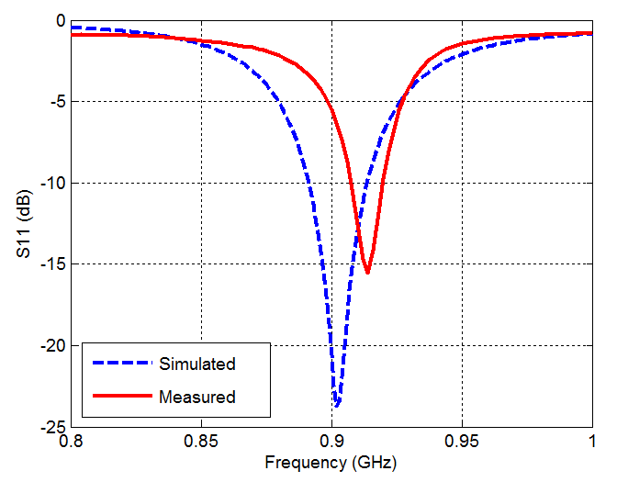
Current Distribution and Measured S11
(YANG Peng, LI Yan, HUANG Jun, HE Shiquan, JIANG Lijun, Terry YE)

