Slide 1
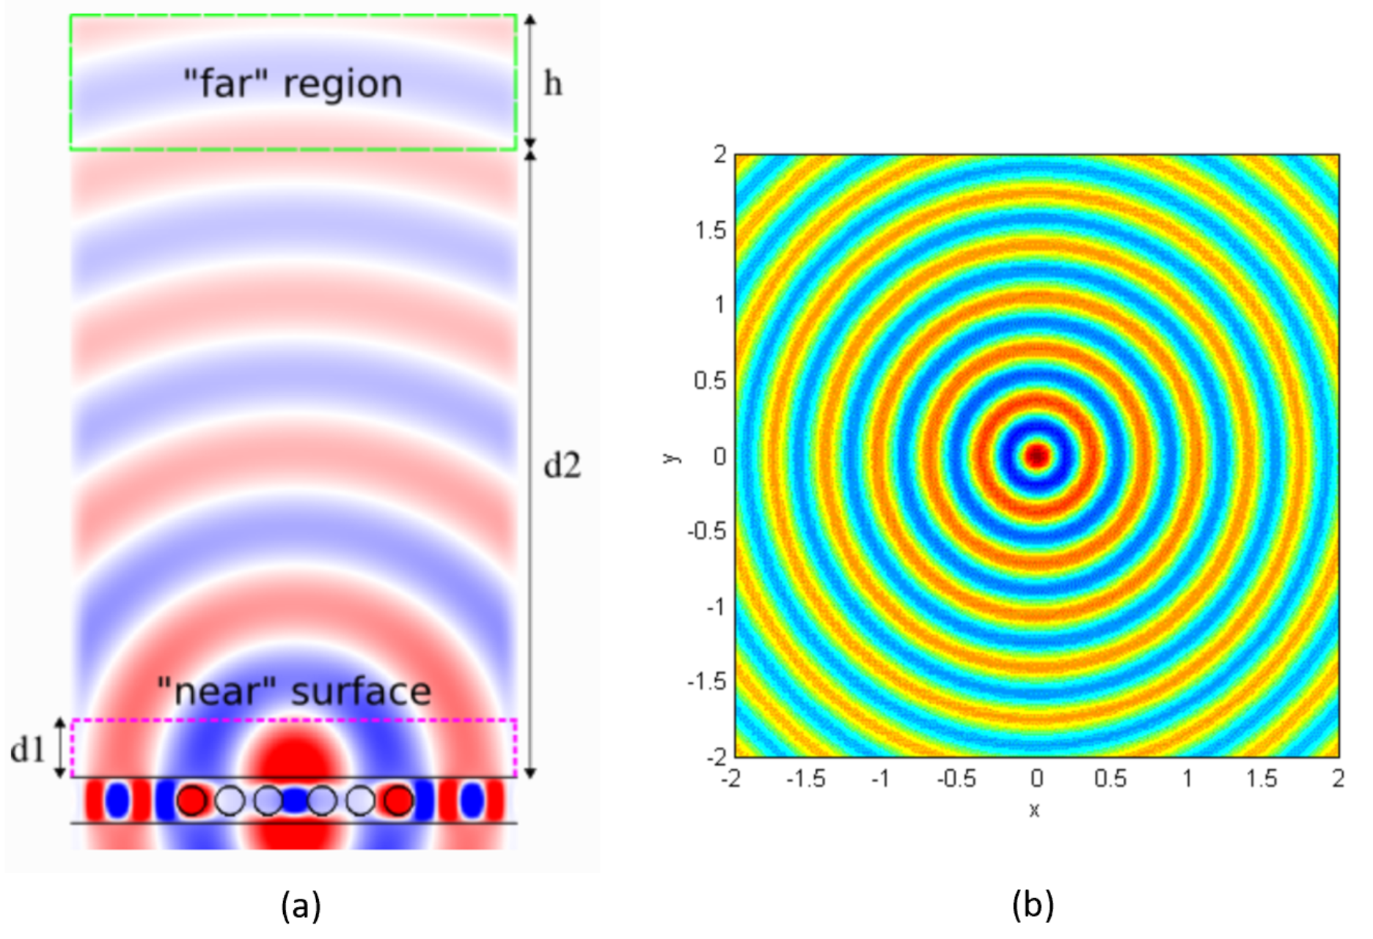
(a)Radiation from a leaky hole in a waveguide, simulated using MEEP at MIT.
(b) Purdue Engineering ME513.

Slide 3
Broadside Direction
Endfire Direction

Slide 4
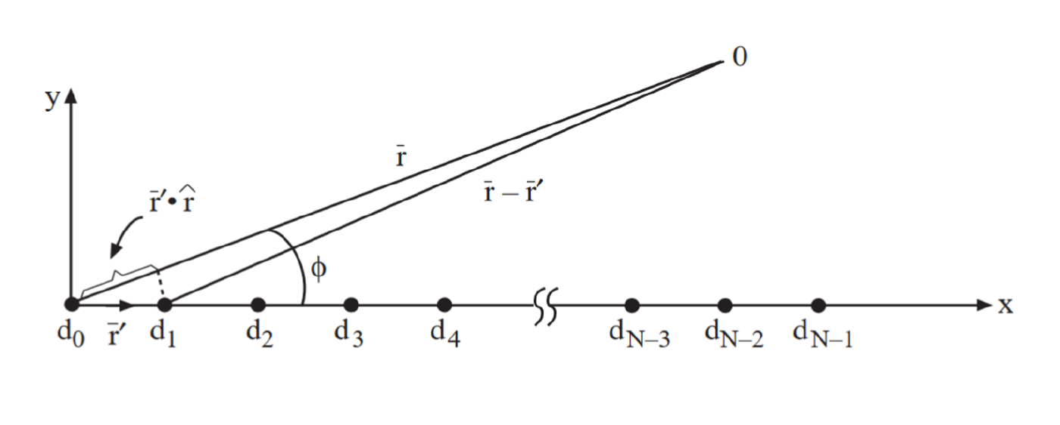

Slide 10
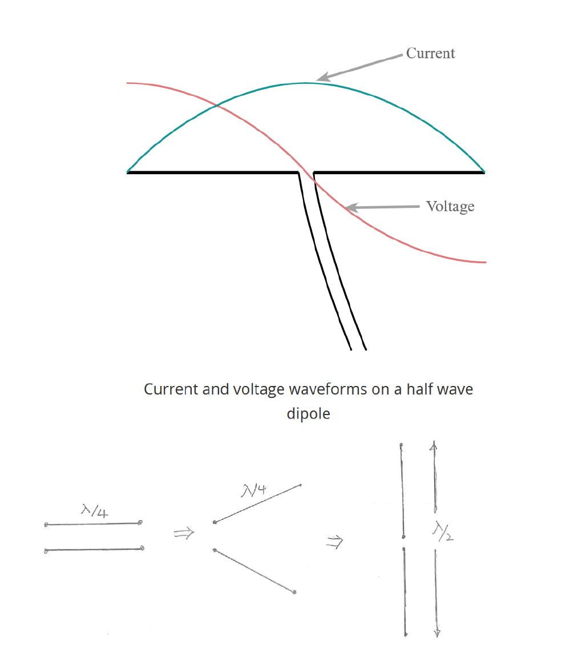

Slide 11
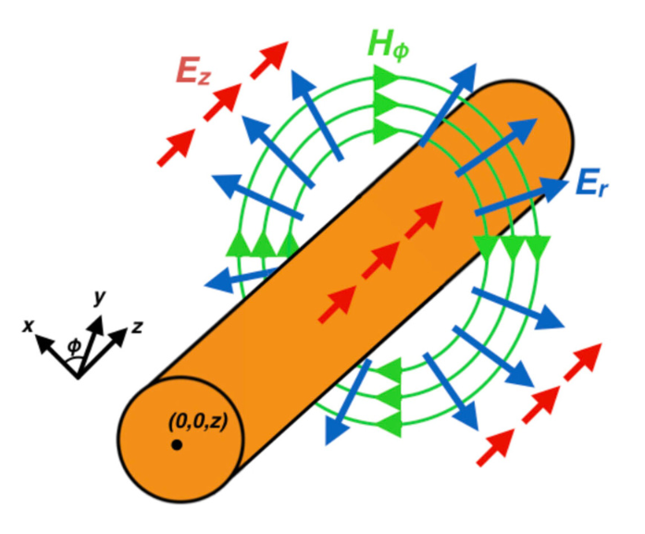
A Goubau Line—A weak waveguide.

Slide 13
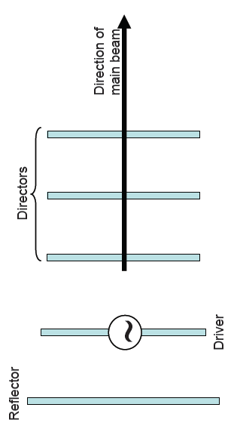
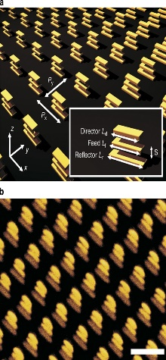
The Tale of Three Physics; Circuit Physics; Wave Physics; Ray Physics;
Circuit Physics—Computer Chip
Wave Physics
Yagi-Uda 1926
Ray Physics
Inspired nano-antennas:
Dregely et al.

Slide 14
Cavity backed slot antenna

Slide 17
Microstrip patch antennas

Slide 19
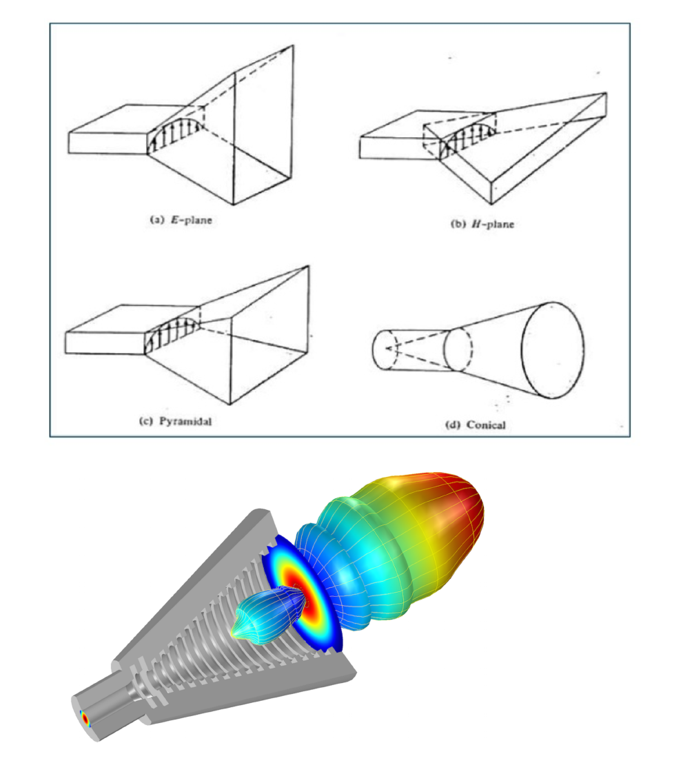
Horn antennas

Slide 21
Vivaldi antenna

Slide 23
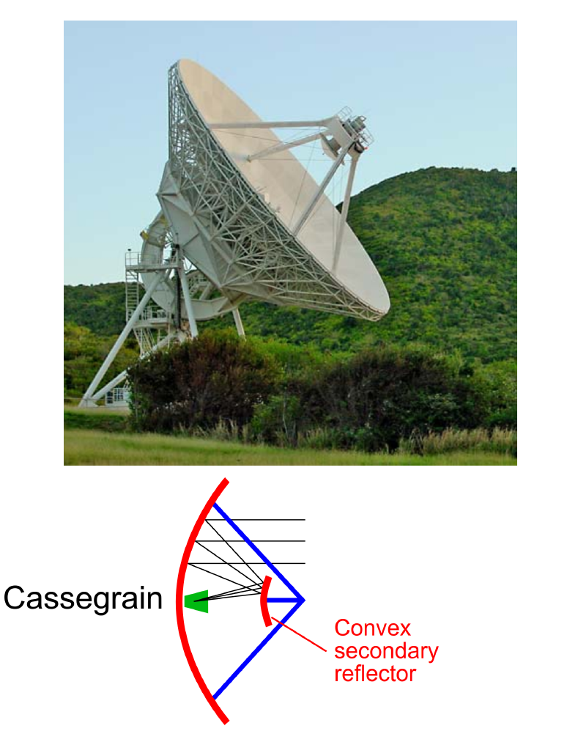
Parabolic reflector antenna

Slide 24
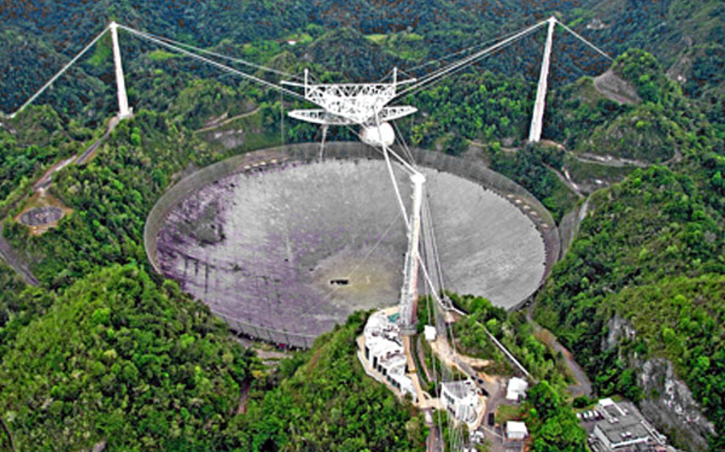
FAST and Arecibo Radio Astronomy Antennas

Slide 25
Reflectarray

Slide 26
Lens antenna

Slide 27
Small antenna-PIFA, planar inverted F antenna

Slide 28
Small antenna-U Slot antenna

