Slide 15
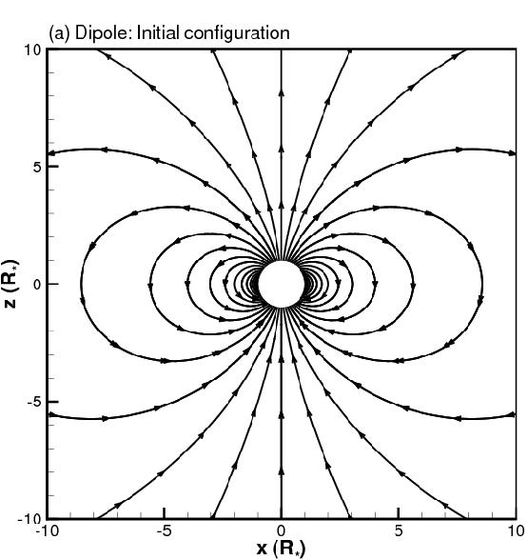

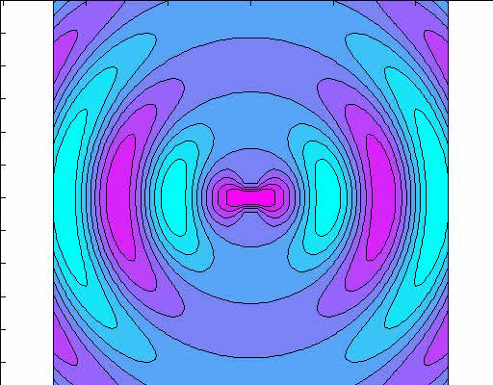

Van der Waals Force is Very Short Range
Near Field
Van der Waals force is a short-range
cooperative effect.
In the far field, it is small.
From Xiong Jie, 2006

Slide 16

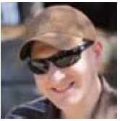








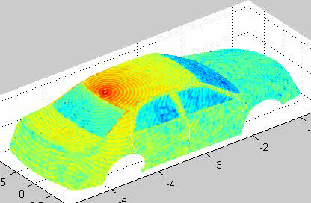
Animation of Current Distribution on Car (2005)
I.T. Chiang
A.J. Hesford
L.J. Jiang
M.K. Li
M.S. Tong
K. Pirapa
M. Delaquil
G. Sorenson
S. Ohnuki
J. Xiong
Antenna generates a circularly polarized field and current on rooftop of the car.
2 GHz antenna on a 4.25 m size car is equivalent to 100 GHz on a 8 cm board
Note also works by Zhen Peng and Z.P. Nie’s group.

Slide 17
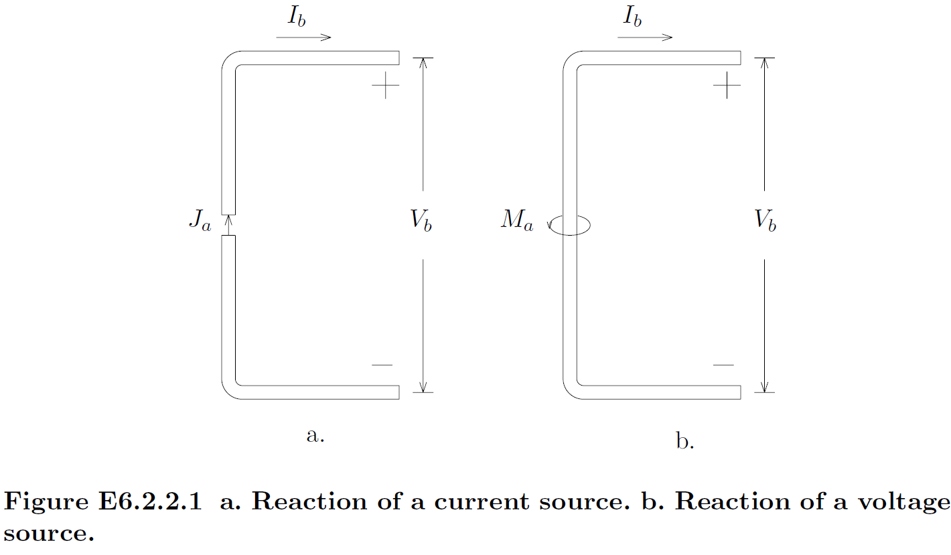

Slide 18
