Slide 9
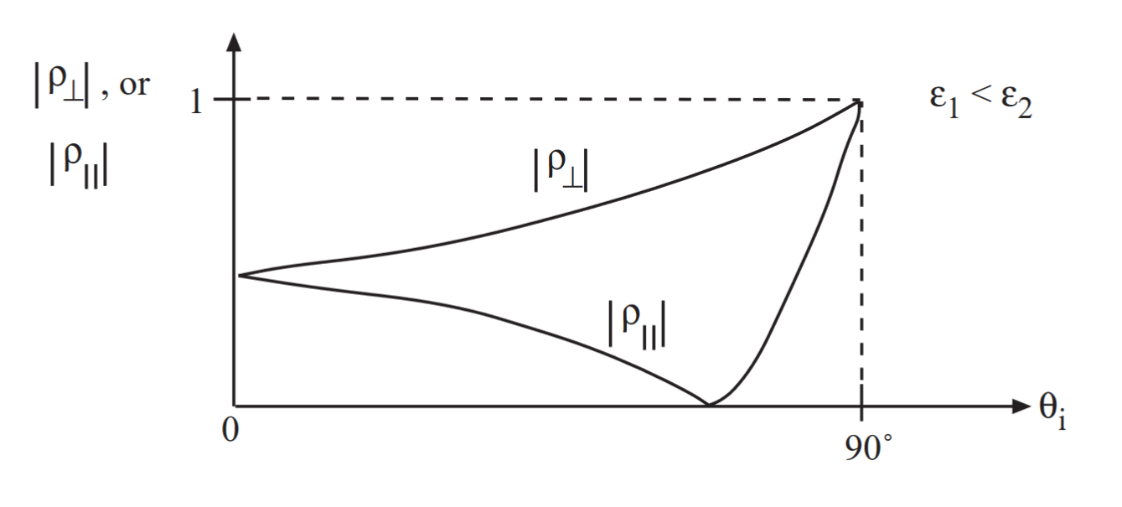
Brewster Angle

Slide 10
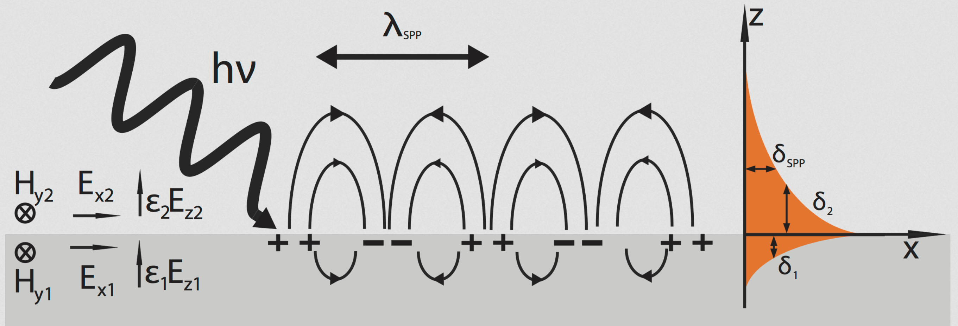
Surface Plasmon Polariton—Courtesy of wikipedia
https://en.wikipedia.org/wiki/Surface_plasmon

Slide 11
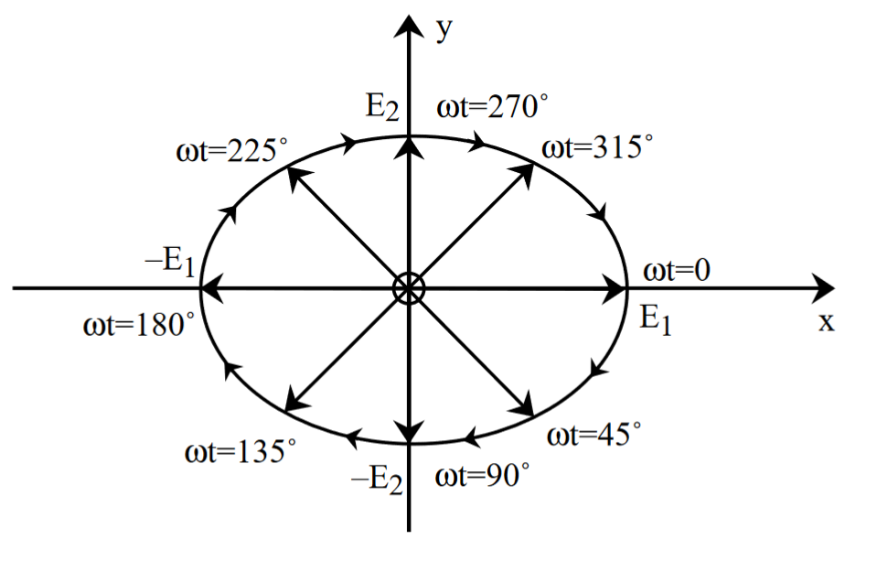
Elliptically Polarized Wave

Slide 12
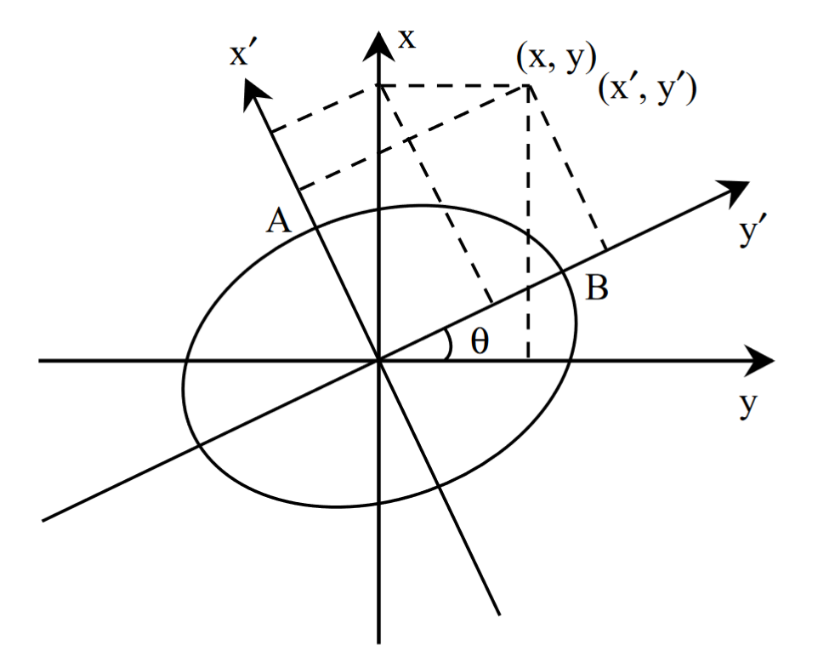
Tilted Ellipse

Slide 13
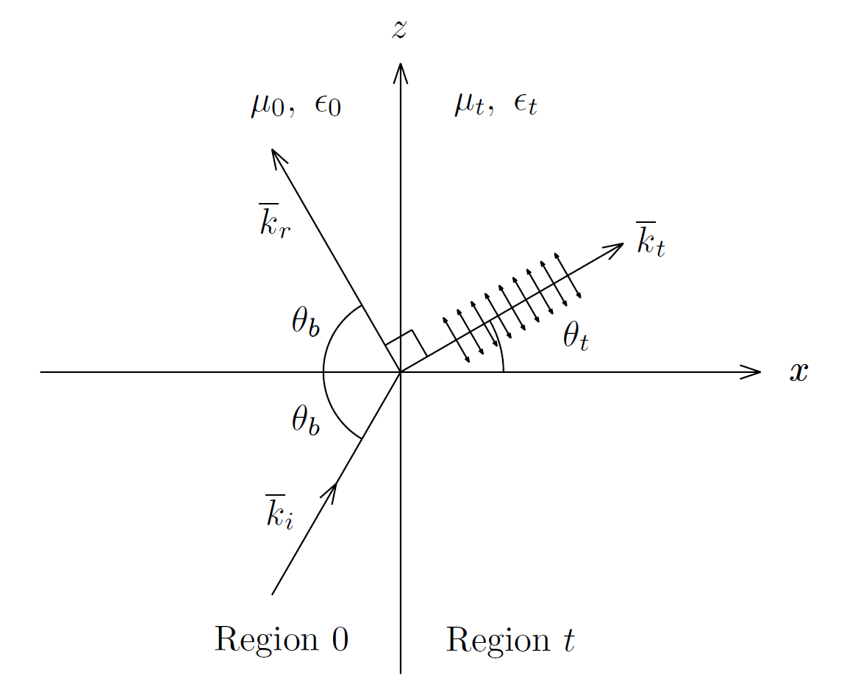
Brewster Angle Effect—Courtesy of JA Kong

Slide 14
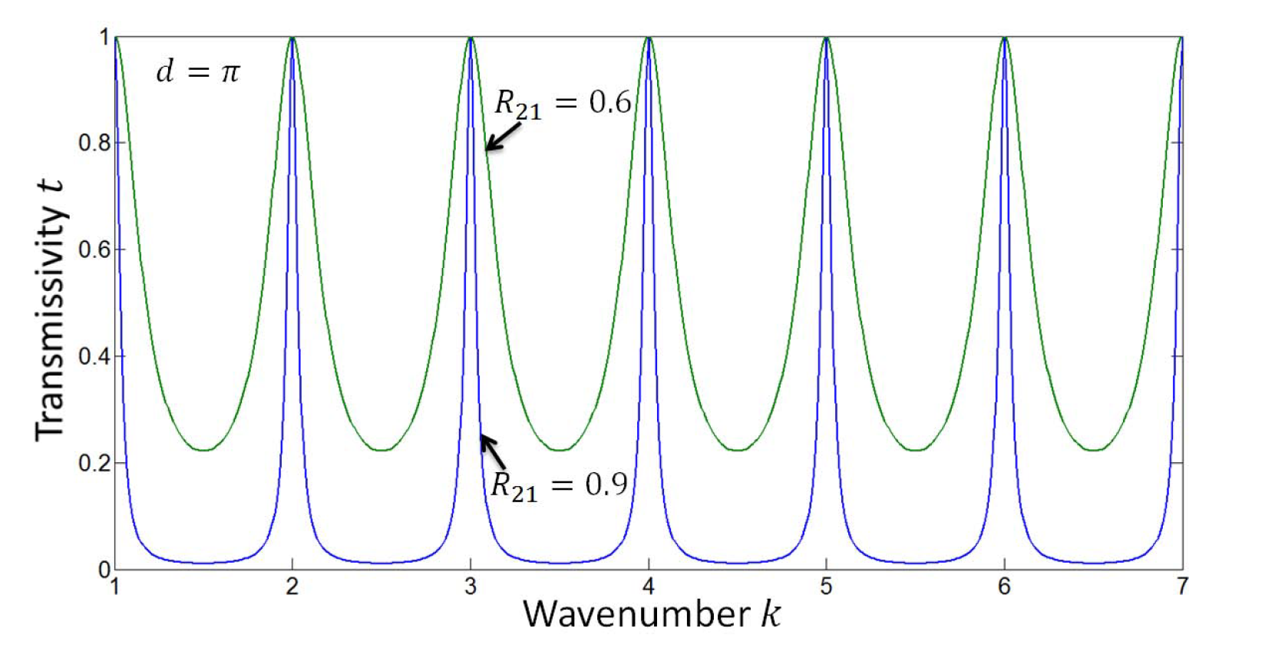
Fabry Filter--Etalon

Slide 16
