Slide 14
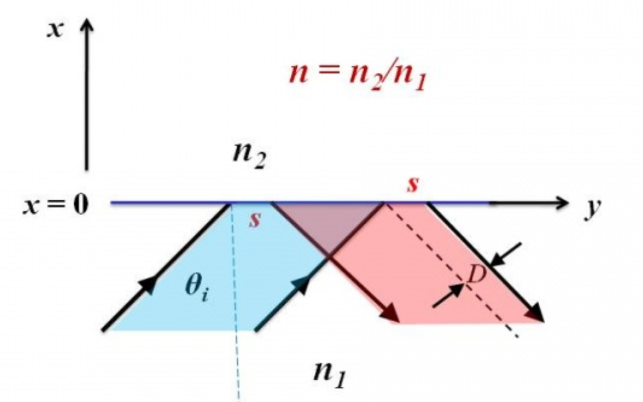

Slide 20
Goos-Hanschen Shift--Paul R. Berman (2012), Scholarpedia, 7(3):11584.

Slide 21
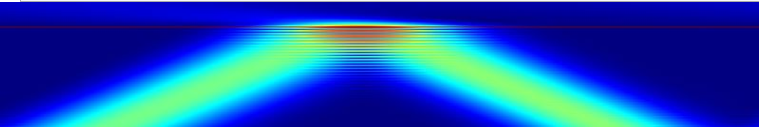
Goos-Hanschen Shift--Paul R. Berman (2012), Scholarpedia, 7(3):11584.

Slide 22
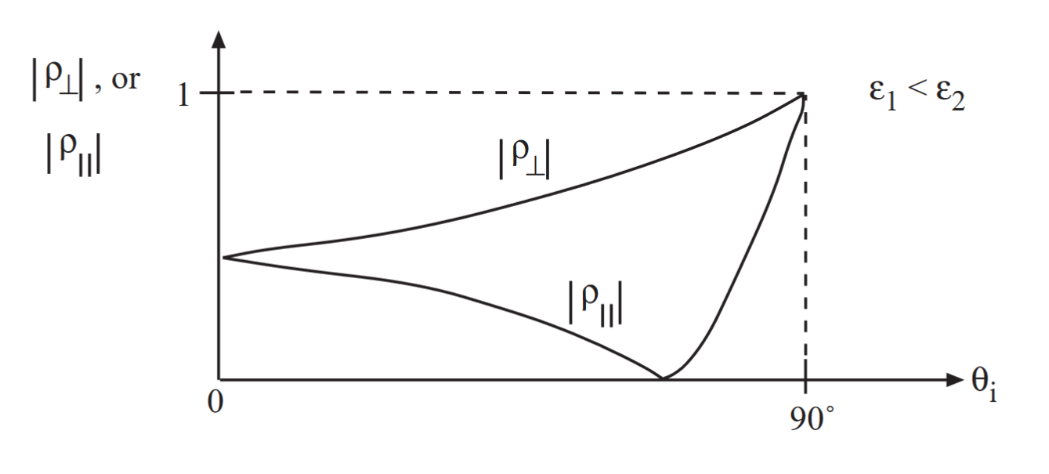

Slide 23
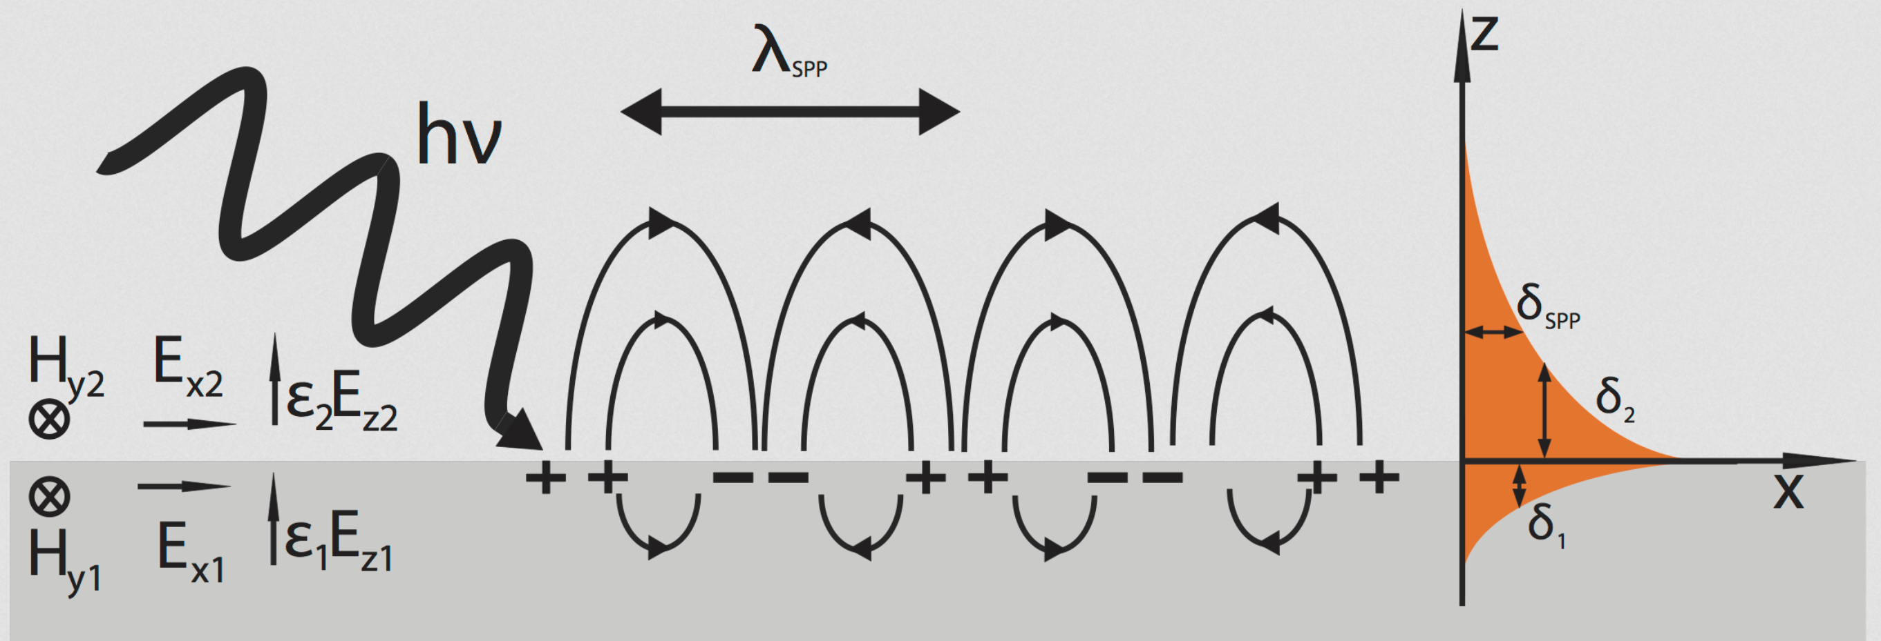
Surface Plasmon Polariton—Courtesy of wikipedia
https://en.wikipedia.org/wiki/Surface_plasmon

