Slide 1
ECE 255
Feb 6, 2018 Lecture
Instructor: Weng Cho Chew
Email: wcchew@purdue.edu
Office: 3053 Wang Hall

Slide 2
Emergence of MOSFET
MOSFET—Metal oxide semiconductor field effect transistor. Widely used in ICs.
Pros:
  Its fabrication process is simpler than BJT. More error-tolerant.
  It draws little current and hence less power.
Cons:
  Less linear than BJT. Does not provide high fidelity amplification.

Slide 3
Device Structure and Physics
Two n⁺ source (S) and drain (D) regions.
A p region (body).
Current flows from S to D via channel region.
Gate voltage controls the current flow.
Substrate is known as the body.
Gate electrode

Slide 4
Two Kinds of MOSFET
Enhancement-type MOSFET: Off in quiescent state, and turned on by a gate voltage.
Depletion-type MOSFET: On in quiescent state, and turned off by a gate voltage.
MOSFET are also called IGFET where IG stands for insulated gate.
Enhancement-type MOSFET.

Slide 5
Creating a Conducting Channel
N-channel MOSFET or NMOS with
Positive gate voltage applied.
Hence, the name:
Field Effect Transistor.
First, depletion region is formed by “uncovering”.
Higher voltage induces n-type channel, also called an inversion layer.

Slide 6
More on MOSFET
The voltage at which inversion happens is the threshold voltage (0.1 to 1.0V).
The excess voltage is overdrive voltage or effective voltage.
An NMOS transistor in operation.

Slide 7
More Math and Physics

Slide 8
More Math and Physics, Contd.

Slide 9
Small v_{DS} Model for MOSFET
From
charge per unit length
From
where
then
And the conductance is:
i_{D} is linearly proportional to v_{DS}.

Slide 10
Small v_{DS} Model for MOSFET, Contd.
i_{D} is linearly proportional to v_{DS}. The slope is dependent on v_{GS} .

Slide 11
Large v_{DS} Model for MOSFET
When v_{DS} is large, then the n-channel width is a function of x.
The channel width is thicker near the source and thinner near the drain.

Slide 12
Large v_{DS} Model for MOSFET
Small v_{DS} case:
Large v_{DS} case:

Slide 13
Channel Pinch-Off and Saturation
When v_{DS}=V_{OV,} the channel width is zero at drain. The saturation current is:
The saturation voltage is:
As a function of v_{OV,}

Slide 14
The I-V Relation for NMOS Transistor

Slide 16
Shape of Channel at Saturation

Slide 17
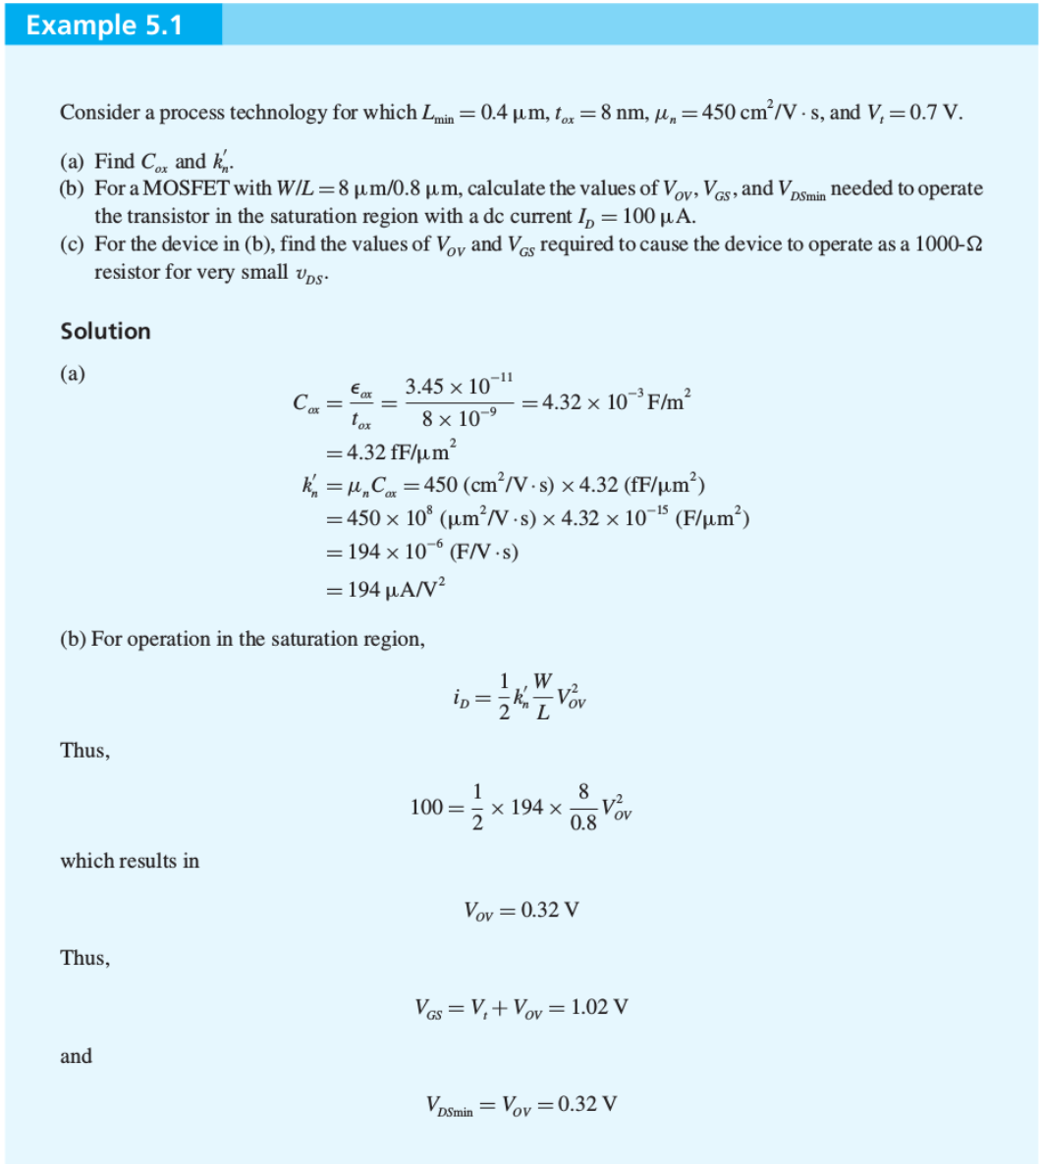

Slide 18
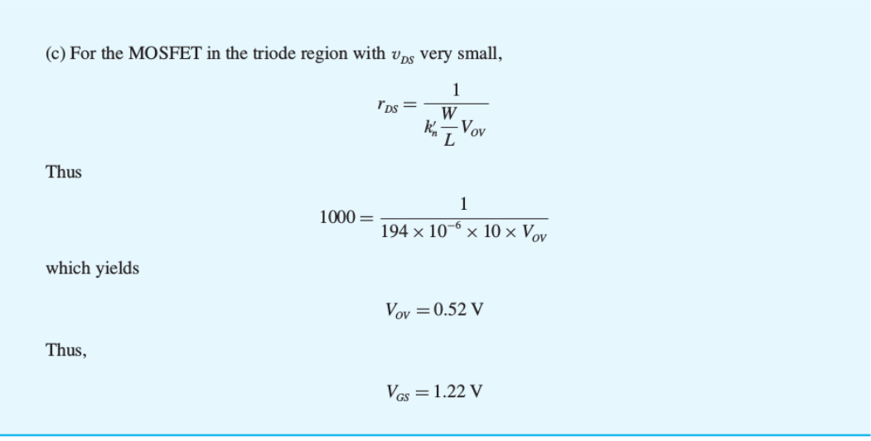

Slide 19
The PMOS Case

Slide 20
Complementary MOS (CMOS)

Slide 21
Clicker Question 1 (1 Point)
Which is the major difference of a MOSFET from a BJT?
Three-terminal device
Absence of exponential relationship
Presence of a depletion region

