Slide 1
ECE 255
Jan 25, 2018 Lecture
Instructor: Weng Cho Chew

Slide 2
More on Diodes
Clamped capacitor as a DC restorer:
Works because Q=CV.
Good for restoring the DC component after a signal passes through a capacitor.
Used in pulsewidth modulation.

Slide 3
The Real Case with Leakage
Voltage follower
KVL
Multiply by C
i
O.D.E.
Homogeneous solution
Single time-constant circuit

Slide 4
Voltage Doubler
A DC Restorer
A capacitor smoother

Slide 5
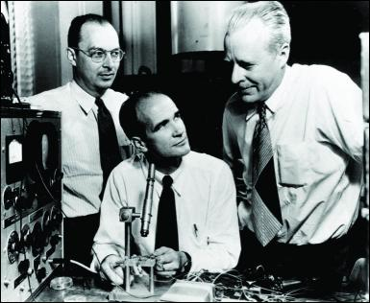
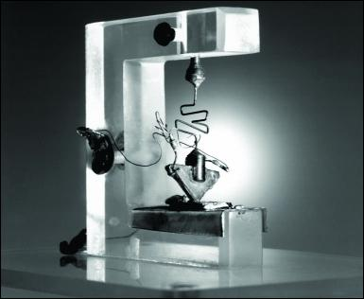
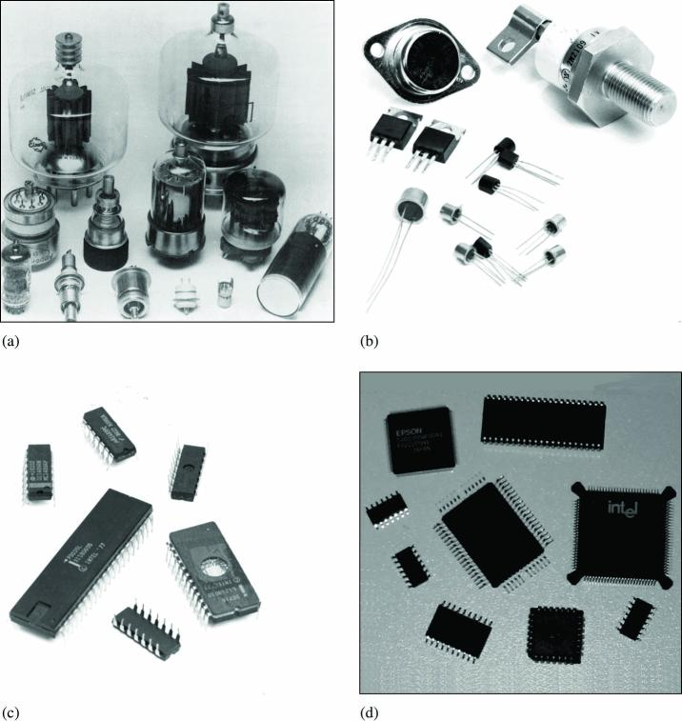
Bipolar Junction Transistors
One of the greatest inventions of the modern era.
Shockley, Brattain, and Bardeen invented it in 1948.
Can amplify a signal compared to a diode.
Replaces vacuum tube technology.

Slide 6
Device Structure and Physical Operation
npn transistor
pnp transistor

Slide 8
An NPN Transistor in Active Mode

Slide 9
Active Mode of NPN
Electron carriers are injected into the p region from n emitter region and become minority carriers.
The CBJ is reverse biased and sweeps up minority carriers that diffuse into the depletion region.
The p region is lightly doped and made thin to reduce EHP (electron-hole pair) recombination.
The emitter n region is heavily doped to produce an ample supply of injected minority carriers into the base.

Slide 10
Reason for Amplification—Active Mode
The collector current is coming from the deluge of excess carriers injected into the base region.
This excess carriers are trapped by the depletion region at the CBJ. Hence, the collector current is independent of the voltage bias of CBJ.
Hence, a small causes a large .
, the current amplication factor should be made large.

Slide 11
More Math
It It is called the current amplification factor or the common-emitter current gain.

Slide 12
Reminder--Simple PN Junction
Minority Carrier Injections

Slide 13
Minority Carriers of NPN Transistor
--Active Mode

Slide 14
More Math
BJT case:
Compared to diode case:

Slide 15
Equivalent Circuit Model
Distillation and condensation: model of BJT in active mode.
SPICE model.
T Model
Voltage controlled current source
Current controlled current source
PI Model

Slide 16
Real World Transistor
Real world transistor is grown by epitaxy, lithography, and different diffusion doping processes.

Slide 17
Transistor in Saturation Mode

Slide 18
Transistor in Saturation Mode
0.7 V
0.4 V
saturation

Slide 19
A PNP Transistor in Active Mode
NPN transistor is more agile than PNP.
But NPN and PNP can be used in tandem.

Slide 20
Vacuum Tubes
Good for HIFI (high fidelity) audio systems because of low noise.
Low noise because the electrons move through vacuum with no collision.
They are still good sources for microwave and terahertz signals.

Slide 21
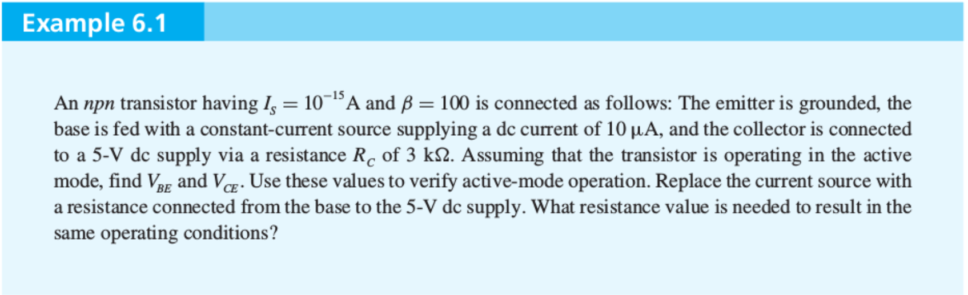
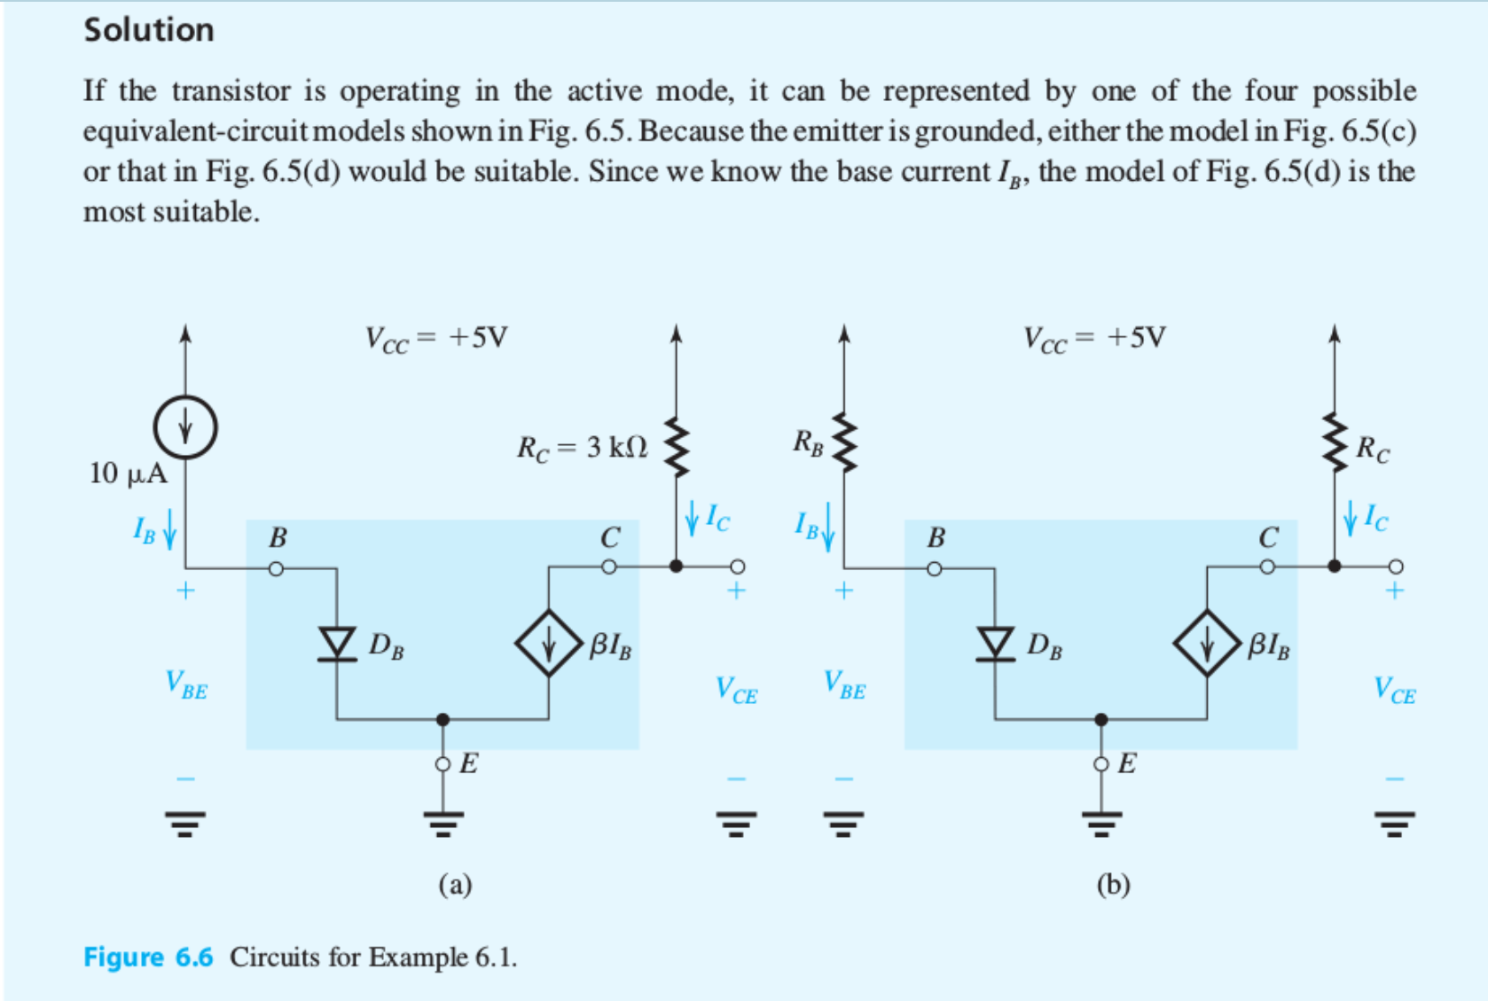

Slide 22
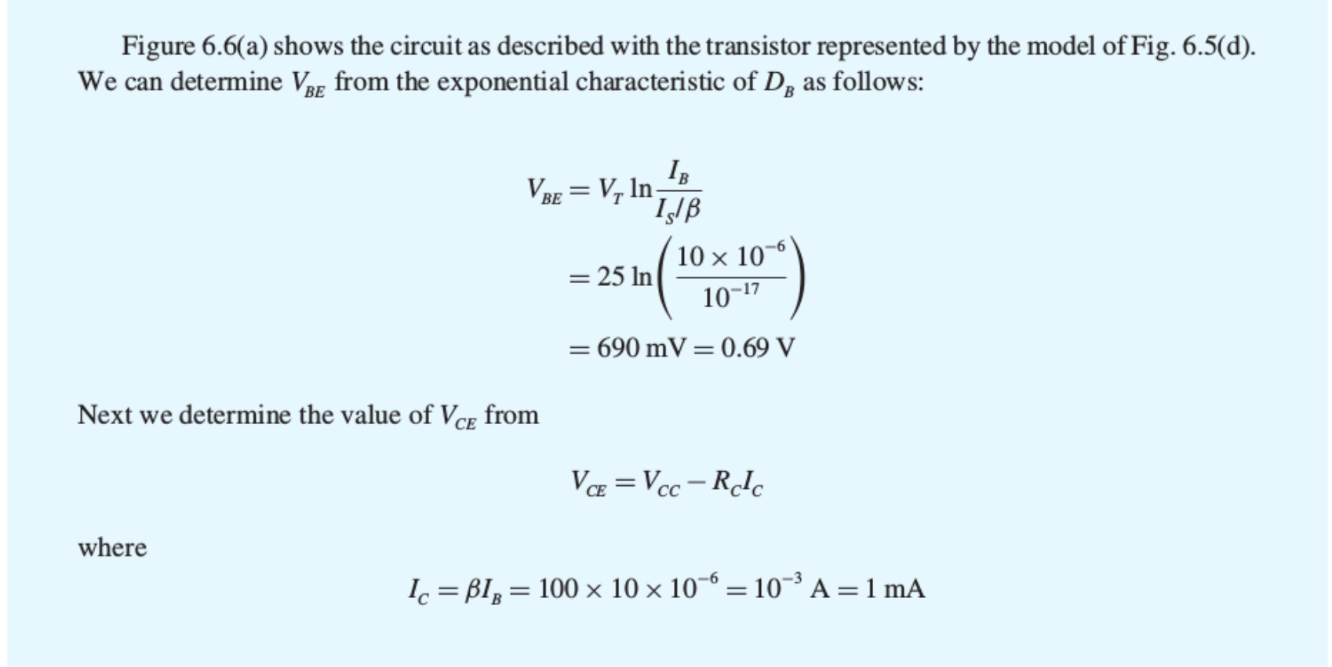
Example 6.1 Contd.

Slide 23
Clicker Question 1 (1 Point)
Which is the most useful mode of a BJT?
Active
Cutoff
Saturation

