Slide 1
ECE 255
Jan 23, 2018 Lecture
Instructor: Weng Cho Chew

Slide 2
Zener Diodes
Voltage regulators, rectifiers, and clamping circuits.
Symbol
Internal voltage
Linear circuit approximation
around Q point.

Slide 3
Zener Diode As Shunt Regulator
has a temperature coefficient in mV/C

Slide 4
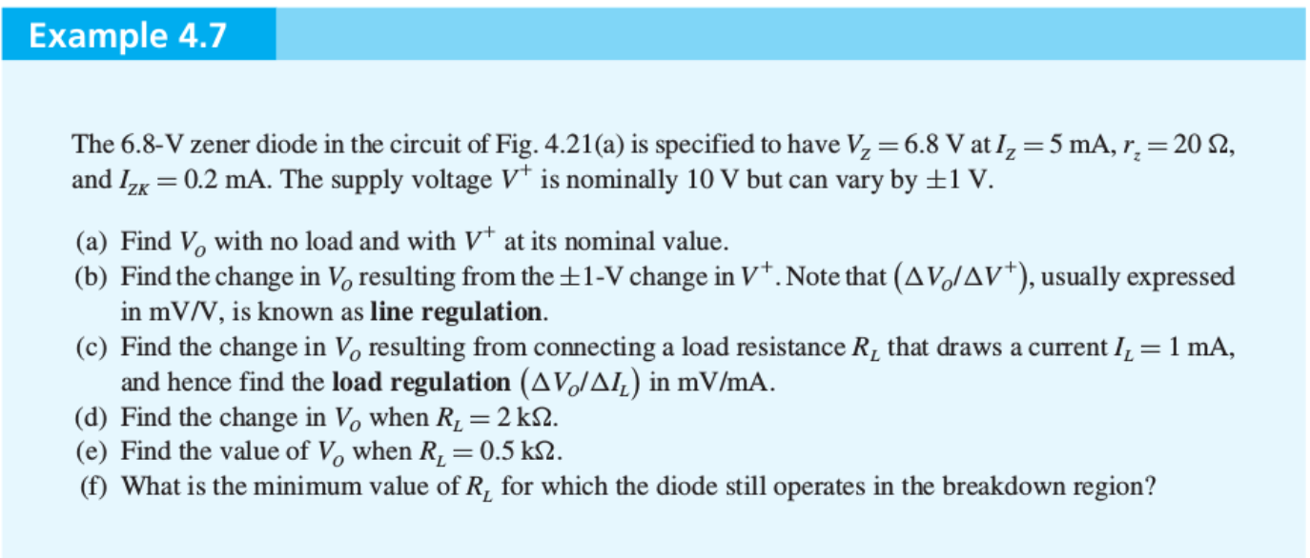
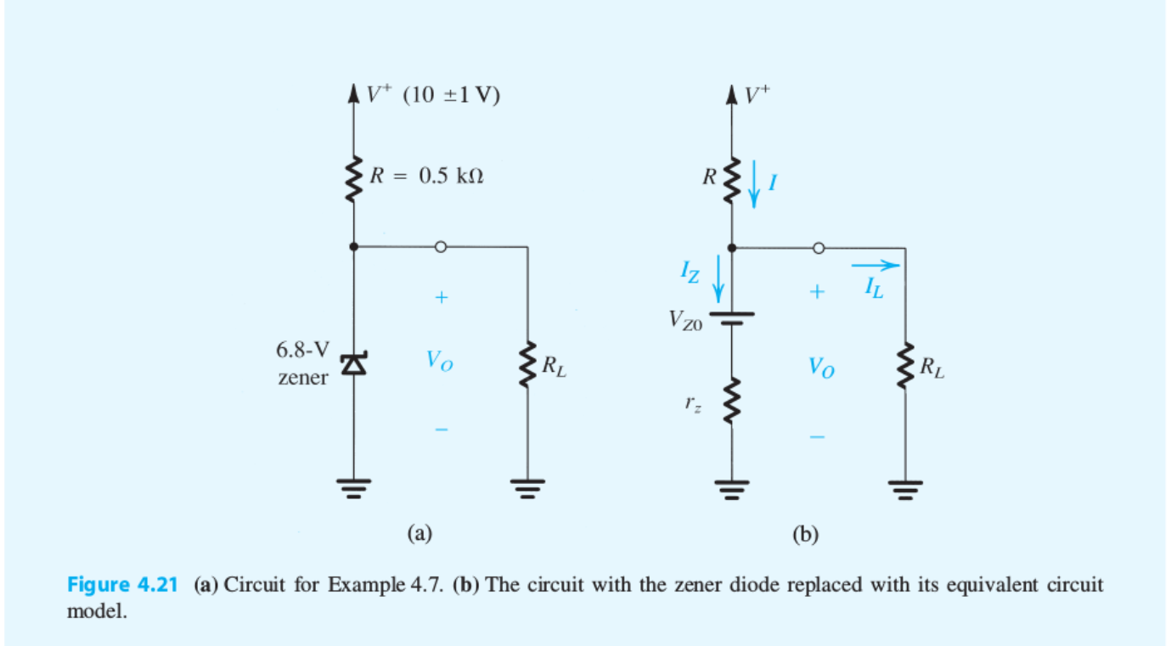

Slide 5
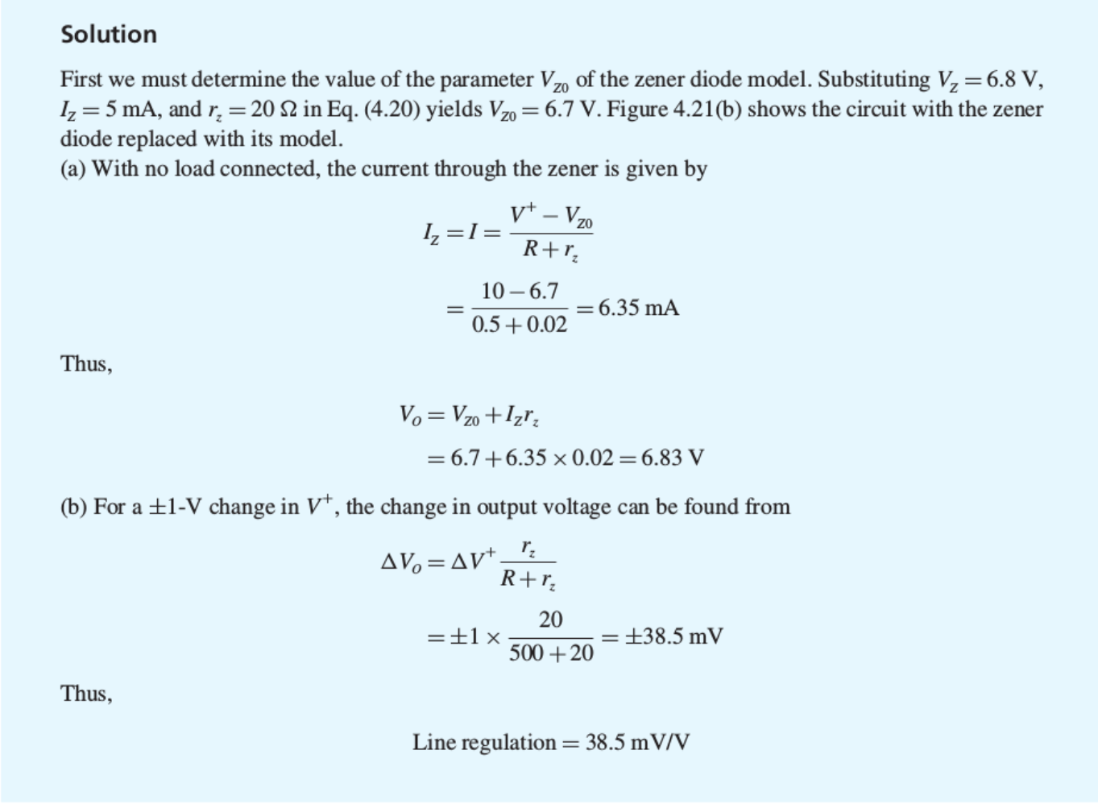


Slide 6
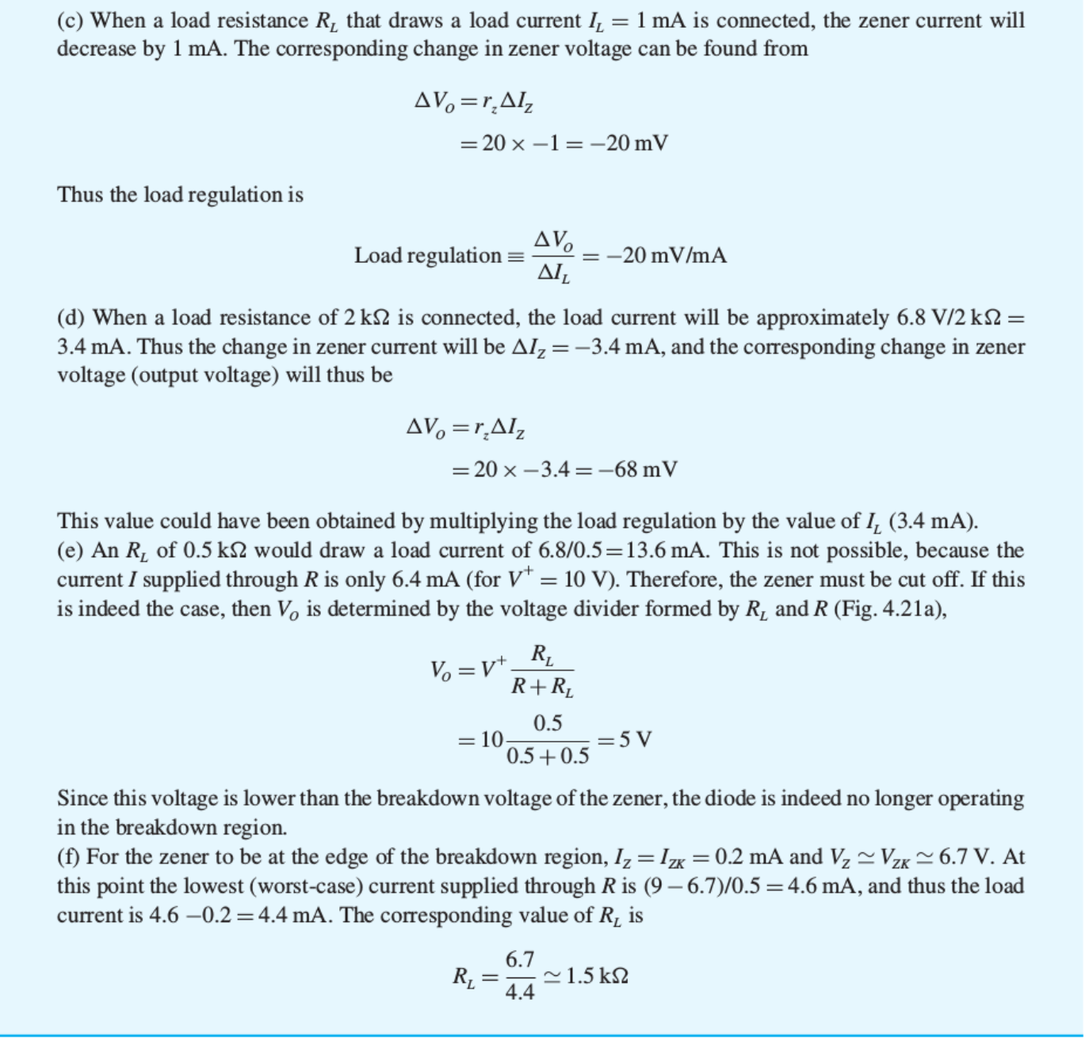

Slide 7
Diodes as Rectifiers
Full wave rectifier

Slide 8
Half-Wave Rectifier
A constant voltage drop model for the diode.
PIV (peak inverse voltage)

Slide 9
Full-Wave Rectifier

Slide 10
Bridge Full-Wave Rectifier

Slide 11
Removing Current Ripple with Capacitor
Ideal Capacitor Case:
Capacitor holds charge forever
Capacitor cannot discharge.

Slide 12
Non-Ideal Capacitor Case
Capacitor cannot hold charge forever

Slide 13
A Smoothed Waveform
A full wave rectifier case.

Slide 14
Math of Waveform Smoothing
Diode open circuit:
Assuming that:
Ripple Voltage
Diode off

Slide 15
Math of Waveform Smoothing, Contd.
Diode conducting:
Diode on interval
Diode current during conduction interval :
From KCL:
Then average diode current:

Slide 16
Clamping and Limiter Circuit
An ideal voltage clamping circuit
A non ideal voltage clamping circuit

Slide 17
The Application of an Ideal Clamping Circuit

Slide 18
Designs of Clamping Circuits

Slide 19
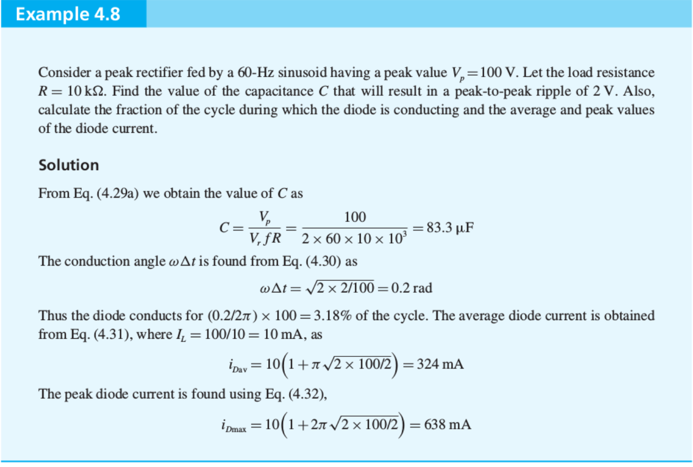
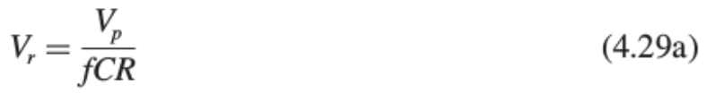


Slide 20
Clicker Question 1 (1 Point)
Which of the following is not a full-wave rectifier?
A transformer with a center tap
A diode connected to a capacitor
Bridge circuit

