Slide 1
ECE 255
Jan 18, 2018 Lecture
Instructor: Weng Cho Chew

Slide 2
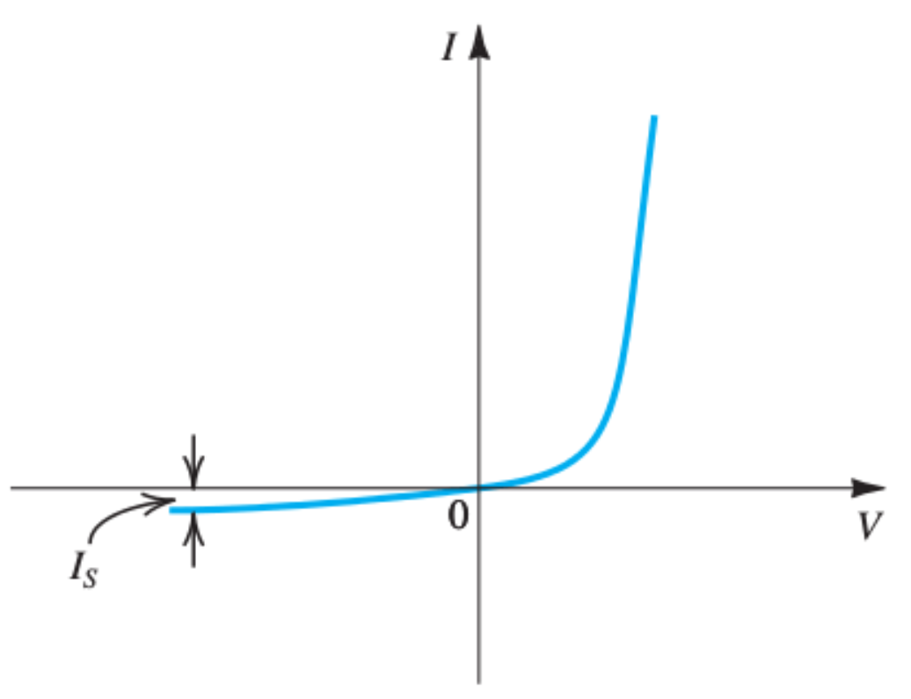
The Actual Diode
The current-voltage (I-V) characteristic is highly nonlinear:

Slide 3
The Ideal Diode
The circuit symbol is shown.
The I-V characteristic is simplified: just on (forward biased) and off (reversed biased).
The equivalent circuits are short and open circuits
Piece-wise linear curve.

Slide 4
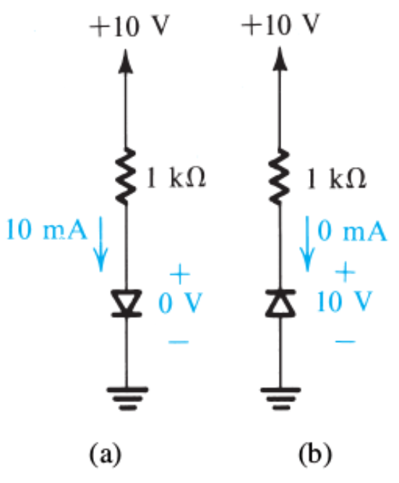
Two Modes of Operation
Use external resistor to limit the forward biased (short circuit) current.

Slide 5
A Simple Rectifier Circuit
(a) Rectifier circuit.
(b) Input waveform.
(c) Equivalent circuit for on mode.
(d) Equivalent circuit for off mode.

Slide 6
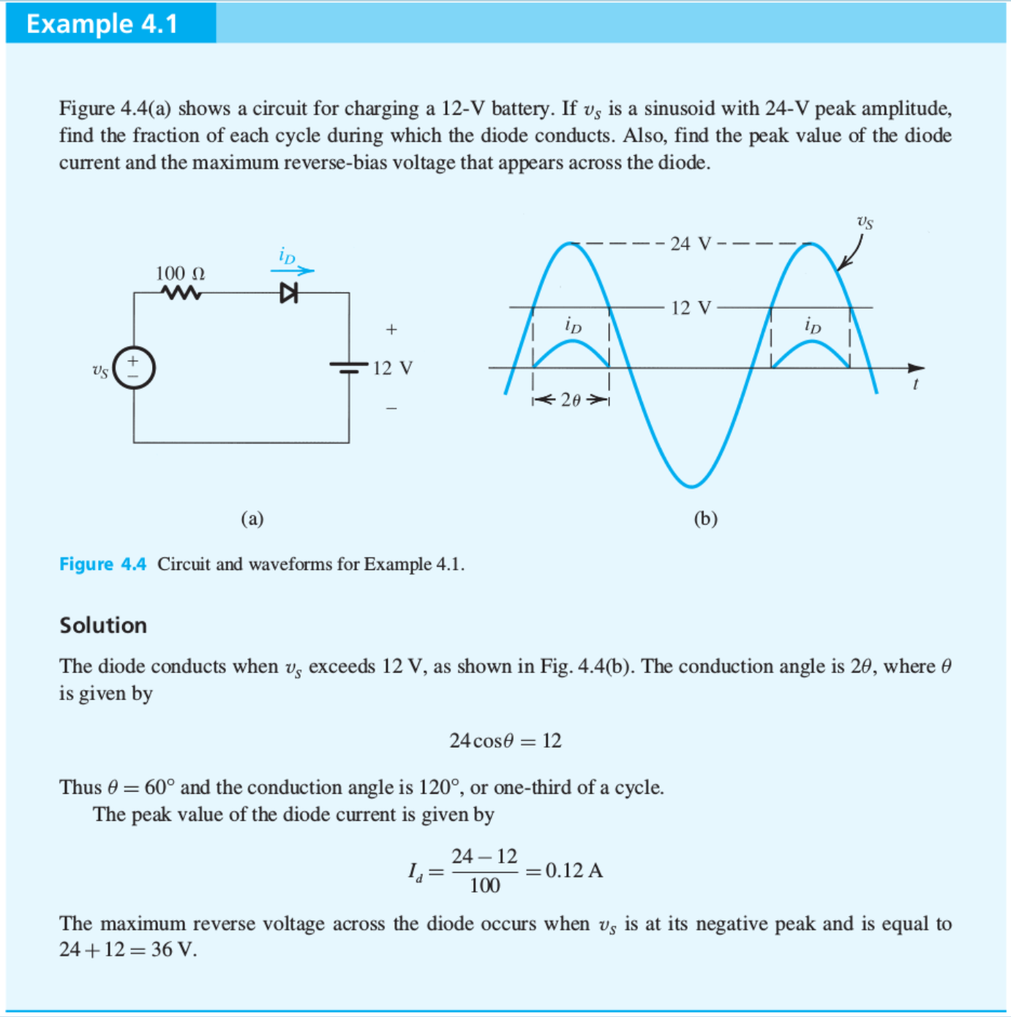

Slide 7
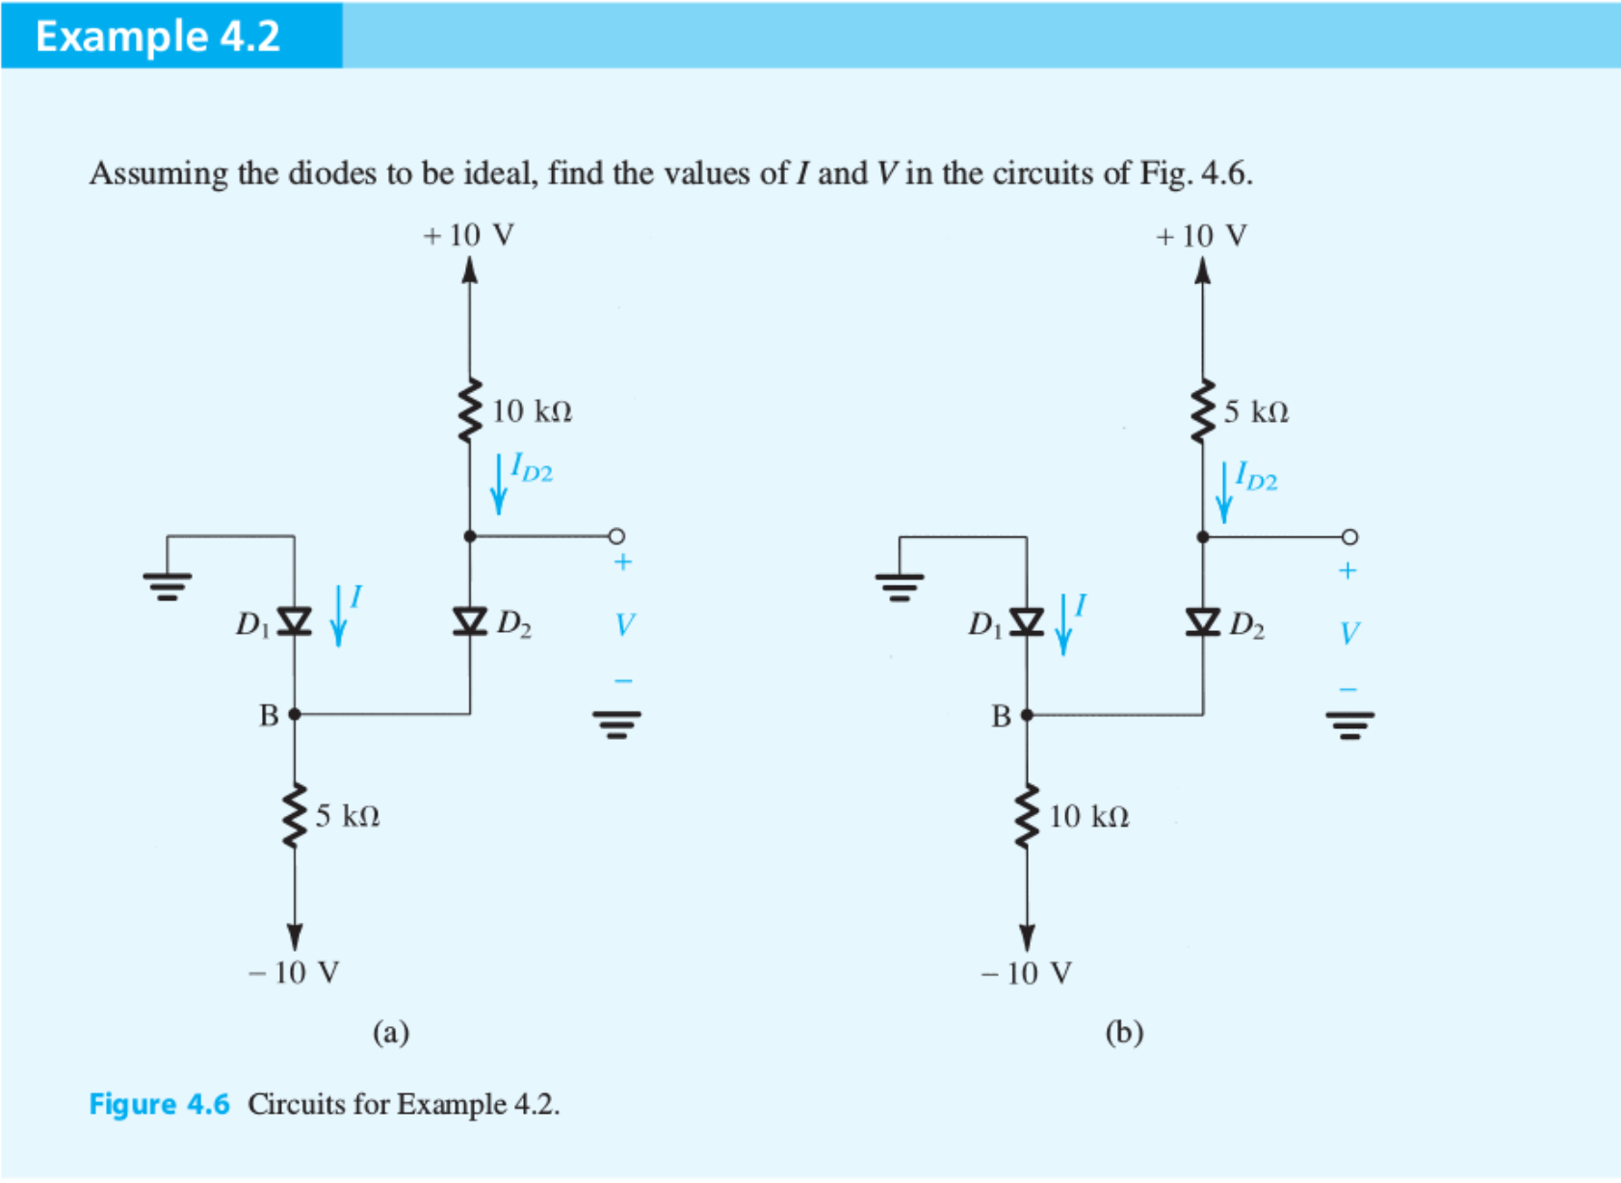
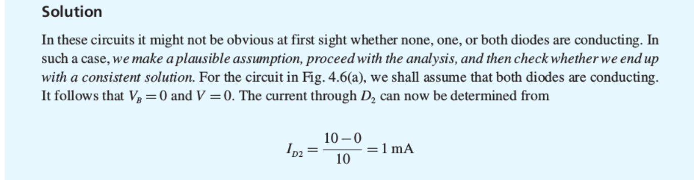

Slide 8
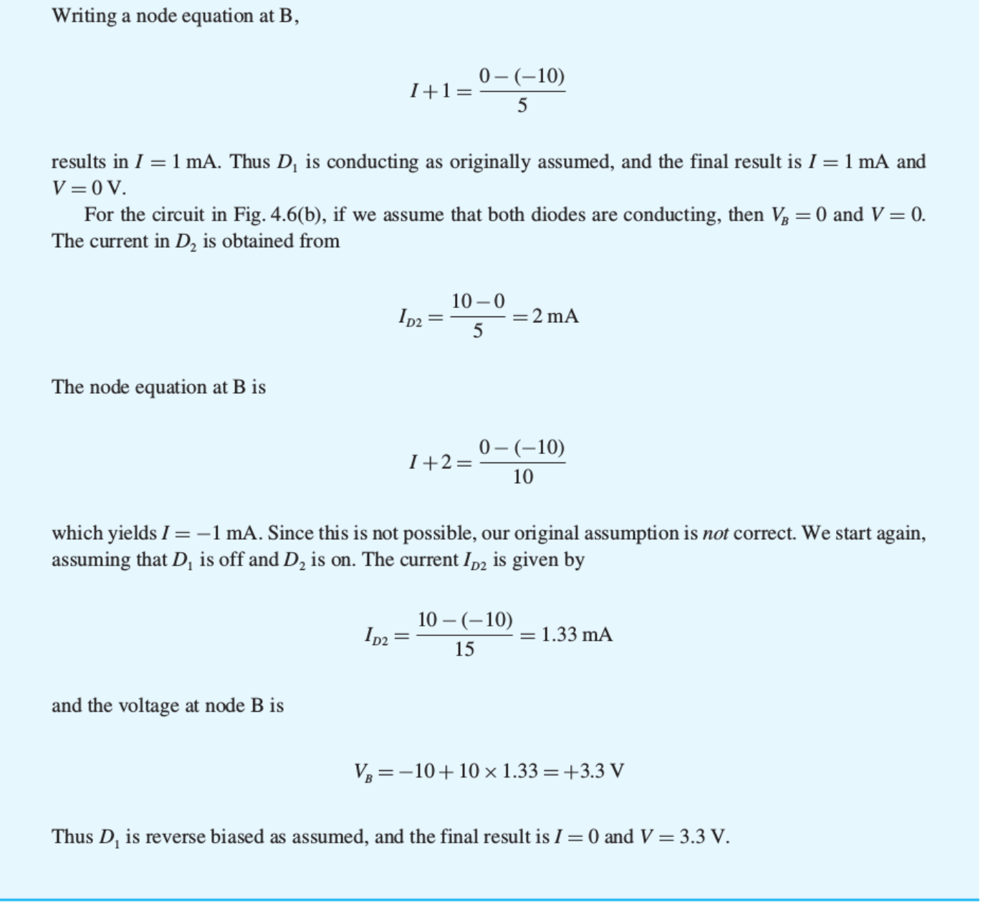

Slide 9
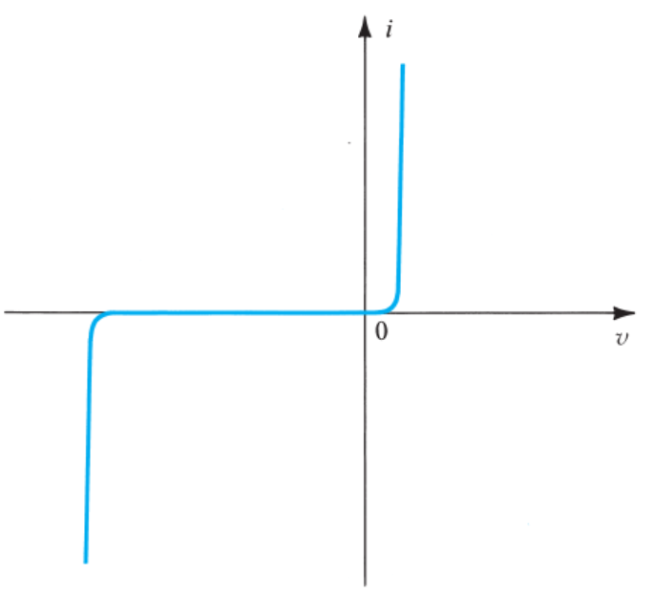
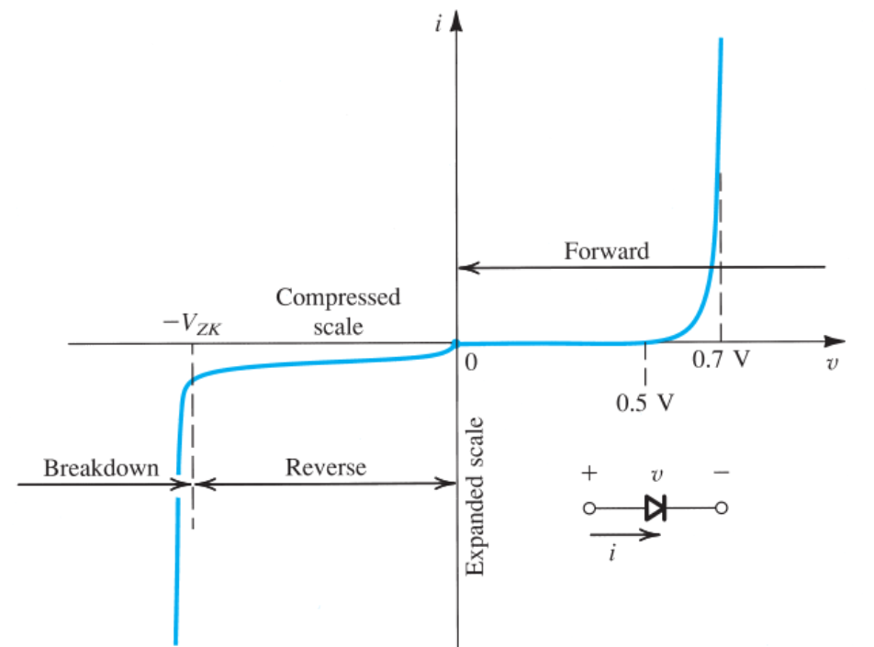
I-V Characteristic of Junction Diode
Forward bias region:
Reverse bias region:
Breakdown region:
Expanded I-V curve
cut-in voltage

Slide 10
Forward Bias Region
Exponential model:
Inverting:

Slide 11
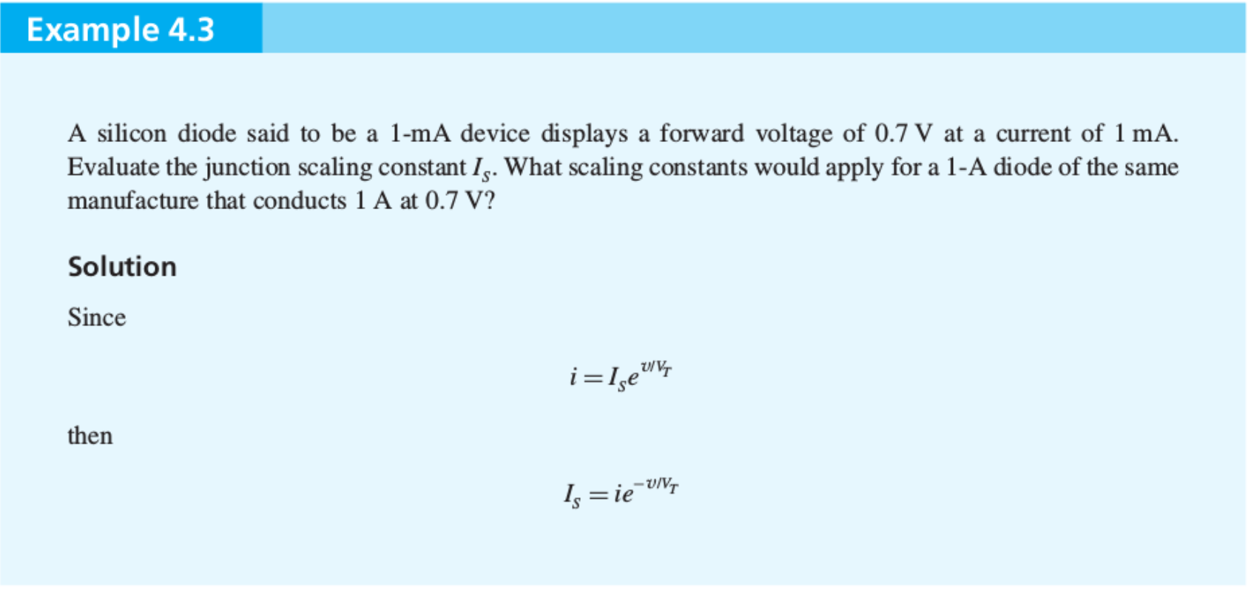
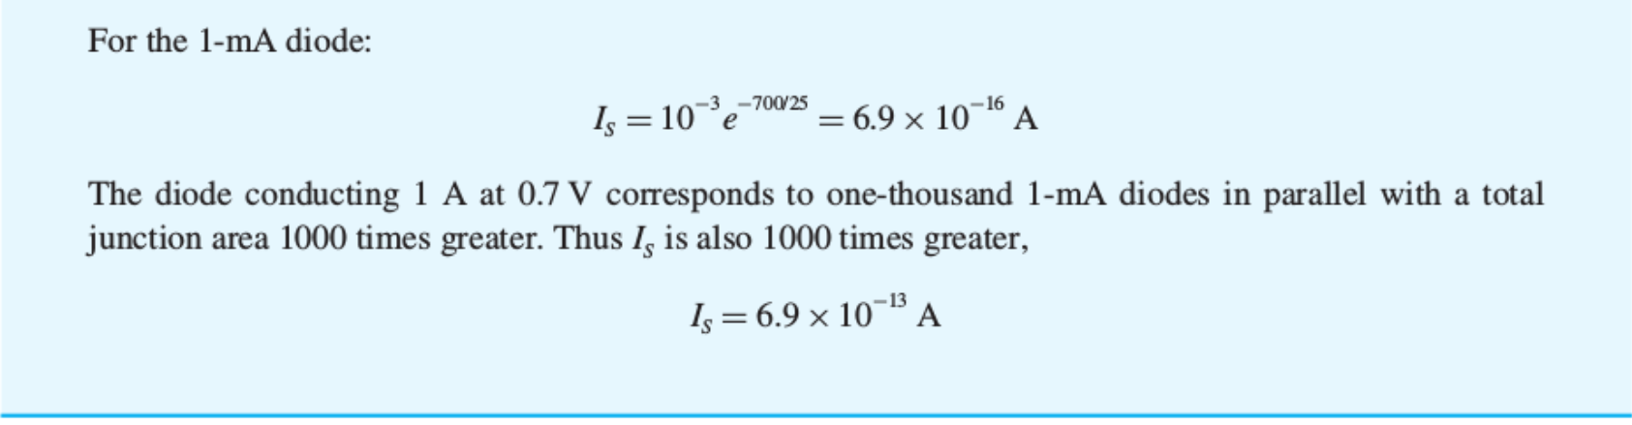

Slide 12
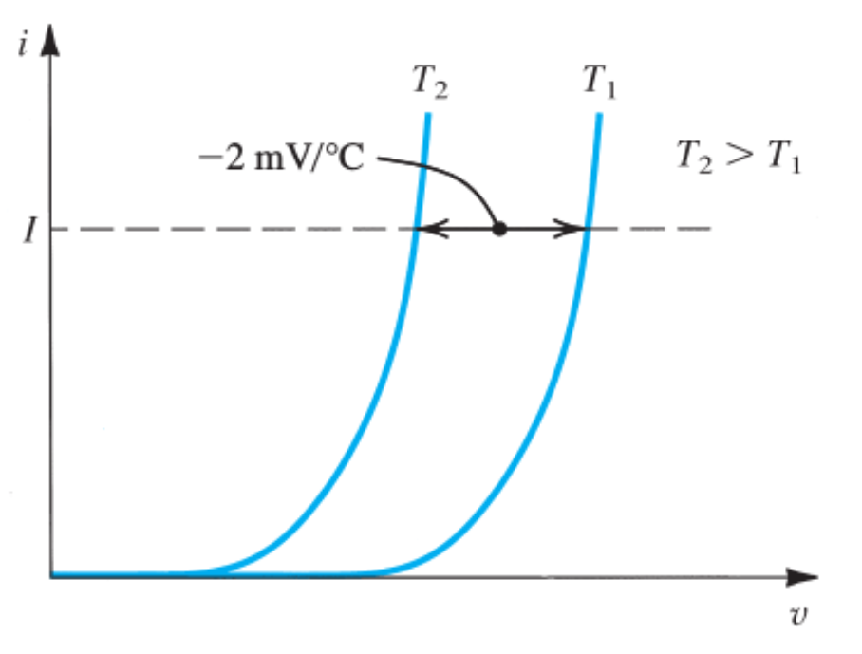
I-V Characteristic—T Dependence
The voltage changes with temperature for a fixed current:

Slide 13
Reverse-Bias Region
doubles every
The Breakdown Region
The breakdown voltage:

Slide 14
More on Diode Modeling
Diode connected to a resistor and a battery:
Eliminating in the first equation gives:
Transcendental equation

Slide 15
Graphical Analysis
Solving the transcendental equation (nonlinear equation) by graphical method.

Slide 16
Solving Nonlinear Equation—Iterative Method
Solving nonlinear equation by iterative method or method of successive approximation.

Slide 17
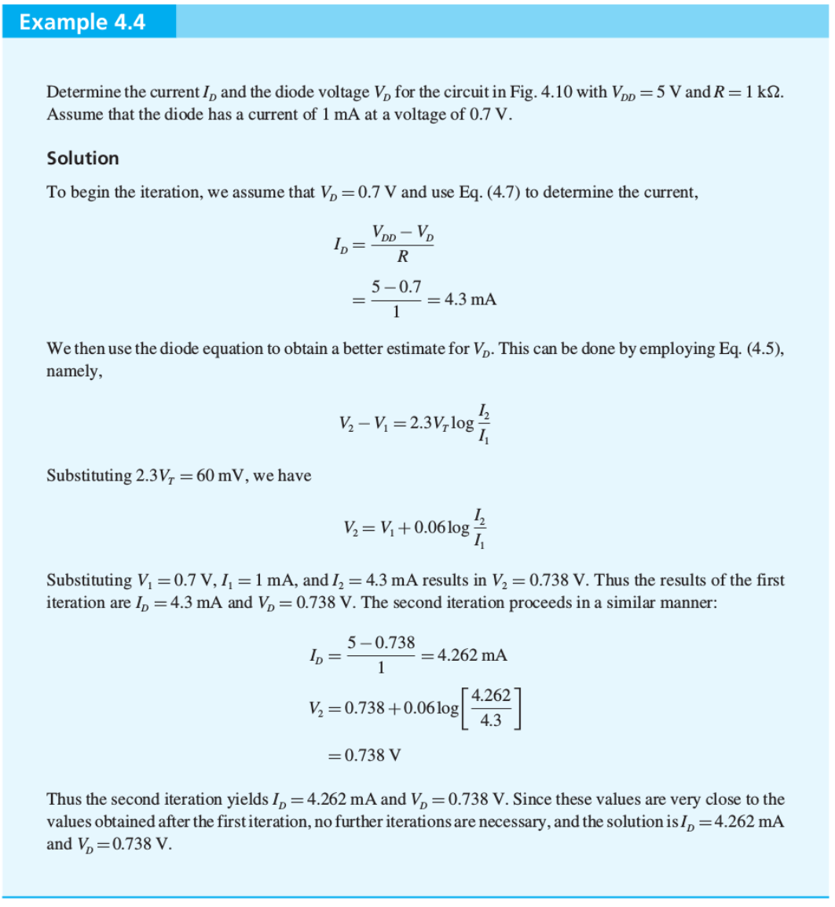

Slide 18
Constant Voltage Drop Model
Good for rapid analysis

Slide 19
Small Signal Model
Small signal approximation

Slide 20
Small Signal Model, Contd.
A resistor model:
Diode small-signal resistance or incremental resistance:

Slide 21
Math Viewpoint
Taylor series expansion:
Quiescent point

Slide 22
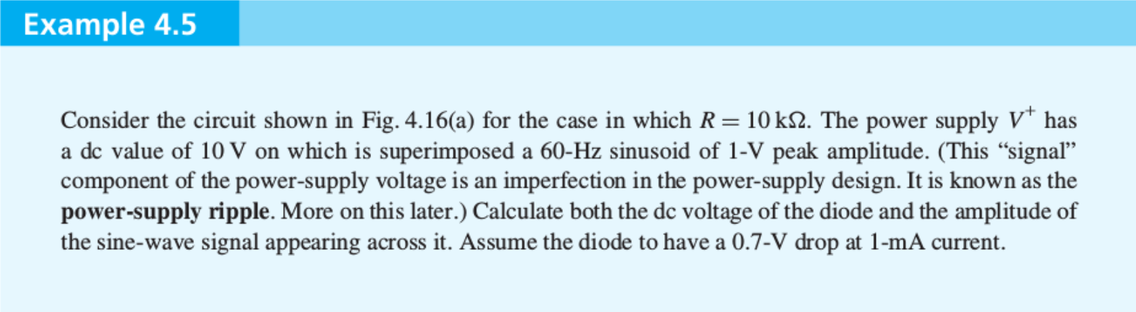
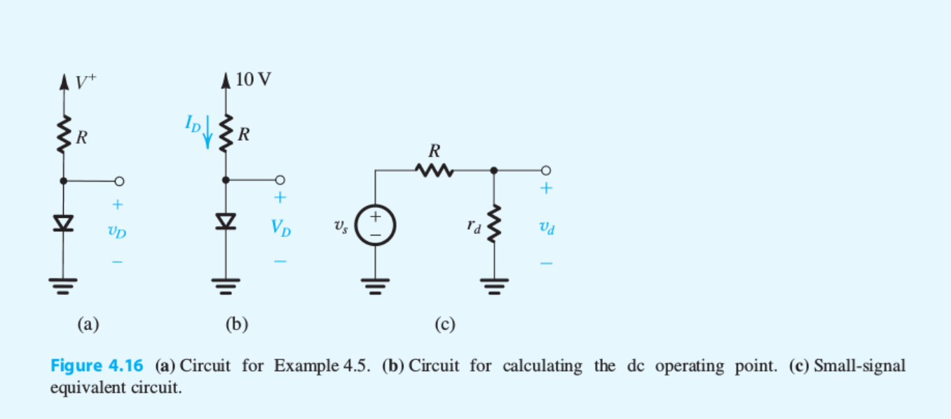

Slide 23
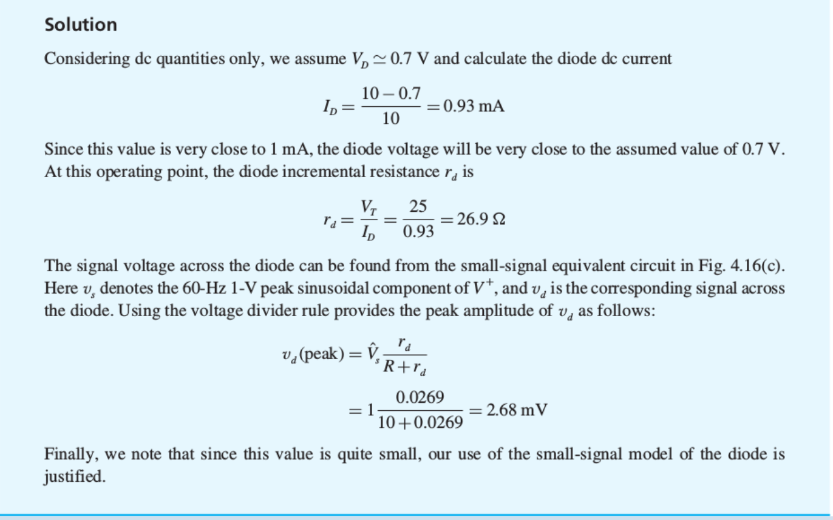

Slide 24
Clicker Question 1 (1 Point)
The nonlinear diode equation cannot be solved by:
Iterative method.
Graphical method.
Linear method.

