Slide 1
ECE 255
Jan 16, 2018 Lecture
Instructor: Weng Cho Chew

Slide 2
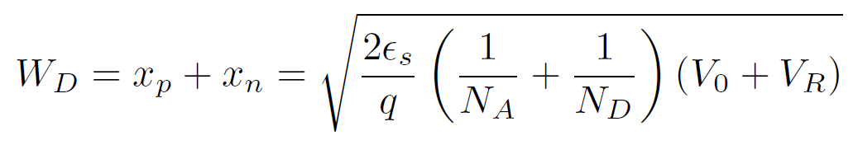
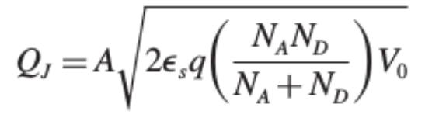
PN Junction, Contd.
By charge neutrality:
It can be shown that:
With reverse bias, it is:
Junction charge storage is:

Slide 3
PN Junction, An Example
A pn junction has
The voltage barrier is
The width of the depletion region is

Slide 4
Derivation of Einstein Relationship
At equilibrium, drift current = diffusion current.
But
Hence
Or
Define
Einstein relationship
And integrating
Boltzmann’s Law

Slide 5
Carrier Injection
At equilibrium, according to Boltzmann’s law,
With forward biasing, assuming quasi-equilibrium,
With some manipulations,

Slide 6
Carrier Injection, Contd.
Excess carrier injected into the n region is
By the same token, excess carrier injected into the p region is

Slide 7
Biasing of PN Junction
Diffusion current equals drift current at zero bias (quiescent case).
At forward bias, a lower voltage drop appears across the depletion region. Hence, much minority carriers cross the PN junction.
At reverse bias, a higher voltage drop appears across the depletion region. Hardly any minority carriers cross the junction.

Slide 8
Excess Charge Carrier
Excess carrier as a function of x,
The corresponding diffusion current is

Slide 9
Minority Carrier Injections

Slide 10
Diffusion Currents
Hole diffusion current,
Electron diffusion current,

Slide 11
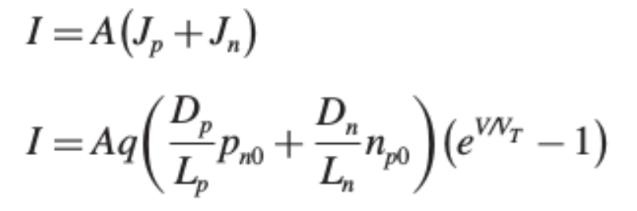

Total Diffusion Current
Total diffusion current is sum of hole and electron diffusion currents,
Substituting for
The saturation or scaling current is,
Diffusion current >> Drift current

Slide 12
PN Junction Biasing
(a) Diffusion current equals drift current at zero bias (quiescent or equilibrium case).
(b) At forward bias, a lower voltage drop appears across the depletion region. The diffusion current > drift current due to minority carrier injection by Boltzmann’s law.
(c) At reverse bias, a higher voltage drop appears across the depletion region. The diffusion current becomes miniscule as few minority carriers are injected across the barrier due to Boltzmann’s law.
(d) The drift current is always small, because it is due to minority carriers that “accidently” migrate into the depletion region.

Slide 13
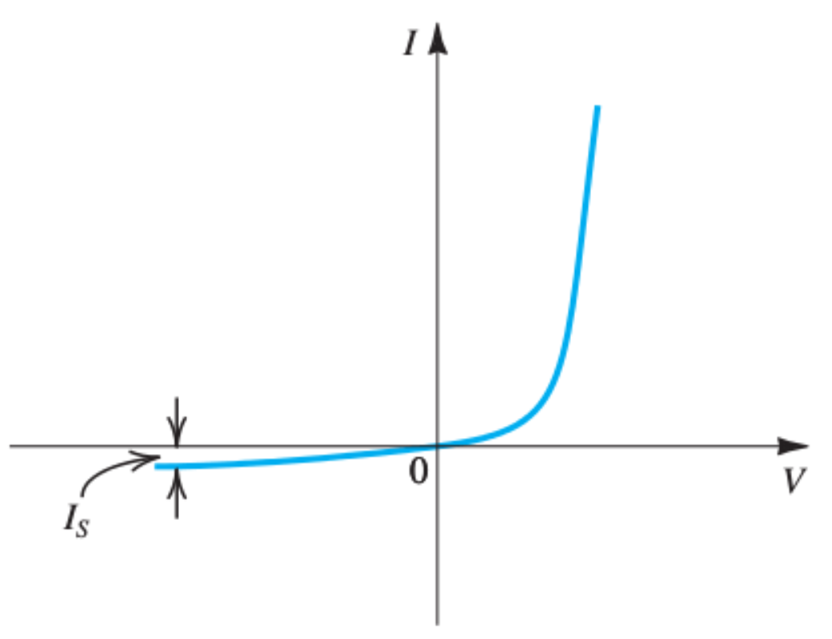
I-V Characteristic of a Diode

Slide 14
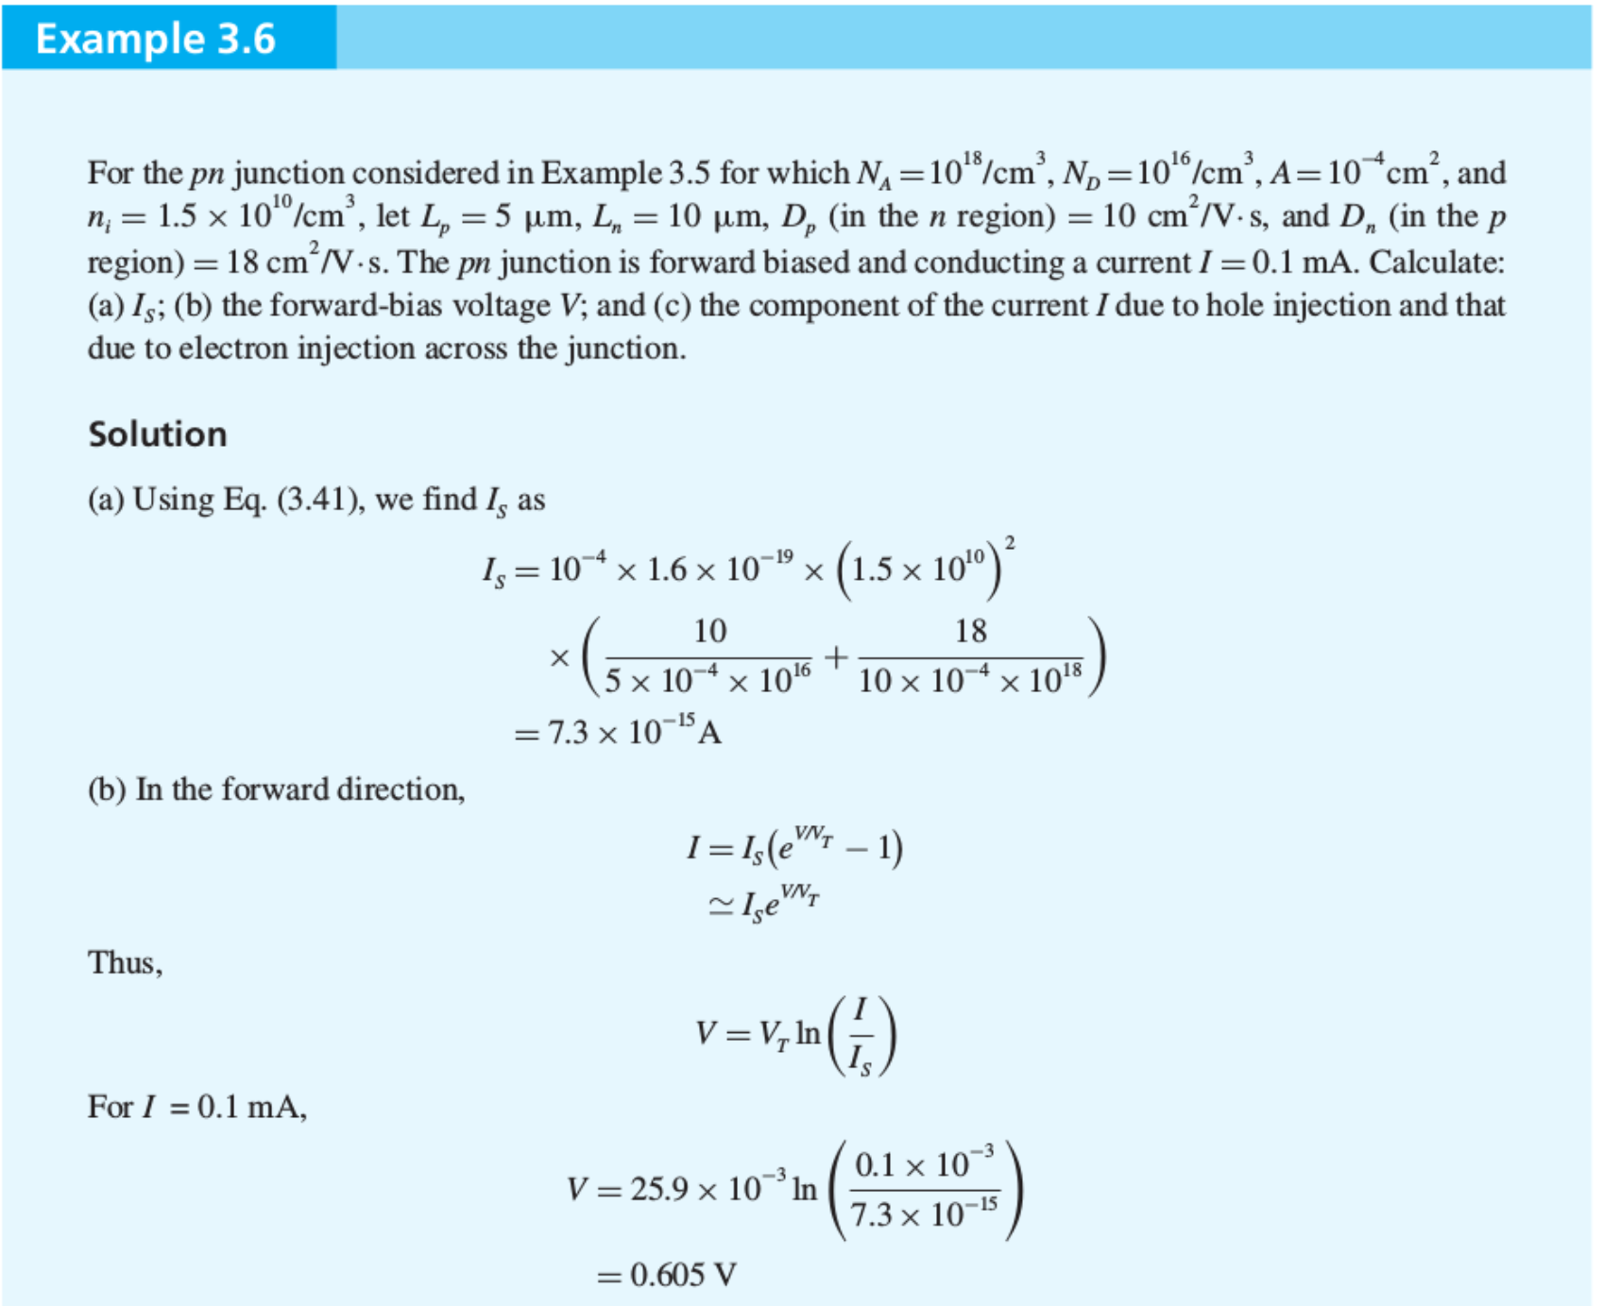

Slide 15
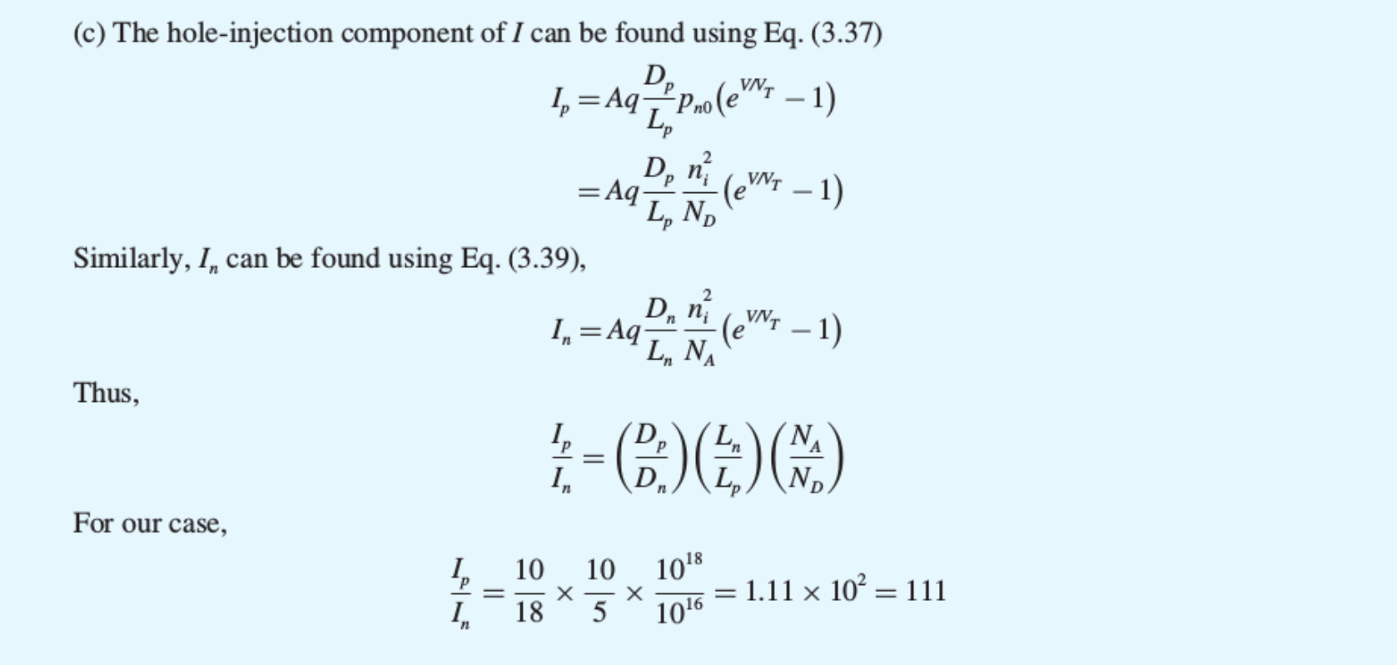
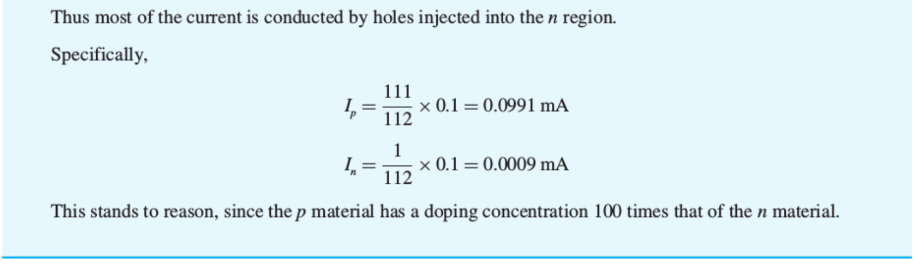

Slide 16
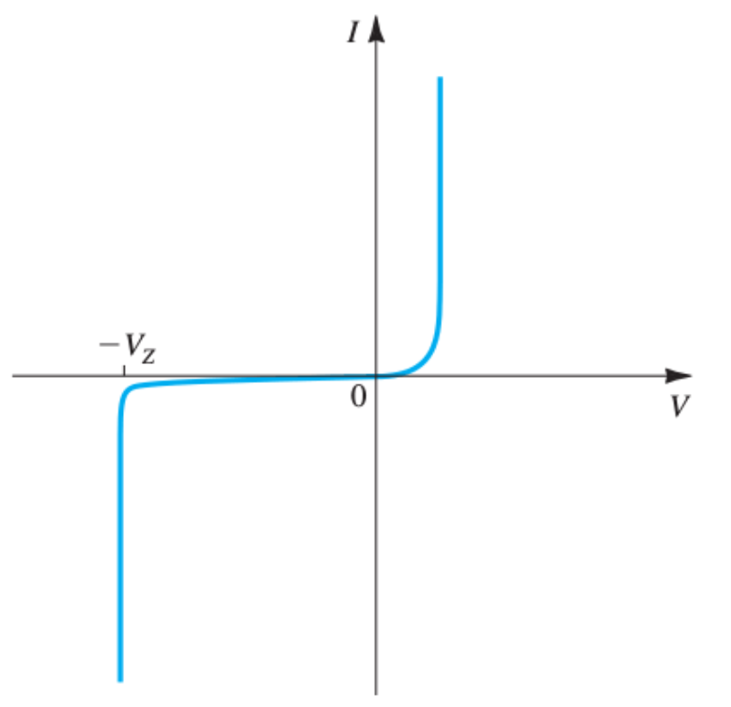
Reverse Breakdown
Reverse breakdown can be a Zener effect, or avalanche effect.
It is cause by the covalent bond breakdown:
Insulator Conductor

Slide 17
Clicker Question 1 (1 Point)
What causes the surge in minority carrier injection under forward bias?
Einstein’s relationship
Boltzmann’s law
Random walk

