Slide 1
ECE 255
Jan 11, 2018 Lecture
Instructor: Weng Cho Chew

Slide 2
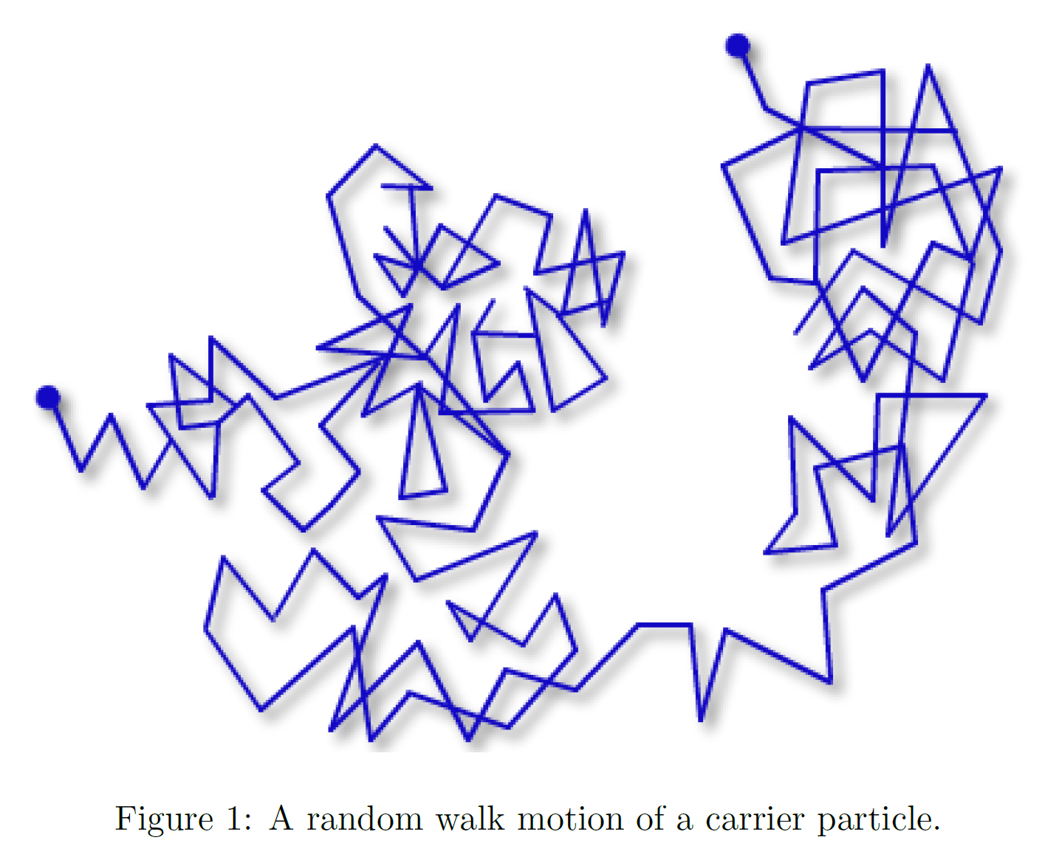
Random Walk
The carriers move about randomly by thermal agitation.
They do not have a preferred direction and the average current is zero.

Slide 3
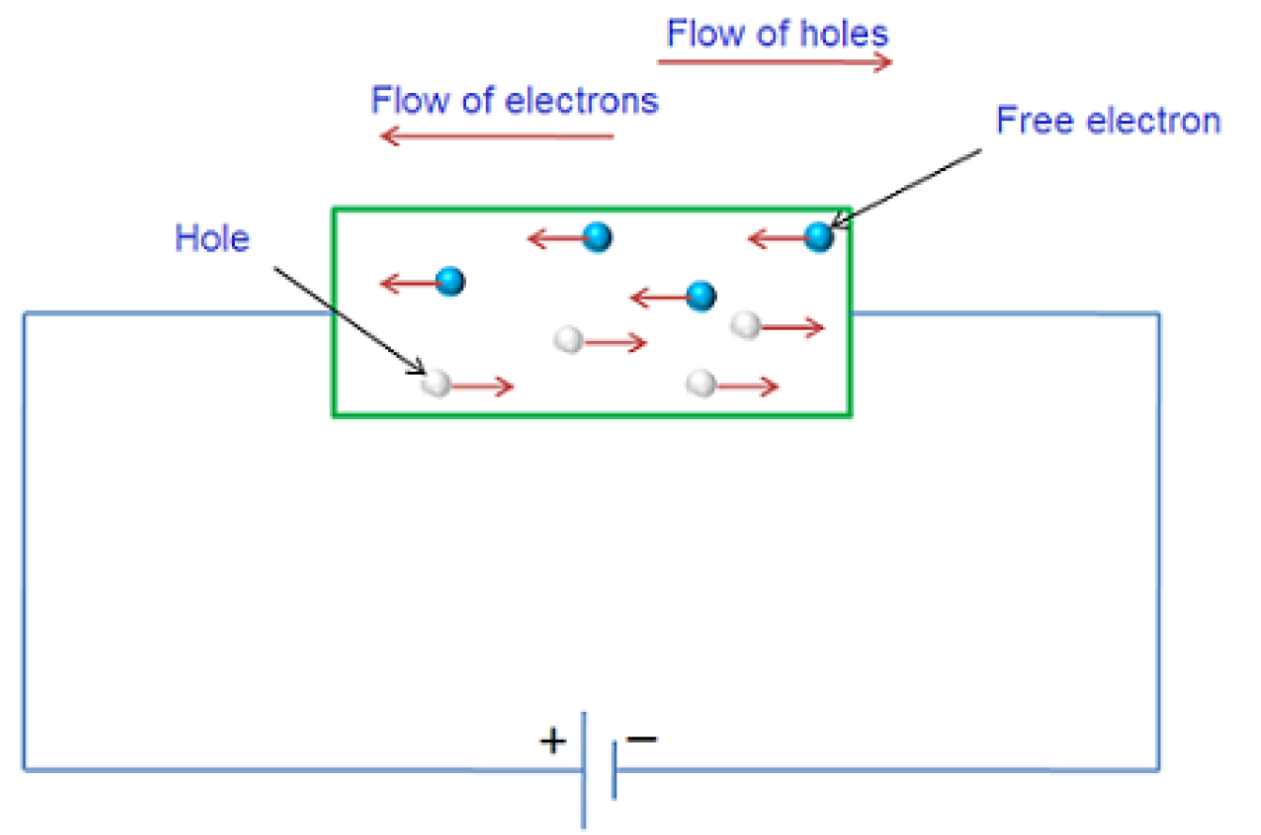
Drift Current
An applied electric field causes the random walk to be non random.
The carriers move in a preferred direction on average.

Slide 4
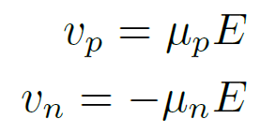


Drift Current, Contd.
The charged carriers moves in a preferred direction acquiring a velocity.
The hole carrier velocity is in the direction of E field.
The electron carrier velocity is opposite to the direction of the E field.
The constant is the hole mobility.
The constant is the electron mobility.

Slide 5
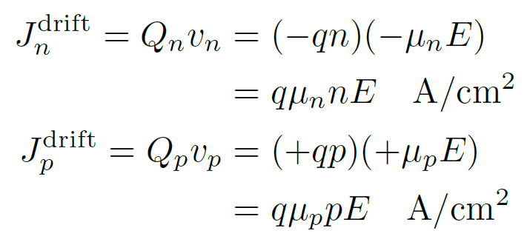

Drift Current, Contd.
If the charge density is Q, then the current density is Qv.
Here,

Slide 6
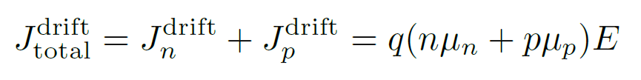

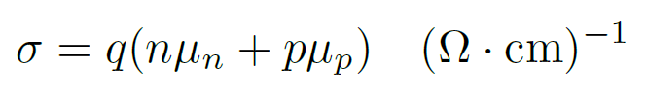
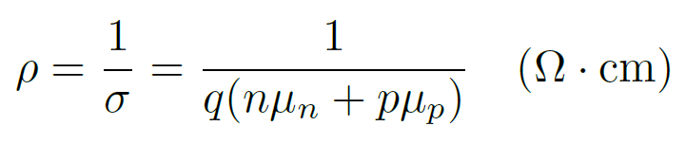
Drift Current, Contd.
Total drift current:
Or
The conductivity is
The resistivity is

Slide 7
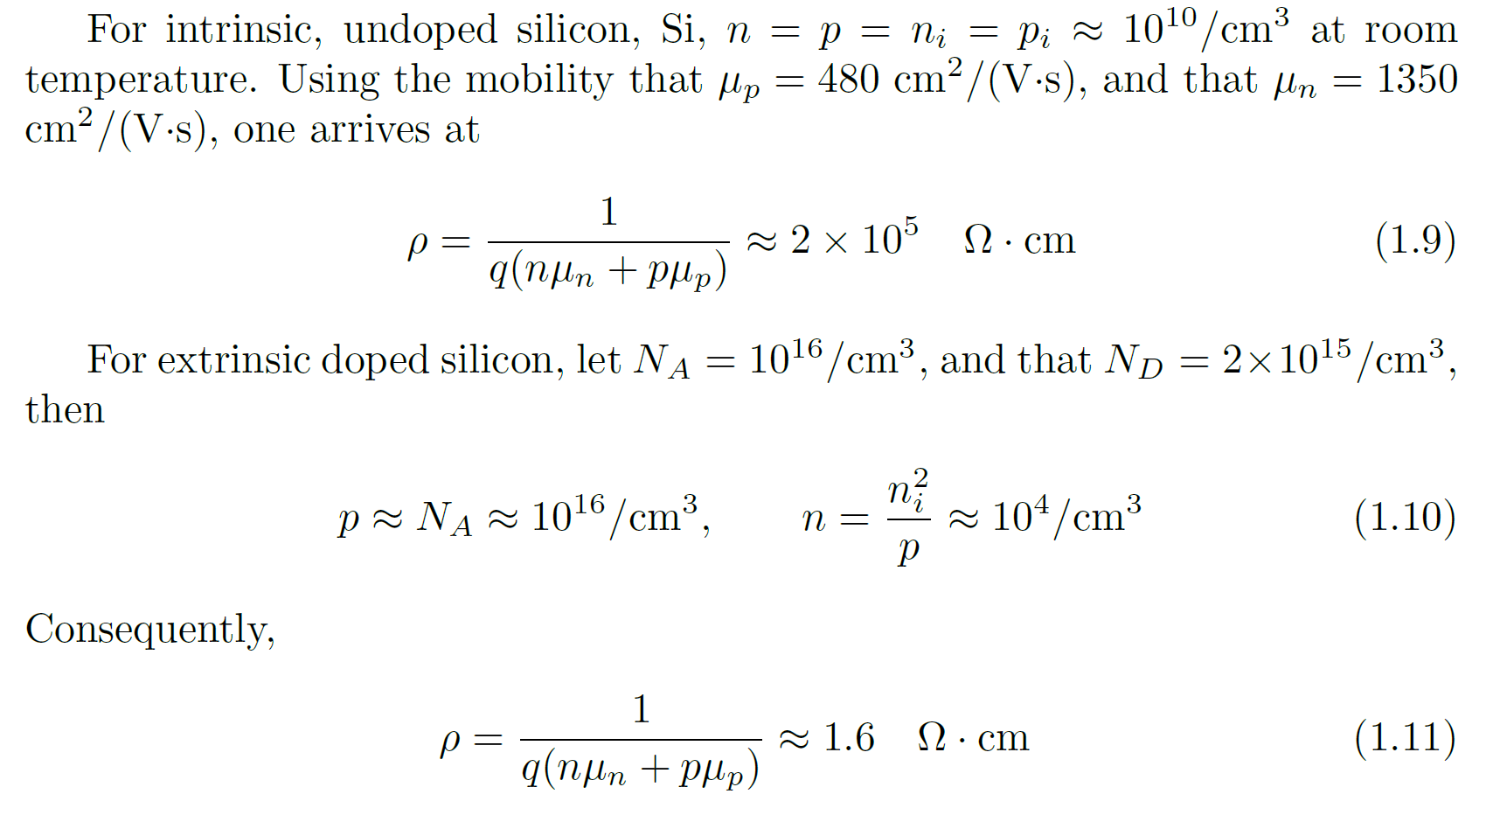
Drift Current, An Example

Slide 8
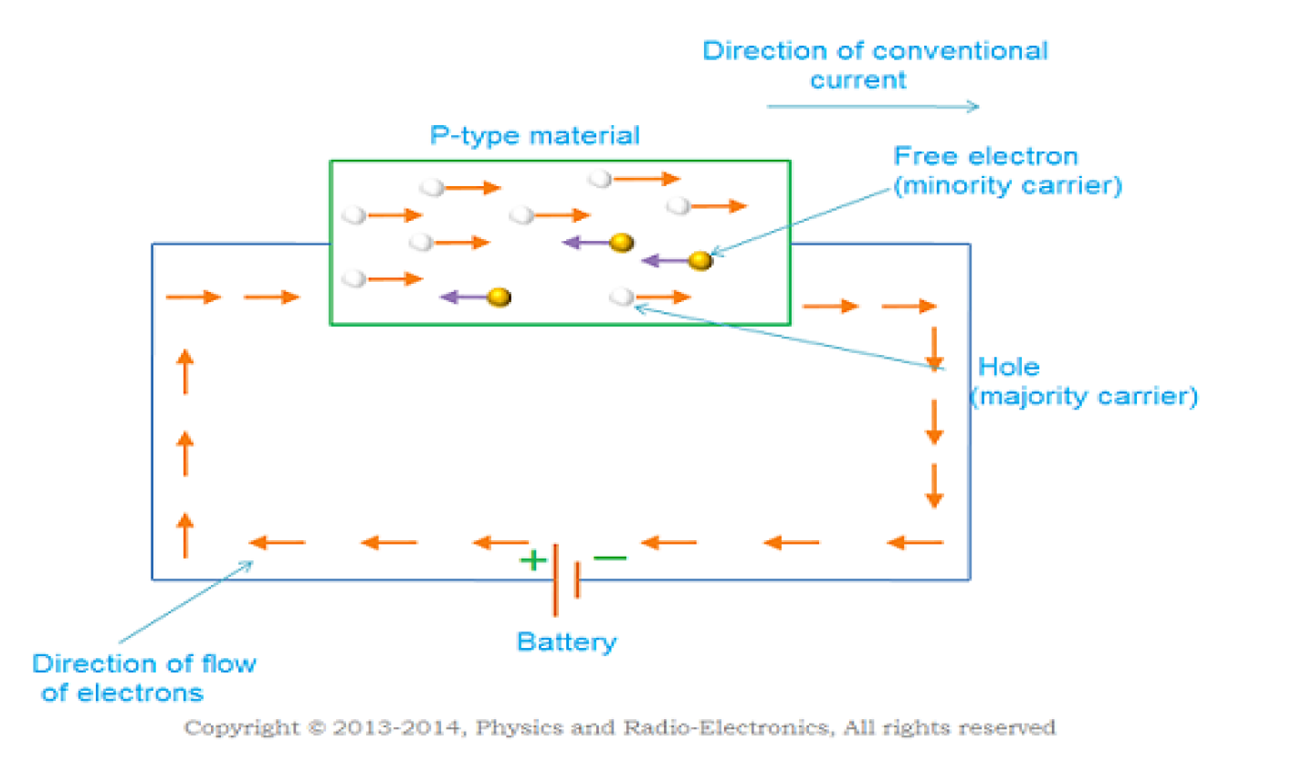
Drift Current, Contd.
Drift current in a p-type material.
The majority carrier is hole.
Both carriers (majority and minority) contribute to the total current.

Slide 9
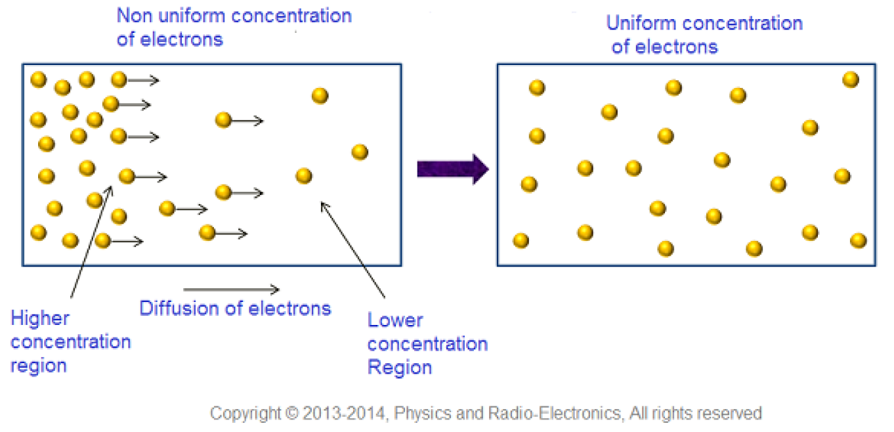
Diffusion Current
Particles diffuse from region of high concentration to region of low concentration.
For gas, it is the collision forces that cause them to diffuse apart.
For charge carriers, it is the like charges they are carrying that cause them to repel each other.

Slide 10
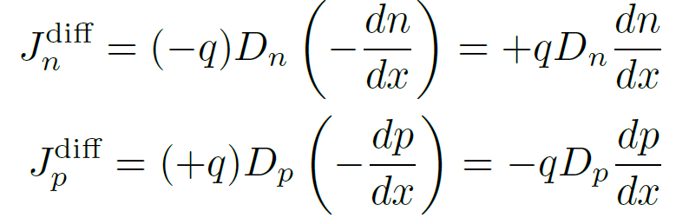
Diffusion Current
Diffusion current is due to concentration gradient:
They are also called diffusion constant or diffusivity.

Slide 11
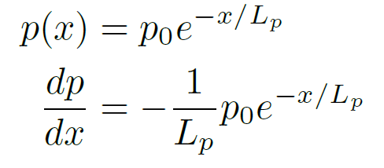

Diffusion Current and Recombination Rate
A possible concentration profile is exponential:
The above implies that:
If then,

Slide 12
Drift-Diffusion Current, Summary
Both types of carriers contribute to diffusion current:
Both drift and diffusion currents contribute to total electric current:

Slide 13
PN Junction
Uncovered charges
When n-type and p-type materials are joined together.
A carrier depletion region (also called space charge region) is formed by diffusion.
An internal electric field is formed to preclude further diffusion.
An internal electric field or potential barrier is formed. Now,

Slide 14
PN Junction, Contd.
By Boltzmann’s law:
From the above, it follows that:
At the far left:
At the far right:

Slide 15
PN Junction, Contd.
Finally, junction built in voltage is:
Einstein relationship
Thermal voltage
Once the mobility is known, the diffusion coefficient is known.
The higher the temperature, the higher the diffusion coefficient.

Slide 16
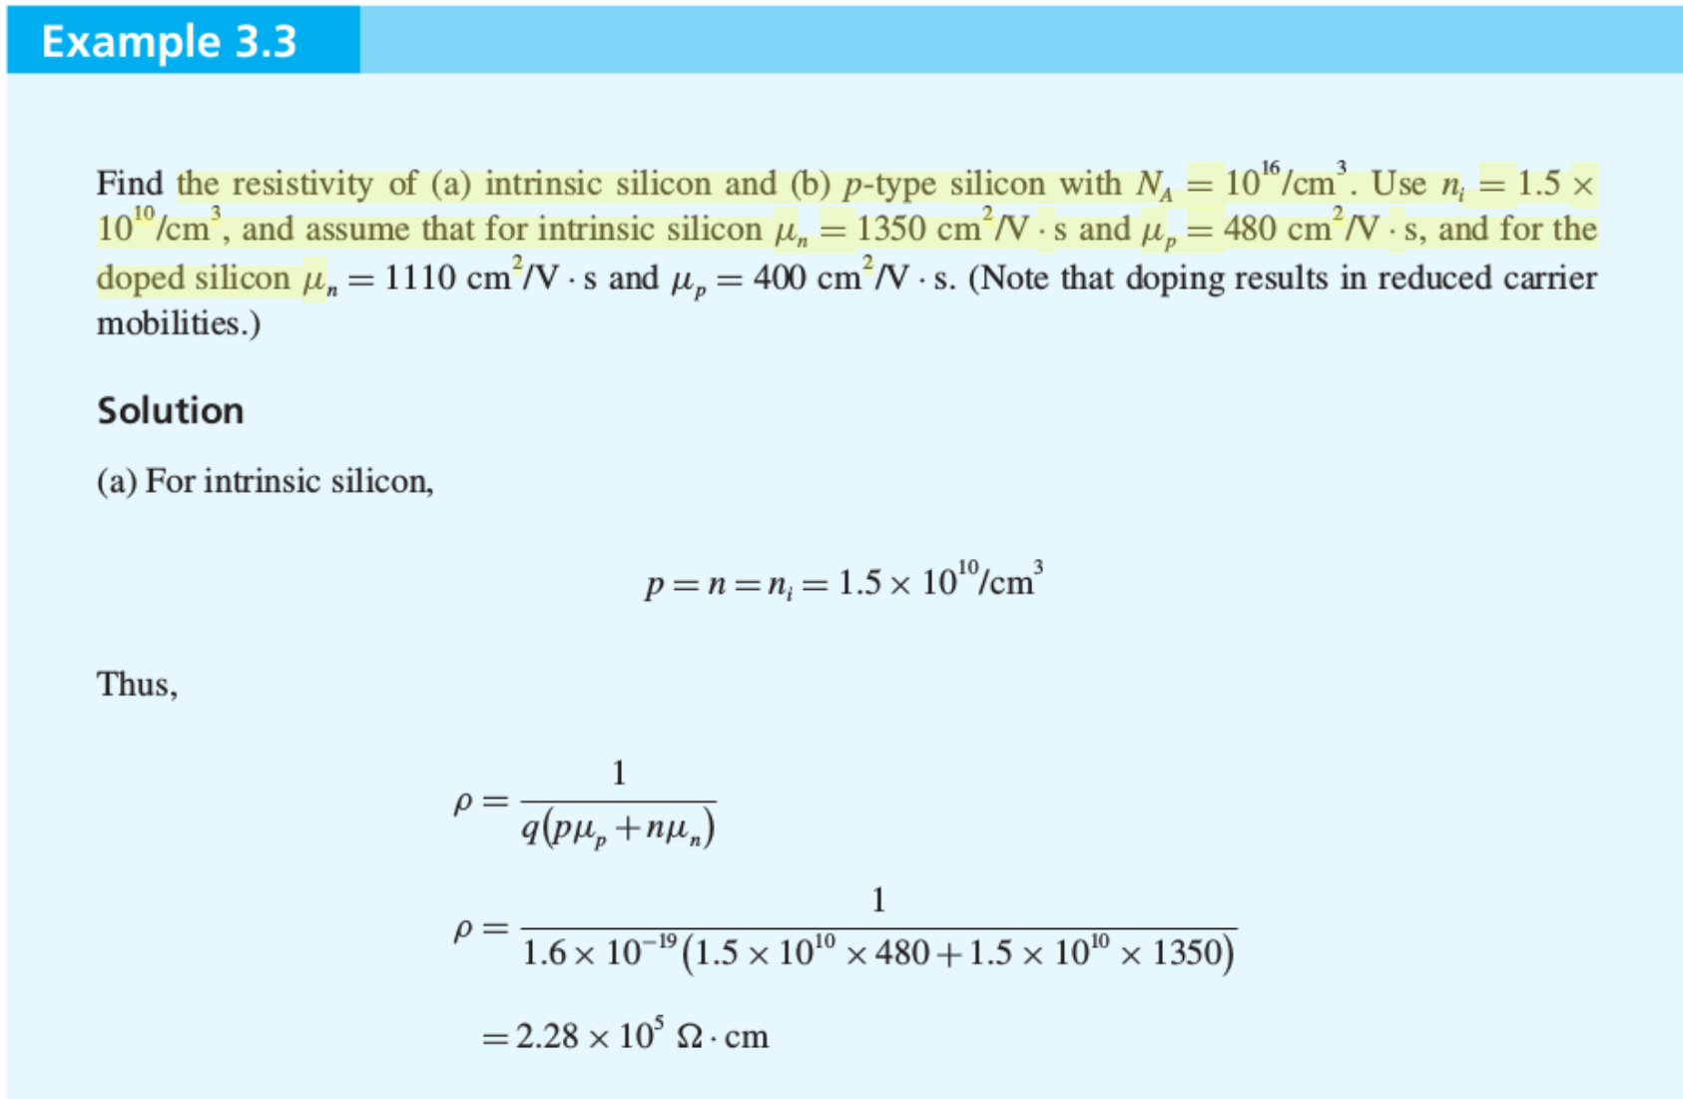

Slide 17
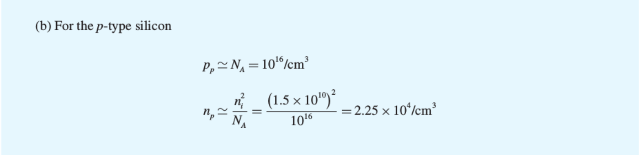
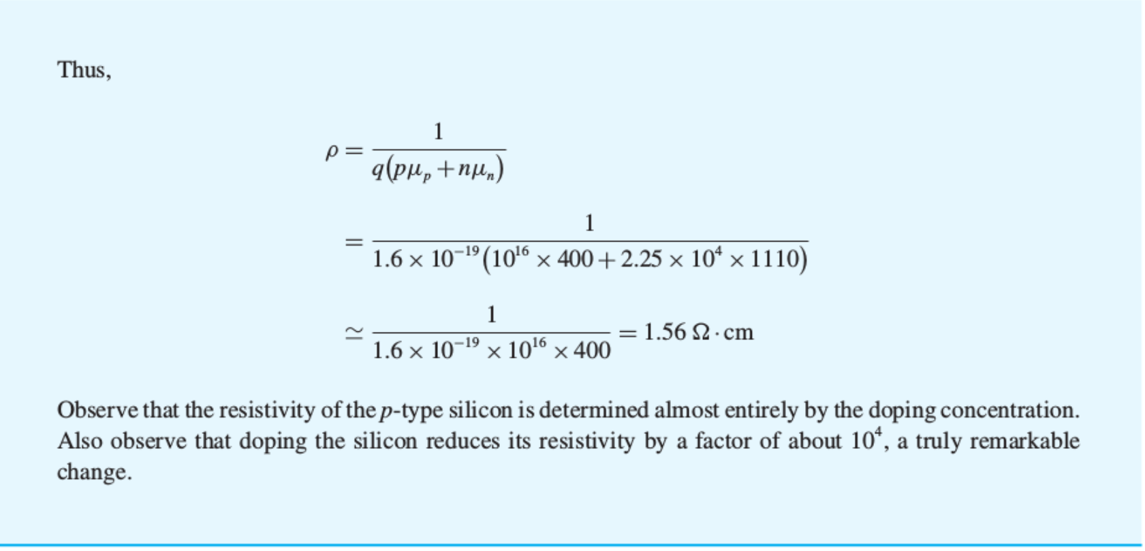

Slide 18
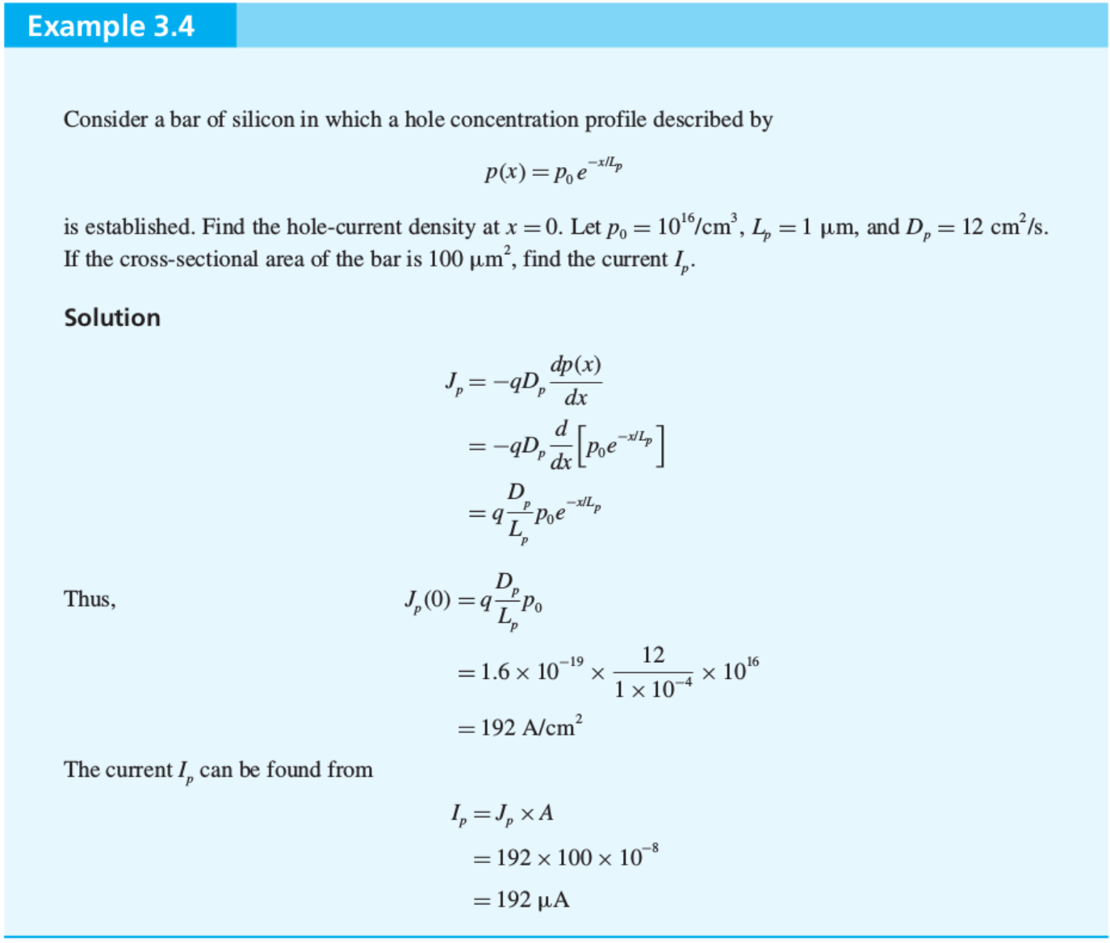

Slide 19
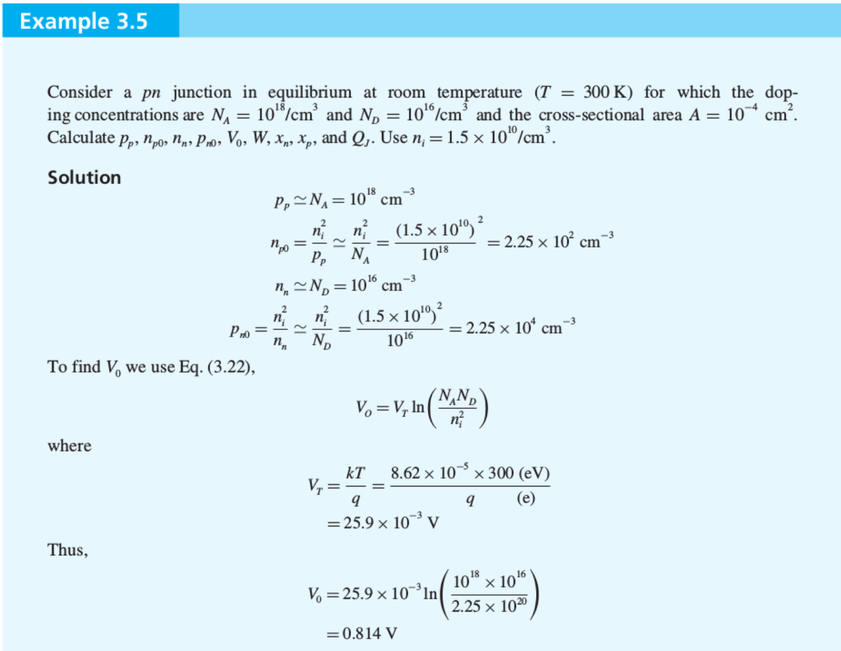

Slide 20
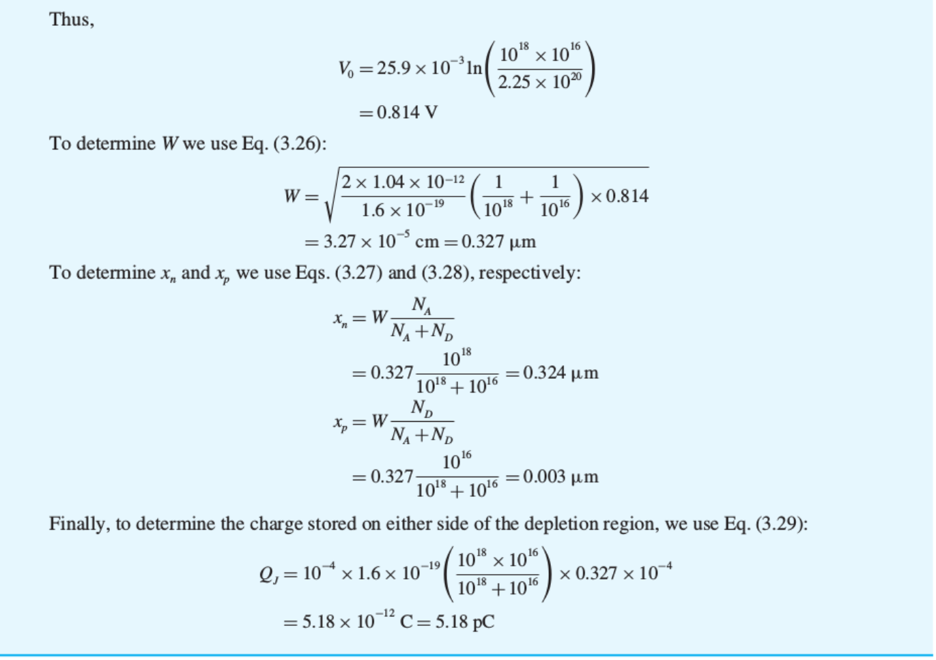
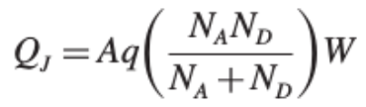

Slide 21
Clicker Question 1 (0 Point)
What causes the diffusion current to flow?
Concentration gradient
Electric field
Random walk

