Slide 1
ECE 255
Apr 10, 2018 Lecture
Instructor: Weng Cho Chew
Email: wcchew@purdue.edu
Office: 3053 Wang Hall

Slide 2
DC Offsets

Slide 3
DC Offsets, Contd.

Slide 4
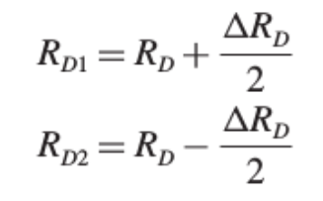
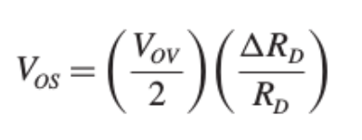
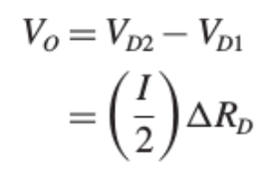
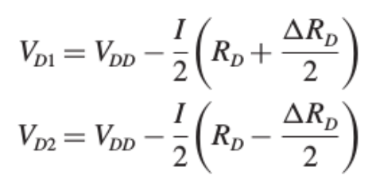
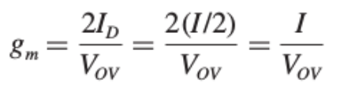
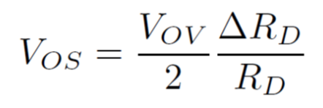
DC Offsets, Contd.
Resistor mismatch:
Finally,

Slide 5
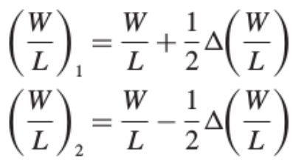
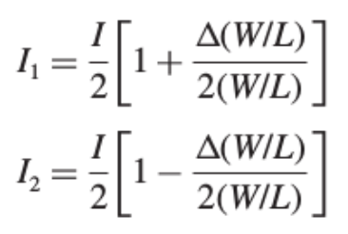
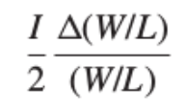
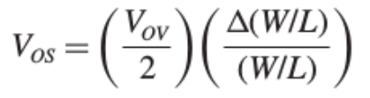
DC Offsets, Contd.
MOSFET geometry mismatch:

Slide 6
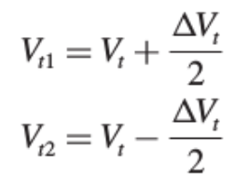
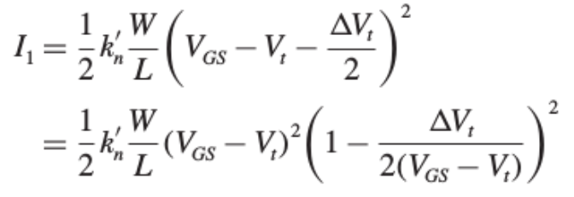
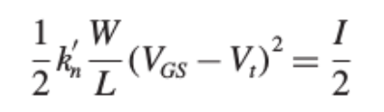
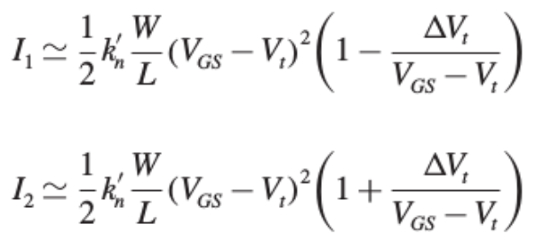
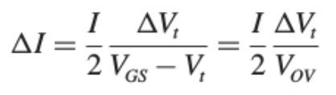

DC Offsets, Contd.
V_{t} mismatch:

Slide 7
DC Offsets, Contd.

Slide 8
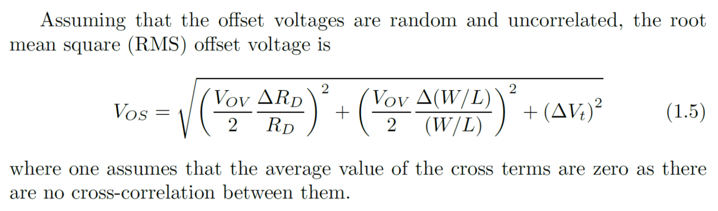
DC Offsets, Contd.

Slide 9
DC Offsets, Contd.

Slide 10
Current Mirror Load for Diff. Amps.

Slide 11
Conversion to Single-Ended Output

Slide 12
A Naïve Way

Slide 13
Differential-to-Single-Ended Conversion

Slide 14
Differential Gain of the Current-Mirror-Loaded MOS Pair

Slide 15
Differential Gain of the Current-Mirror-Loaded MOS Pair, Contd.

Slide 16
Differential Gain of the Current-Mirror-Loaded MOS Pair, Contd.

Slide 17
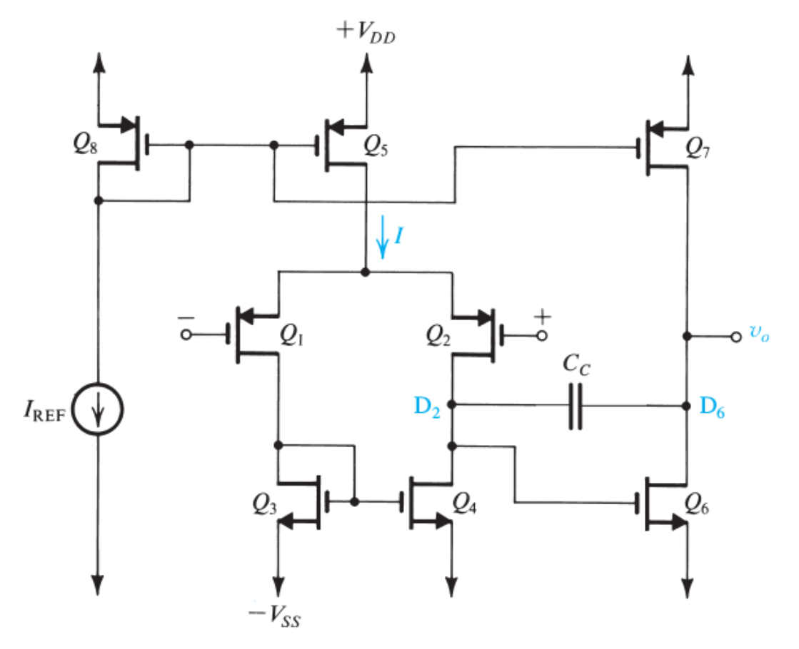
A Two-Stage CMOS Op Amp

Slide 18

Voltage Gain

Slide 19
Input Offset Voltage

Slide 20
Input Offset Voltage, Contd.

Slide 21
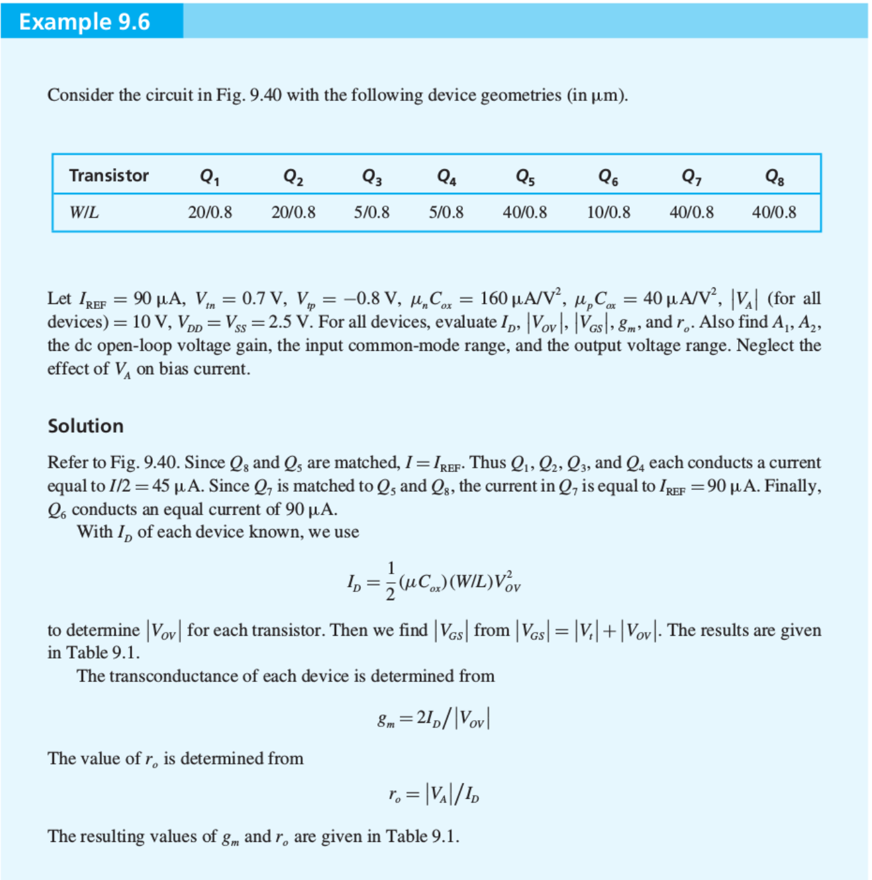
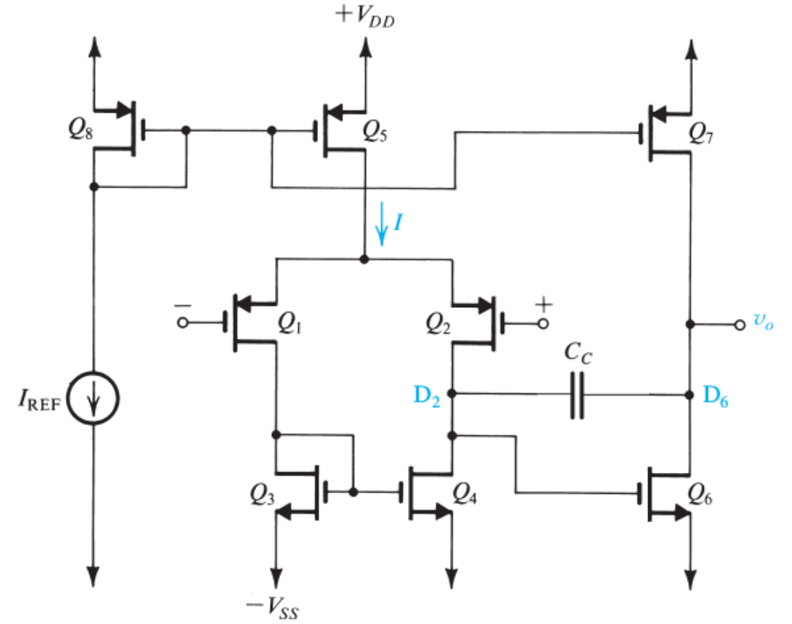

Slide 22
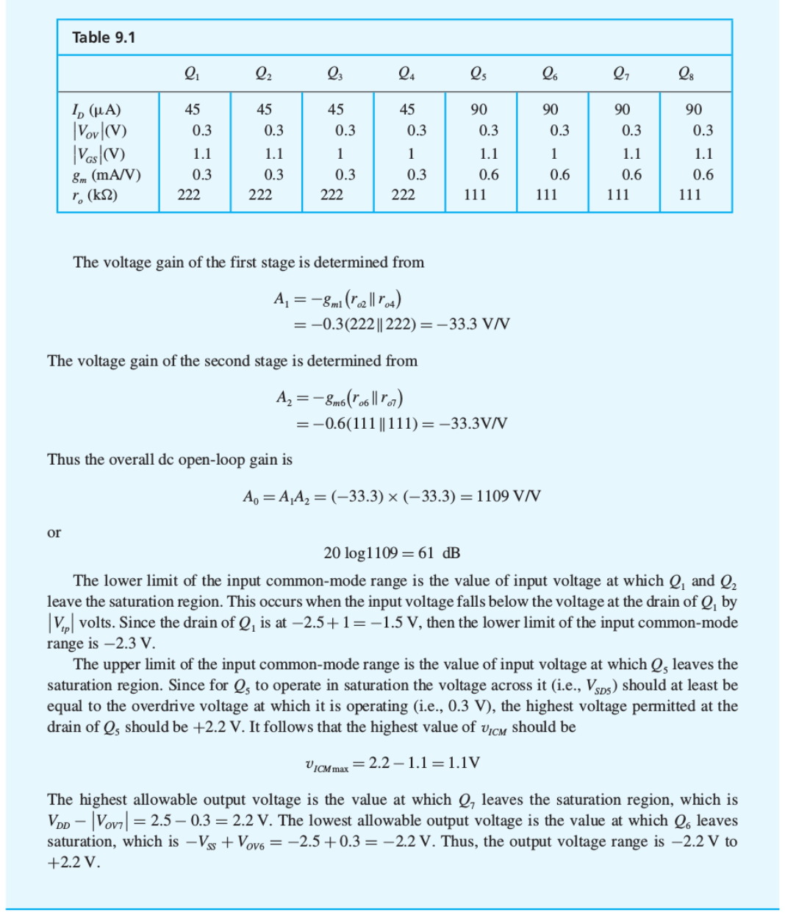

Slide 23
Clicker Question 1 (1 Point)
In order to connect differential amplifiers to other amplifers, it needs a:
Single-ended output
Double-ended output
None of the above.

