Slide 1
ECE 255
Apr 5, 2018 Lecture
Instructor: Weng Cho Chew
Email: wcchew@purdue.edu
Office: 3053 Wang Hall

Slide 2
Basic MOSFET Current Source

Slide 3
Basic MOSFET Current Source, Contd.

Slide 4
Current Mirror

Slide 5
Early Effect on I_{o}

Slide 6
Effect of V_{o} on I_{o}

Slide 7
MOS Current-Steering Circuits

Slide 8
MOS Current-Steering Circuits, Contd.

Slide 9
MOS Current-Steering Circuits, Contd.

Slide 10
MOS Current-Steering Circuits, Contd.

Slide 11
BJT Circuits

Slide 12
BJT Circuits

Slide 13
BJT Circuits, Contd.

Slide 14
BJT Circuits, Contd.

Slide 15
A Simple Current Source

Slide 16
A Simple Current Source, Contd.

Slide 17
Current Steering

Slide 18
Base-Current Compensation

Slide 19
Base-Current Compensation, Contd.

Slide 20
Small-Signal Operation of Current Mirrors

Slide 21
Small-Signal Operation of Current Mirrors, Contd.

Slide 22
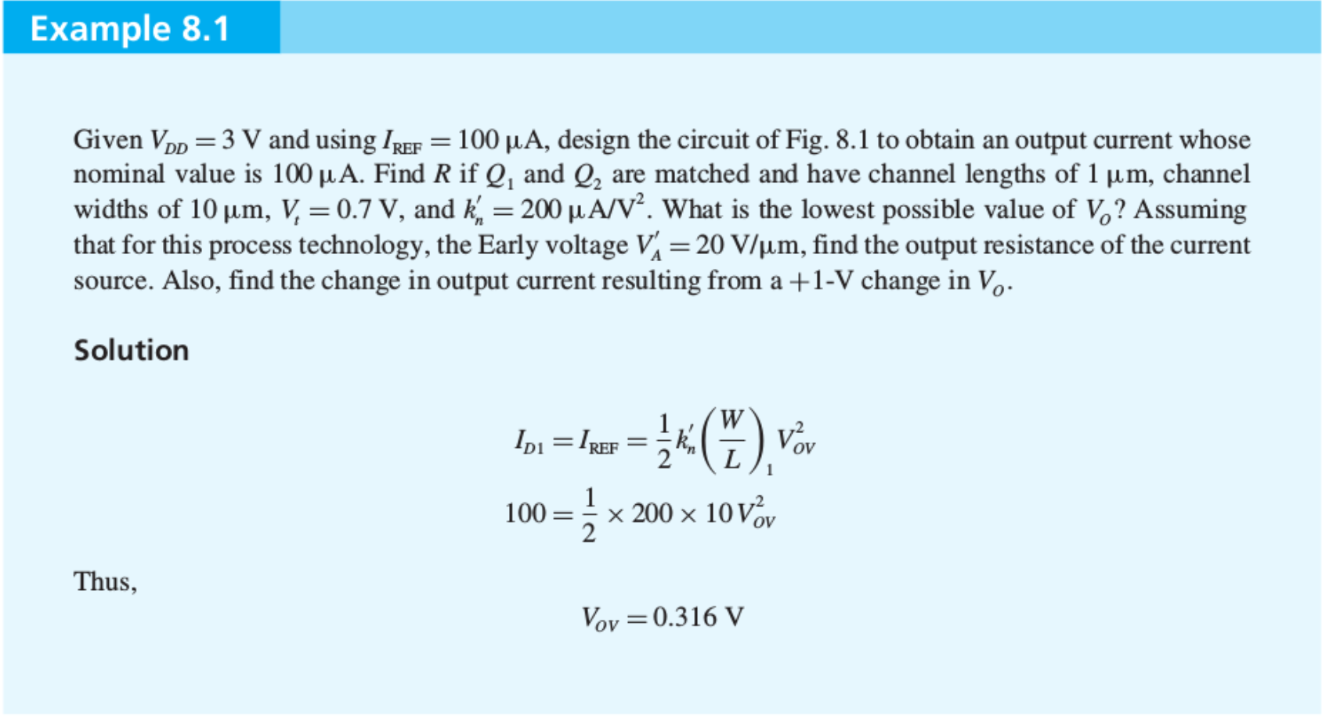
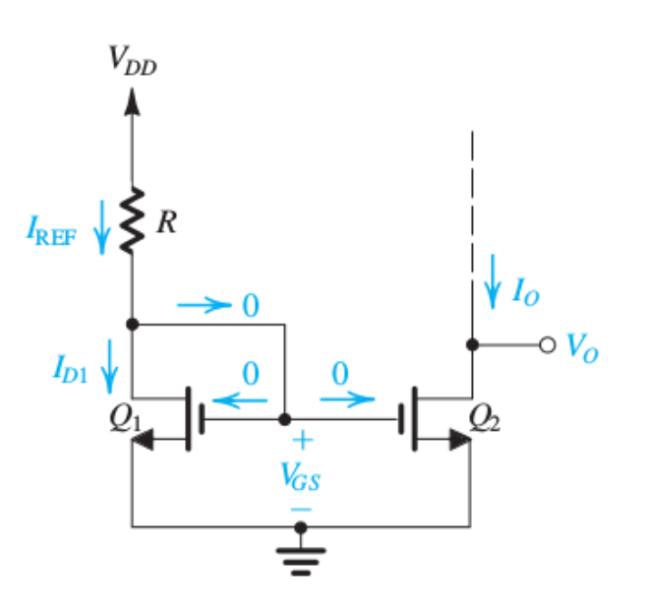

Slide 23
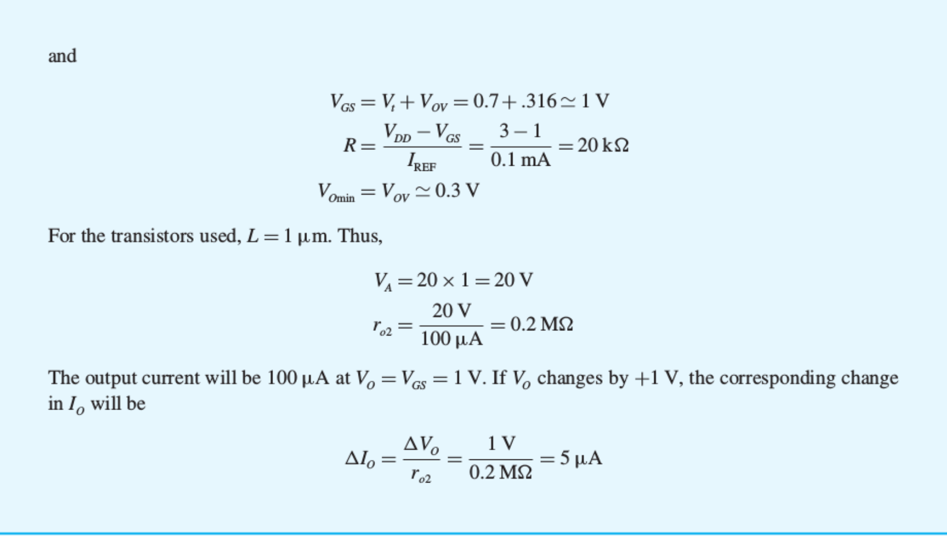

Slide 24
Clicker Question 1 (1 Point)
Which of the answer is false?
Current mirrors work because the two transistors have the same:
V_{GS}.
V_{BE}.
None of the above.

