Slide 1
ECE 255
Apr 3, 2018 Lecture
Instructor: Weng Cho Chew
Email: wcchew@purdue.edu
Office: 3053 Wang Hall

Slide 2
Alternate View

Slide 3
Input Differential Resistance, Contd.
For the emitter resistance case:

Slide 4
Alternate View w/ Emitter Resistance

Slide 5
Differential Voltage Gain
See Fig. 12

Slide 6
Differential Half-Circuits
Differential Mode Case

Slide 7
Differential Mode Case

Slide 8
Small Signal Circuit for Diff. Mode Amp.

Slide 9
General Case—
Analysis A La Jaeger and Blalock

Slide 10
Differential-Mode Case—
A La Jaeger and Blalock

Slide 11
Common-Mode Case—
A La Jaeger and Blalock

Slide 12
Common-Mode Half-Circuits

Slide 13
Common-Mode Rejection
MOS Case

Slide 14
Common-Mode Rejection—MOS Case

Slide 15
CMR—MOS Case

Slide 16
Effect of Mismatch

Slide 17
Common-Mode Rejection Ratio

Slide 18
Effect of g_{m} Mismatch on CMRR
According to Sedra and Smith, the analysis is rather long.

Slide 19
BJT Case

Slide 20
BJT Case

Slide 21
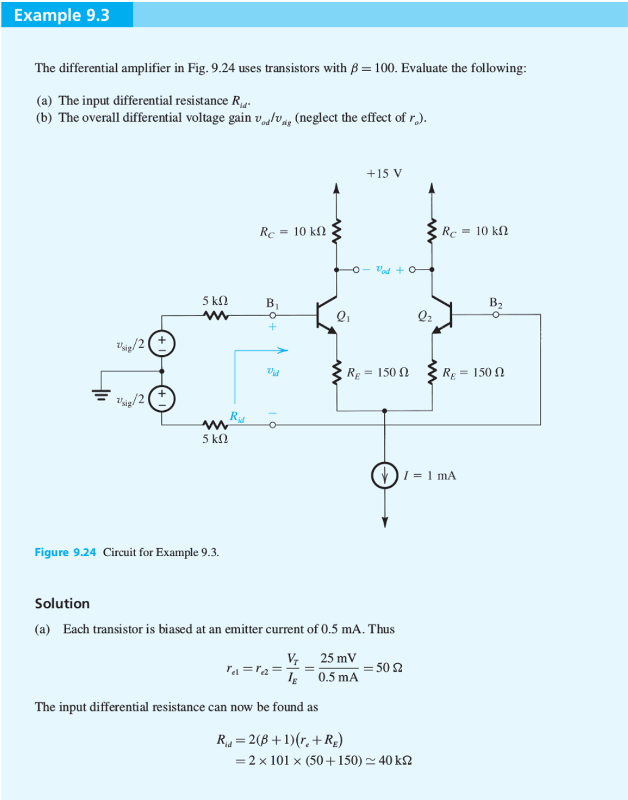

Slide 22
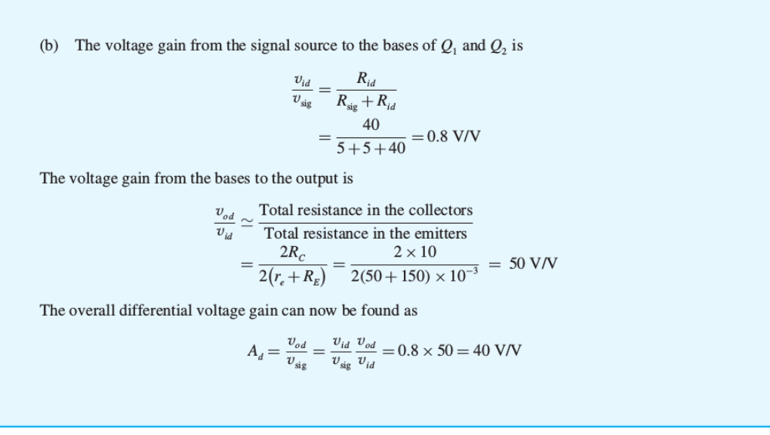

Slide 23
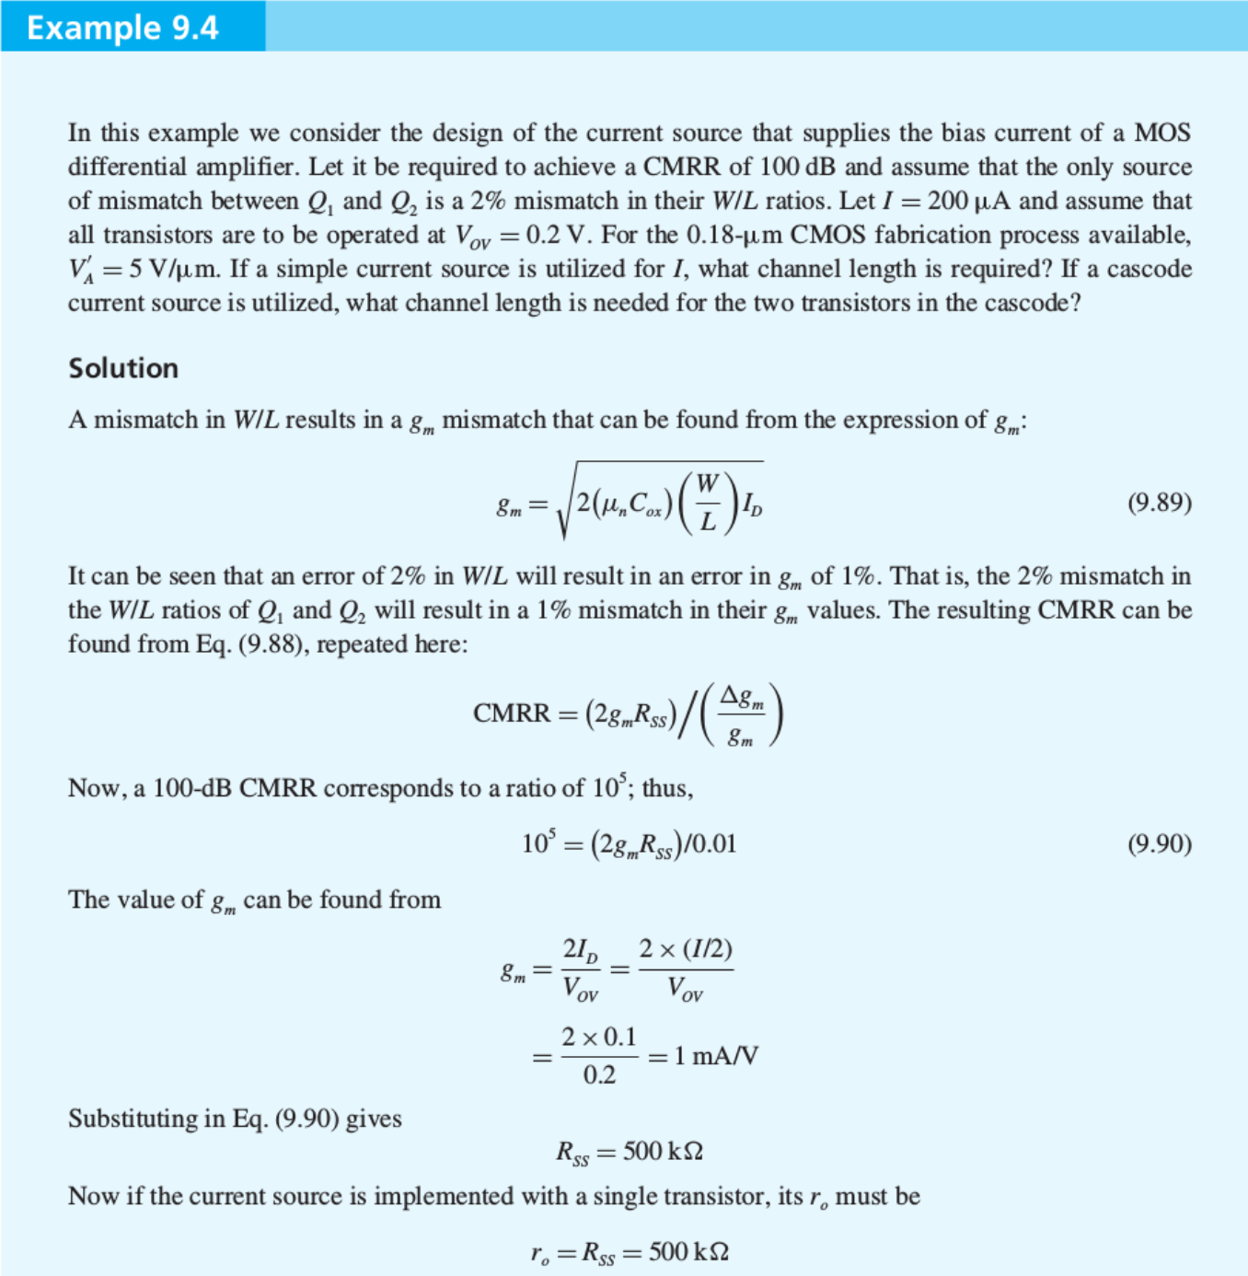

Slide 24
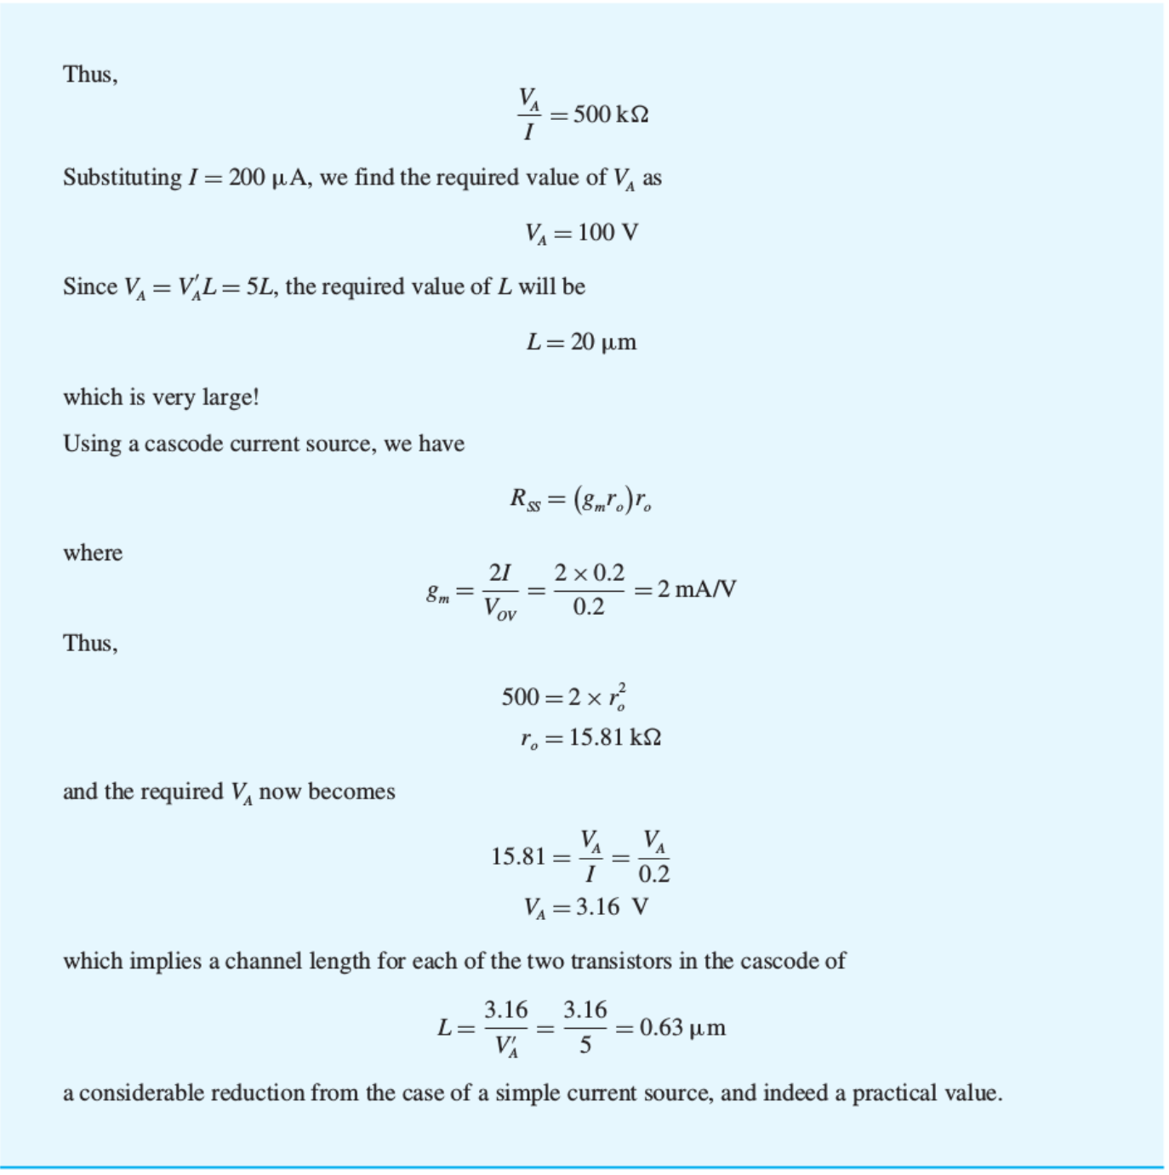

Slide 25
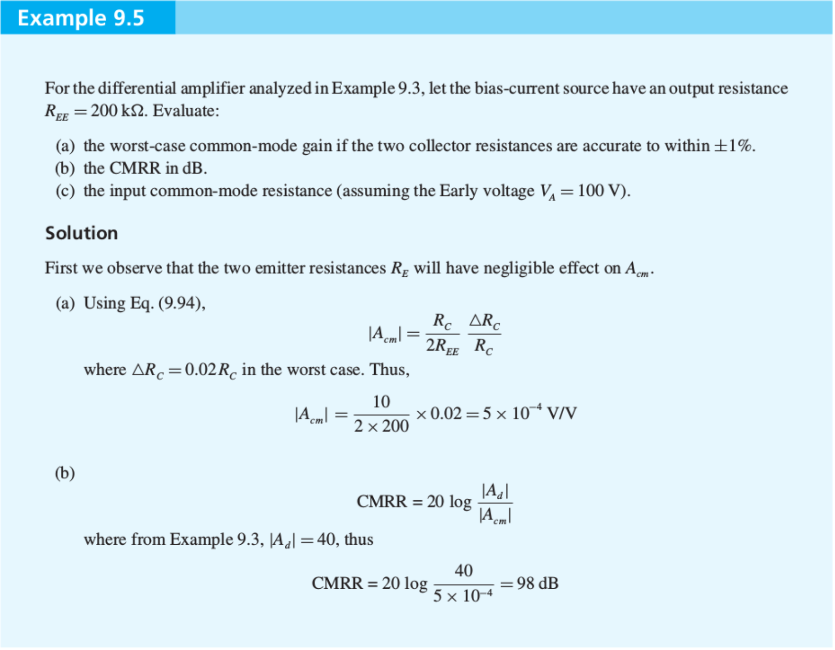
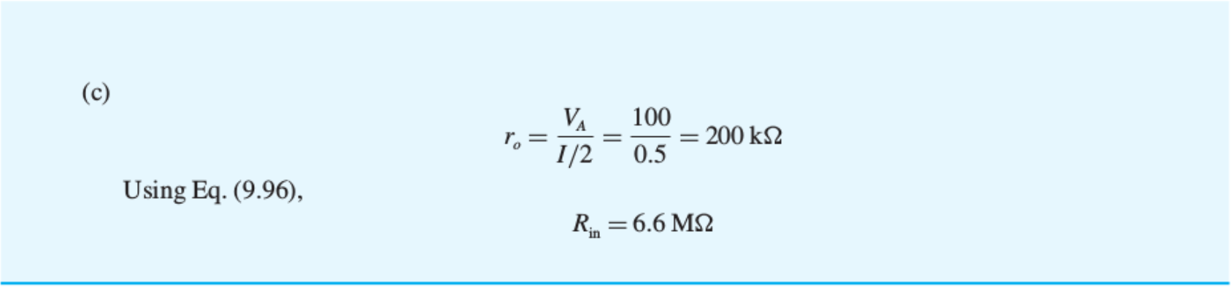

Slide 26
Clicker Question 1 (1 Point)
Which of the answer is false?
The differential amplifier can be decomposed into half-circuits because of:
Symmetry.
Anti-symmetry.
None of the above.

