Slide 1
ECE 255
Jan 9, 2018 Lecture
Instructor: Weng Cho Chew

Slide 2
Clicker Test Question 1
Have you used clicker in class before?
Yes
No

Slide 3
Clicker Test Question 2
Have you registered your clicker on Black Board?
Yes
No

Slide 4
ECE 255
Introduction to Semiconductor Drift Currents Diffusion Currents
Basic Knowledge
Diode Normal Breakdown | Bipolar Junction Transistor Q (I_{c}, V_{CE}) | Field-effect Transistor Q (I_{DS}, V_{DS})
DC Analysis
Small Signal Model
Small Signal Model
Bipolar Junction Transistor Based Amplifier Voltage Gain, Av Input, Output Resistance Common-Emitter Common-Collector Common-Base | Field-effect Transistor Based Amplifier Voltage Gain, Av Input, Output Resistance Common-Source Common-Drain Common-Gate
AC Analysis
Bipolar Junction Transistor Based Amplifier Low cutoff frequency High cutoff freqency | Field-effect Transistor Based Amplifier Low cutoff frequency High cutoff freqency
Frequency Analysis

Slide 5
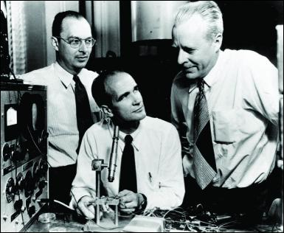
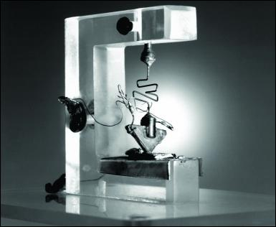
The Start of the Modern Electronics Era
Bardeen, Shockley, and Brattain at Bell Labs - Brattain and Bardeen invented the bipolar transistor in 1947.
The first germanium bipolar transistor. Roughly 50 years later, electronics account for 10% (4 trillion dollars) of the world GDP.

Slide 6
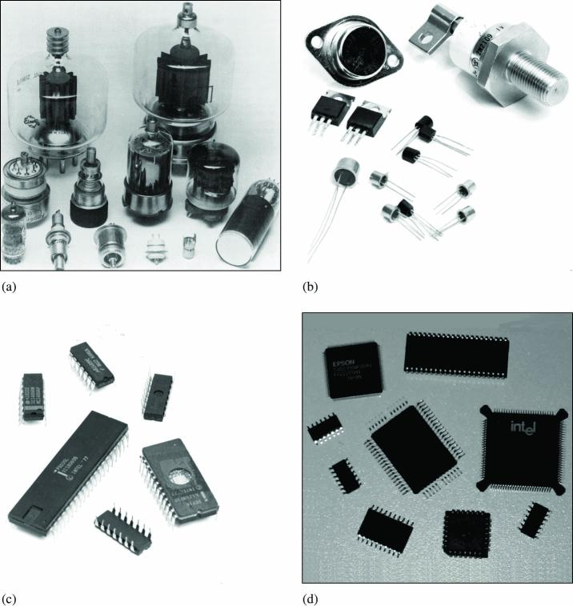
Evolution of Electronic Devices
Vacuum
Tubes
Discrete
Transistors
SSI and MSI
Integrated
Circuits
VLSI
Surface-Mount
Circuits

Slide 7
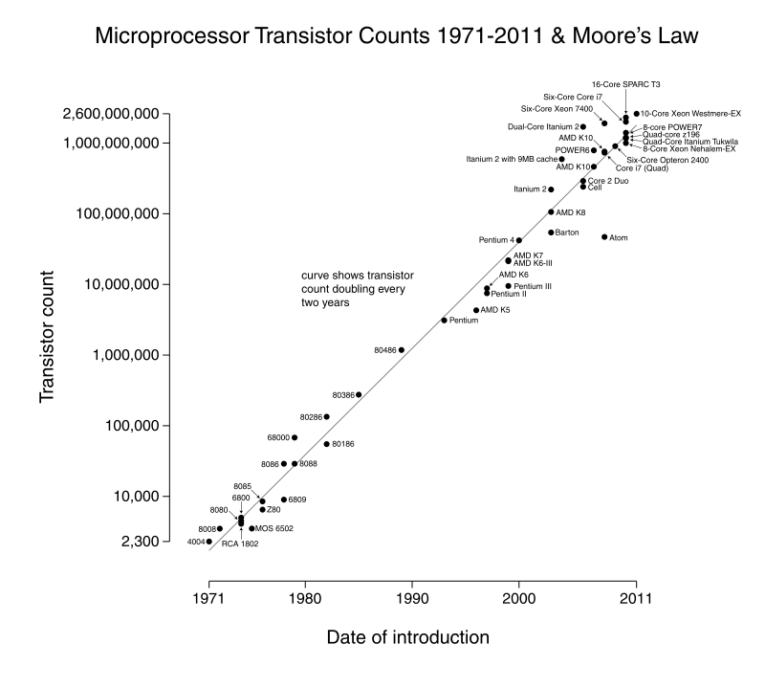
Moore’s Law
The number of transistors in a dense IC doubles approximately every two years.

Slide 8
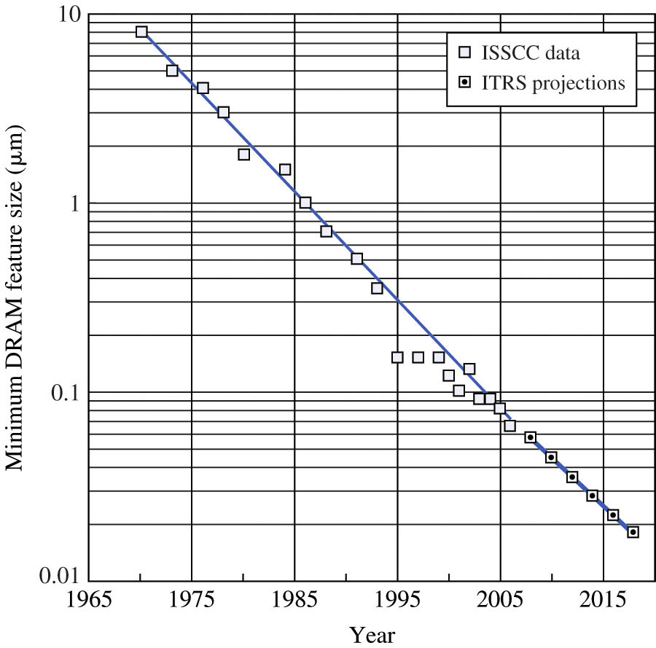
Device Feature Size
Feature size reductions enabled by process innovations.
Smaller features lead to more transistors per unit area and therefore higher density.
ISSCC--International Solid-State Circuits Conference
ITRS--International Technology Roadmap for Semiconductors

Slide 9
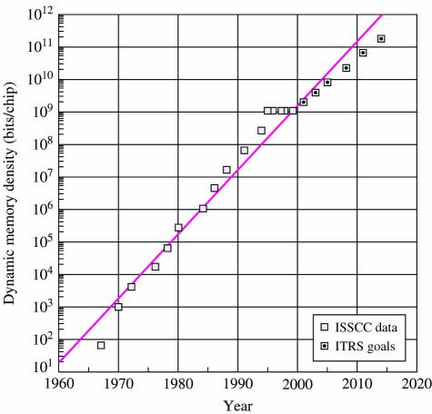
Rapid Increase in Density of Microelectronics
Memory chip density versus time
ISSCC--International Solid-State Circuits Conference
ITRS--International Technology Roadmap for Semiconductors

Slide 10
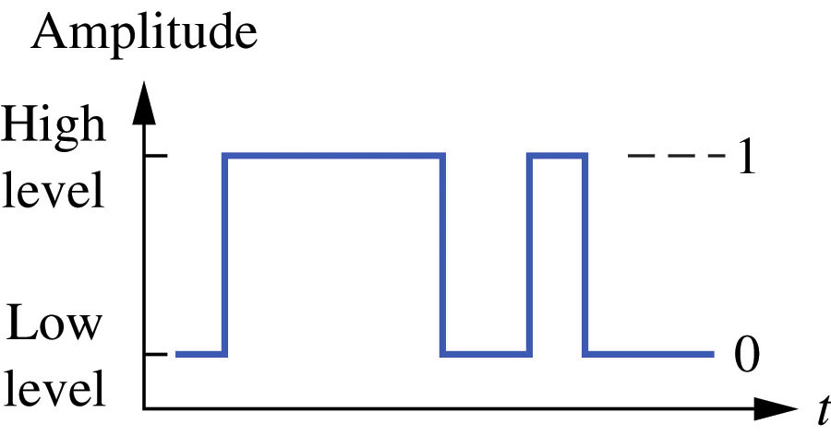
Figure 1.6 Digital Signals

Slide 11
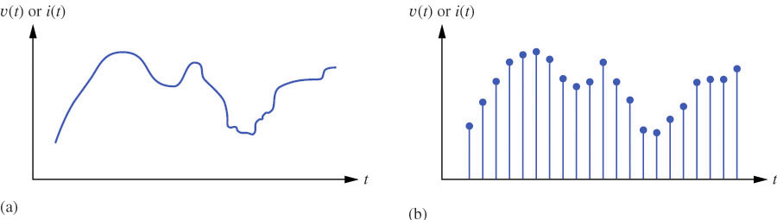
Figure 1.7
Analog Signal
Digital Signal

Slide 12
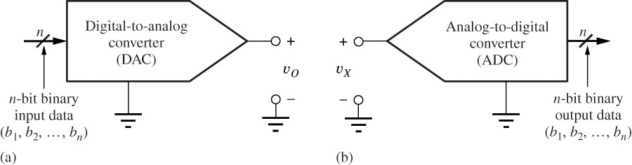
Figure 1.8

Slide 13
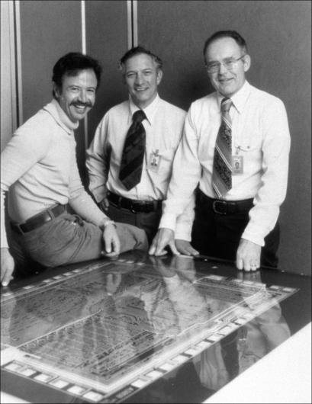
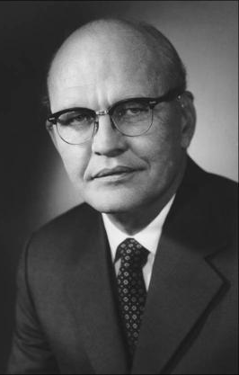
The Inventors of the Integrated Circuit
Andy Grove, Robert Noyce, and Gordon Moore with Intel 8080 layout.
Jack Kilby

Slide 14
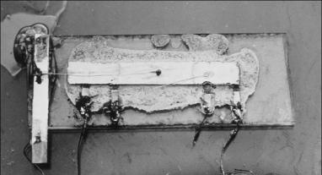
The Kilby Integrated Circuit
Active device
Semiconductor die
Electrical contacts
(wiki) As of 2016, the largest transistor count in a commercially available
single-chip processor is over 7.2 billion—the Intel Broadwell-EP Xeon.

Slide 15
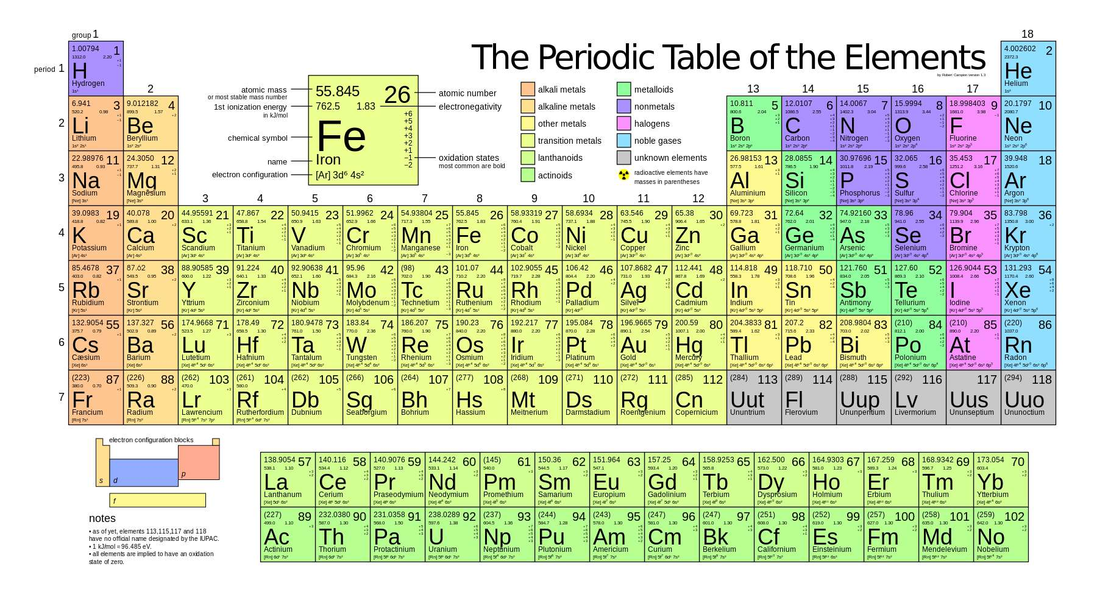
Full Periodic Table (Carbon Column, Most Important)

Slide 16
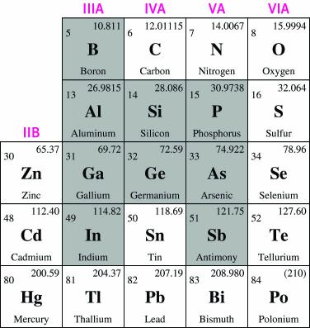
Semiconductor Materials (cont.)
Semiconductor | Bandgap Energy E_{G} (eV)
Carbon (diamond) | 5.47
Silicon | 1.12
Germanium | 0.66
Tin | 0.082
Gallium arsenide | 1.42
Gallium nitride | 3.49
Indium phosphide | 1.35
Boron nitride | 7.50
Silicon carbide | 3.26
Cadmium selenide | 1.70
IV
IV
IV
IV
III-V
III-V
III-V
III-V
IV
II-VI

Slide 17
Solid-State Electronic Materials
Electronic materials fall into three categories:
Insulators Resistivity (ρ) > 10⁵ Ω-cm
Semiconductors 10⁻³ < ρ < 10⁵ Ω-cm
Conductors ρ < 10⁻³ Ω-cm
Elemental semiconductors are formed from a single type of atom, typically Silicon.
Compound semiconductors are formed from combinations of column III and V elements or columns II and VI.
Germanium was used in many early devices.
Silicon quickly replaced germanium due to its higher bandgap energy, lower cost, and is easily oxidized to form silicon-dioxide insulating layers.

Slide 18
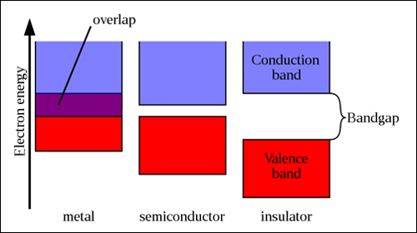
Bandgaps of Different Materials

Slide 19
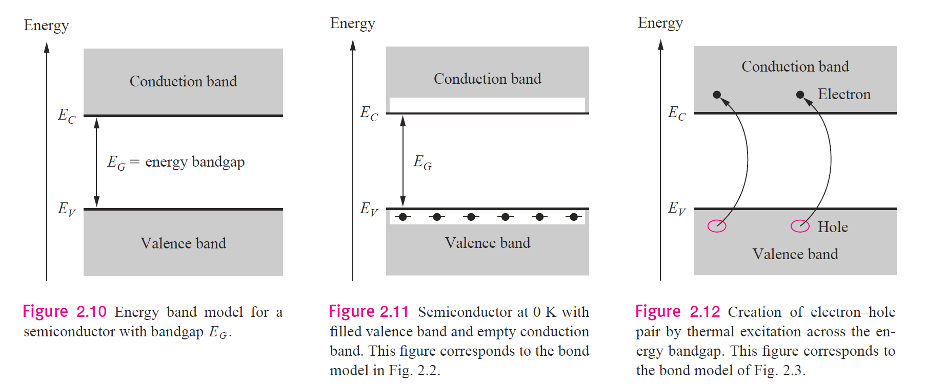
Bandgap in Semiconductor

Slide 20
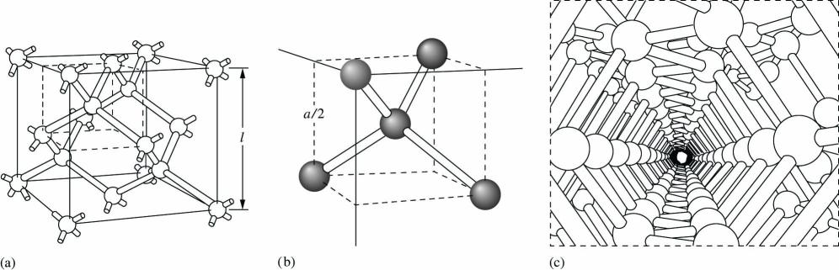
Covalent Bond Model
Silicon diamond lattice unit cell.
(stackable)
Corner of diamond lattice showing four nearest neighbor bonding.
(non-stackable)
View of crystal lattice along a crystallographic axis.

Slide 21
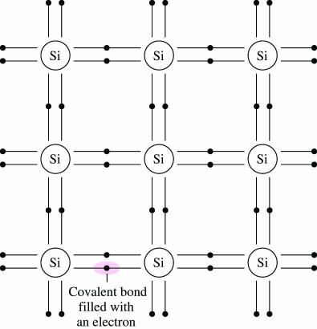
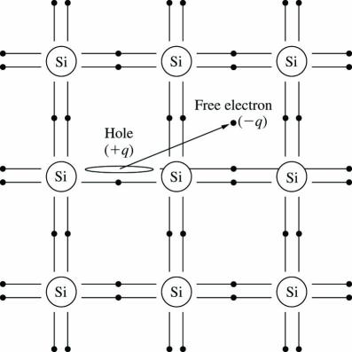
Silicon Covalent Bond Model (cont.)
Near absolute zero, all bonds are complete. Each Si atom contributes one electron to each of the four bond pairs.
Increasing temperature adds energy to the system and breaks bonds in the lattice, generating electron-hole pairs.
Holes and electrons are charge carriers.

Slide 22
Electron-hole Concentrations
A vacancy is left when a covalent bond is broken.
The vacancy is called a hole.
A hole moves when the vacancy is filled by an electron from a nearby broken bond (hole current).
Hole density is represented by p.
For intrinsic silicon, n = n_{i} = p.
The product of electron and hole concentrations is pn = n_{i}².
The pn product above holds when a semiconductor is in thermal equilibrium (not with an external voltage applied).

Slide 23
Intrinsic Carrier Concentration
Recombination and thermal generation causes n and p to remain constant.
The density of intrinsic carriers in a semiconductor as a function of temperature and material properties is:
E_{G} = semiconductor bandgap energy in eV (electron volts)
k = Boltzmann’s constant, 8.62 x 10⁻⁵ eV/K
T = absolute temperature, K
B² = material-dependent parameter, 1.08 x 10³¹ K⁻³ cm⁻⁶ for Si
B=7.3 x 10¹⁵ K^{-3/2} cm⁻³ for Si
Bandgap energy is the minimum energy needed to free an electron by breaking a covalent bond in the semiconductor crystal.

Slide 24
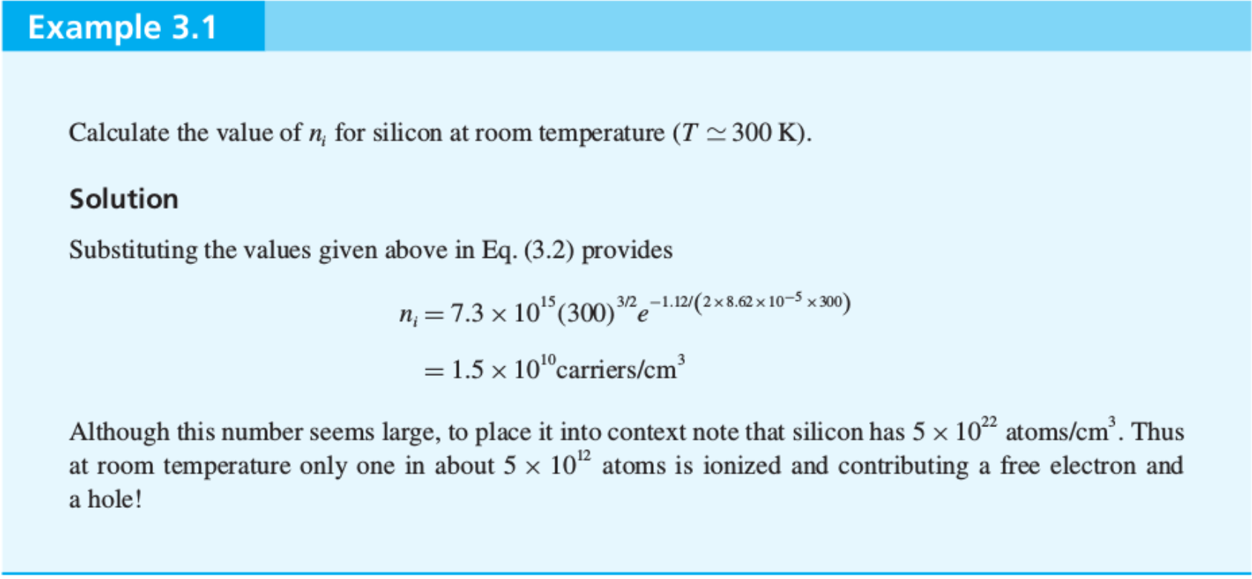
Example 3.1 from S&S

Slide 25
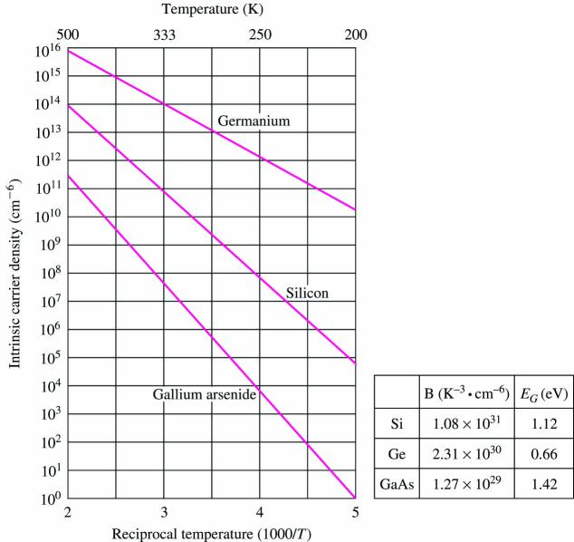
Intrinsic Carrier Concentration (cont.)
Electron density is n (electrons/cm³) and n_{i} for intrinsic material n = n_{i}.
Intrinsic refers to properties of pure materials.
n_{i} ≈ 10¹⁰ cm⁻³ for Si
Intrinsic carrier density (cm⁻³)

Slide 26
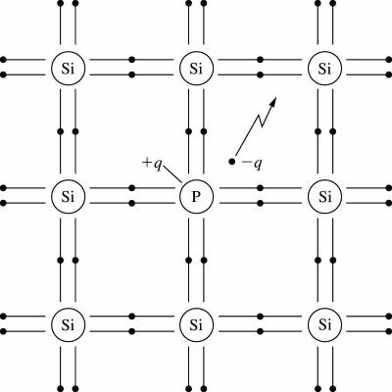
Donor Impurities in Silicon
Phosphorous (or other column V element) atom replaces silicon atom in crystal lattice.
Since phosphorous has five outer shell electrons, there is now an ‘extra’ electron in the structure.
Material is still charge neutral, but very little energy is required to free the electron for conduction since it is not participating in a bond.
n type doped silicon with phosphorous. Electron carrier density (concentration) n is increased.

Slide 27
Doping to Change Carrier Density
Minority carrier
Majority carrier

Slide 28
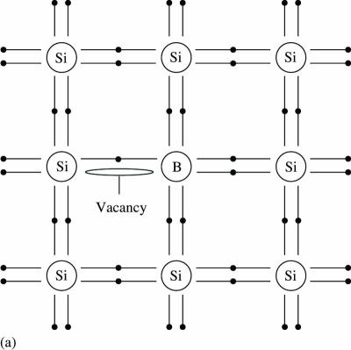
Acceptor Impurities in Silicon
Boron (column III element) has been added to silicon.
There is now an incomplete bond pair, creating a vacancy for an electron.
Little energy is required to move a nearby electron into the vacancy.
As the ‘hole’ propagates, charge is moved across the silicon.

Slide 29
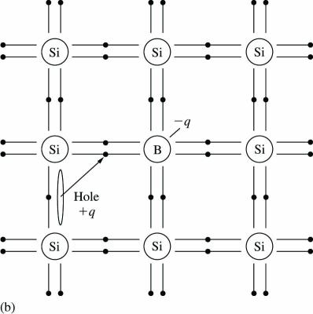
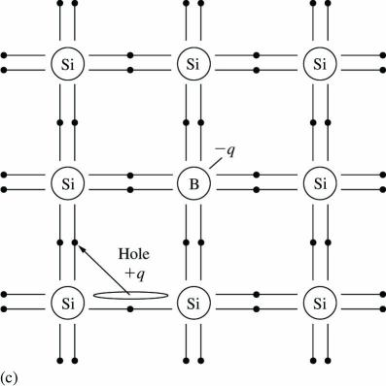
Acceptor Impurities in Silicon (cont.)
Hole is propagating through the silicon.
p type doped silicon with phosphorous. Hole carrier density or concentration p is increased.

Slide 30
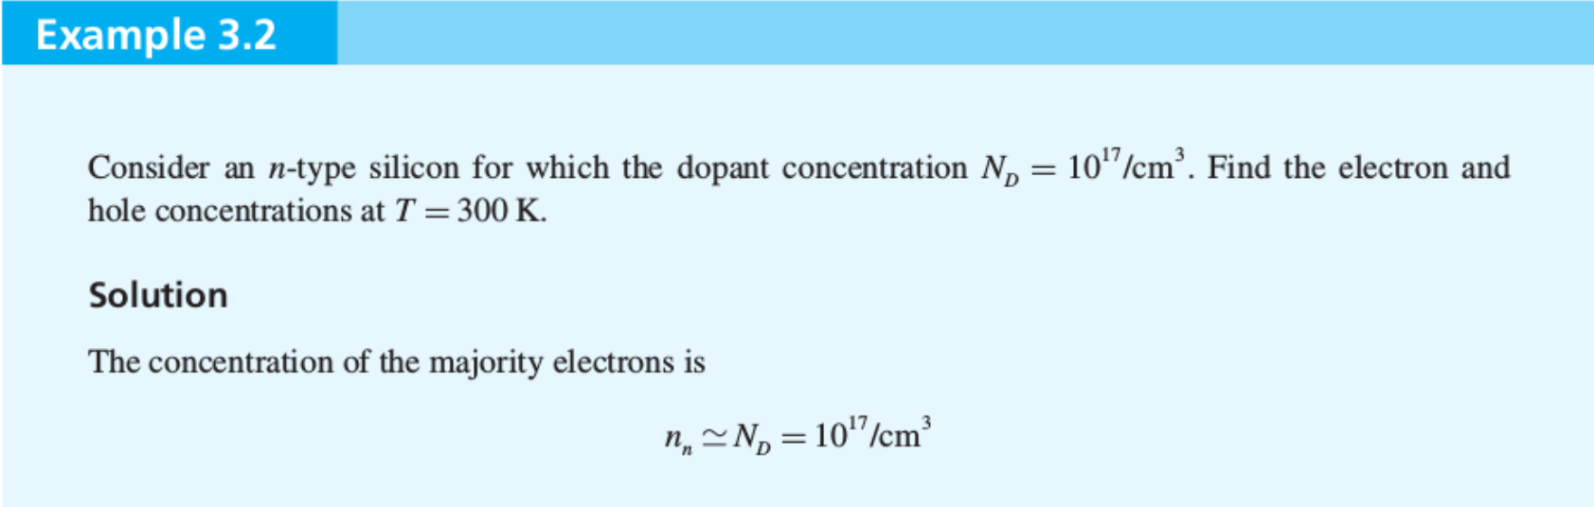
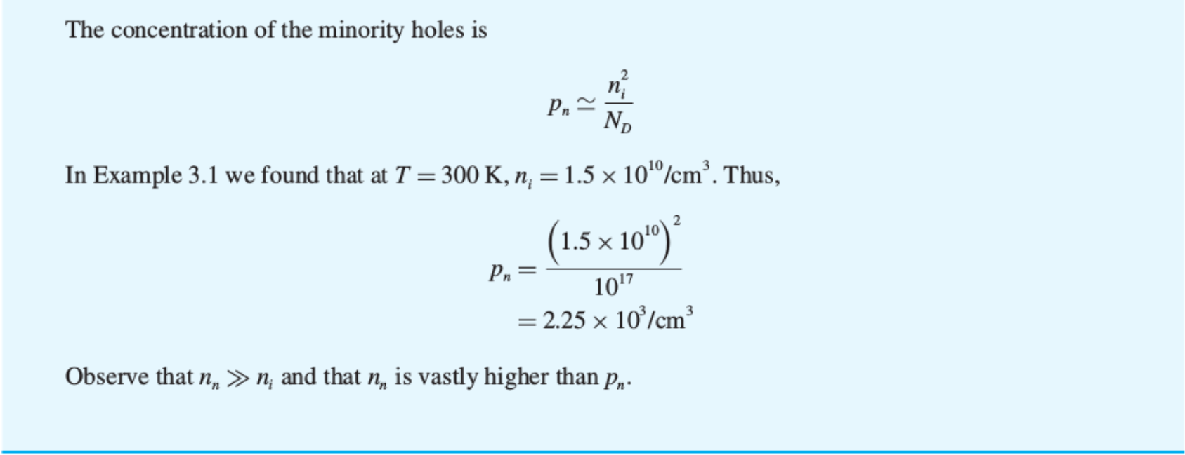
Example 3.2 of S&S

Slide 31
Prior Concepts You Need to Know
Kirchhoff’s Voltage and Current Laws
Thevenin & Norton Theorem:
Any linear electrical network with voltage and current sources and only resistors can be replaced at terminals by an equivalent voltage source, V_{th}, and an equivalent resistance, R_{th}.

Slide 32
Clicker Question 1 (0 Point)
What is the intrinsic carrier density (n_{i}) of Si at room temperature:
10¹⁰ cm⁻³
10²² cm⁻³
10⁴ cm⁻³

Slide 33
Clicker Question 2 (0 Point)
How many Si bonds are broken by thermal energy at room temperature?
10%
100%
~1 per 10¹³ bonds
50%

Slide 34
Clicker Question 3 (0 Point)
Si: T=300K, N_{D}=10¹⁷/cm³, is it n type or p type?
n type
p type
intrinsic

Slide 35
Clicker Question 4 (0 Point)
Si: T=300K, N_{D}=10¹⁷/cm³, hole concentration p=?
10¹⁷/cm³
0/cm³
10¹⁰/cm³
10³/cm³

