Slide 1
ECE 255
Mar 27, 2018 Lecture
Instructor: Weng Cho Chew
Email: wcchew@purdue.edu
Office: 3053 Wang Hall

Slide 2
Differential Amplifiers
Differential amplifiers rejects unwanted noise called common-mode noise.
Remnant electric field induces smaller signal in a differential amplifier.
In differential amplifiers, the difference of two terminals is always taken, rejecting unwanted signals.

Slide 3
MOS Differential Pair

Slide 4
Common Mode Operation

Slide 5
Common Mode Input Voltage

Slide 6
Max. Common Mode Voltage
To keep transistors in saturation mode:

Slide 7
Min. Common Mode Voltage
To keep V_{CS} > 0

Slide 8
Differential Input Signal

Slide 9
Differential Input Signal, Contd.

Slide 10
Differential Input Voltage

Slide 11
Large Signal Operation

Slide 12
Large Signal Operation, Contd.

Slide 13
Reducing to Common Mode Case
Alternate representation:

Slide 14
i_{D} vs v_{id} Curve

Slide 15
Small Signal Approximations

Slide 16
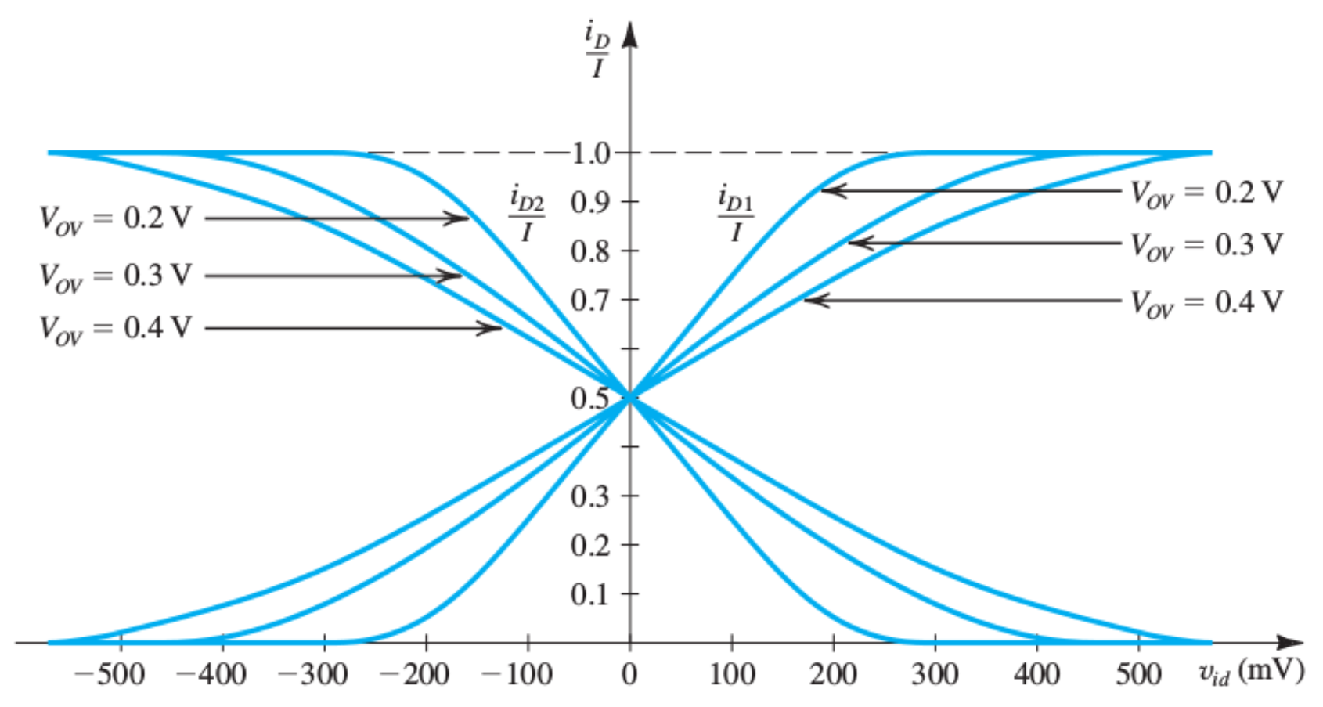
i_{D} vs v_{id} Curve for Various V_{OV}

Slide 17
Remarks on Large Signal Operation

Slide 18
Clicker Question 1 (1 Point)
The primary reason of having a differential amplifier is:
It is cheaper to design.
It rejects environmental noise.
It produce a high quality linear amplifier.

