Slide 1
ECE 255
Mar 20, 2018 Lecture
Instructor: Weng Cho Chew
Email: wcchew@purdue.edu
Office: 3053 Wang Hall

Slide 2
Discrete Circuit Amplifiers
Discrete circuit amplifiers are mostly BJT’s due to tradition.
They were used by hobbyists to make HiFi amplifiers.
Capacitors are used as DC blockers but become short circuits at high frequencies.

Slide 3
A Discrete-Circuit
Common-Source Amplifier

Slide 4
Salient Points
The DC or Q point is the operating point.
The source sees a signal or AC ground.
C_{S} is called the bypass capacitor.
1/(jωC_{S})<<R_{S} when
C_{C1} and C_{C2} are couping capacitors.
R_{S} stabilizes the DC biasing point.

Slide 5
Important Formulas and Voltage Gains

Slide 6
A Discrete-Circuit
Common-Emitter Amplifier

Slide 7
Salient Points
The DC or Q point is the operating point.
The source sees a signal or AC ground.
C_{E} is called the bypass capacitor.
1/(jωC_{E})<<R_{E} when
C_{C1} and C_{C2} are couping capacitors.
R_{E} stabilizes the DC biasing point.

Slide 8
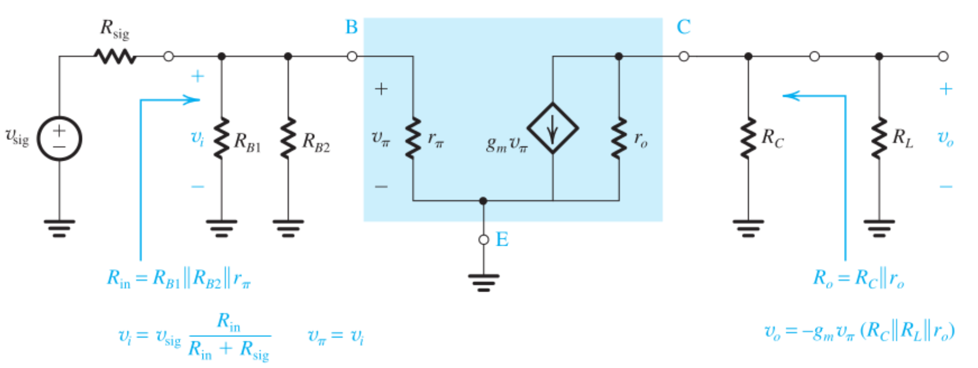
Important Formulas and Voltage Gains

Slide 9
CE Amplifier with Emitter Resistance

Slide 10
Important Formulas
Cf.

Slide 11
A Common Base (CB) Amplifier

Slide 12
Some Important Formulas

Slide 13
An Emitter Follower

Slide 14
Some Important Formulas

Slide 15
Output Resistance

Slide 16
Some Important Summaries
The input resistance and output resistance are important for maximum power transfer. This is especially so in a multi-stage amplifiers.
The CE and CS have high voltage and current gain. They can be cascaded to produce even more gain.
The CB and CG have low current gain, but high voltage gain. Hence, they have low input impedance but high output impedance.
The CC and CD have low voltage gain, but high current gain. Hence, they have high input impedance, but low output impedance. They are good voltage buffer.

Slide 17
Amplifier Frequency Response
The gain of the amplifier is not a constant.

Slide 18
Salient Points
The coupling and bypass capacitors become open circuits at low frequencies, deteriorating the performance of the amplifer.
At high frequencies, parasitic or internal capacitances become like short circuits.

Slide 19
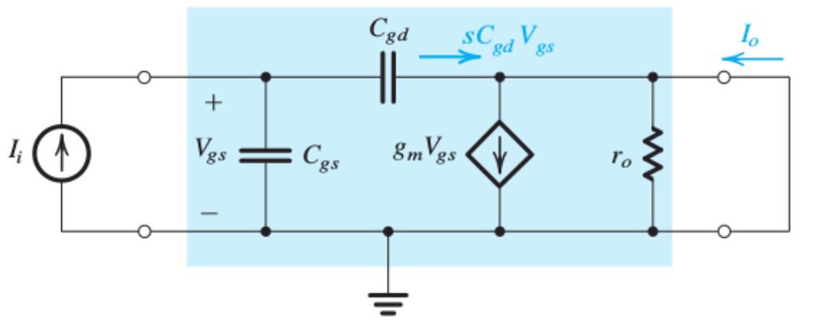
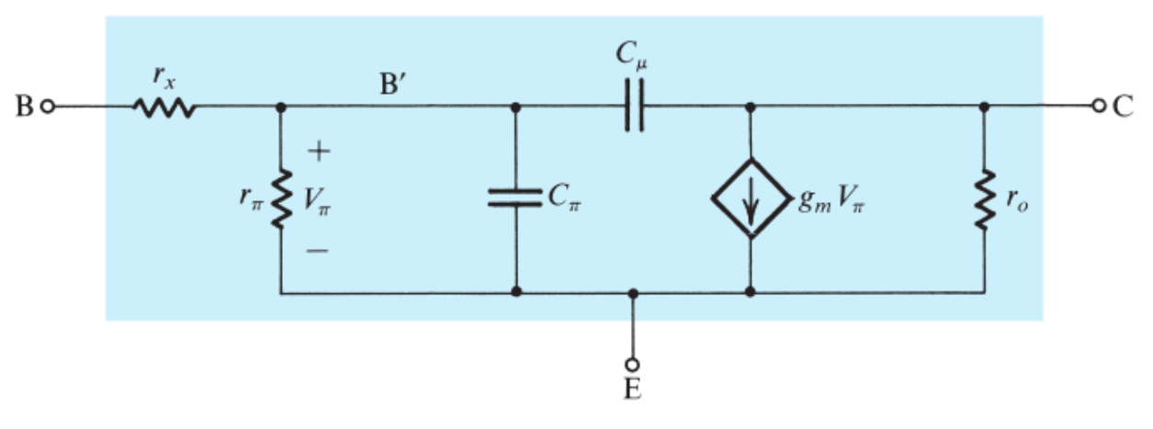
Hybrid Pi Model of MOSFET and BJT at High Frequency
MOSFET
BJT

Slide 20
Clicker Question 1 (1 Point)
What causes the discrete-circuit amplifier to lose its performance at low frequencies?
Coupling and bypass capacitances.
Internal and parasitic capacitances.
None of the above.
None of the above.

