Slide 1
ECE 255
Mar 8, 2018 Lecture
Instructor: Weng Cho Chew
Email: wcchew@purdue.edu
Office: 3053 Wang Hall

Slide 2
Key About Linearization
Convert a nonlinear system into a linear system.
Linear systems are a lot easier to solve.
They can be solved by casting the equations into a set of linear algebraic equations.
These linear algebraic equations, even then they are large having many variables, can be solved by a computer.
Hence, commercial software, such as SPICE, have been developed to address the solutions of such large linear systems.

Slide 3
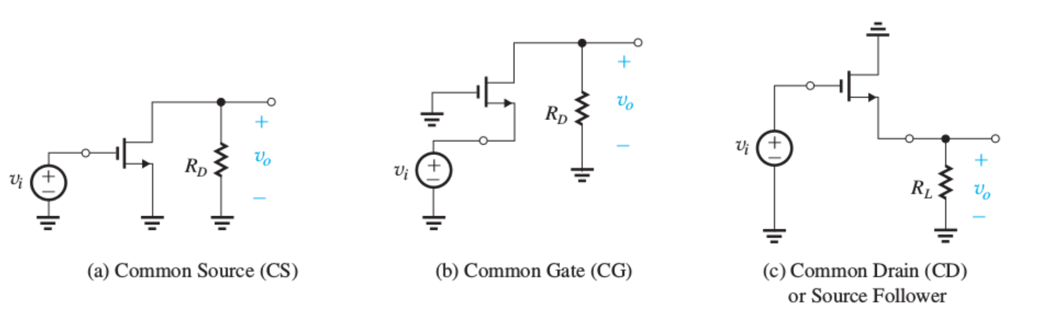
Three Basic Configurations--MOSFET
Common source amplifiers.
Common gate amplifiers.
Common drain amplifiers or source follower.

Slide 4
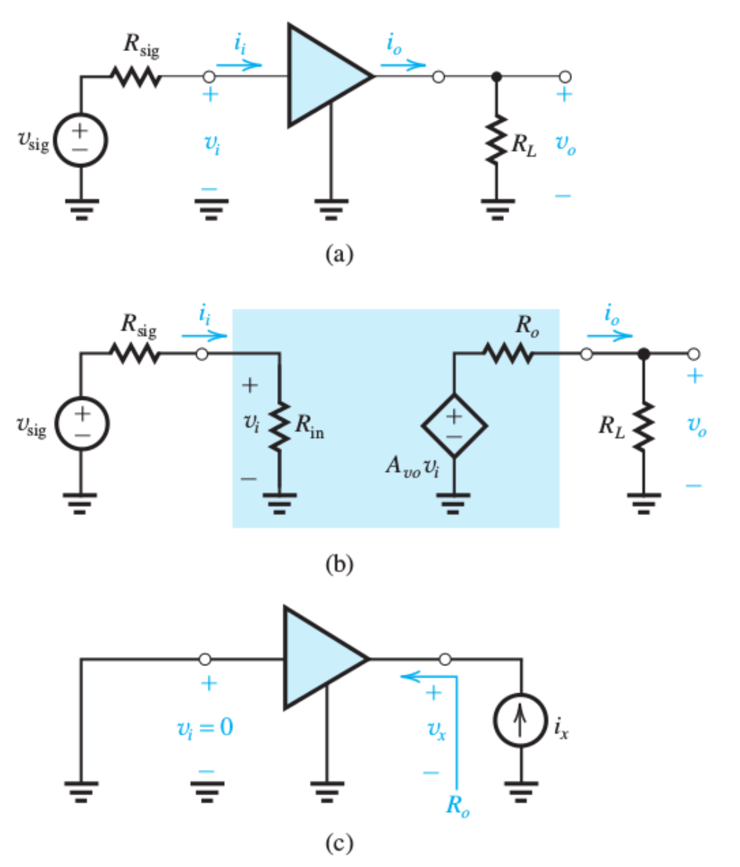
Characterization of an Amplifier

Slide 5
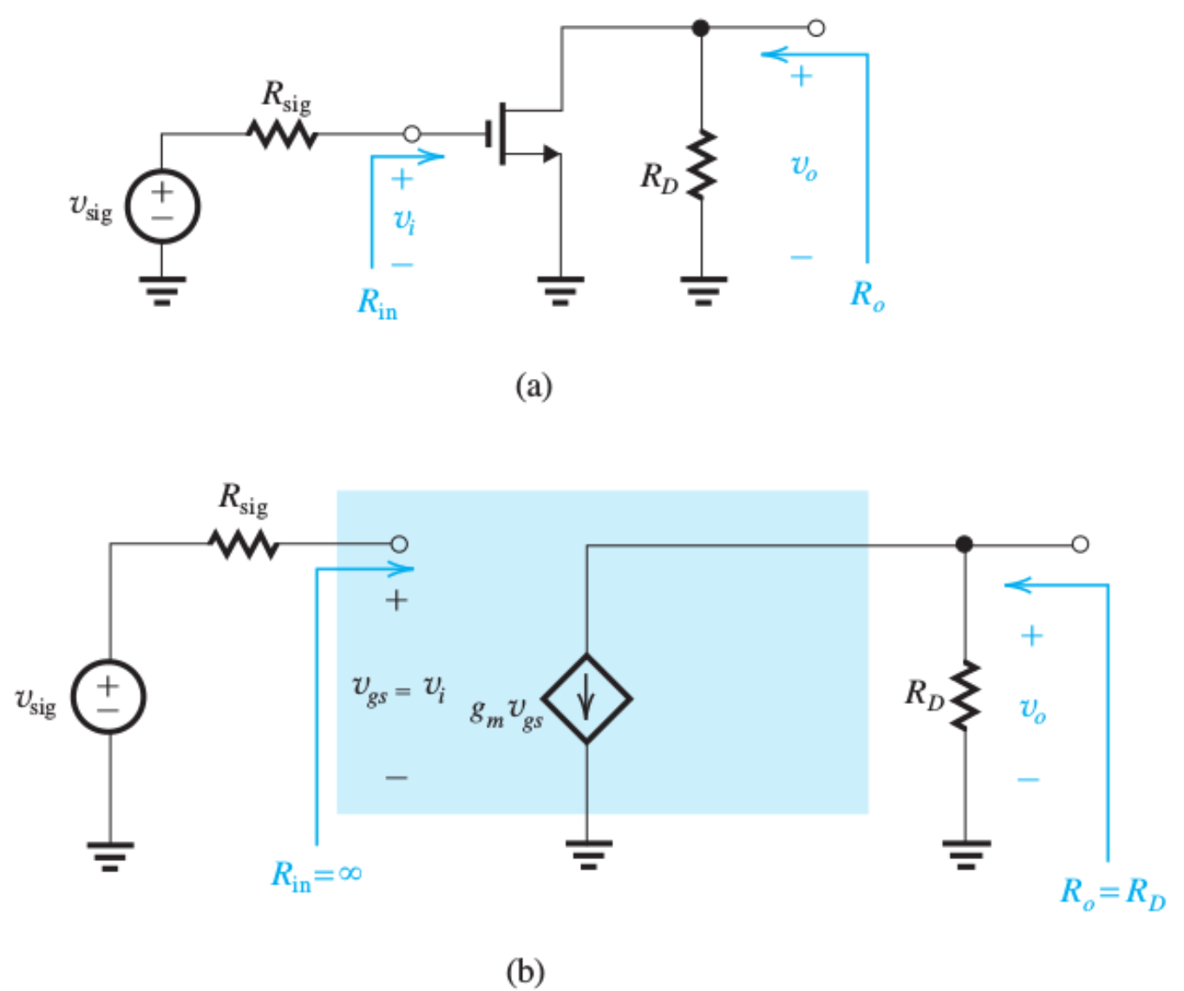
Common Source Amplifier

Slide 6
Characteristic Parameters
Cf. BJT case

Slide 7
Final Remarks on CS Amplifier

Slide 8
CS Amplifier with Source Resistance

Slide 9
CS Amp. with Source Resistance Contd.
Cf. BJT case

Slide 10
CS Amplifier more…
Cf. BJT case

Slide 11
Summary of CS Amp. w/ Source Resistance

Slide 12
Common-Gate (CG) Amplifier

Slide 13
CG Amplifier, Contd.
Cf. BJT case

Slide 14
Summary of CG Amplifier

Slide 15
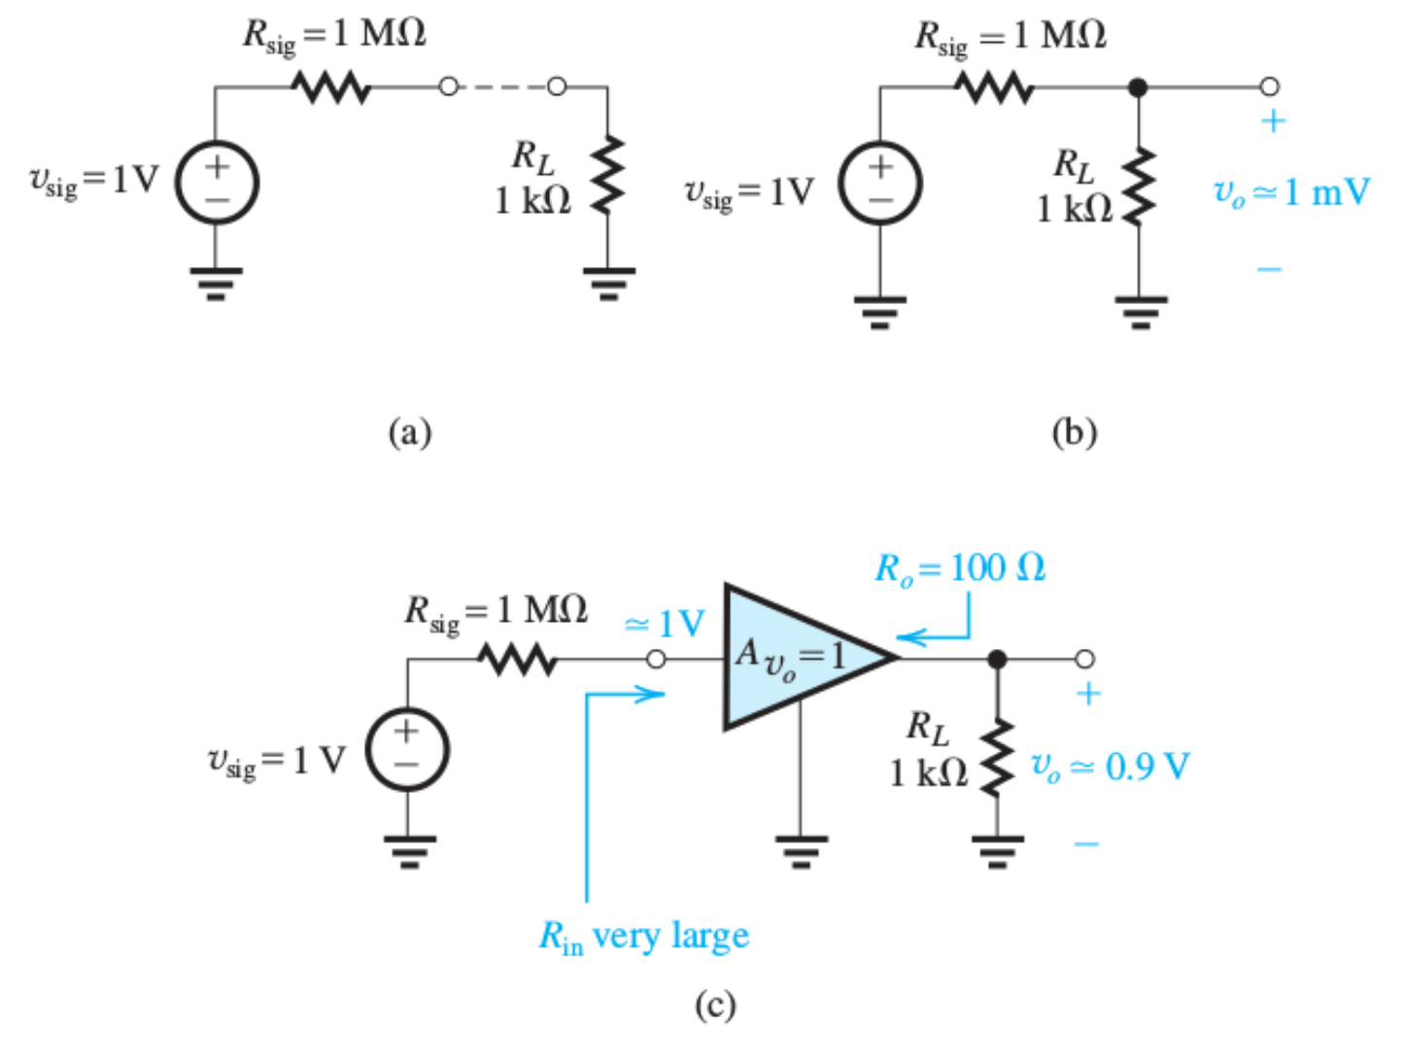
Use of a Unity Gain Amplifier

Slide 16
Common Drain Amplifier (Source Follower)

Slide 17
Source Follower (Common Drain)
Voltage buffer and a common drain amplifier.
Cf. BJT case

Slide 18
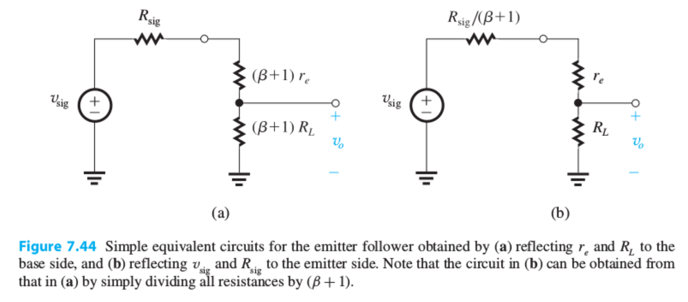
Emitter Follower as a Voltage Divider

Slide 19
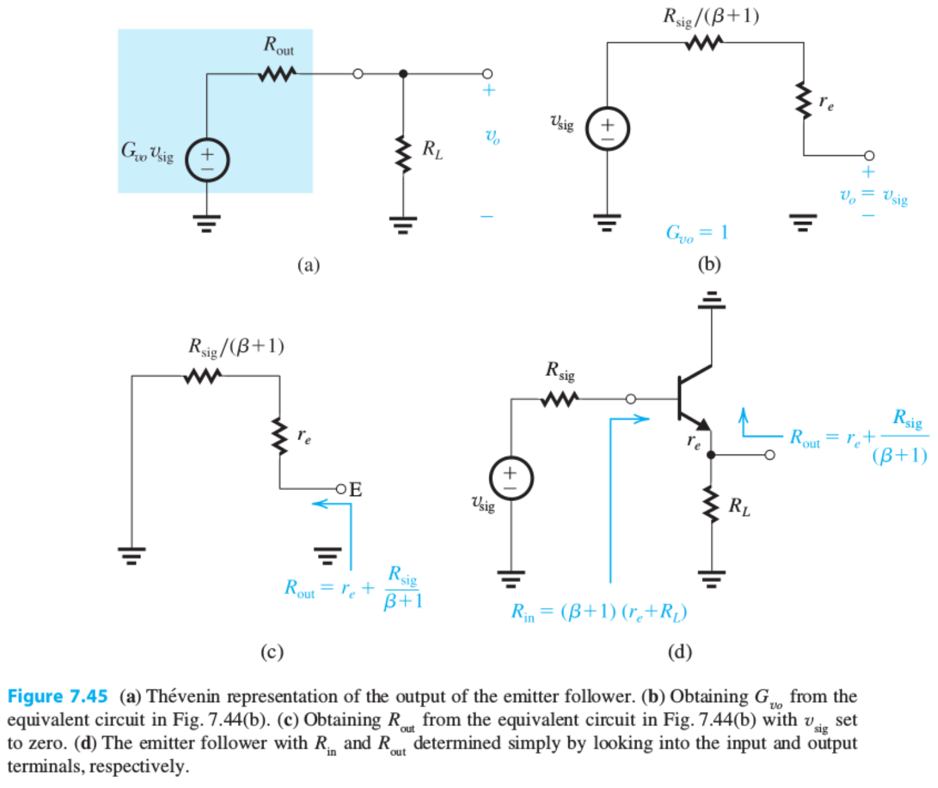
Thevenin Equivalence of Emitter Follower

Slide 20
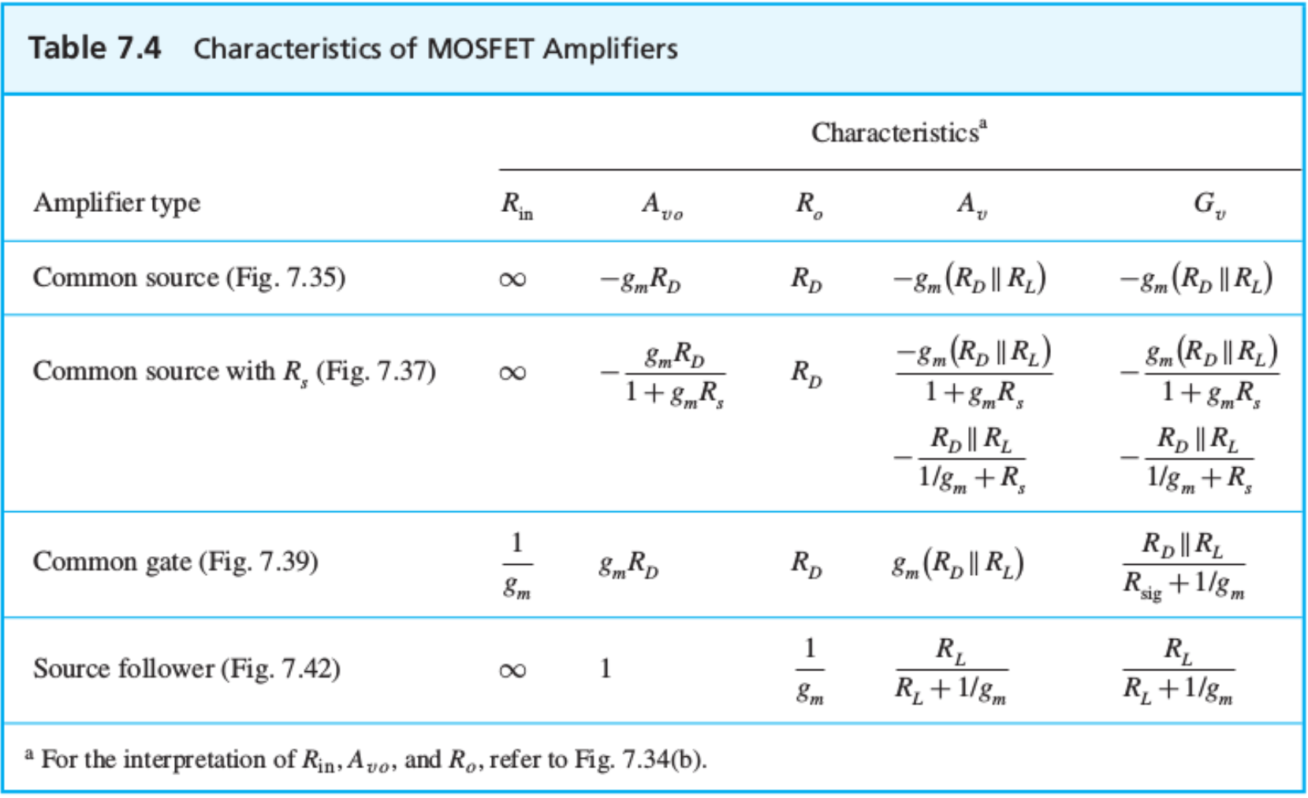
Summary Table

Slide 21
Summary and Comparison

Slide 22
Clicker Question 1 (1 Point)
What is the marked difference of a MOSFET amplifiers from a BJT amplifiers?
Low input impedance.
High or infinite input impedance.
None of the above.
None of the above.

