Slide 1
ECE 255
Mar 6, 2018 Lecture
Instructor: Weng Cho Chew
Email: wcchew@purdue.edu
Office: 3053 Wang Hall

Slide 2
Linearization-MOSFET
Having figured out how to bias the MOSFET transistor to be in the saturation region, the next thing is to put the transistor to good use.
We see how to use the transistor to amplify small signals.
Small signals are added on top of the DC voltages and currents, and they are usually much smaller.
This follows Sect. 7.2 of the text book.

Slide 3
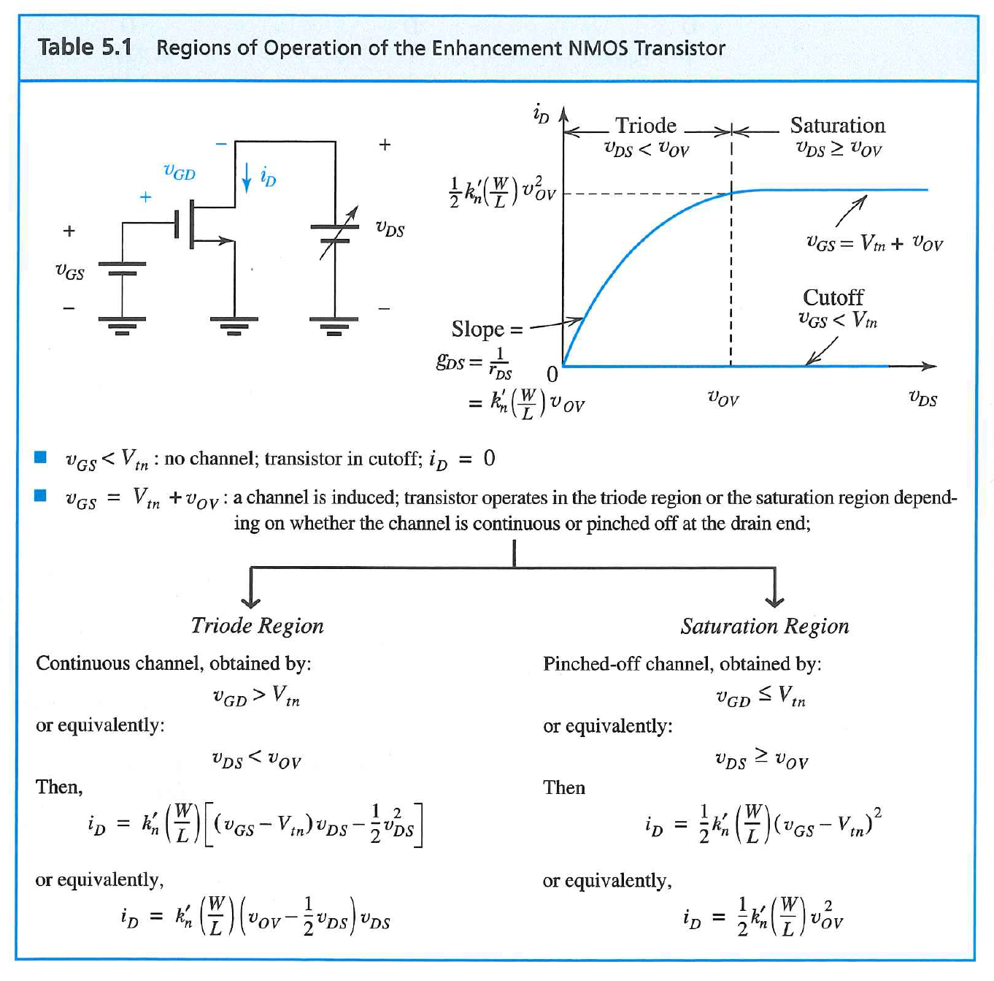
Review of MOSFET

Slide 4
More to Remind Us of MOSFET
Triode Region
Entering Saturation

Slide 6
MOSFET Linearization—Small Signal

Slide 7
Graphical Rep of Linearization

Slide 8
More on Small Signal Analysis…

Slide 9
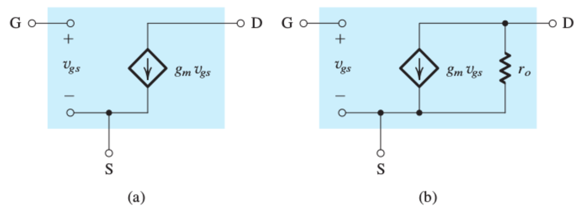
Small Signal Equivalent Circuit Models

Slide 10
Early Effect—Finite Output Resistance

Slide 11
MOSFET Transconductance g_{m}

Slide 12
Graphical Depiction

Slide 13
Morphing from hybrid-pi to T Equivalent Circuit Model

Slide 14
Early or Channel Modulation Effect

Slide 15
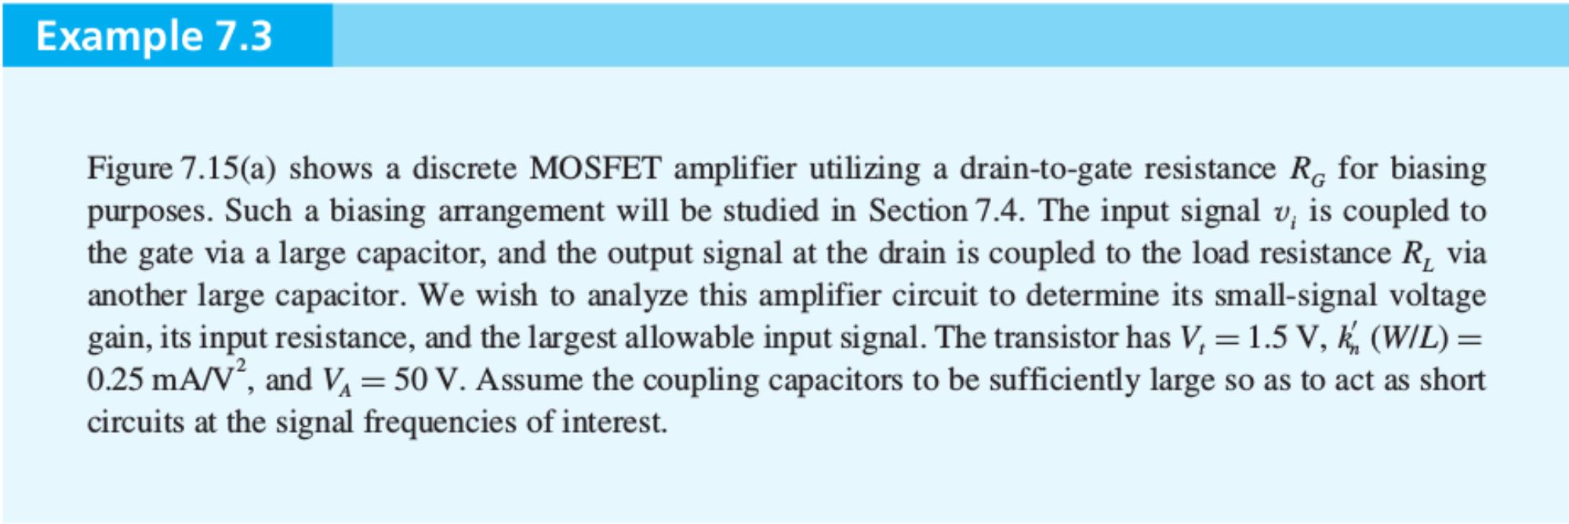
m

Slide 16
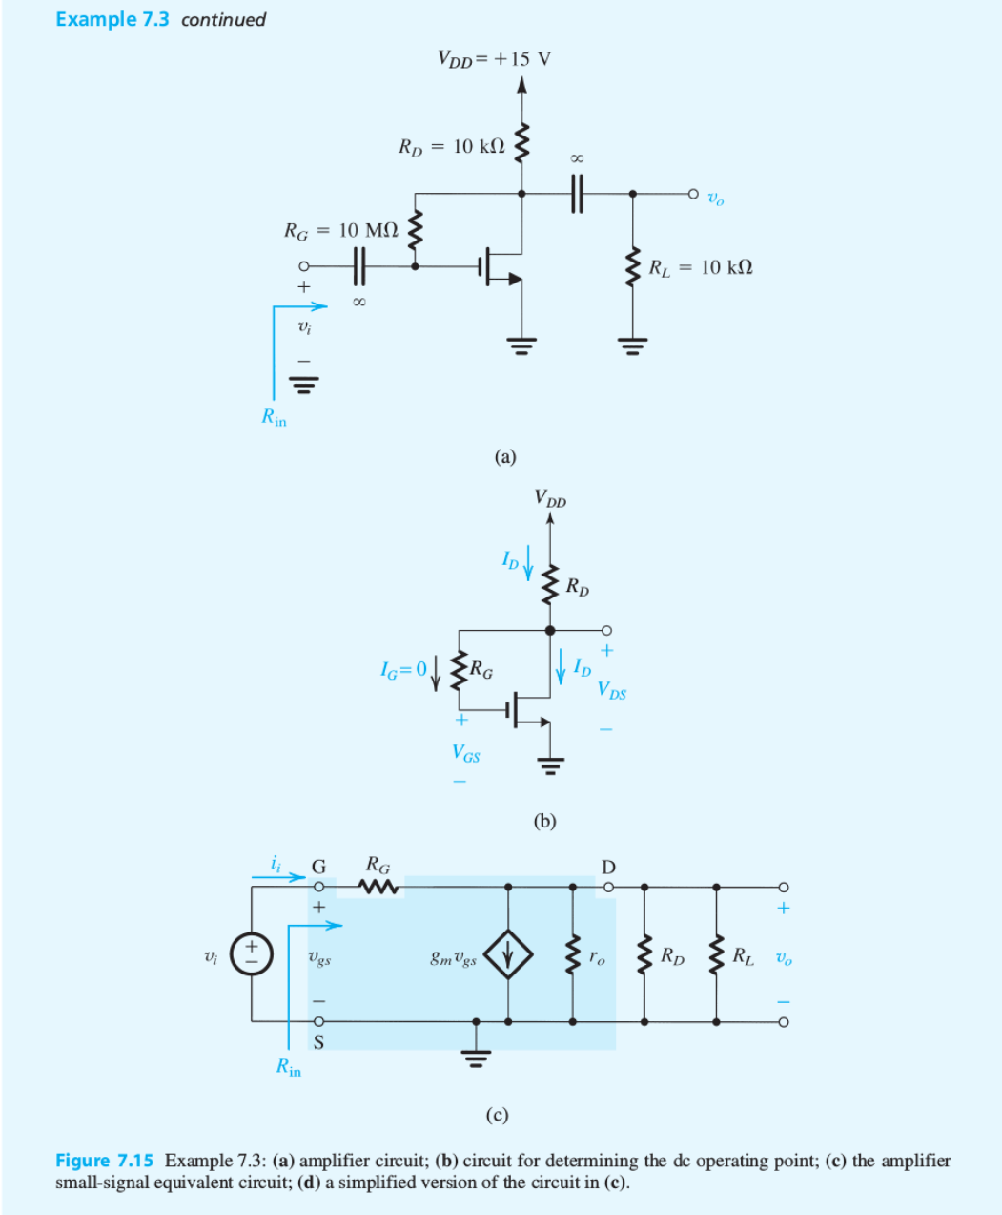

Slide 17
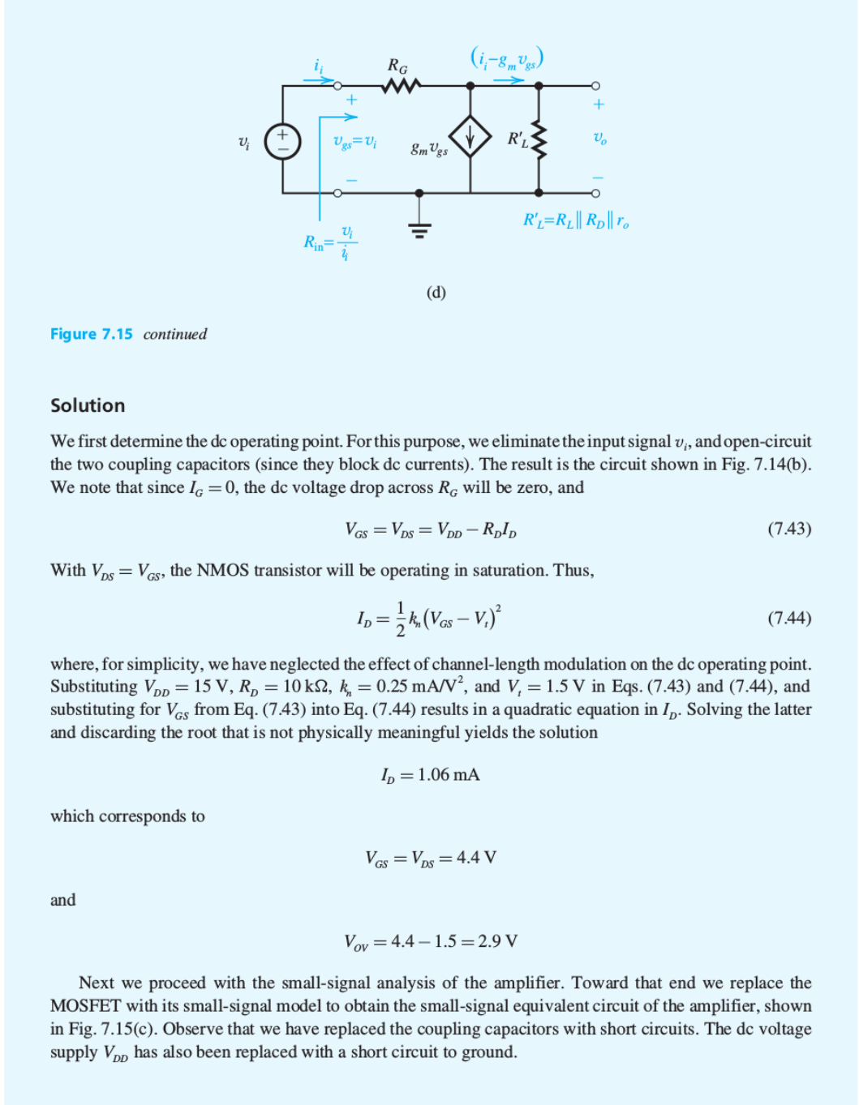

Slide 18
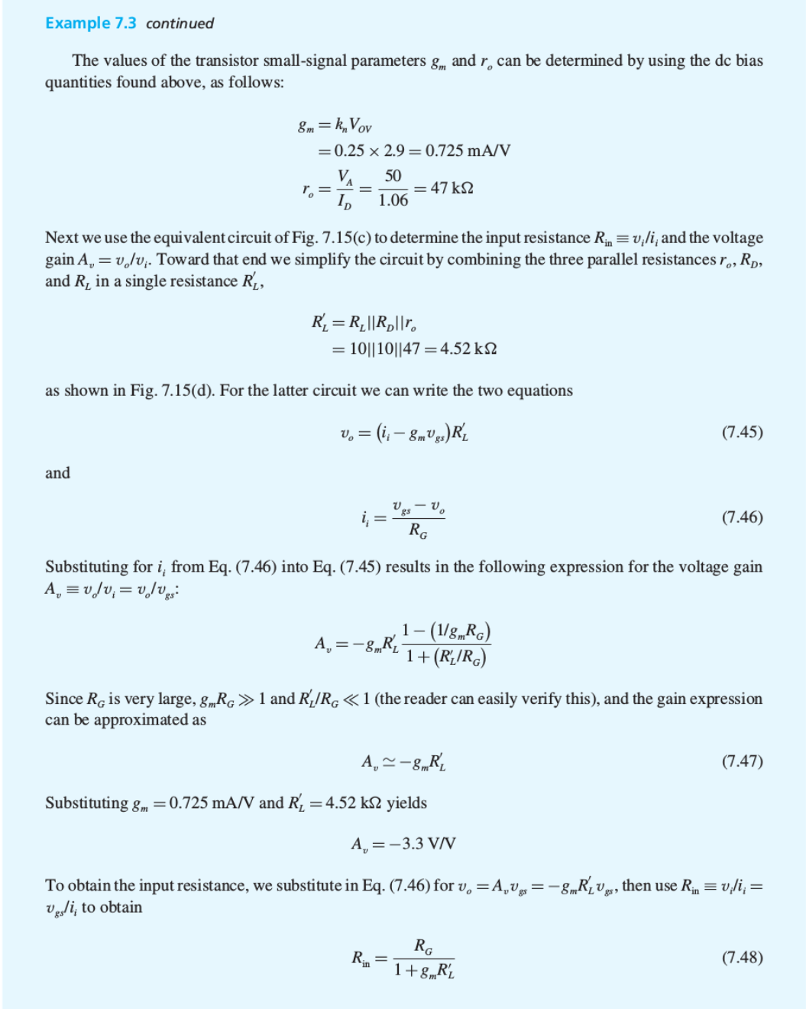

Slide 19
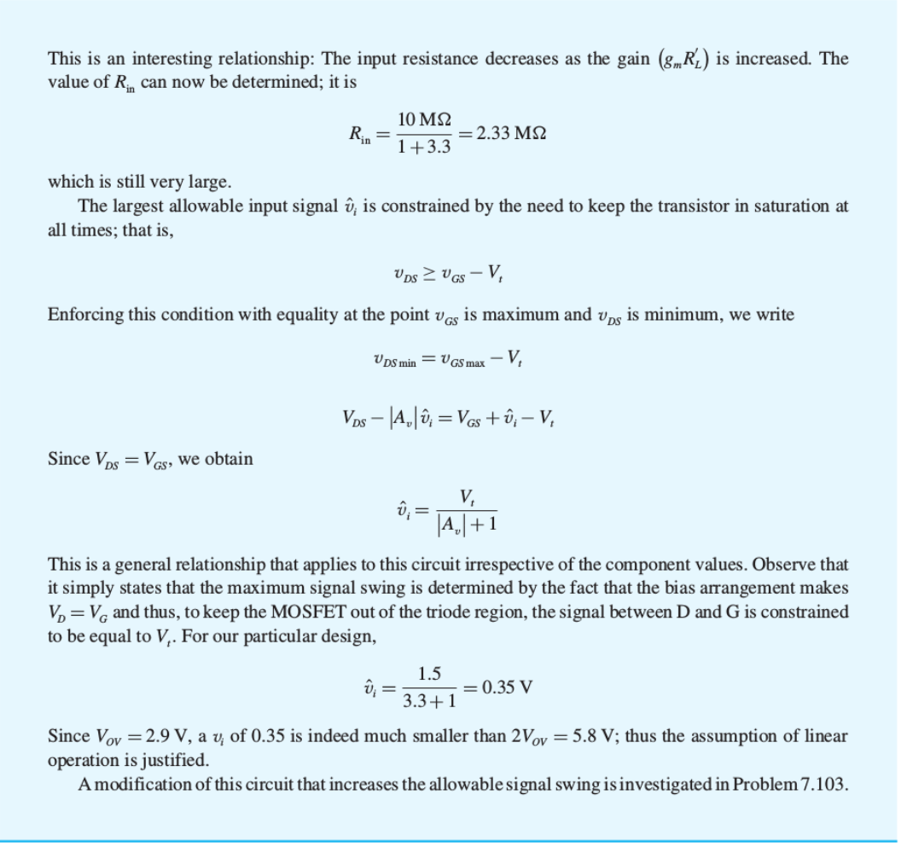

Slide 20
Different Regimes of Operation

Slide 21
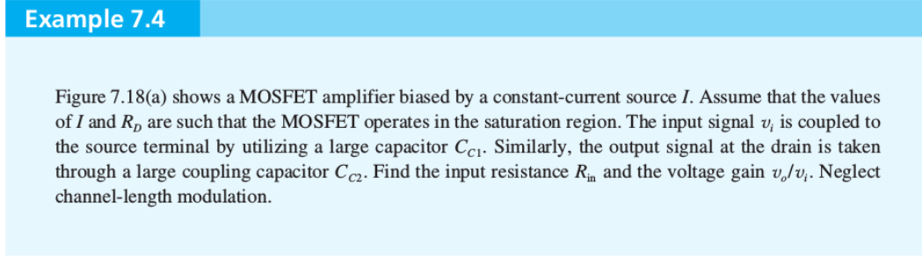

Slide 22
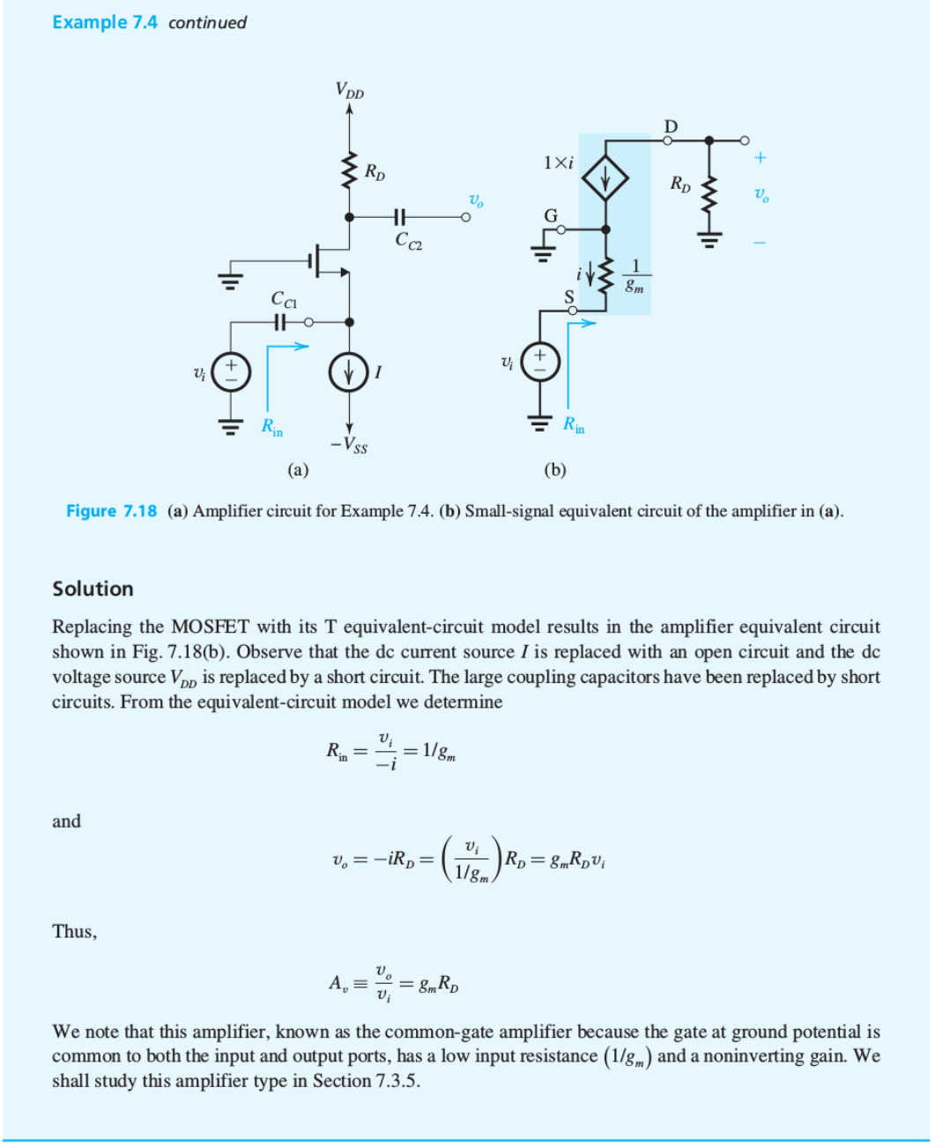

Slide 23
Clicker Question 1 (1 Point)
Why are the ways that the transconductance of a MOSFET can be changed?
By varying W, L, V_{OV} and I_{D}.
By varying V_{T} and I_{D}.
By varying V_{T} and R_{D} .

