Slide 1
ECE 255
Mar 1, 2018 Lecture
Instructor: Weng Cho Chew
Email: wcchew@purdue.edu
Office: 3053 Wang Hall

Slide 2
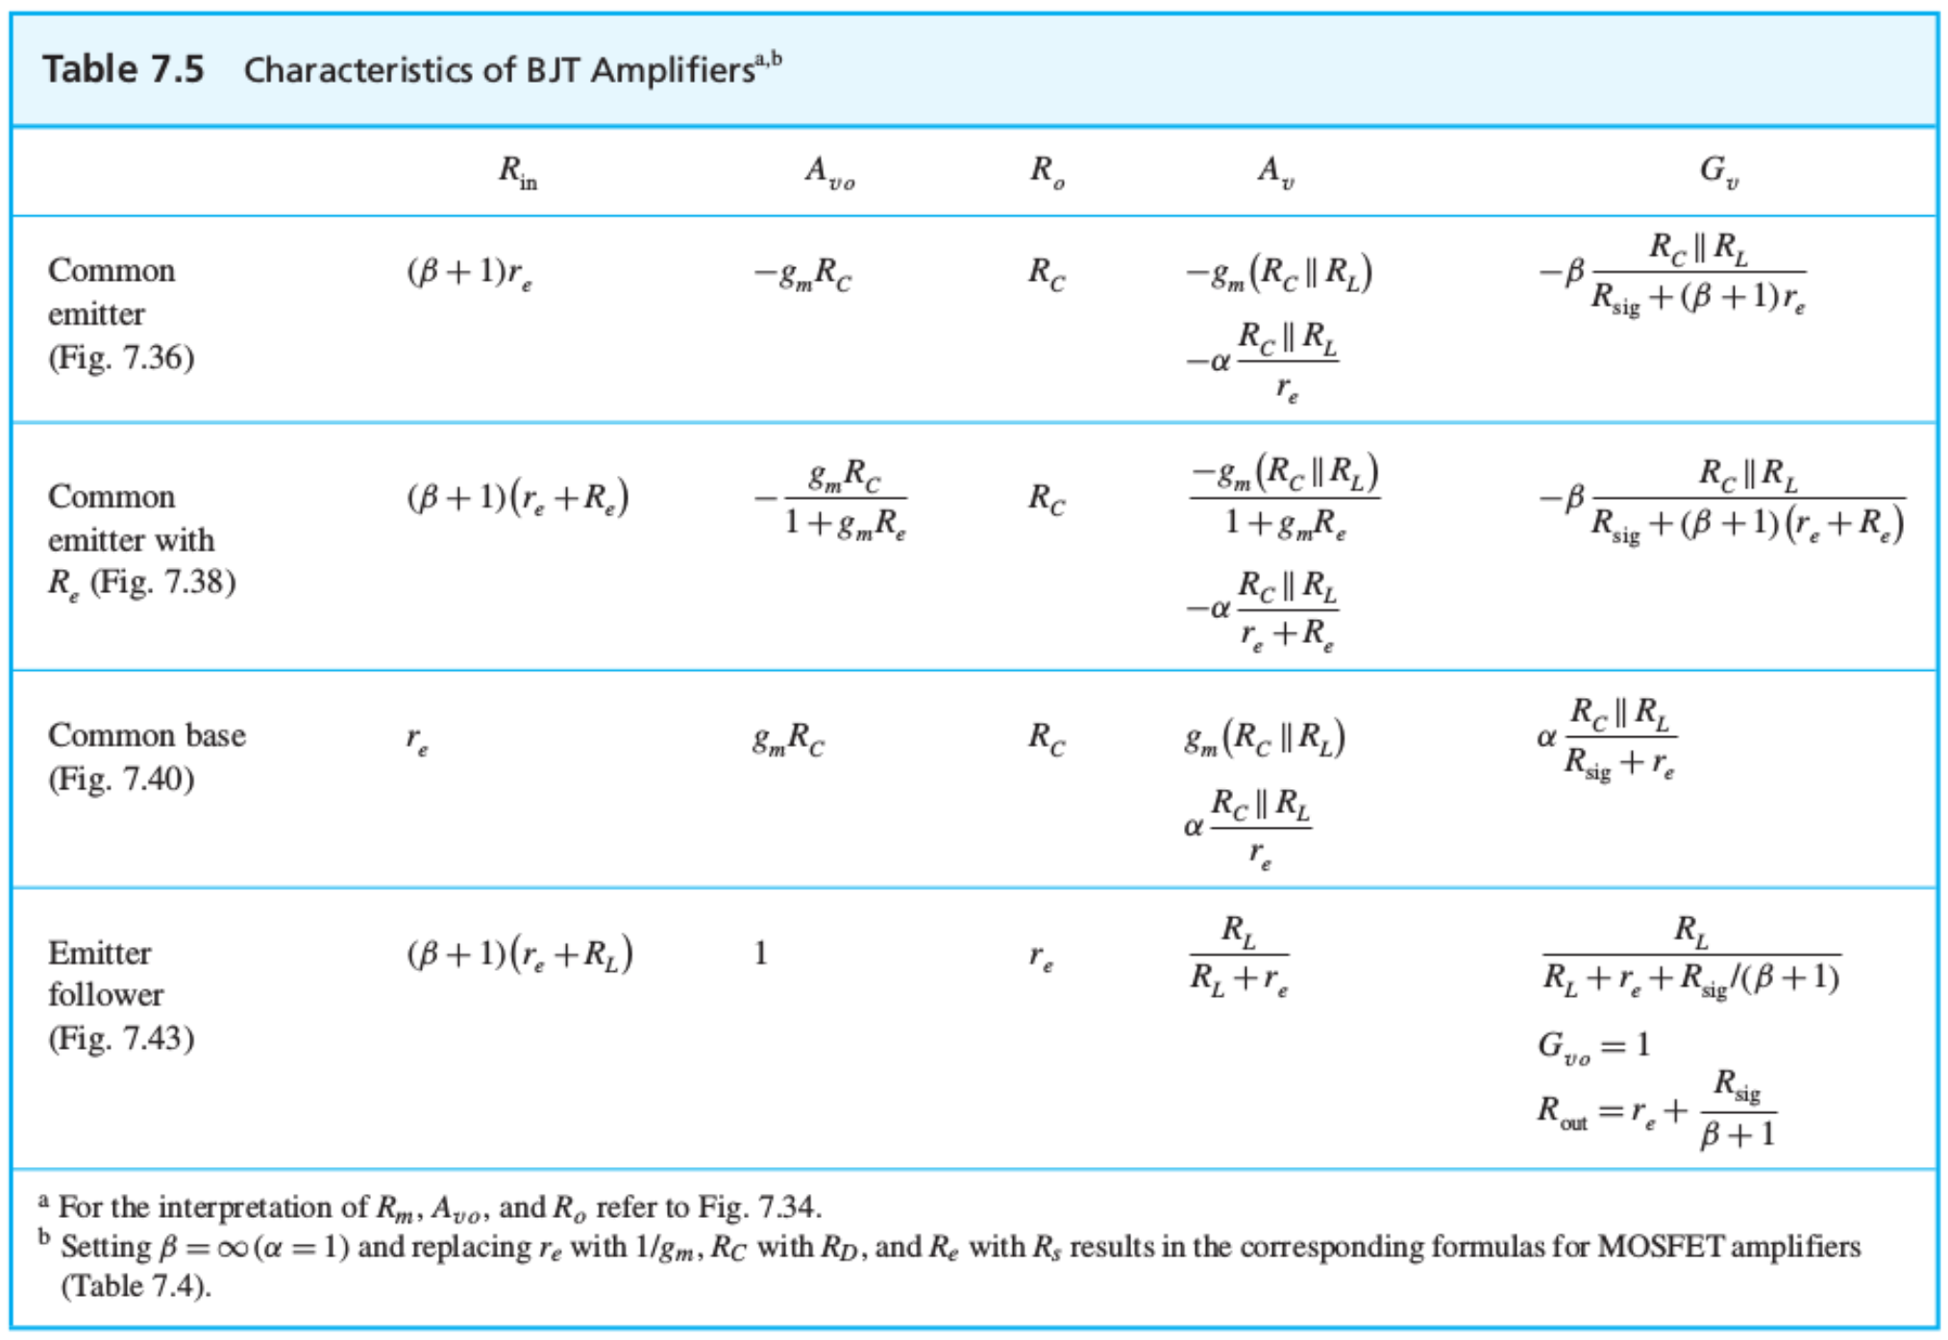
Summary Table of BJT Amplifiers

Slide 3
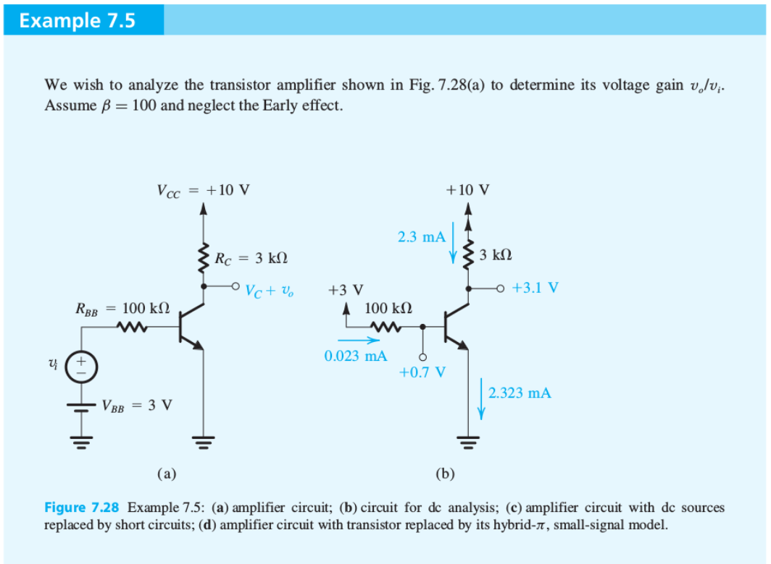
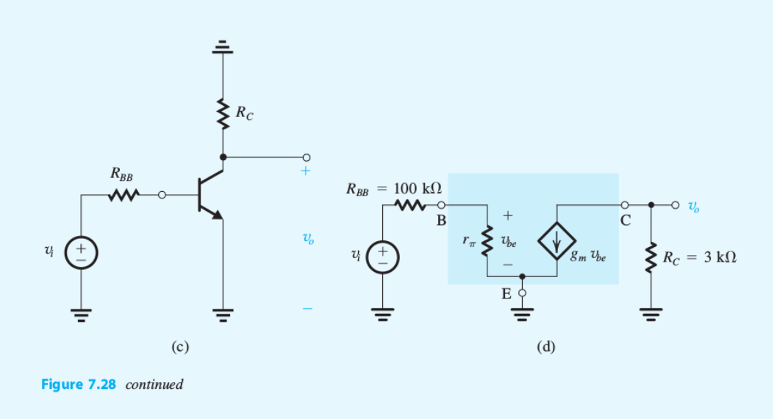

Slide 4
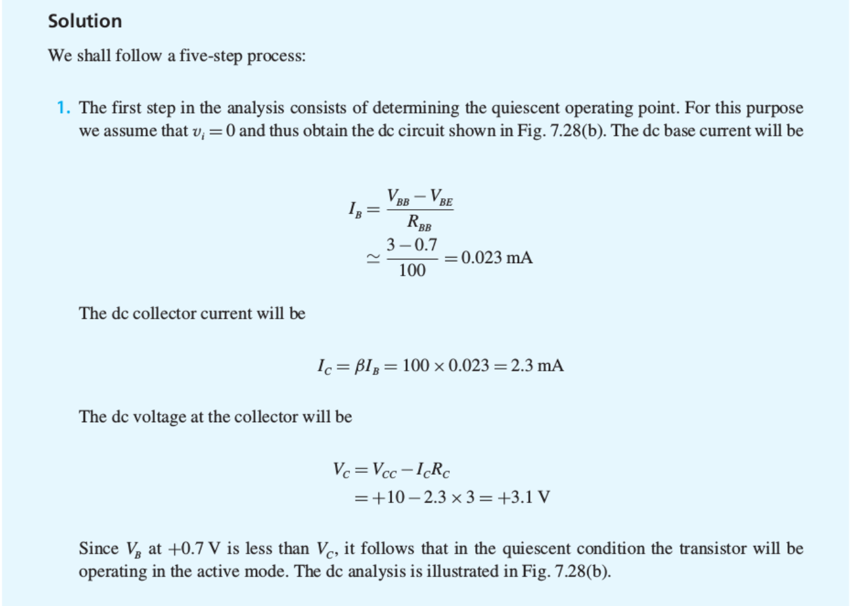

Slide 5
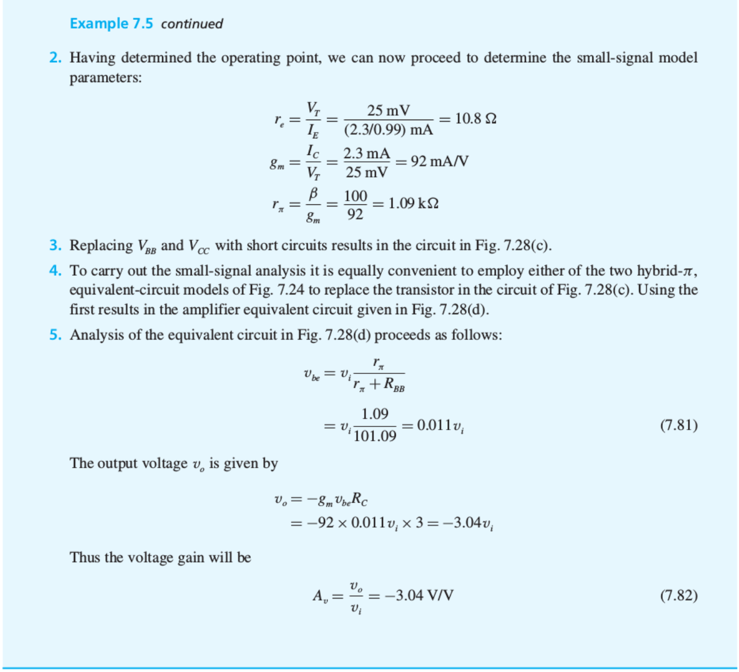

Slide 6
Biasing Needs of NPN and PNP Transistors in Active Modes
Parallel case for PNP.

Slide 7
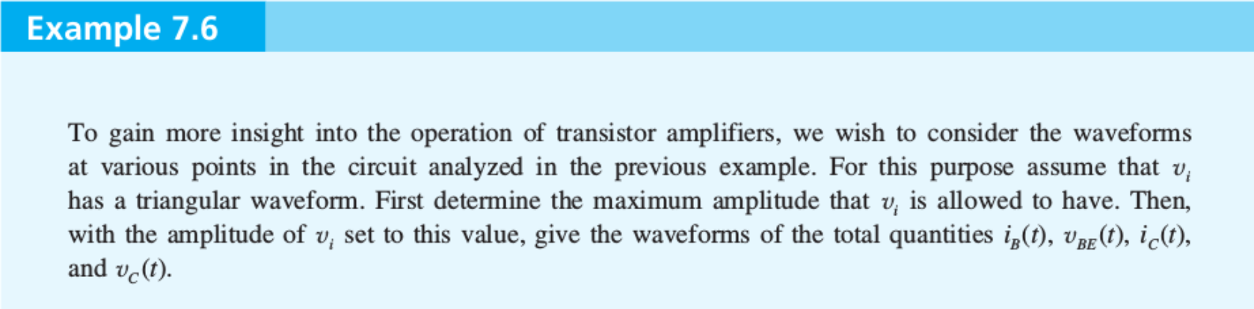
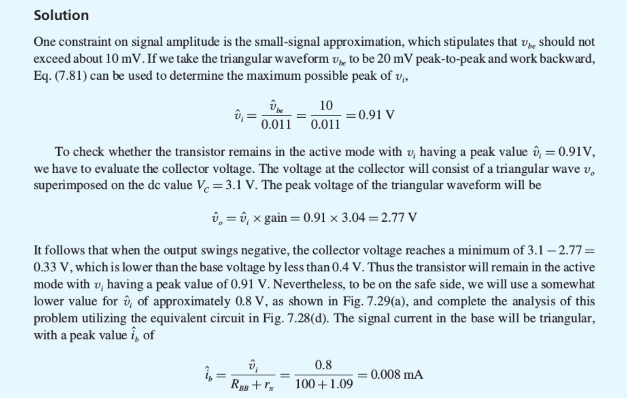

Slide 8
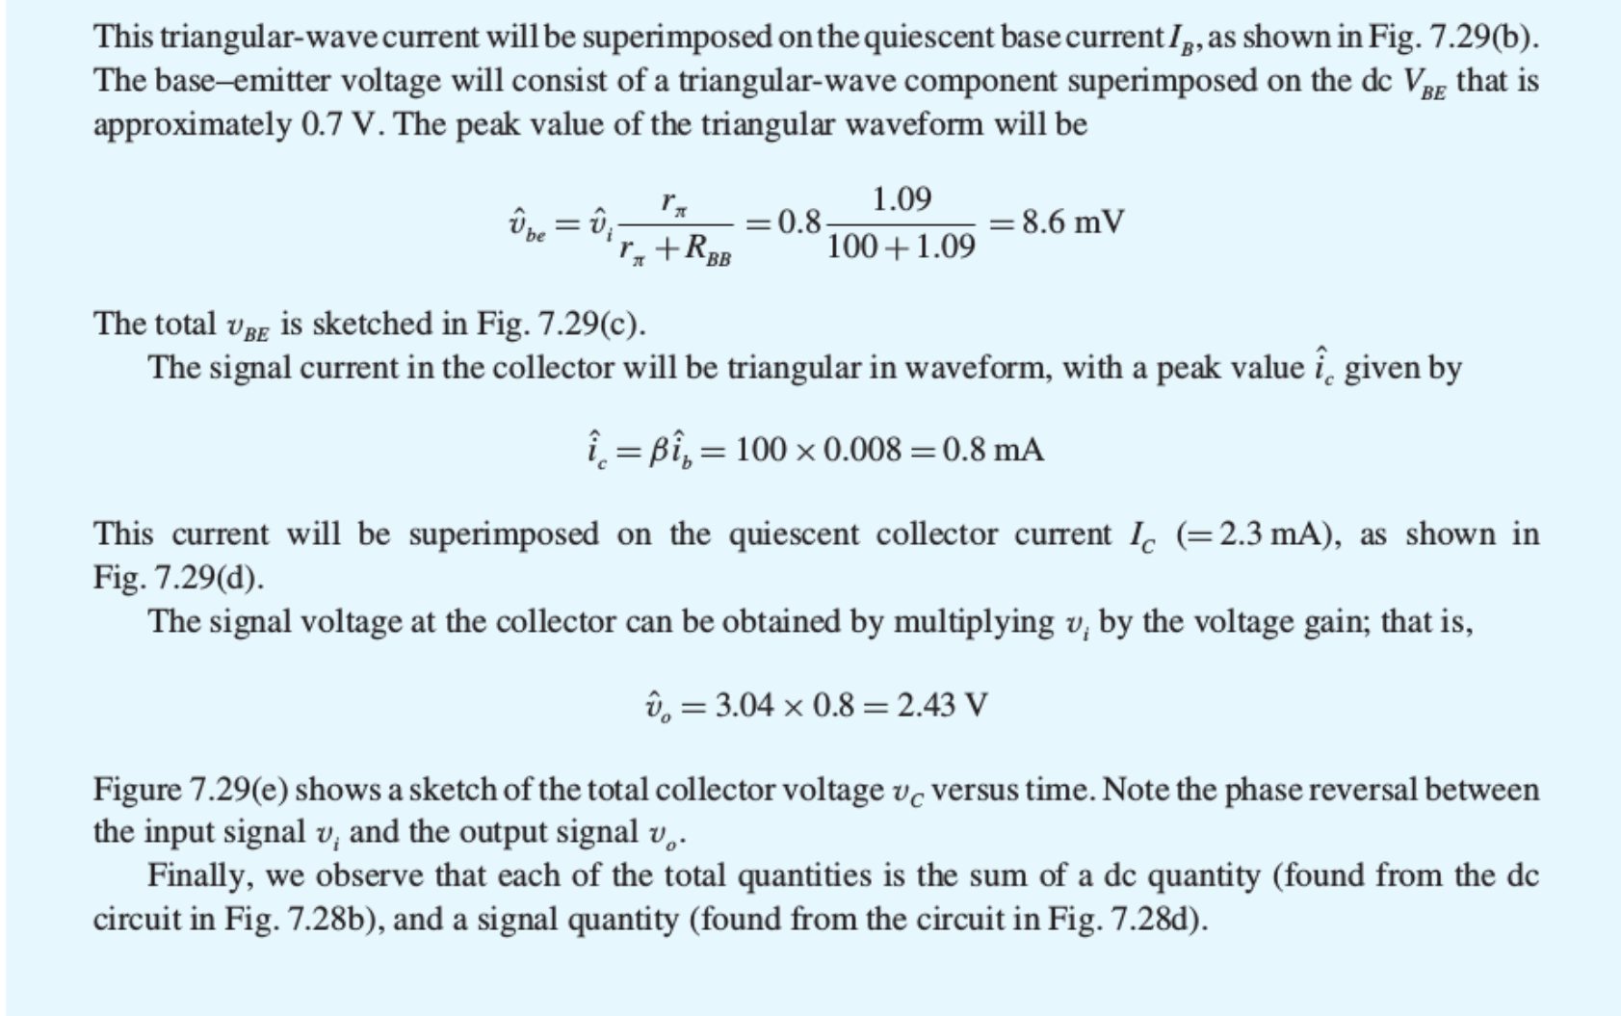

Slide 9
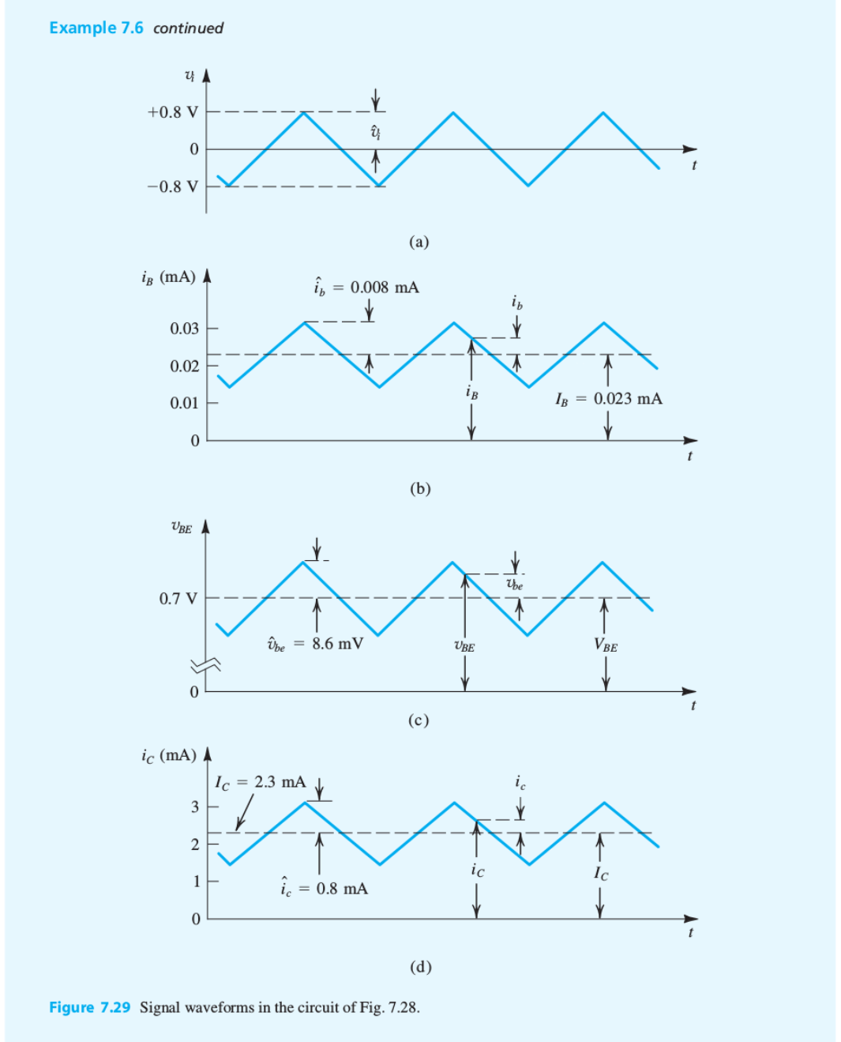

Slide 10
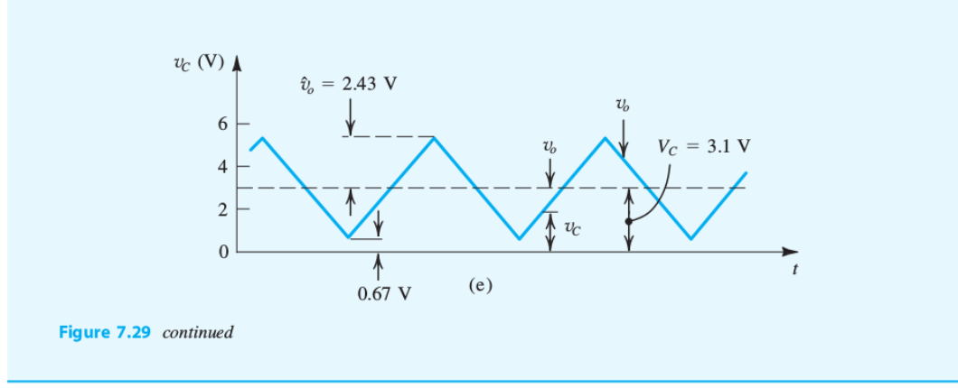

Slide 11
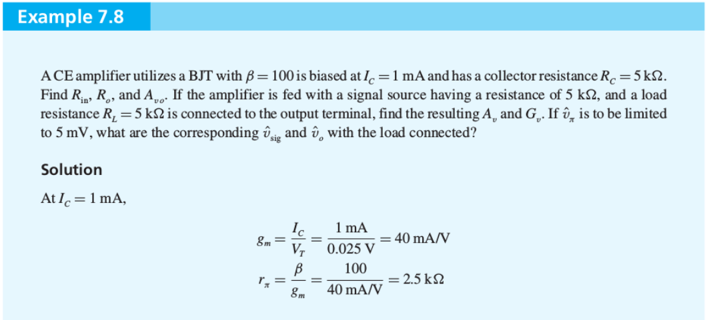
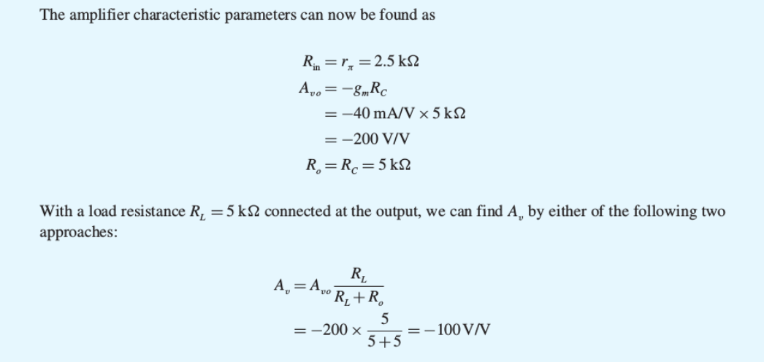

Slide 12
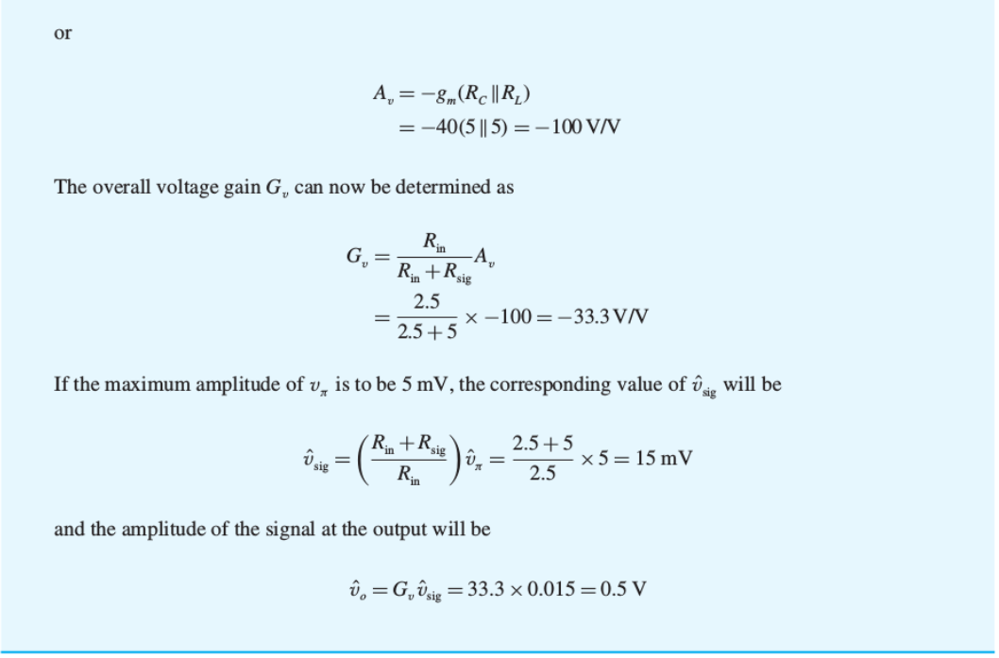

Slide 13
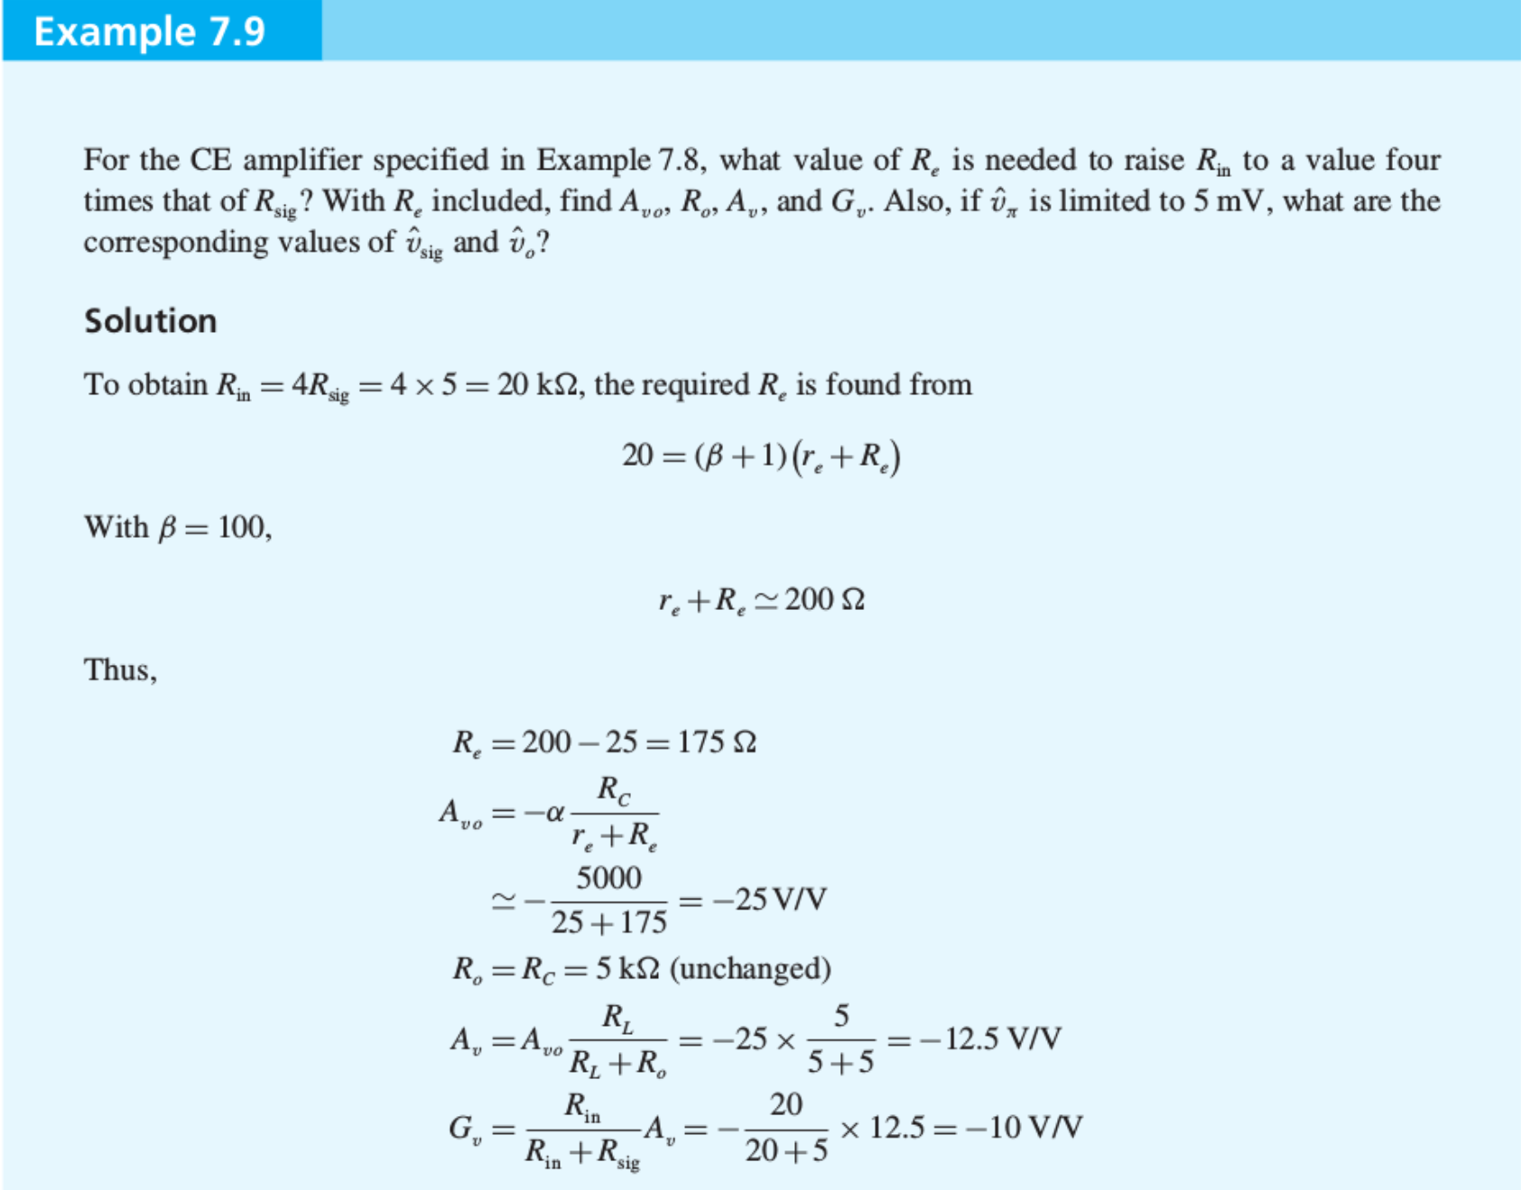

Slide 14
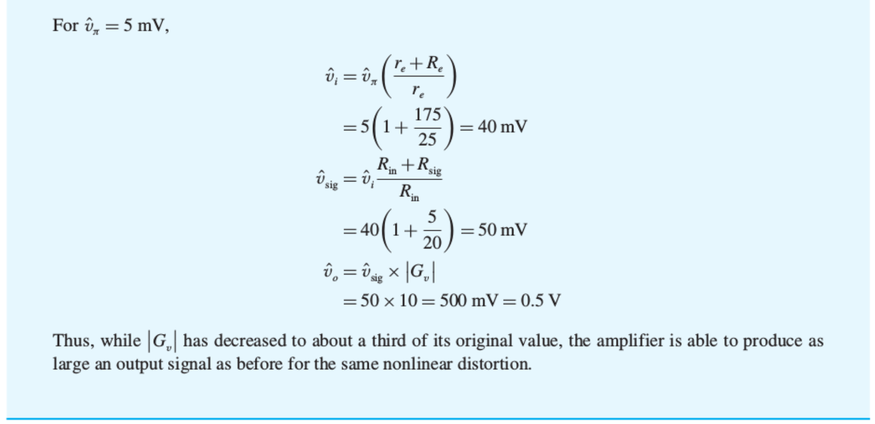

Slide 15
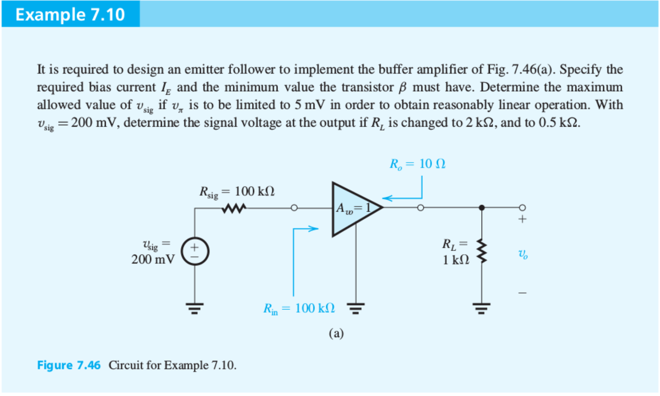

Slide 16
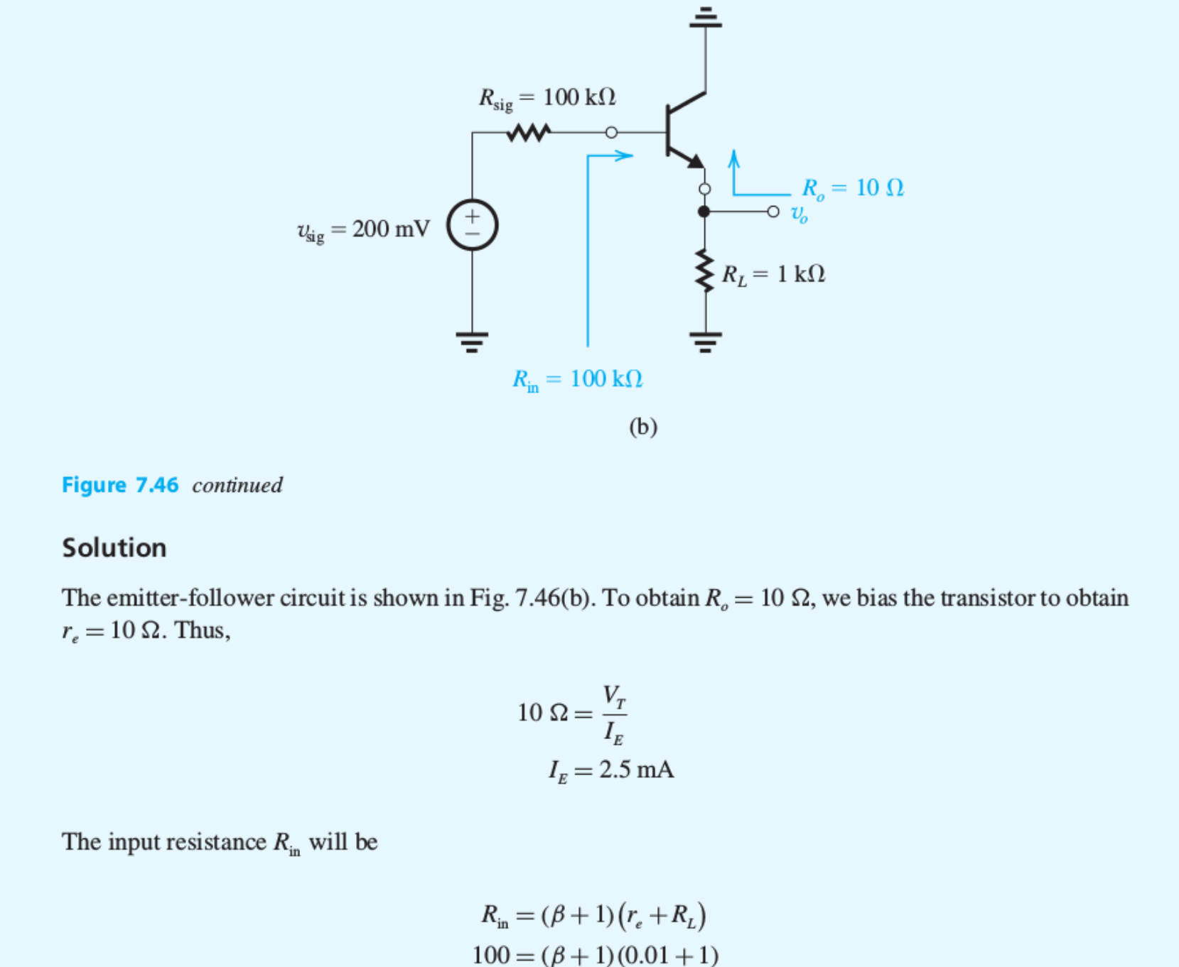

Slide 17
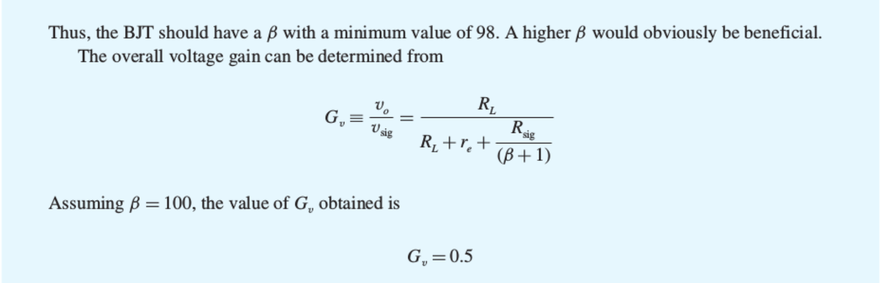

Slide 18
Clicker Question 1 (1 Point)
Why is the emitter follower a good voltage buffer?
It has a high input impedance and high output impedance.
It has a low input impedance and a high output impedance.
It has a high input impedance and a low output impedance.

