Slide 1
ECE 255
Feb 27, 2018 Lecture
Instructor: Weng Cho Chew
Email: wcchew@purdue.edu
Office: 3053 Wang Hall

Slide 2
Key About Linearization
Convert a nonlinear system into a linear system.
Linear systems are a lot easier to solve.
They can be solved by casting the equations into a set of linear algebraic equations.
These linear algebraic equations, even then they are large having many variables, can be solved by a computer.
Hence, commercial software, such as SPICE, have been developed to address the solutions of such large linear systems.

Slide 3
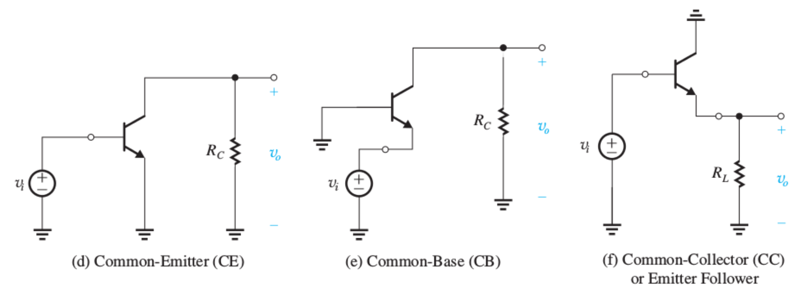
Three Basic Configurations--BJT
Common emitter amplifiers.
Common base amplifiers.
Common collector amplifiers of emitter follower.

Slide 4
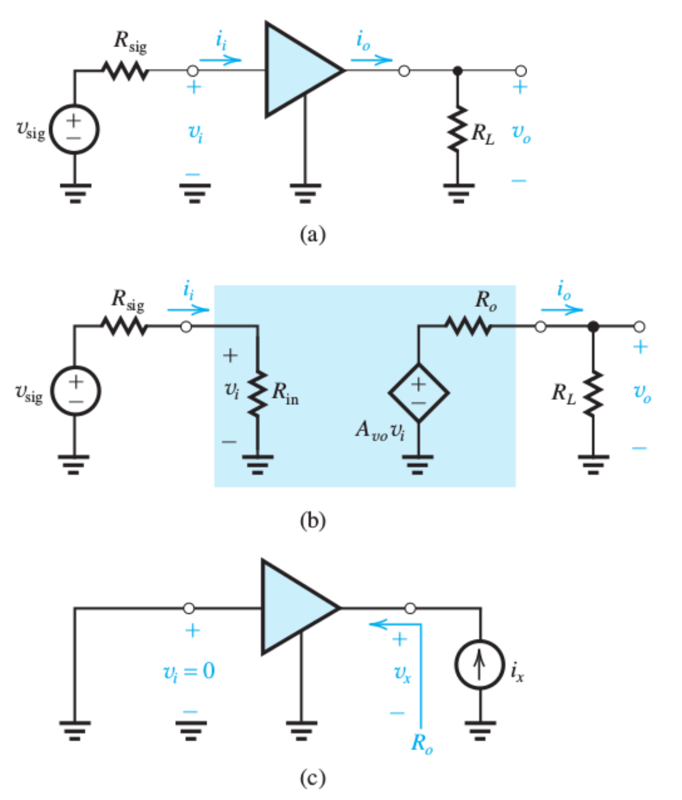
Characterization of an Amplifier

Slide 5
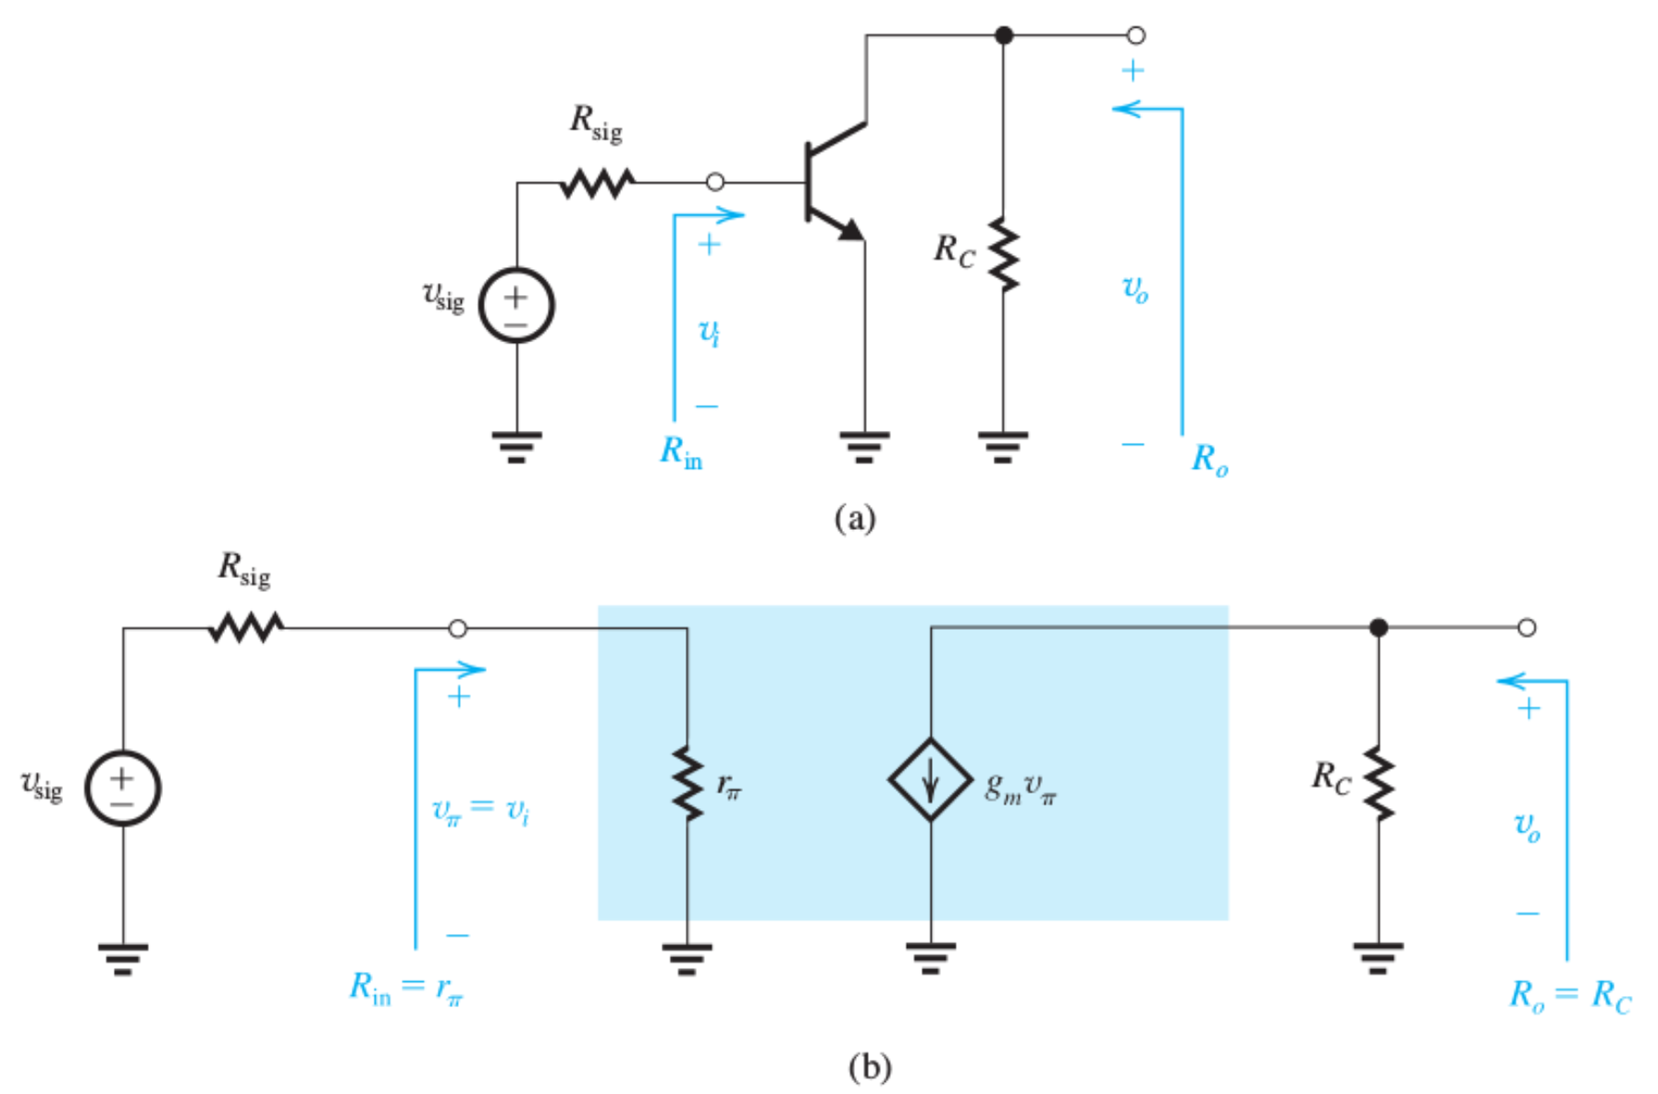
Common Emitter Amplifier

Slide 6
Characteristic Parameters

Slide 7
Final Remarks on CE Amplifier

Slide 8
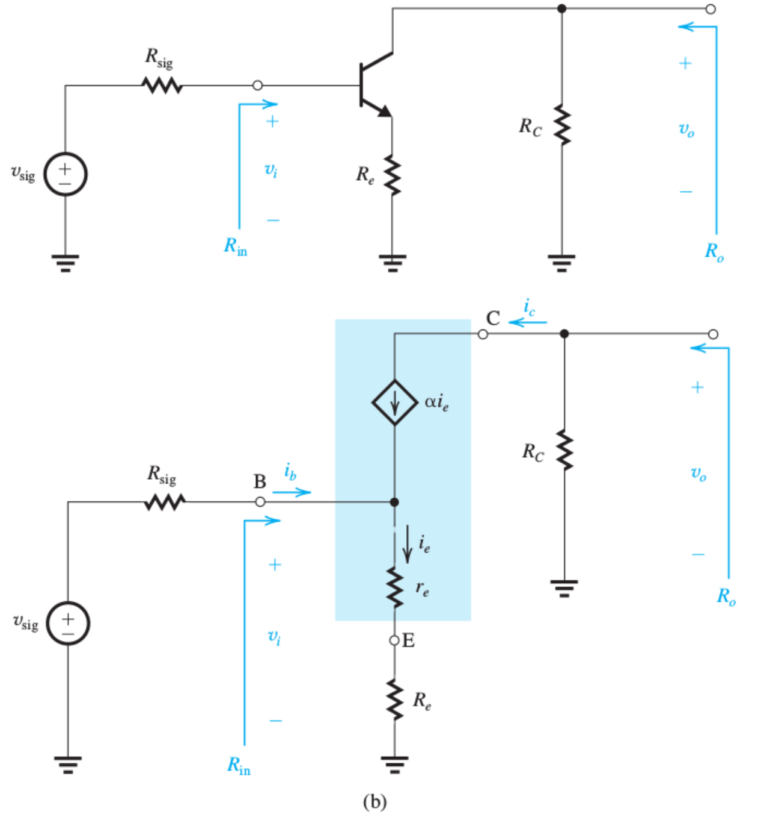
CE Amplifier with Emitter Resistance

Slide 9
CE with Emitter Resistance Contd.

Slide 10
CE Amplifier more…

Slide 11
Emitter Resistance Improves Linearity

Slide 12
Summary of CE Amp. w/ Emitter Resistance

Slide 13
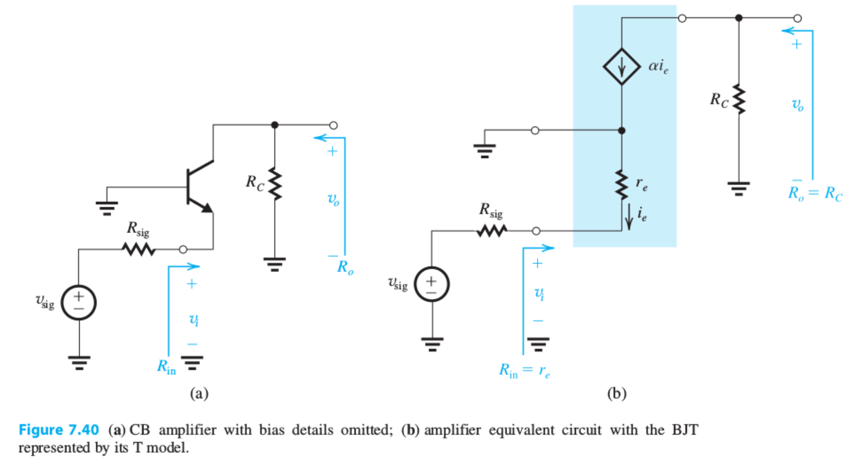
Common-Base (CB) Amplifier

Slide 14
CB Amplifier, Contd.

Slide 15
Summary of CB Amplifier

Slide 16
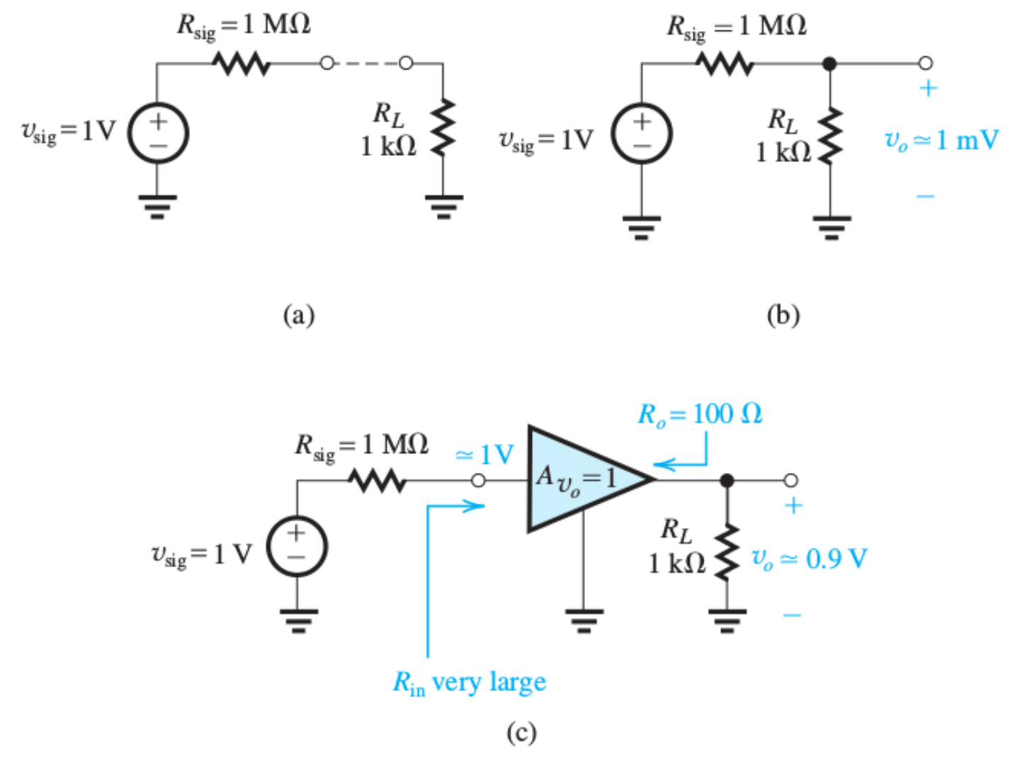
Use of a Unity Gain Amplifier

Slide 17
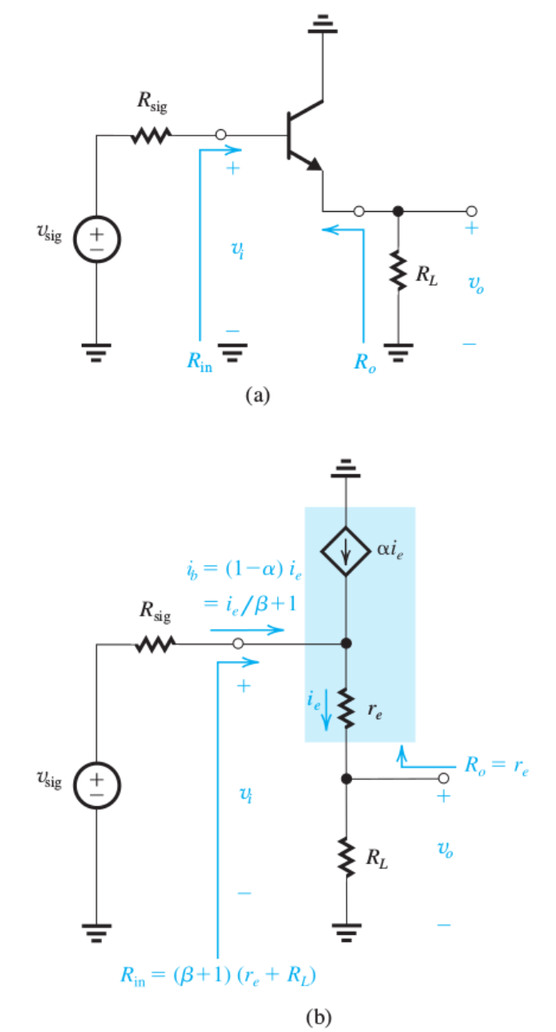
Common Collector Amplifier (Emitter Follower)

Slide 18
Emitter Follower (Common Collector)
Voltage buffer and a common collector amplifier.

Slide 19
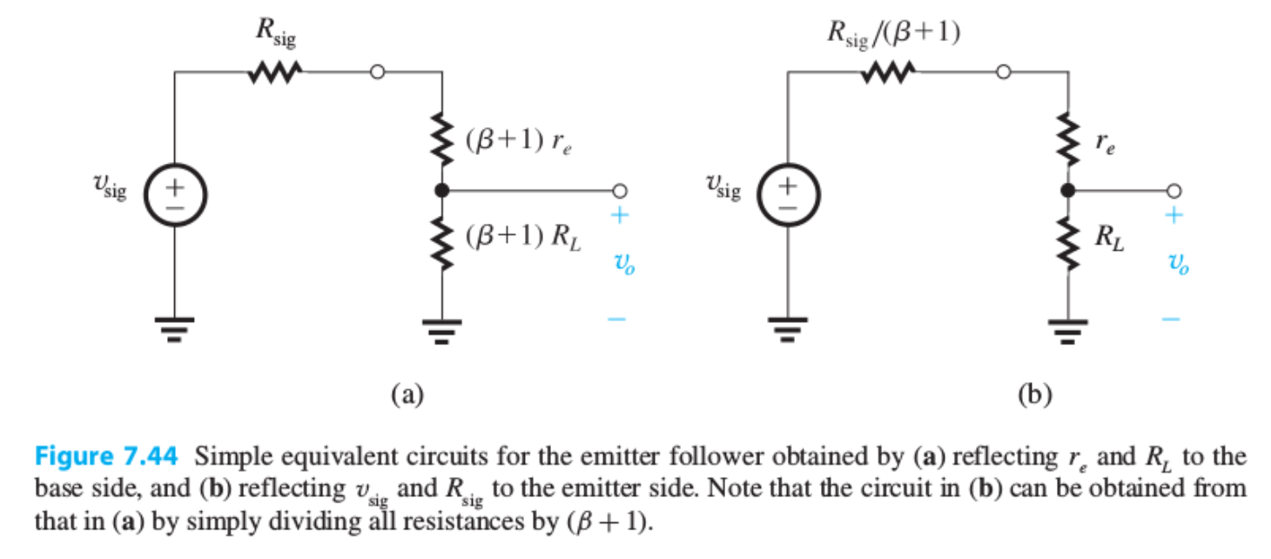
Emitter Follower as a Voltage Divider

Slide 20
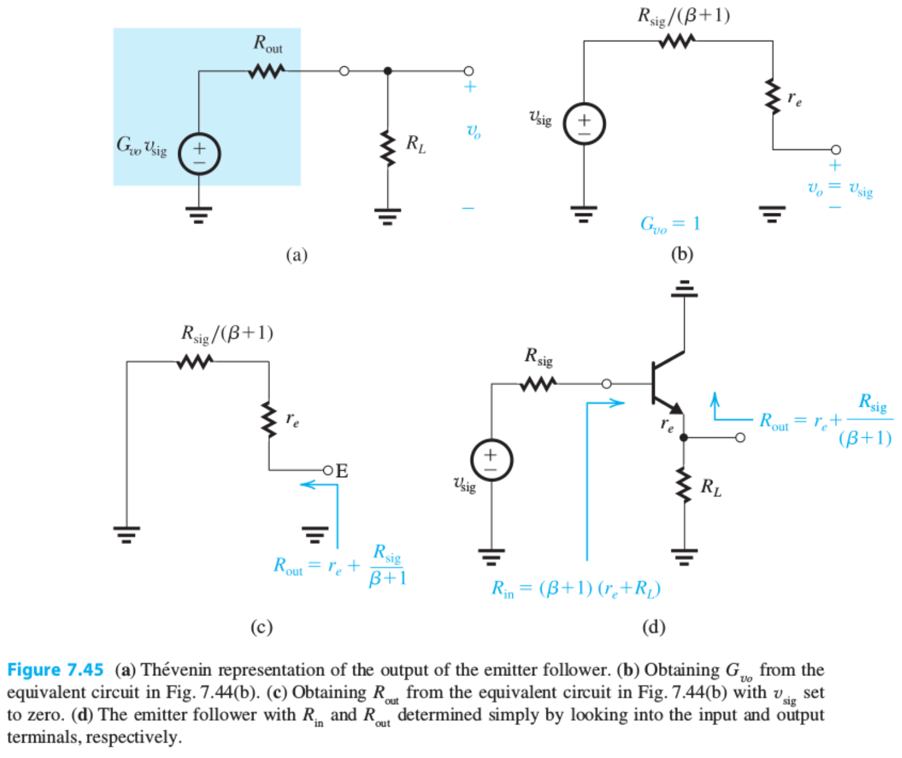
Thevenin Equivalence of Emitter Follower

Slide 21
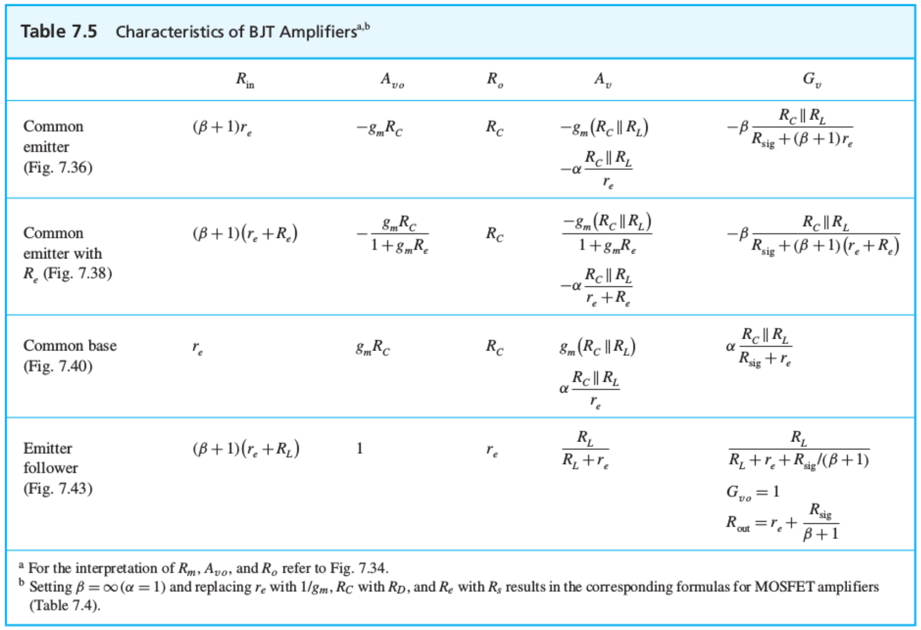
Summary Table

Slide 22
Clicker Question 1 (1 Point)
Of the three basic configurations, which one has the lowest input impedance?
The common emitter amplifier.
The common base amplifier.
The common collector amplifier.

