Slide 1
ECE 255
Feb 20, 2018 Lecture
Instructor: Weng Cho Chew
Email: wcchew@purdue.edu
Office: 3053 Wang Hall

Slide 2
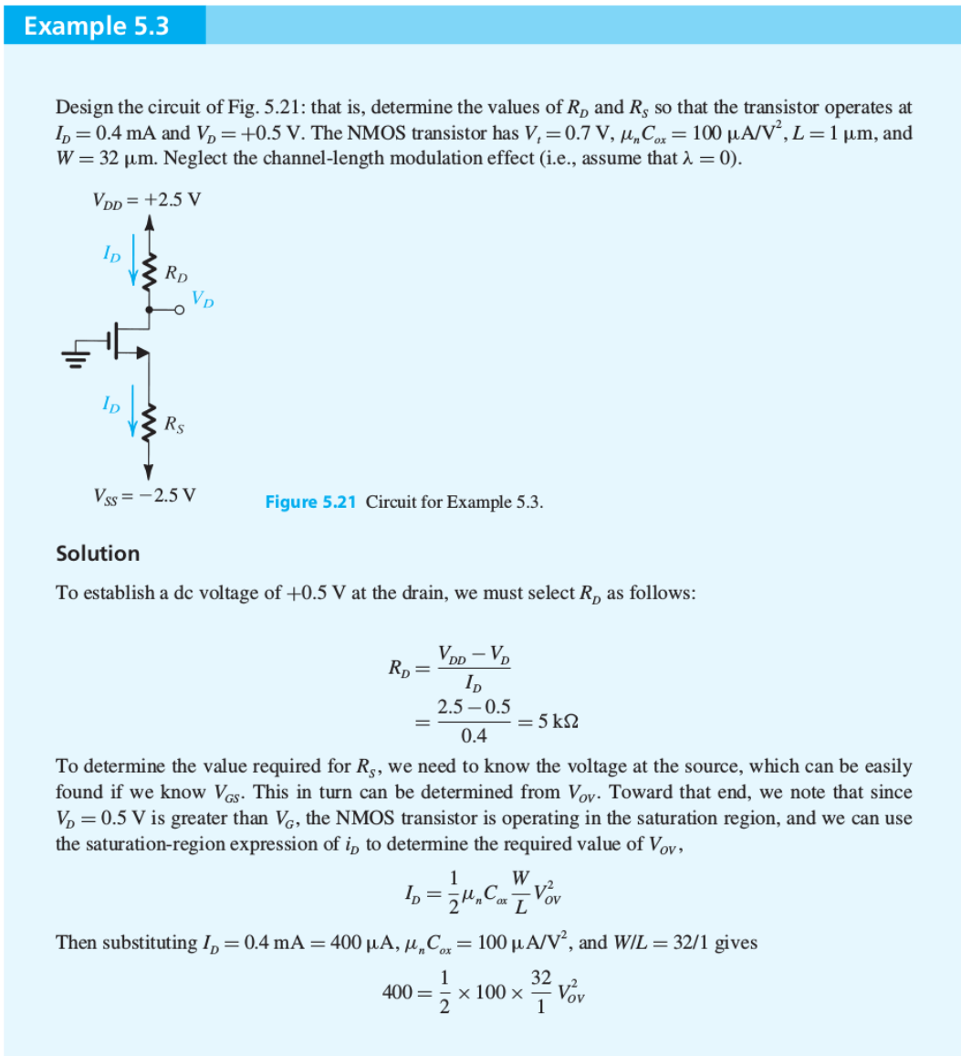

Slide 3
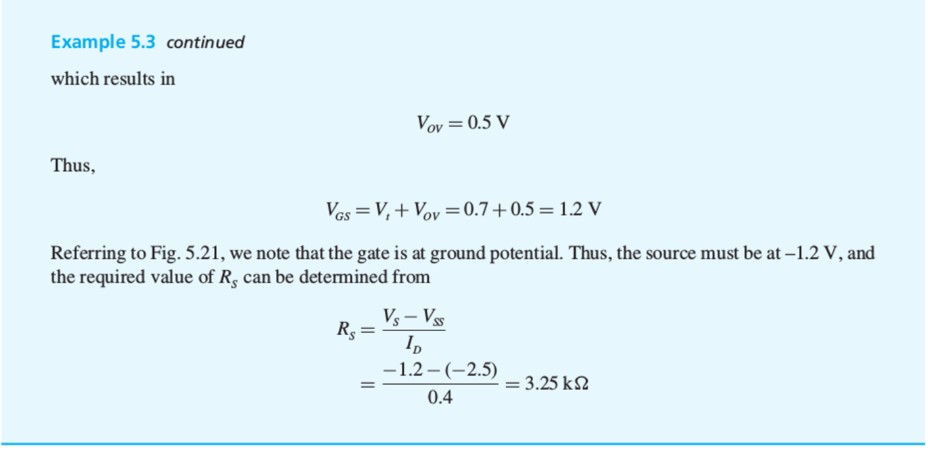

Slide 4
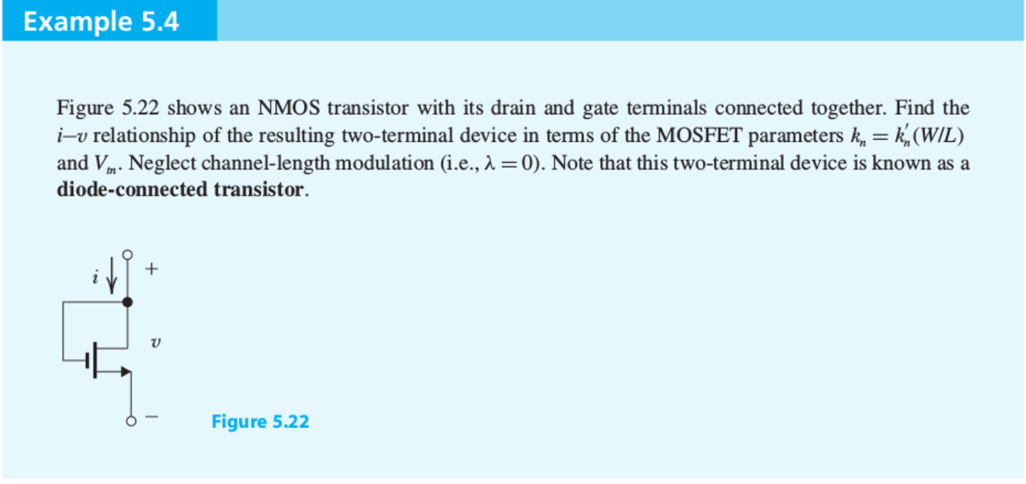
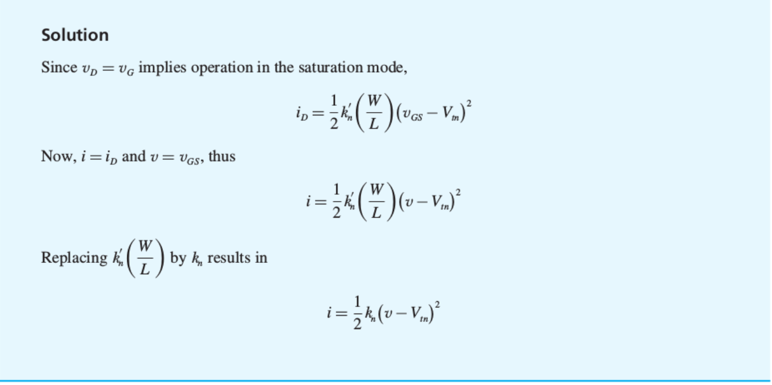

Slide 5
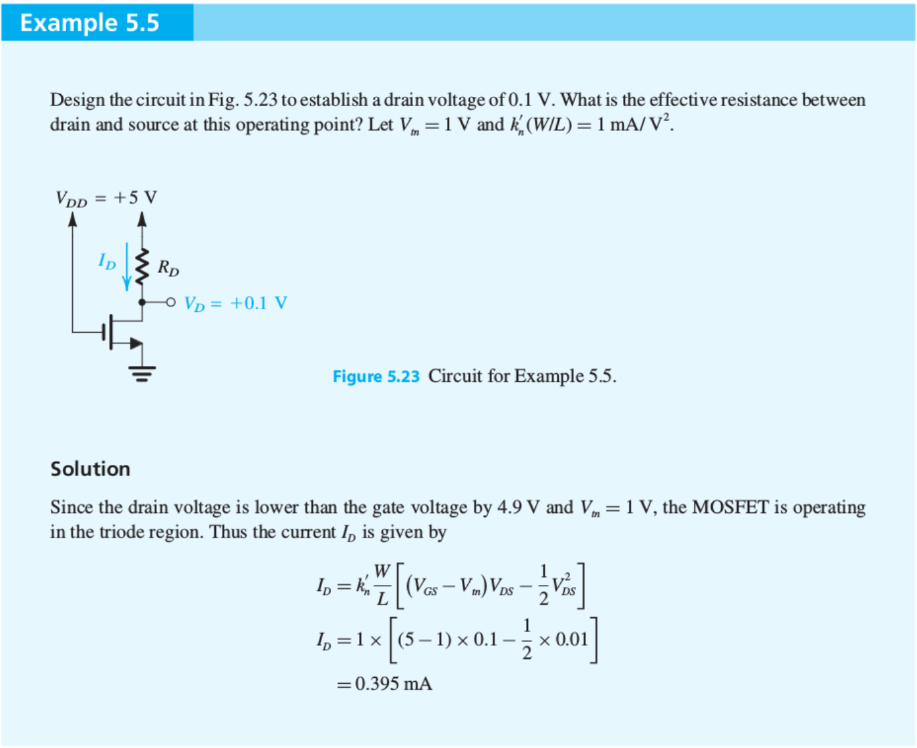

Slide 6
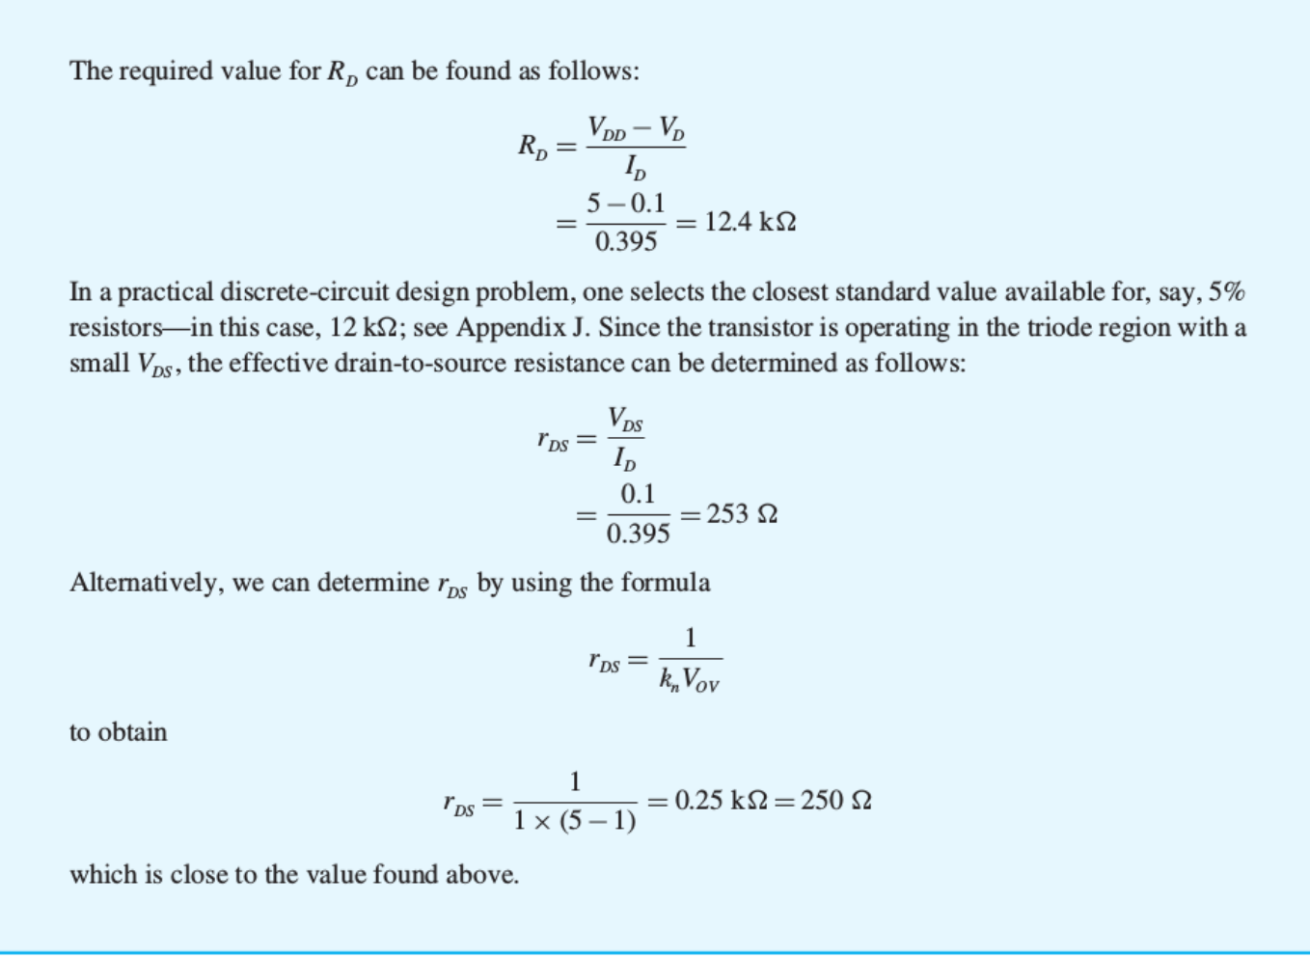

Slide 7

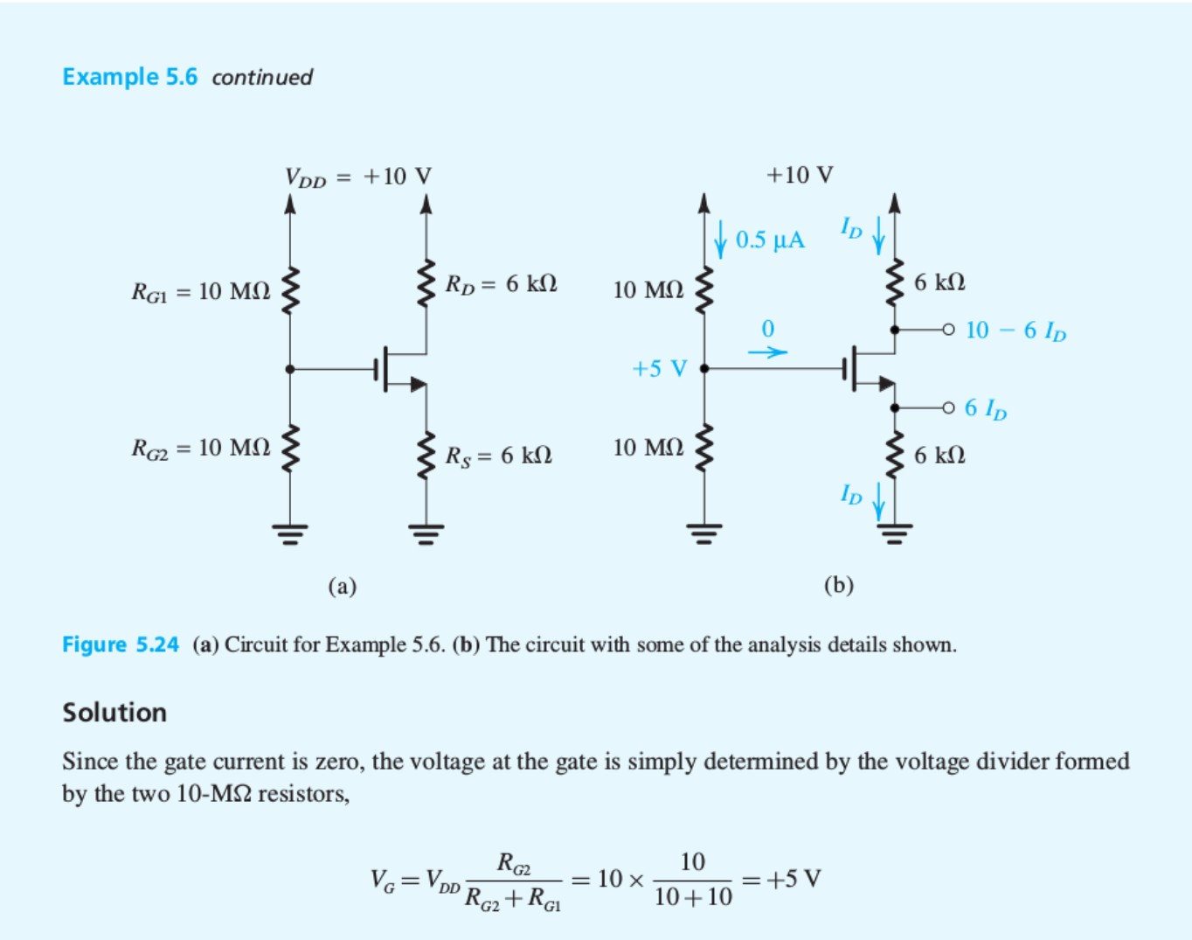

Slide 8
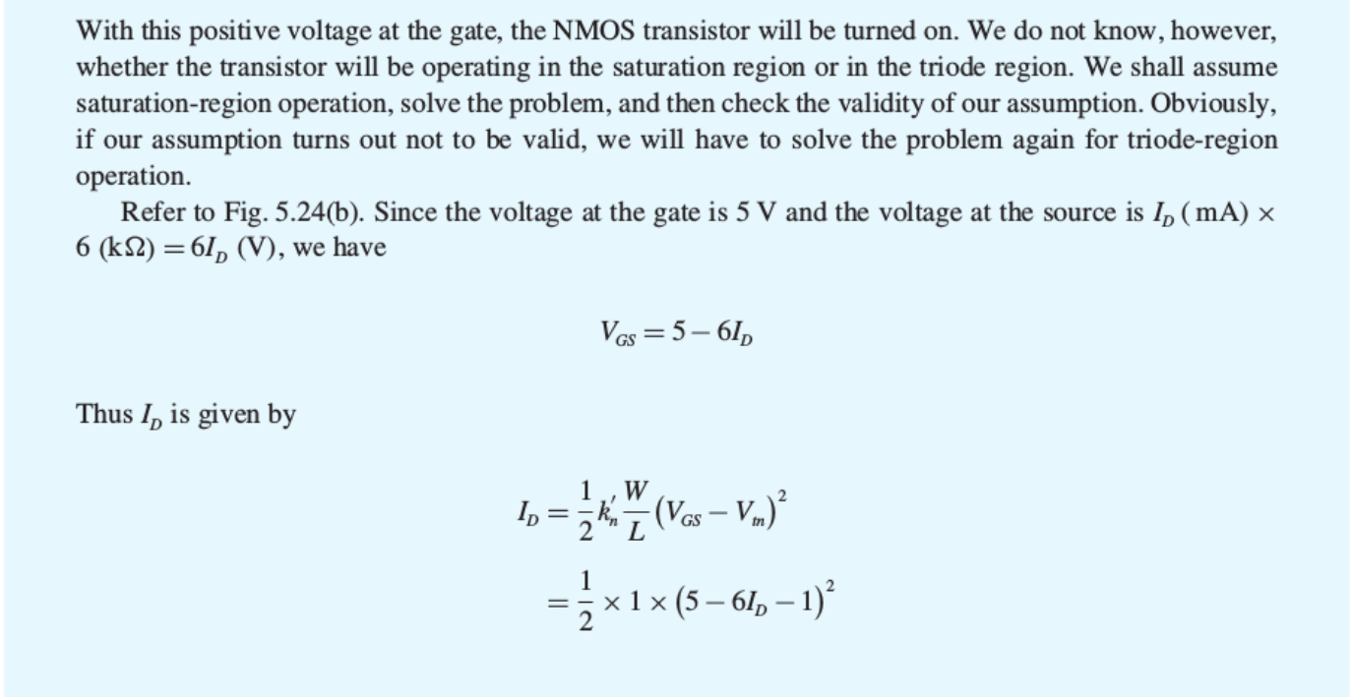
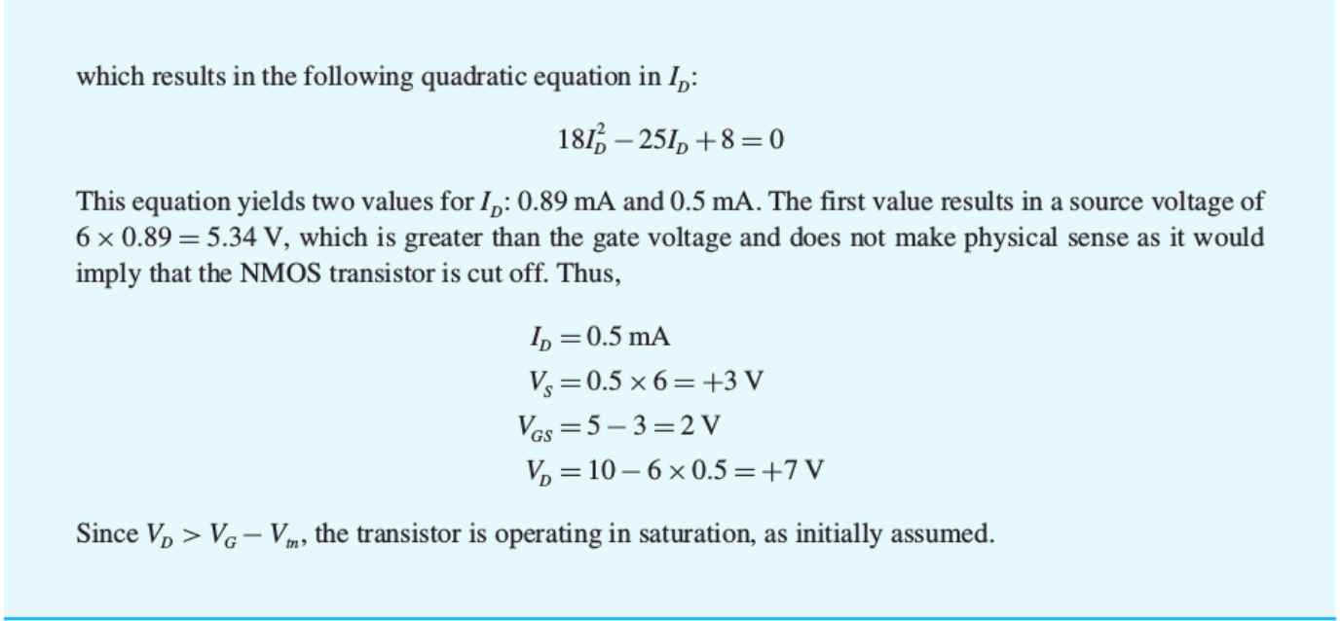

Slide 9

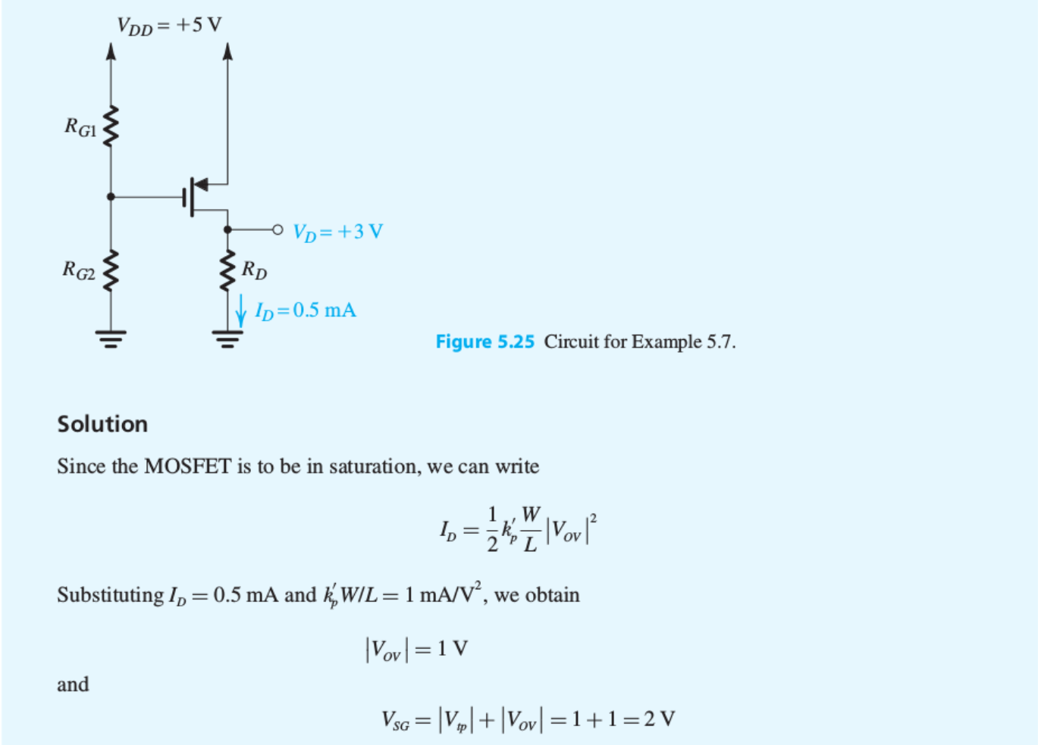

Slide 10
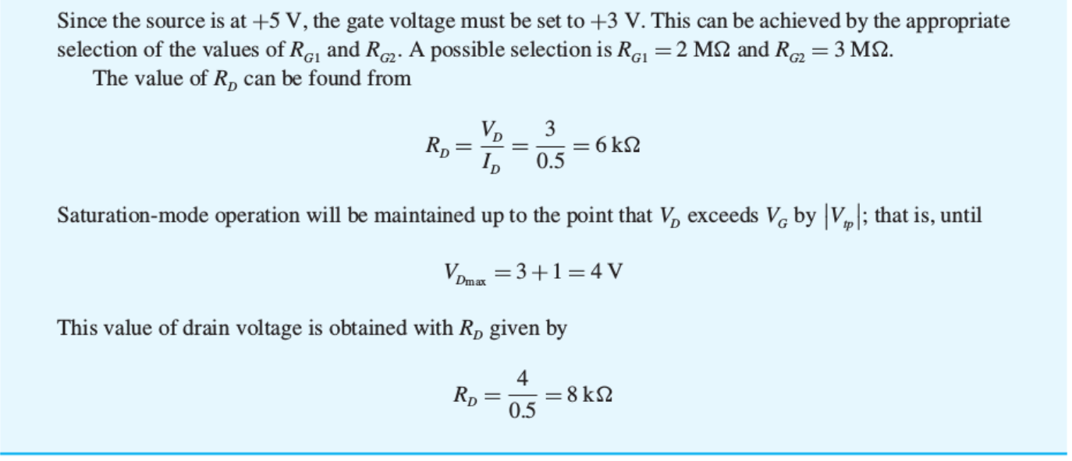

Slide 11
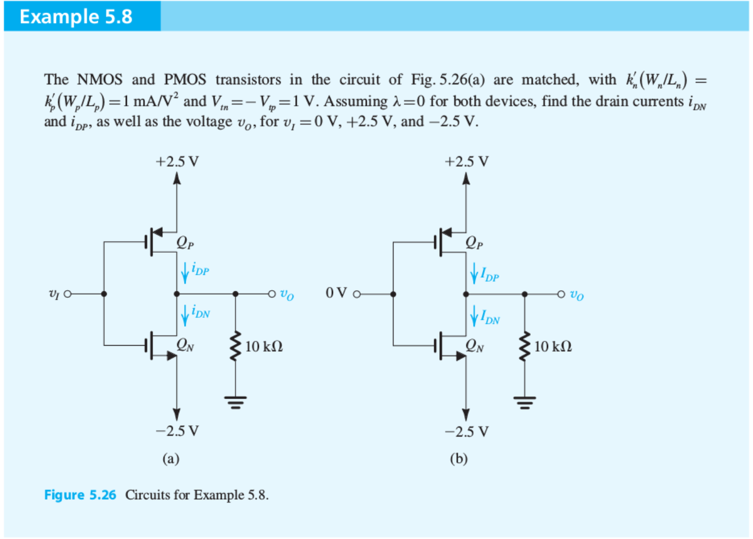

Slide 12
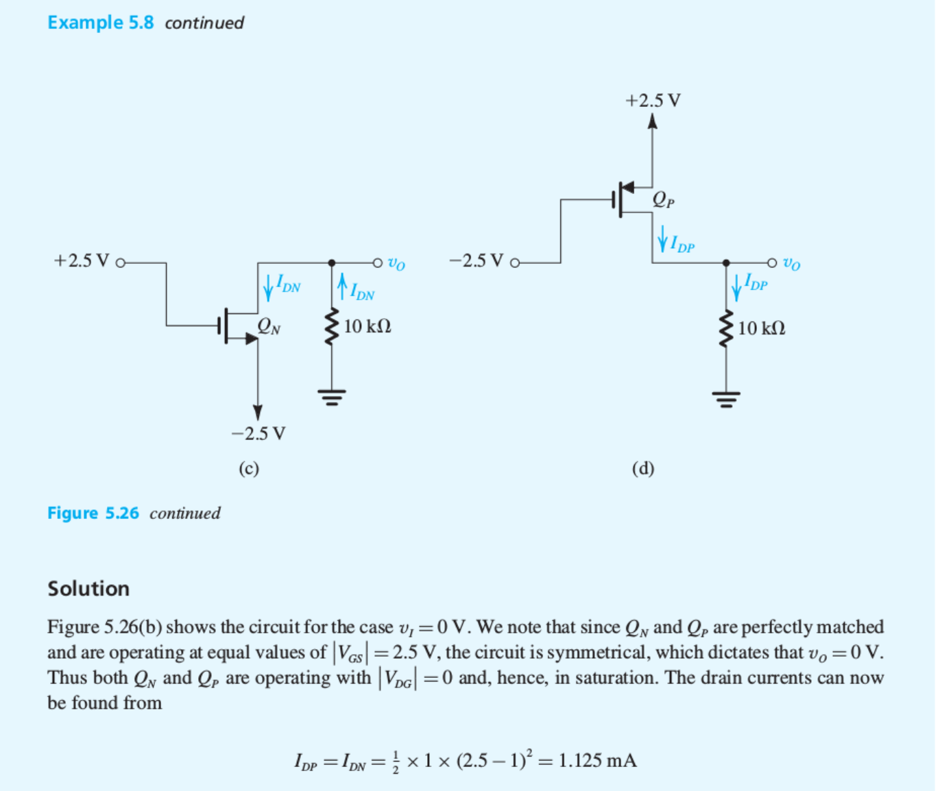

Slide 13
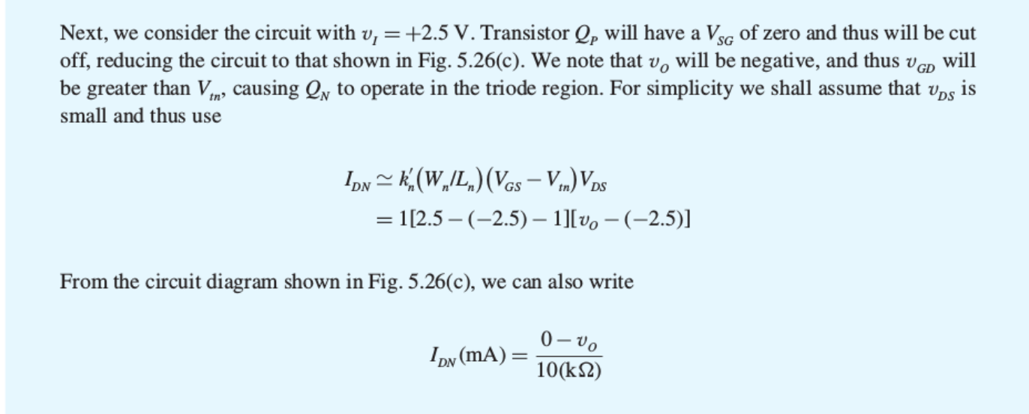


Slide 14
Clicker Question 1 (1 Point)
Why is the study of MOSFET at DC important?
Pick the most important answer.
How to bias the MOSFET in the operating regime
How to supply power to MOSFET
To get the MOSFET in the OFF mode

