Slide 1
ECE 255
Feb 8, 2018 Lecture
Instructor: Weng Cho Chew
Email: wcchew@purdue.edu
Office: 3053 Wang Hall

Slide 2
Current-Voltage Characteristics of MOSFET
Circuit Symbols
Device Structure
(reminder)

Slide 3
Other Prevailing Circuit Symbols
Bulk=Body

Slide 4
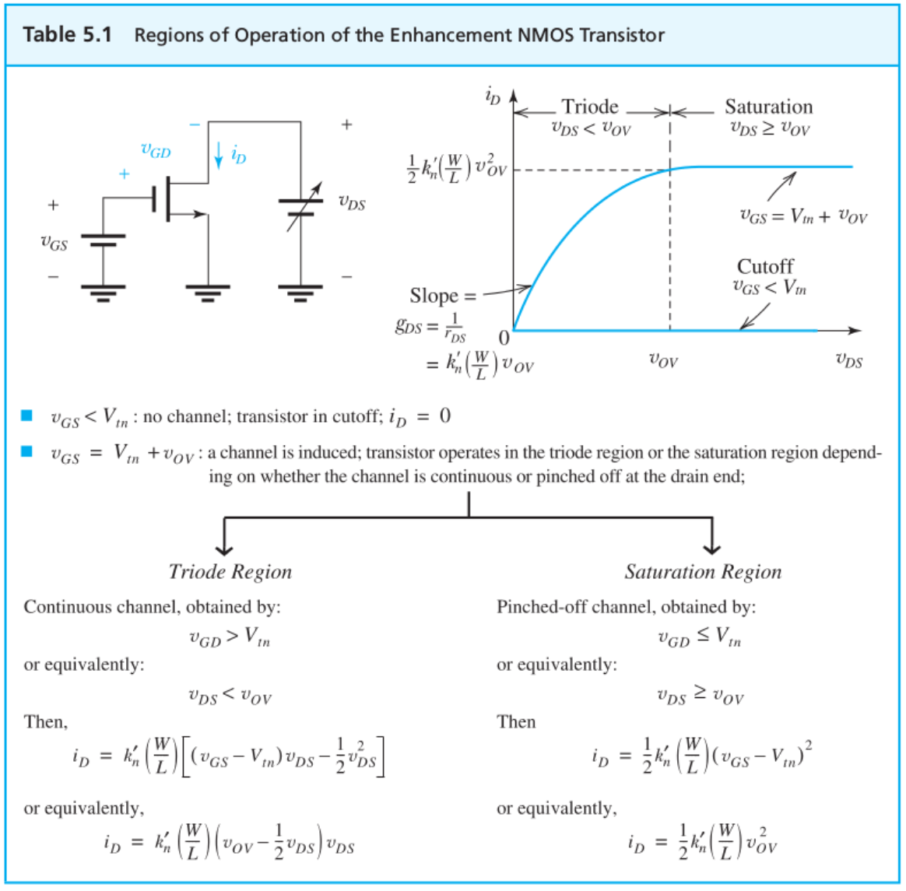

Slide 5
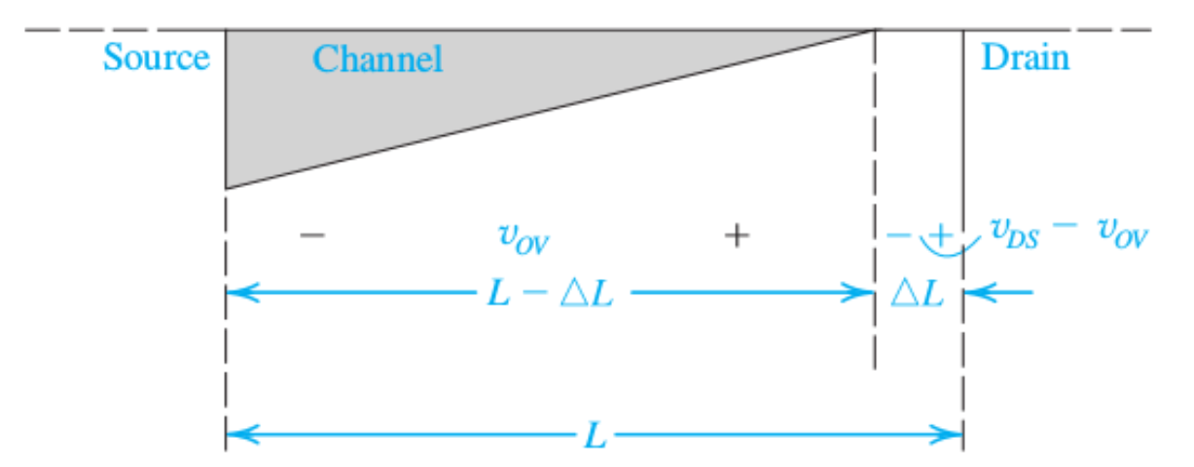
Channel Region In Saturation

Slide 6
Reminder Slide: Channel Just Entering Saturation and Triode Region
Entering Saturation
Triode Region

Slide 7
Different Regimes of Operation

Slide 8
I-V Curves for Different V_{OV}

Slide 10
i_{D} versus v_{GS} for MOSFET

Slide 11
Equivalent Circuit for MOSFET
BJT for comparison

Slide 13
Early Effect—Finite Output Resistance

Slide 14
Some Math

Slide 16
Equivalent Circuit to Account for the Early Effect

Slide 17
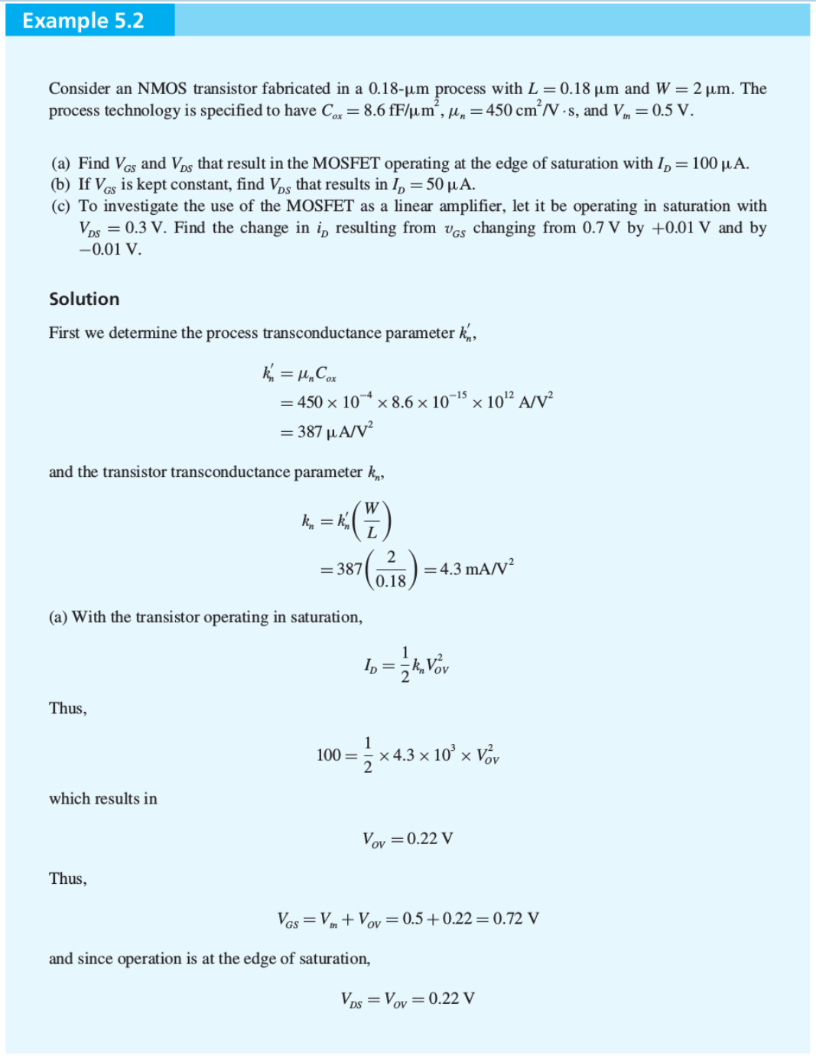

Slide 19
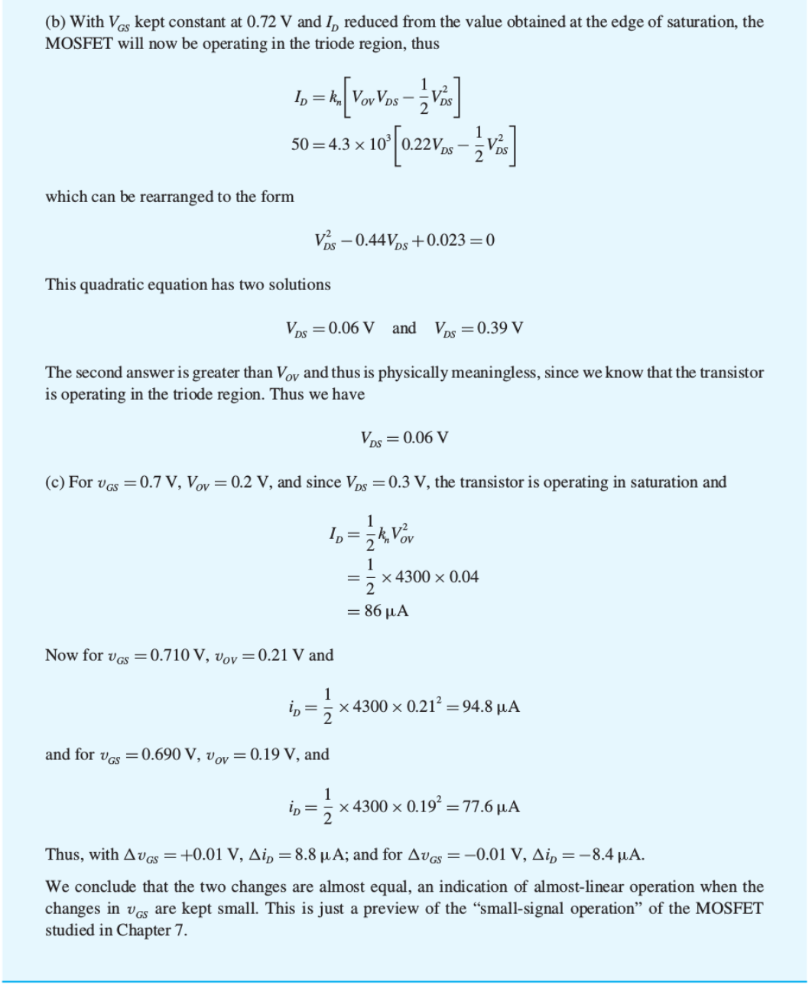

Slide 21
Clicker Question 1 (1 Point)
A MOSFET is less linear than a BJT because the transistor current i_{DS} is related to v_{GS}
Algebraically and quadratically
Exponentially
Linearly

