Slide 1
Lean Systems Engineering
John Sullivan
Professor – School of Aeronautics and Astronautics
Director - Center for Advanced Manufacturing
Purdue University
Special Government Employee – NASA

Slide 2
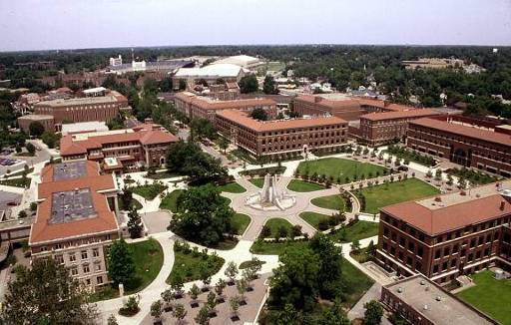

Purdue University

Slide 3
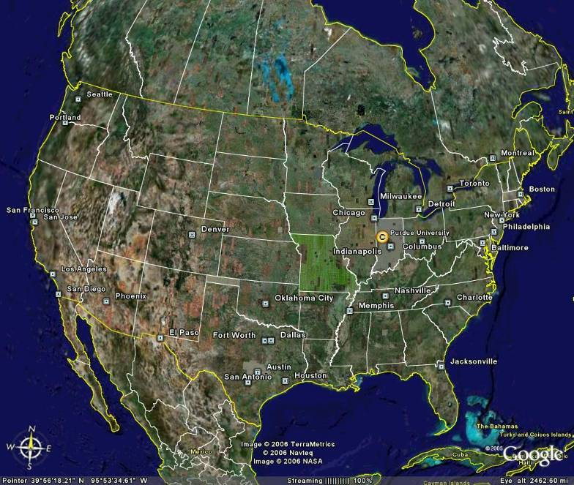

Slide 4
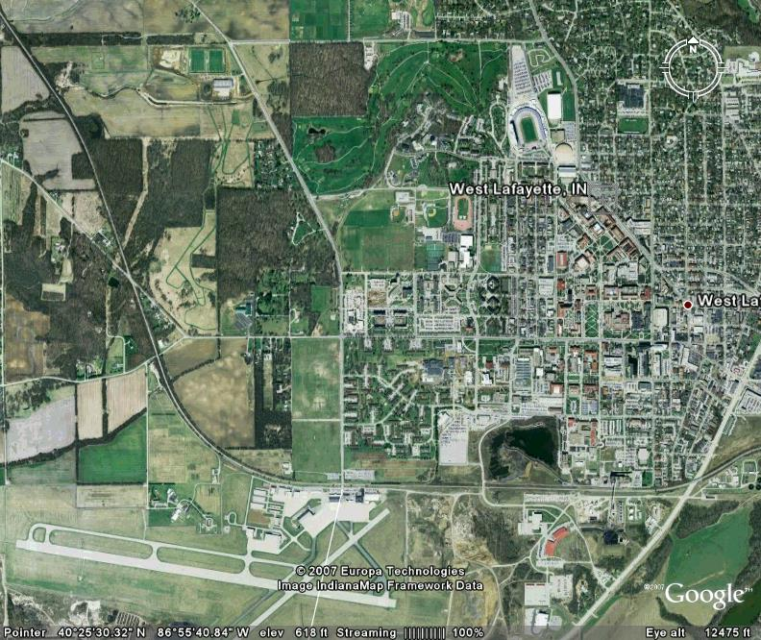

Slide 5

Purdue Facts
Land-grant university
Established in 1869
5 campuses - 68,000 students
3,000 faculty
Main Campus: West Lafayette, IN
  145 buildings
  400 research labs
  2,300 Faculty
  38,847 students
  7,996 graduate students
  60 programs
Budget ~$1 B/year
Research support expenditures
  $350M/year

Slide 6
School of Aeronautics and Astronautics

Slide 7
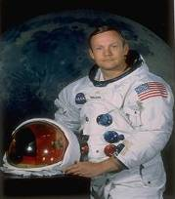
Purdue has had 22 alumni selected for space flight. Purdue astronauts include the first man to set foot on the moon, Neil A. Armstrong, and the last to leave it, Eugene A. Cernan
Amelia Earhart’s Lockheed Electra
flying laboratory was outfitted in Purdue’s Hangar 1.

Slide 8
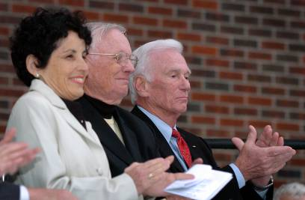
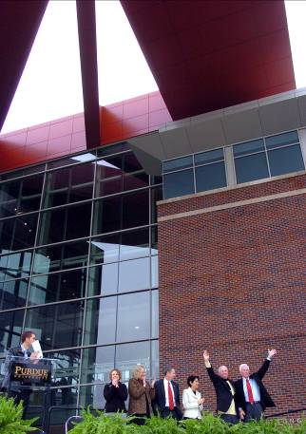
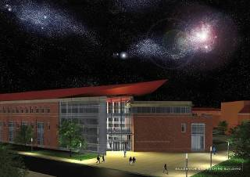
Neil Armstrong Hall of Engineering
Dedicated October 27, 2007
President Cordova Neil Armstrong Eugene Cernan

Slide 9
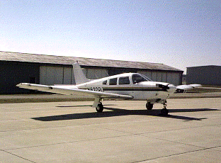
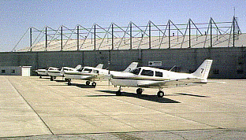
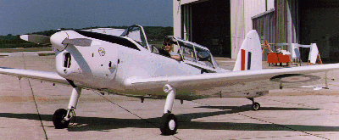
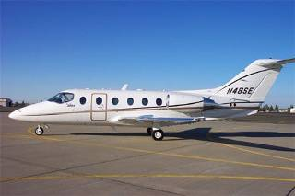
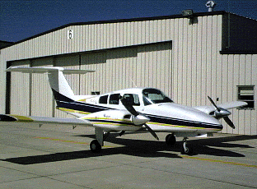
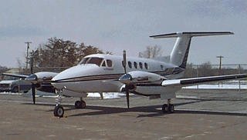
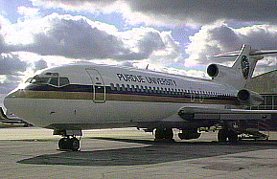
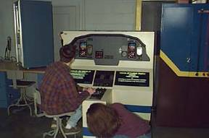
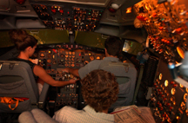

Slide 10
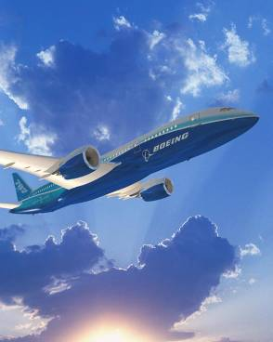
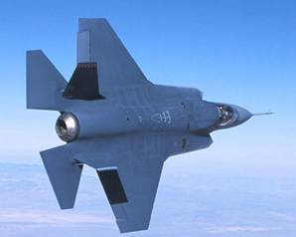
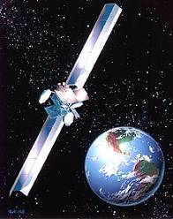
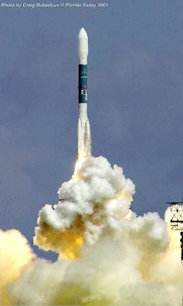
Mission: To prepare men and women to be leaders in Aerospace Engineering by providing exceptional educational and research programs
Purdue AAE graduates have leadership roles in many areas of aerospace engineering
  Presidents and VPs of major aerospace entities; NASA Center Directors; Chief Scientists and Chief Engineers; Program Directors and Lead Engineers
More than 7000 total alumni

Slide 11
Major Spacecraft Subsystems and Space Mission Features
Orbit Design
Launch Vehicle
Systems
Navigation
Design
Operations
Concept

Slide 12
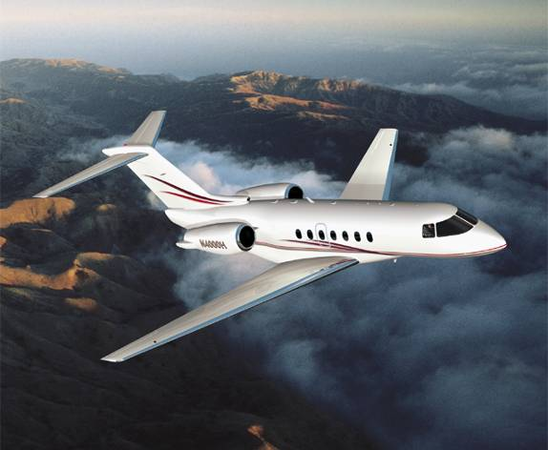
Major Aircraft Subsystems and Mission Features
Propulsion
Aerodynamics
Structures and Materials
Sensors
and actuators
Flight mechanics
and controls
Design
Air Traffic
Management
Safety
Maintainability

Slide 13
450 Undergraduates
250 Graduate Students
26 Faculty
Budget ~$12 Million/year
$7.2 Million External Research Funding

Slide 14


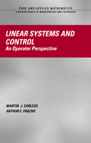

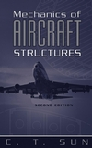



Slide 15
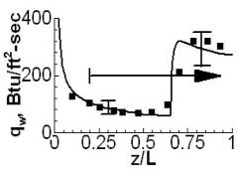
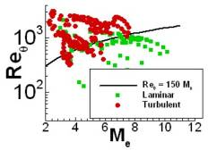
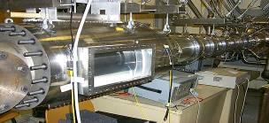
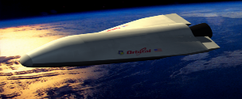
Hypersonic Boundary Layer Transition
S.P. Schneider
Problem
Hypersonics offers potentially revolutionary capabilities
Development ongoing without proper modeling of BL transition
  Current models not suitable for advanced geometries, maneuvering trajectories, hypersonic velocities
Approach
Combine computations with ground and flight tests
Replace 1970’s era empirical correlations with mechanism-
based models
Cooperative National Effort
200% Error
Boeing/AFOSR Mach 6 Quiet Tunnel at Purdue
Reduced risk and development costs for new hypersonic vehicles
  Improved aerodynamic heating models
  Targeted TPS design for weight reduction
  Improved prediction of signatures & C3I performance
  Tailored mission planning

Slide 16
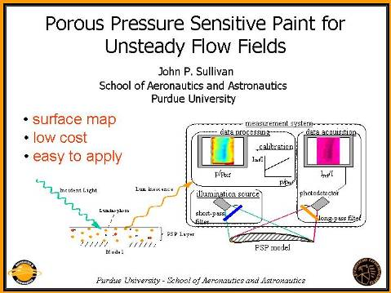
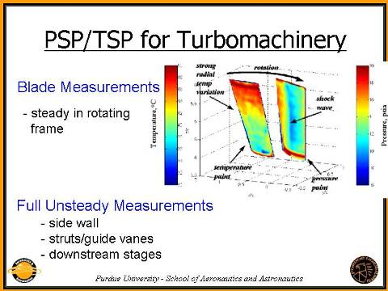
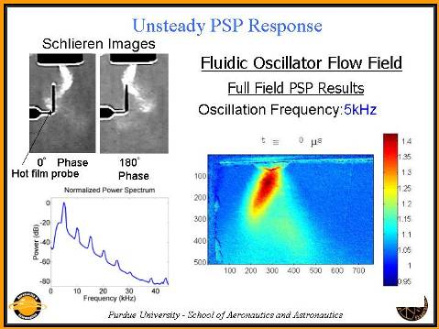
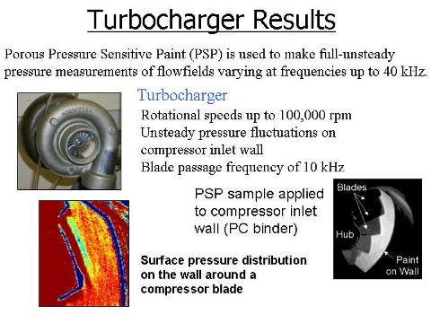

Slide 17
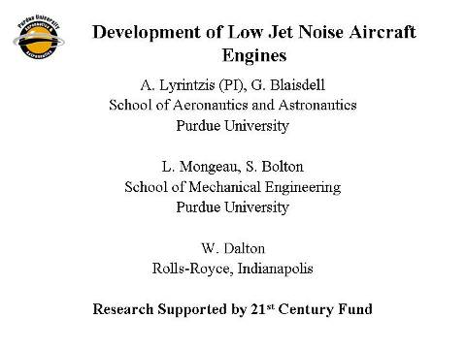
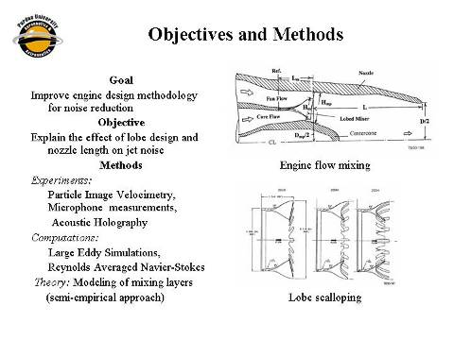
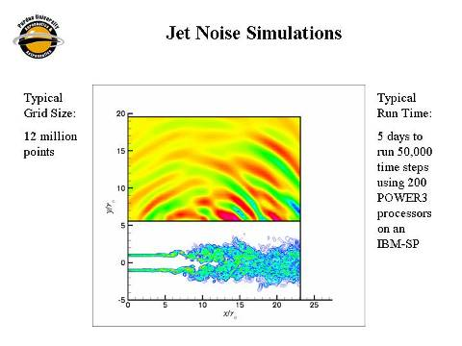
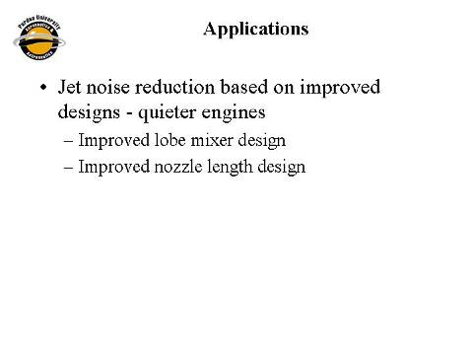

Slide 18
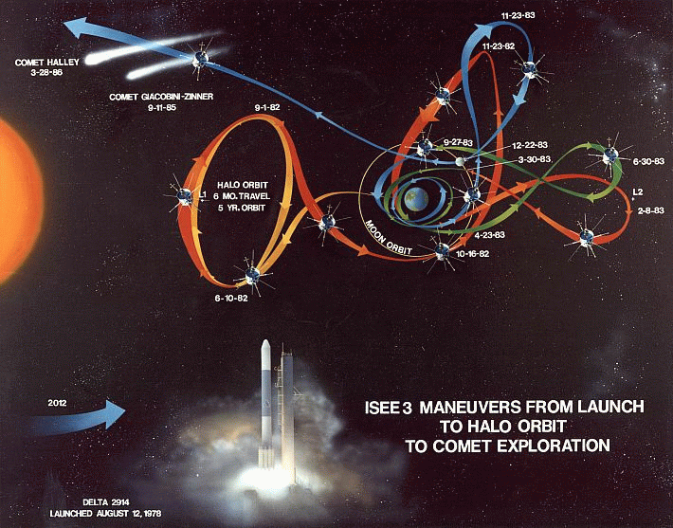
ISEE-3 / ICE

Slide 19
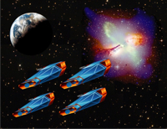
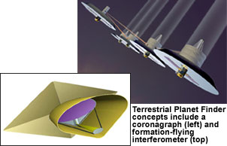
Formation Flying
Terrestrial Planet Finder
Constellation-X

Slide 20
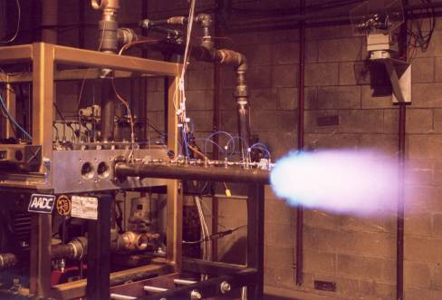
Pulse Detonation Lab
Eagle Talon 16 valve 4 cylinder engine head providing high speed operation capabilities up to 100 Hz
Valve speed controlled by electric motor with variable frequency drive
Ignition timing performed with, encoder, function generator, and automotive racing ignition system
Detonation speed measured by high frequency pressure transducers
Pulsed Detonation Engine Test Stand
15 Hz Air/Ethylene

Slide 21
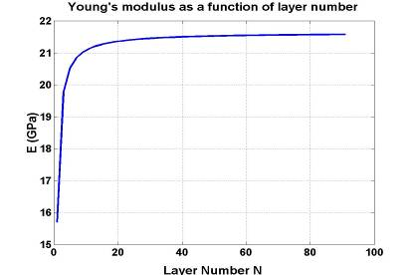

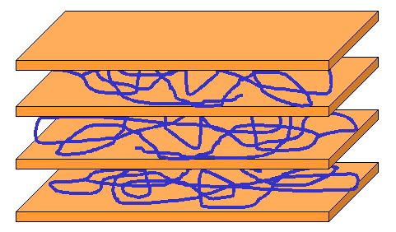
Mechanics of Nanomaterials
C.T. Sun
Modeling of Nanomaterials
Develop efficient models for materials
at nanoscales
Simulate behavior of nanomaterials
Sample Result
Young’s modulus decreases as size
of the material decreases
Use of Nanomaterials to improve
Composite Properties
Currently, nanomaterials such as nanoclay platelets are used to improve the matrix
properties of conventional fiber composites to reduce matrix cracking, and
increase interlaminar fracture toughness and compressive strength of the composite
size
Nanoclay Platelet
Dimension:
length = 0.5 ~ 1 micron,
thickness =1nm
Carbon Nanotube
Modulus: 1 – 2 Tpa, Strength: 50 – 150 GPa
Current: 1 billion amps/sq cm (1000 times of copper)
Heat conduction: twice of diamond

Slide 22
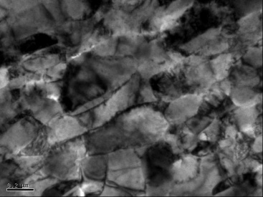

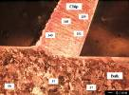
Large Scale Manufacturing of Nanocrystalline Materials
Significant Result
Objective
Develop a low-cost process for producing
nanocrystalline materials in particulate and
bulk forms for discrete product applications
TEM
Image
Hardness (kg/mm²⁾
Method
Chip formation by machining has been
established as a process for producing
metals and alloys with nanocrystalline
structures (NS)
Comminution, Consolidation, and
Composites Processing offer routes for
making bulk forms
200 nm
OFHC
Copper
Iron
1018
Steel
Stainless
Steel
Nickel
Large volume production
Cost ~ $1/lb over cost of raw material
Future Work
S. Chandrasekar chandy@ecn.purdue.edu
W. D. Compton dcompton@ecn.purdue.edu
K. P. Trumble driscol@ecn.purdue.edu
A. H. King alexking@ecn.purdue.edu
T. N. Farris farrist@ecn.purdue.edu
Product applications in ground
transportation, agriculture equipment,
and aerospace sectors.

Slide 23
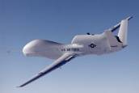
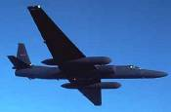
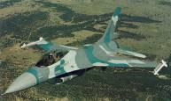
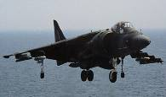
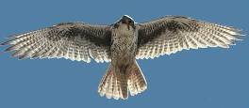
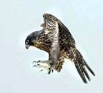
Air Vehicle Morphing- why? sensor to shooter combined
ISR mission:
High altitude, long range / endurance
Attack mission:
High speed dash,
high speed turns
Hunt: soar, observe
Attack: dive, maneuver
Notes:
Military systems use several different types of aircraft and complex information
links to perform missions. One morphing aircraft concept envisions a single
aircraft as both sensor and shooter with reduced complexity in the information
System as well as quick response. This mission does not fit all scenarios but is
one of the types being considered as morphing technology looks for a home.

Slide 24
Boeing / Purdue AAE Morphing Aircraft Research
Morphing aircraft description
Use recent advances in smart materials / adaptive structures to make significant shape changes during flight
Provide new capabilities for military and civilian multi-role aircraft applications
S₁
S₂
S₁
S₁
S₂
S₂
Potential wing area change strategies
Purdue Role (Subcontract to Phantom Works)
W.Crossley, principal investigator
Research expertise in optimization applied to aircraft system design
“Morphing as an Independent Variable” to identify promising technologies and set development goals for these technologies
Office of Naval Research Effort
“Naval Morphing Aircraft Capability and Feasibility Study”
Define high pay-off capabilities for Naval morphing aircraft
Define ability of state-of-the-art morphing technologies to accomplish the defined capabilities

Slide 25
Weight Estimation of Morphing Wing Structures
Objectives
  Credible weight predictions needed for sizing of morphing wing aircraft
  Develop simulation model-based equations that incorporate structural concerns (static loads, aeroelastic loads, etc.)
Approach
  ASTROS to model and predict weight of morphing wing concepts
  Design of Experiments / Response Surface Method to develop parametric morphing wing weight equations
Supported by AFRL Multi-Disciplinary Technologies Center
  AFRL POCs: B. Sanders, M. Blair, Continuing effort through 12/31/03
  Purdue PIs: W. Crossley, T. Weisshaar, currently Directing DARPA Morphing Aircraft Program
Shear element rib and spar models
Aerodynamic paneling

Slide 26
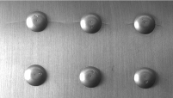







well-characterized
experiments
HKS ABAQUS Brief
in-service
failures
ΔQ
life prediction
local model
of contact
P
P
p(x)
Q
q(x)
Fretting in Aerospace Structures
Materials Processing & Tribology Research Group

Slide 27






AAE 451 Senior Design
End of Undergrad Career
  Spacecraft or Aircraft
Design Options
  Paper Design
  Design, Build, Fly
Engineering Team Work
  Major/Minor Knowledge
  Interdisciplinary Work
http://cartoon.ecn.purdue.edu/~aae451/

Slide 28


Spring 2001 AAE 451 Project
Sentinel UAV student team
Matt Ackerman Craig Hamilton Jeff McCormick Wael Nour
Kacie Burton Mike Jungquist Michelle Nokes Tanya Tuinstra

Slide 29




AAE 490T/590T
Aircraft Design and Build for 2001 World Championships in RC Pattern Aerobatics, the HYPERION
  Team of 5 AAEs, 1 IE, 3 ATs
    Interdisciplinary Work
    High Tech Manufacturing Materials and Methods
    High Quality Demand
Micro Air Vehicle Competition
  Design, Build, and Fly
    Surveillance Aircraft
    Endurance Aircraft
    About 6”-16” in Size

Slide 30

Hyperion Aircraft

Slide 31
Lean Systems Engineering
Lean
Systems Engineering
Lean Engineering

Slide 32


孫子

Slide 33
Large complex Aerospace Projects
Airbus 380
  > two years late
  >2 billion Euros lost, stock dropped 4 billion Euros
Boeing 787
  Two years late
  $2 billion lost
Hubble Space Telescope
  Flawed mirror
  Require Shuttle mission to fix

Slide 34

Delays attributed to the 530 km of wiring
  100,000 wires and 40,300 connectors
Switch from copper to Aluminum wire
Configuration management problem
  German and Spanish Airbus CATIA version 4
  British and French version 5.

Slide 35

Boeing's early production issues fundamentally originated in a lack of oversight on both design and assembly integration for the high level of outsourcing.

Slide 36

Hubble Space Telescope
Systems Engineering Case Study
https://acc.dau.mil/GetAttachment.aspx?id=37600&pname=file&aid=9105&lang=en-US

Slide 37


Slide 38


Optics and Communications System

Slide 39



Slide 40



Mirror Flaw

Slide 41

HST Mission #1
Add Optics to correct for bad mirror Corrective Optics Space Telescope Axial Replacement (COSTAR)
Reduce Vibrations from Solar Panels

Slide 42
Systems Engineering

Slide 43
00:00
30
The
second guide to
Systems
Engineering
Colin A. White | Chief Technology Officer | Enterprise Architect
www.colinwhite.net | whiteca@gmail.com | Dec 08

Slide 44

00:02
Q: What IS Systems Engineering?

Slide 45

00:04
Q: What IS Systems Engineering?
A: there is no universally
accepted definition…

Slide 46

00:06
… but generally accepted to mean
“ A multi-disciplinary approach
to building BIG complex things”

Slide 47

00:08
A prescriptive,
method-oriented
way to
manage complexity

Slide 48

00:10
The Systems Engineering Lifecycle uses rigorous, structured processes

Slide 49

00:12
It has many similarities to the
Project Management Lifecycle
and PMBOK processes.

Slide 50

00:04
Systems Engineering includes factors like cost and risk management

Slide 51

00:16
Specific techniques and methods
vary between industries
(e.g. UML, IDEF0, DFD etc)

Slide 52

Rooted in the 1960s approaches to engineering… but around since the 1940s.
00:18

Slide 53

00:20
Used widely in Aerospace,
Civil Engineering and
Federal Agencies
(particularly NASA and DoD)

Slide 54
00:22
… and also popular with academic institutions

Slide 55

00:24
considered by private industry
to be ‘old fashioned’ and ‘too linear’
and not widely understood.

Slide 56

00:26
The Systems Engineering
lifecycle is very
requirements
oriented…

Slide 57

00:28
… and generally
incompatible with highly iterative, discovery oriented approaches
like Agile development and R&D.

Slide 58

00:30
Main professional body for systems engineers is
INCOSE
founded in 1990.
www.incose.org

Slide 59

System of Systems

Slide 60
What is Lean Manufacturing
Lean is a leading edge manufacturing technology which aims to identify and eliminate or reduce “Lean Wastes” (non value added
activities) in any manufacturing environment (regardless of size or
industry) by using systematic Lean Tools
Waste & Value
Is your
$$$
Wasted?
Lean
Kills
Waste!
Adding Value
6%
Overproduction &
Unutilised Human
Excess Inventory
Resources
22%
10%
Motion
14%
Overprocessing
Waiting
8%
18%
Rework & Repair
Transportation
10%
12%
ADVANCED MANUFACTURING CONSULTANCY SDN. BHD.

Slide 61


Slide 62


Slide 63




What is Sigma
The term "Sigma" is often used as a scale for levels of "goodness" or quality. Using
this scale, "Six Sigma" equates to 3.4 defects per one million opportunities (DPMO).
Therefore, Six Sigma started as a defect reduction
effort in manufacturing and was then applied to
other business processes for the same purpose

Slide 64


Slide 65
Why is
Lean Systems Engineering
Important

Slide 66


Slide 67

Products come to Market much Faster

Slide 69


“…the reason the enlightened prince and the wise general conquer the enemy whenever they move and their achievements surpass those of ordinary men is foreknowledge”
Sun Tzu – The Art of War
Aerospace Systems Design – Spring 2008
Professor T.A. Weisshaar

Slide 70
Product development a few questions
How do new products come into existence?
What is “design” anyway?
What role does analysis play in design?
What is the difference between design and production?
How does analysis and production fit together?
How do we come up with “game-changer” concepts?

Slide 71




Historical experience
a healthy dose of planned doing
“We began unpacking today”
  Orville Wright’s Diary
    October 9, 1903
The New York Times
“The flying machine which
will really fly might be evolved by the combined and continuous
efforts of mathematicians
and mechanicians in from one million to ten million years”
    October 9, 1903
(in response to Samuel Langley’s Aerodrome crash into the Potomac two days earlier)
The Wright Brothers – winners with a systematic approach

Slide 72


Preventing Technological Surprise taking control of product development
The U.S. missed
opportunities to pioneer:
  Turbo-jet engine
  High speed swept wings
  The result,
  the Jet fighter is developed by Britain and Germany
Why?
  Community is satisfied with status quo
  No readily apparent need identified by military
  Community complacency & arrogance
  Multiple investigators reject new ideas
  Over-reliance on “expert authorities”
British Gloster E28/39
German Me 262

Slide 73








Design for the Future
The voice of technology-break with the past
“… so many out-of-the-way things had happened lately that Alice had begun to think that very few things indeed were really impossible.” - Alice in Wonderland
Space System Cost Barrier: Access to Space
$20,000/kg
Coke Can
to Space $8,000
Paradigm
Shift
Courtesy - Dr. Alok Das
AFRL Space Vehicles
“If you're not failing every now and again, it's a sign you're not doing anything very innovative” - Woody Allen

Slide 74
What do I mean when I say “design something?”
Client
Designer
User
Engineering design – systematic, intelligent generation and evaluation of specifications for artifacts whose form and function achieve stated objectives and satisfy specified constraints
Client statement (need or capability)
Conceptual design
Preliminary design
Detailed design
Final design

Slide 75

Product development and operation
The “fuzzy front”
  A gleam in someone’s eye
  An obvious need
  New discovery
  New capability
  Advocacy
Generation of high level “mission” or operational details and “paper napkin” concepts
Development of “systems level requirements”
Creation of viable concept
Permission to proceed
Design is heavily involved in the front end

Slide 76
Product life cycle the standard version – the client initiates action
Project Definition
  Recognition by client or user that a new system or product is needed to satisfy an operational need
    Mission opportunities, threats, projected mission or performance gaps or deficiencies
    The “acquirer” collaborates with the user to define the system requirements
Procurement-selecting the systems developer or services provider
  Soliciting proposals
  Selecting vendors or performers
  Contracting
Development-translating contract system specifications into a physical system solution
  System engineering design
  Component procurement and development
  System integration, test an evaluation
  Operational test and evaluation
Operations & Support (O&S)
  Validation testing – did we procure the right system?
  Field testing to correct defects
Production – low rate manufacturing
Disposal – mothballing, destruction, sales
“The evolution of any system begins at conception and ends at disposal. Human made systems are conceptualized, planned, organized, scheduled, estimated, procured, deployed, operated, supported and disposed of.” (Wasson – pp. 59-66)

Slide 77
Getting it done – the “least commitment” approach
Strategies, methods & means
A “structured” design approach
What does the client want?
  This is a really fuzzy problem
  The client may not really know or be able to express what he wants – needs help
  Systems approach will help
Decompose the problem
  Define functions
Manage the process
  You want it when?
  Work breakdown structure (WBS)
Teams
Reporting
Tools & Tasks-Generating ideas
  QFD
  Morphological trees
  Metrics & attributes
Design space
  Pugh’s method
  Benchmarking
  Synectics
Client statement (need or capability)
Conceptual design
Associated Reading – Dym & Little / pp. 22-40

Slide 78
Lean Systems Engineering
Lecture #2
John Sullivan
Professor – School of Aeronautics and Astronautics
Director - Center for Advanced Manufacturing
Purdue University
Special Government Employee – NASA

Slide 79


Proposal
Feedback
Needs
Function
“As Designed”
After complete cycle of
VPLM
VPLM
Virtual Product Lifecycle Management
Design
Manufacture
Deliver
Maintain
Sustain
Manufacture
Disposal
Deliver
Many Opportunities
For comparison of
Virtual and Actual
Processes
Maintain
Sustain
“As Built”
Disposal
V & V at every step

Slide 80
Thinking and Tools
  System Thinking
    Systems Engineering is an interdisciplinary approach and means to enable the realization of successful systems. Systems Engineering integrates all the disciplines and specialty groups into a team effort forming a structured development process that proceeds from concept to production to operation. (INCOSE)
  PLM Thinking
    Product Lifecycle Management (PLM) is an integrated, information-driven approach comprised of people, processes/practices, and technology, to all aspects of a product's life and its environment, from its design through manufacture, deployment and maintenance—culminating in the product's removal from service and final disposal. (Grieves)
  Lean Thinking
    Lean Thinking is the dynamic, knowledge driven and customer-focused process through which all stakeholders in a defined enterprise continuously eliminate waste and create value. ( Murman)
Tools (need to add tool sets and show interrelations)
  Systems Engineering (Lean Systems Engineering)
  PLM (CAD, CAM, PDM, etc
  Lean Enterprise (5s, 6 Sigma, etc)

Slide 81
Systems engineering - basics
Multifunction sensor
Dock for elements
Solar panels
Modular elements
I understand the solution, but what’s the problem?
Command/control

Slide 82
Review - The product life cycle, technical activities & interactions
Utilization phase
Acquisition phase
Need
Conceptual & preliminary design
Detail design and development
Production and construction
Product use, support, phase-out, disposal
Conceptual design
Feasibility study
---Needs analysis
---System operational requirements
System maintenance concept
Functional requirements
Advanced product planning
Needs/capabilities
Milestone 1
Go/no-go
Technology/research
Blanchard & Fabrycky, Systems Engineering and Analysis, 4th Edition, pp. 1-51

Slide 83
Systems Engineering Definition
“…an interdisciplinary approach encompassing the entire technical effort required to evolve and verify an integrated and life-cycle balanced people, product and process solutions that satisfy customer needs.”
Systems engineering encompasses:
technical efforts related to development, manufacturing, verification, deployment, operations, support, disposal of, and training for, system products and processes
the definition and management of the system configuration
the translation of the system definition into a work breakdown structure
development of information for management decision-making.
We can’t design a system to do something that we don’t understand and can’t describe to Aunt Millie and Uncle Edgar

Slide 84
Stakeholders
Stakeholder – anyone or any organization having a vested interest in a system, its outcomes and success of the system, its mission, products, services or activities.
System advocate or proponent
System owner
System user
System architect
System developer
Services provider
System administrator
Mission planner
System analyst
System support
System instructor
System critic
System competitor
System adversary
System threat
Stakeholders are the source of system requirements and constraints
Source: Wasson, pp. 44-45

Slide 85

The Systems approach to problem solving
– So simple but so complicated
Here is where it gets hairy
The interactions among and between elements make the systems job complicated – each has to be identified, recognized & dealt with

Slide 86

Simple systems vs. complex systems
Source: Professor Charles Boppe-M.I.T.

Slide 87
Aerospace products complex and important to national economic welfare
Complexity defined
  A system with a large number of parts
  A system with a large number of different parts
  A system with a large number of different parts connected in different ways
  A system with a large number of different parts connected in different ways where the state of the parts and connections change over time
  A system with a large number of different parts connected in different ways where the state of the parts and connections change over time and the people using the system have different cognitive abilities that are applied in performing their jobs
Distinguishing aerospace features
  Very expensive
  Very high reliability required
  Failures are highly visible.. And not tolerated
  High technology involved
  Capable of self-destruction
  Complexity of product processes & organizations the design, develop and operate products
  Strategic importance…Balance of Trade, World Leadership, Quality of life

Slide 88

Aerospace systems
Source: Professor Charles Boppe-M.I.T.

Slide 89

System complexity
- some important definitions

Slide 90
Sources of aerospace complexity
Multiple simultaneous processes
High reliability required
Improved functionality
Large numbers of element and sub-system interdependencies
Very expensive products with demand for cost reductions
Changes in a single element can change systems behavior in ways not predicted
High degree of novelty and technology
Large numbers of people on teams from disparate organizations
Incomplete, changing and conflicting user and stakeholder requirements
Heterogeneous products – hardware, software, live ware – highly interactive
Large number of parts and specialized assembly
Technologies implemented – like computers - to manage product complexity also can increase complexity
Products capable of self destruction – and not in the fun way
Products and problem complexity are similar to telecommunications, computer & automobile industries

Slide 91

A (large) System of (smaller) Systems
Air Traffic Control
When we try to pick out anything by itself we find that it is bound fast by a thousand invisible cords that cannot be broken, to everything in the universe. " John Muir, 1869

Slide 92

At the airport – The air traffic control system with components
Air traffic control or airport perimeter
Input - Electric power
Output –
Commands and advisories for aircraft in the air and on the ground
Archived account of events & actions
Data to other ATC Centers
Input –
Flight plans
Weather state
Air traffic state
Aircraft fuel states
Data from other ATC centers

Slide 93

Summary - A typical system
Inputs
Outputs
Environmental inputs

Slide 94
Systems engineering use
Six phases of technical development
Wild Enthusiasm
Disillusionment
Total confusion
Search for the Guilty
Punishment of the innocent
Promotion of non-participant
  Systems engineering will -
  Introduce objectivity into a subjective process
  Bring uncertainties to the decision maker’s attention and explicitly account for them
  Consider issues in a larger context and determine interactions and side effects
  Shift initial debate from means (how to do it) to consequences (what to do)
  Compare design/product alternatives in a consistent and systematic way – suggest better alternatives and eliminate inferior concepts
  Identify issues and provide new insights
Thought for the day
“However beautiful the strategy, you should occasionally look at the results” – Winston Churchill

Slide 95
User Requirements summary
Who is the client and who are the users? Who will we ask to pay for this?
What technology is dominant today? What will dominate tomorrow?
The user may want something that is not practical. How do we respond?
Define design from an operational point of view
User requirements and system requirements are different
Don’t miss user requirements, solutions, background material, design elements, unverifiable wishes
Example-”I want a satellite” may or may not be a user requirement-it may be a solution to a user requirement
Systems Requirements must be measurable (a number, not a phrase - and testable – turn it on and see what happens)
User requirements = the results that the user expects from the system-short and non-technical-not explained in block diagrams or functional requirements-not requirements in terms of solutions-the real underlying need?
Interactions with other systems?
What is the end goal that the client or the user has in mind? Why would he/she buy it?

Slide 96




Voice of the customer origins of the DC-3

Slide 97



Listen to the customer and then … educate the customer to undreamed of possibilities

Slide 98
Summary systems engineering
Systems engineering is a well-developed process for identifying products and managing their development from cradle-to grave.
Systems engineering and design have a language with specific meaning and sometimes confusing acronyms and jargon.
Systems engineering is embraced by industry to cope with product operational and development complexity
Systems engineering is a process and – like good coaching - not a sure fire answer to how to win a game – the player’s skill still counts – you need coaching and players
A stupid team with systems engineering skills is still a stupid team, but a smart team with systems skills.. The opportunities are endless

Slide 99


Slide 100

Kelley, Tom. The Art of Innovation: Lessons
in Creativity from IDEO, America’s Leading
Design Firm. New York: Doubleday, 2001.

Slide 101


Slide 102


Slide 103


Slide 104


Slide 105


Slide 106


Slide 107
QFD
Quality Function Deployment

Slide 108


Slide 109


Slide 110


Slide 111


Slide 112


Slide 113


Slide 114


Slide 115


Slide 116


Slide 117
Pugh Matrix

Slide 118


Slide 119


Slide 120


Slide 121


Slide 122


Slide 123
Extra

Slide 124


Slide 125
Initial production of the A380 was troubled by delays attributed to the 530 km (330 mi) of wiring in each aircraft. Airbus cited as underlying causes the complexity of the cabin wiring (100,000 wires and 40,300 connectors), its concurrent design and production, the high degree of customization for each airline, and failures of configuration management and change control.^{[27][28]} Specifically, it would appear that German and Spanish Airbus facilities continued to use CATIA version 4, while British and French sites migrated to version 5. This caused overall configuration management problems, at least in part because wiring harnesses manufactured using aluminium rather than copper conductors necessitated special design rules including non-standard dimensions and bend radii: these were not easily transferred between versions of the software.^{[29]}
The highly heralded 787, lighter and more fuel efficient because it is made of composite plastic, has been delayed five times, pushing the first test flight back to the second quarter of this year and the first deliveries to the first quarter of 2010. The first flight originally was set for August or September 2007 and the first deliveries for May 2008.
people inside Boeing that the plane's complex systems software is also causing delay.
Boeing's early production issues fundamentally originated in a lack of oversight on both design and assembly integration for the high level of outsourcing.

Slide 126


