Slide 1
Usable security: Problems
ECE 695
Alexander J. Quinn
3/19/2018

Slide 2
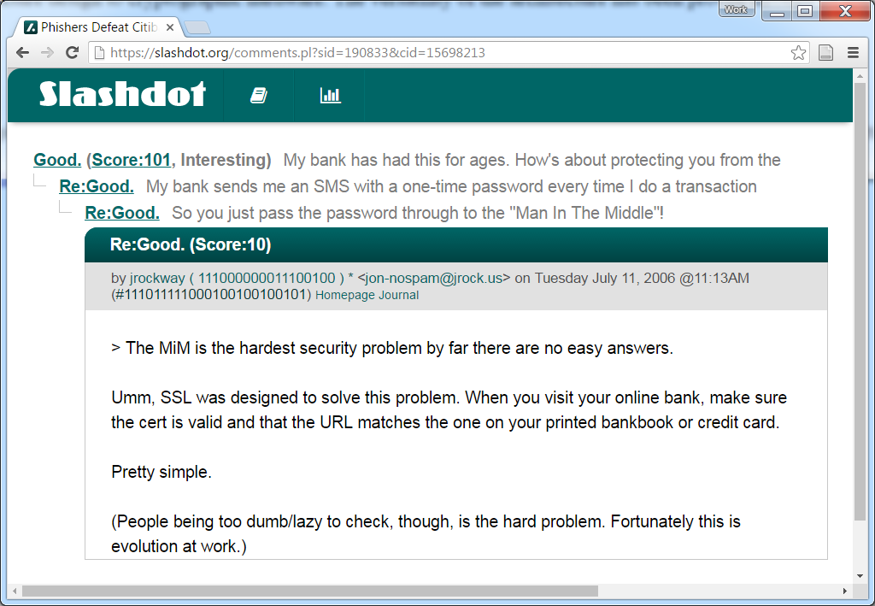
Credit: ‘jrockway’ @ https://slashdot.org/comments.pl?sid=190833&cid=15698213

Slide 3
Problem
(about SSL and Man-In-Demo attacks)

Slide 4
Overview
Problem: expecting too much
Symptoms: security risks
Weak passwords
Phishing
Downloading malware
Social engineering
Solutions: design
… and more backend security

Slide 5
Problem
Expecting too much rationality
Expecting too much attention
Expecting too much memory
Expecting too much knowledge
Expecting too much concern

Slide 6
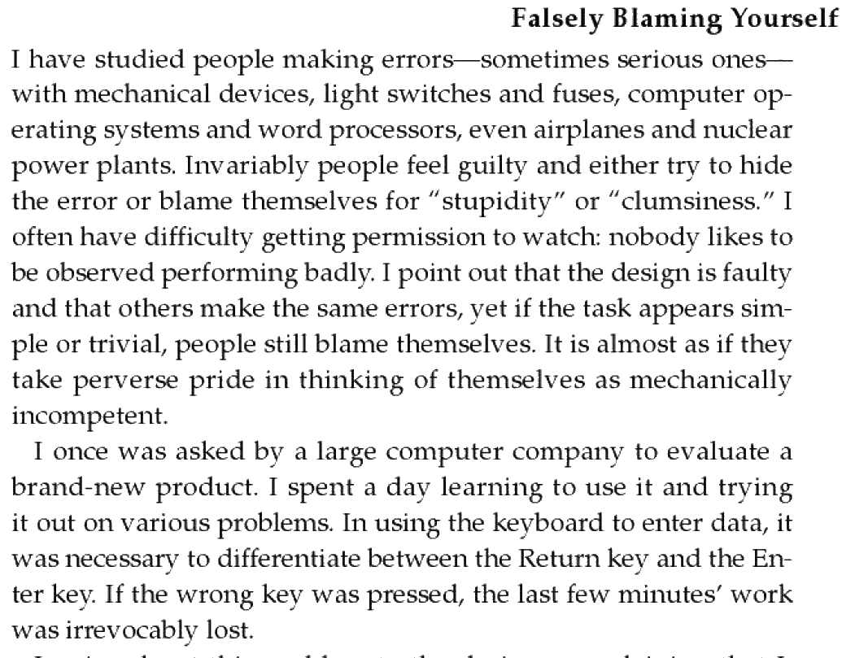
Credit: Don Norman, Design of Everyday Things, chapter 2, p. 65

Slide 7
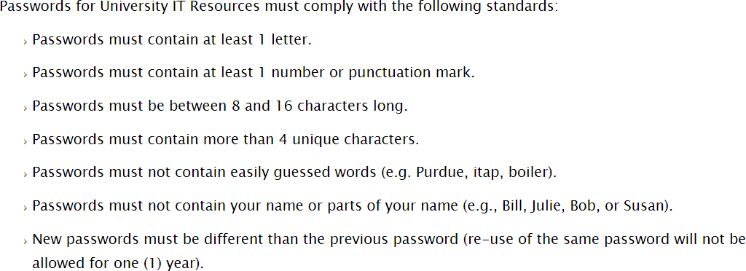

Slide 8
Which of these passwords meets the rules?
1. random-dancer
2. d9l3c93jdlcks93jckdoekcjslqp
3. FuddyHuffaker_$0cje
4. Boilerrrrrrr93kcjslekcu@#$

Slide 9
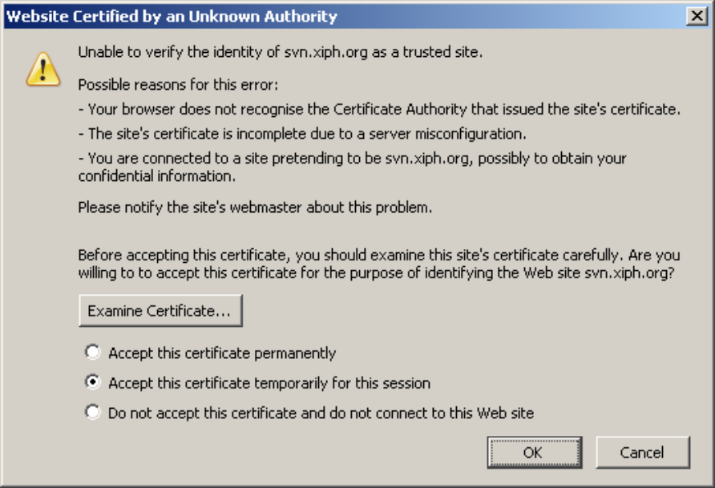
Credit: The Psychology of Security Usability

Slide 10
Subjective Expected Utility Theory
Assume:
User has a utility function to rank options based on future outcomes
User knows all possible alternative strategies
User can estimate probability of outcomes for each alternative
User will choose an alternative based on subjective expected utility
Credit: The Psychology of Security Usability

Slide 11
Subjective Expected Utility Theory
for each possible decision alternative:
x = all possible consequences of making a decision,
which includes recursive evaluation of any
carry-on effects);
p(x) = quantitative probability for x;
U(x) = subjective utility of each consequence;
p(x) × U(x) = probability multiplied by subjective utility;
Credit: Peter Gutmann, Engineering Security (draft, April 2014)

Slide 12
For exercise next time…
If the 3rd digit of your PUID (or SSN) is odd, then think of the worst instance of unusable security you’ve ever seen.
If the 3rd digit is even, think of one that is fake, but might sound real.
Get ready to give a 30-second description.
We’ll vote and see how well we can guess.

Slide 13
More common decision-making
Under pressure
Dynamic
Goals are ill-defined

