Slide 1
Human-Computer Interaction
ECE 695
Alexander J. Quinn
January 8, 2018

Slide 2
HCI at other US universities
U of Washington
DUB - Design-Use-Build
HCDE - Human-Centered Design & Engineering
Degrees: MHCI+D
x 48
U of Illinois
HCI Group
Degrees: none
x 5
Carnegie Mellon
HCII – Human-Computer Interaction Institute
Degrees: MHCI, PhD-HCI
x >30
MIT
Media Lab
(CSAIL: faculty labs)
Degrees: MS, PhD
x >30
UC Berkeley
Berkeley Inst. of Design
Jacobs Institute
Degrees: none
x 20
U of Maryland
HCIL – Human-Computer Interaction Lab
Degrees: MS-HCI
x 26
Stanford
Stanford HCI Group
Degrees: none
x 4
Georgia Tech
School of Interactive Computing
Degrees: MS-HCI and PhD-HCC
x 54

Slide 3
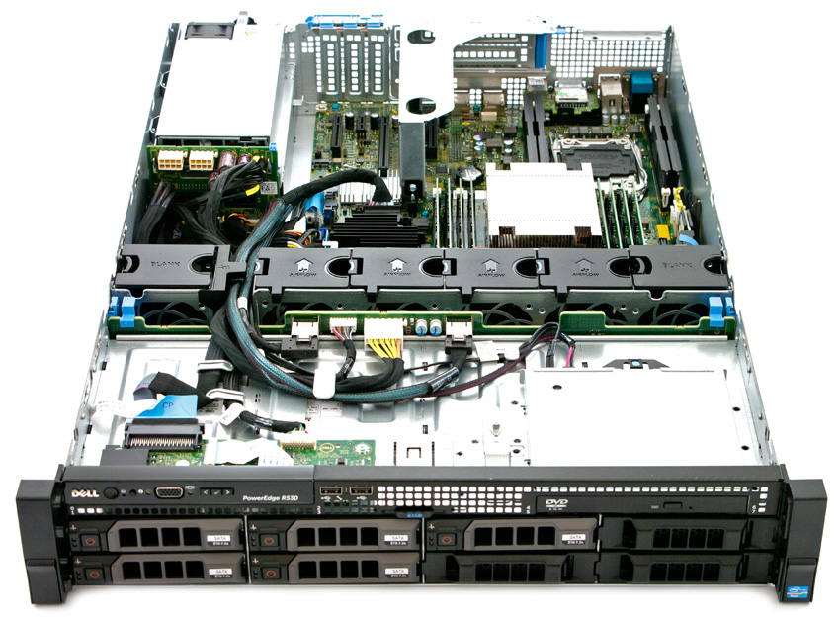
hci.ecn.purdue.edu
Dual Xeon E5-2680v3 CPUs
24 cores / 48 threads @ 2.5 GHz
128 GB RAM
DDR4 @ 2133 million transfers/second
8 TB storage
Near-line storage, RAID6 w/ 4 x 2TB
Dual power supplies
450W, hot-swappable
http://www.storagereview.com/dell_poweredge_13g_r530_review

Slide 4
“Performance”
requests per second
uptime
average response time
peak response time
network throughput
mean time between failures
…

Slide 5
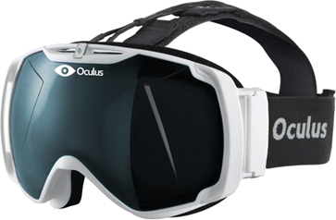
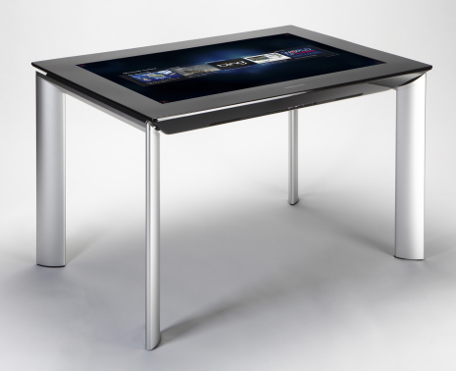
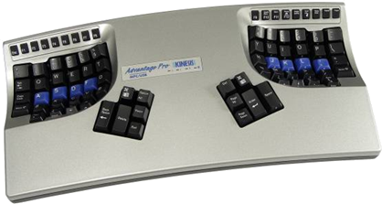
“Performance”

Slide 6
Performance
Parameter | Mean | Range
Eye movement time | 230 ms | 70-700 ms
Decay half-life of visual image storage | 200 ms | 90-1000 ms
Visual Capacity | 17 letters | 7-17 letters
Decay half-life of auditory storage | 1500 ms | 90-3500 ms
Auditory Capacity | 5 letters | 4.4-6.2 letters
Perceptual processor cycle time | 100 ms | 50-200 ms
Cognitive processor cycle time | 70 ms | 25-170 ms
Motor processor cycle time | 70 ms | 30-100 ms
Effective working memory capacity | 7 chunks | 5-9 chunks
Pure working memory capacity | 3 chunks | 2.5-4.2 chunks
Decay half-life of working memory | 7 sec | 5-226 sec
Decay half-life of 1 chunk working memory | 73 sec | 73-226 sec
Decay half-life of 3 chunks working memory | 7 sec | 5-34 sec

Slide 7
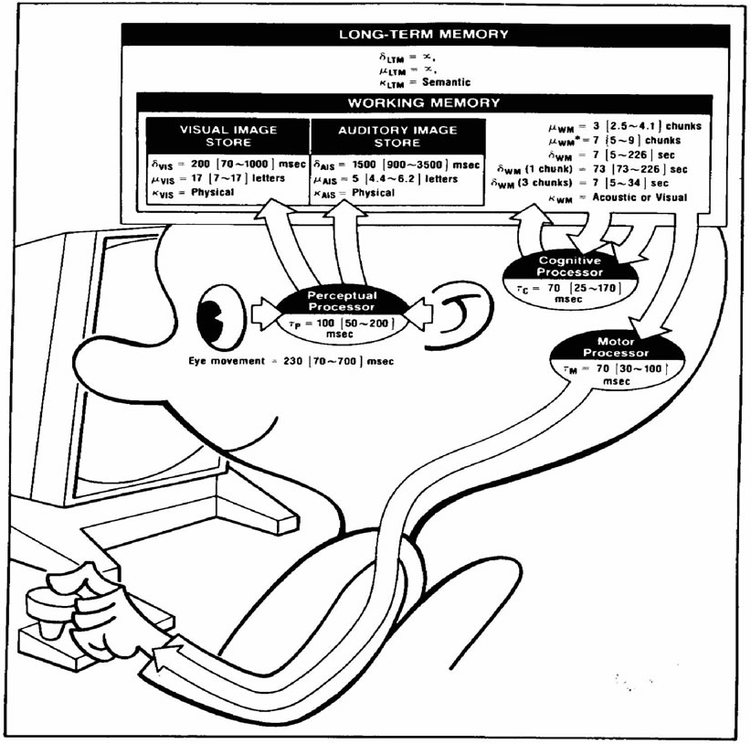
Human Information Processor
(Card, Moran, Newell, 1986)

Slide 8
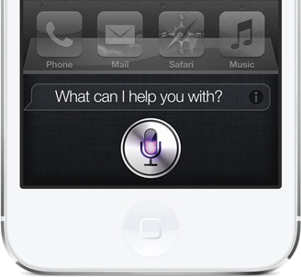
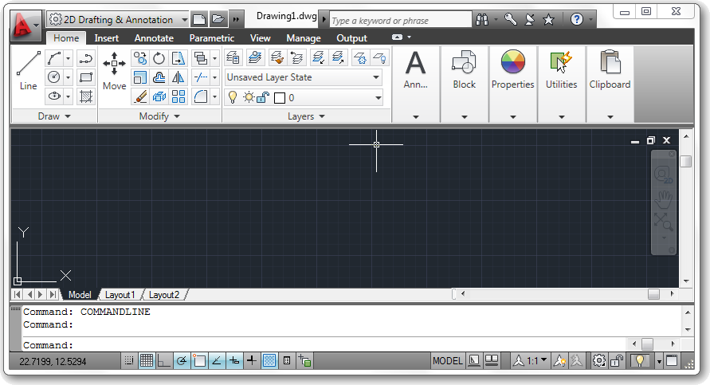
“Performance”

Slide 9
Gulf of execution
Execution
bridge
action
specification
interface
mechanism
intentions
goals
physical
system
interpretation
interface
display
evaluation
Evaluation
bridge
(Don Norman, 1986)

Slide 10
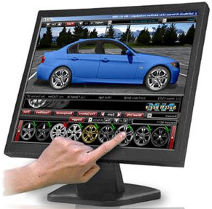
Direct manipulation
Represent objects by physical appearance
Effective conceptual model
Represent actions by effects on screen
Rapid feedback and reversability
Engagement
Feel that you are working on the data/task
https://hcik4.wordpress.com/2008/11/01/direct-manipulation-cont/

Slide 11
Usability
Learnability
Efficiency
Memorability
Errors
Satisfaction
(Jakob Nielson, 1994)

Slide 12
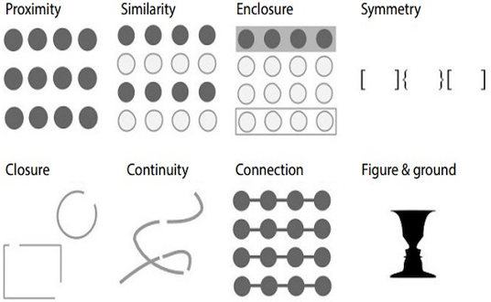
Gestalt grouping principles
http://blog.fusioncharts.com/2014/03/how-to-use-the-gestalt-principles-for-visual-storytelling-podv/

