Slide 1
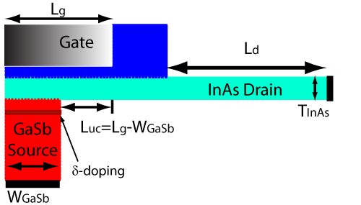
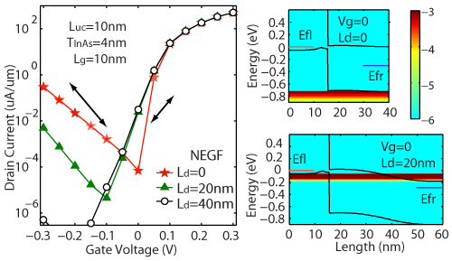
Effects of Underlap and Boundary Condition Zhengping Jiang, Yeqing Lu, Yaohua Tan, Yu He, Michael Povoloskyi, Tillmann Kubis, Alan Seabaugh, Patrick Fay, Gerhard Klimeck
Objectives
Evaluate effects of underlap (L_{d})
Evaluate effects of boundary condition
Methods
Semi-classical potential with corrected parameters
Non-equilibrium Green’s Function
Results
Ambipolar current is due to hole thermal emission
Confinement increases bandgap and reduces ambipolar current
Low I_{OFF} at L_{d}=0nm → boundary condition blocks tunneling
Impacts
Underlap decouples channel from drain contact and suppresses ambipolar current
Define proper open boundary condition is important to predict device performance
Simulation Structure
Spectrum currents show effects of open BC
Upper: tunneling current is blocked due to raised potential at boundary and thermal current is increased
Lower: thermal current is blocked by bandgap
*IEEE ELECTRON DEVICE LETTERS, VOL. 33, NO. 5, MAY 2012

