Slide 1
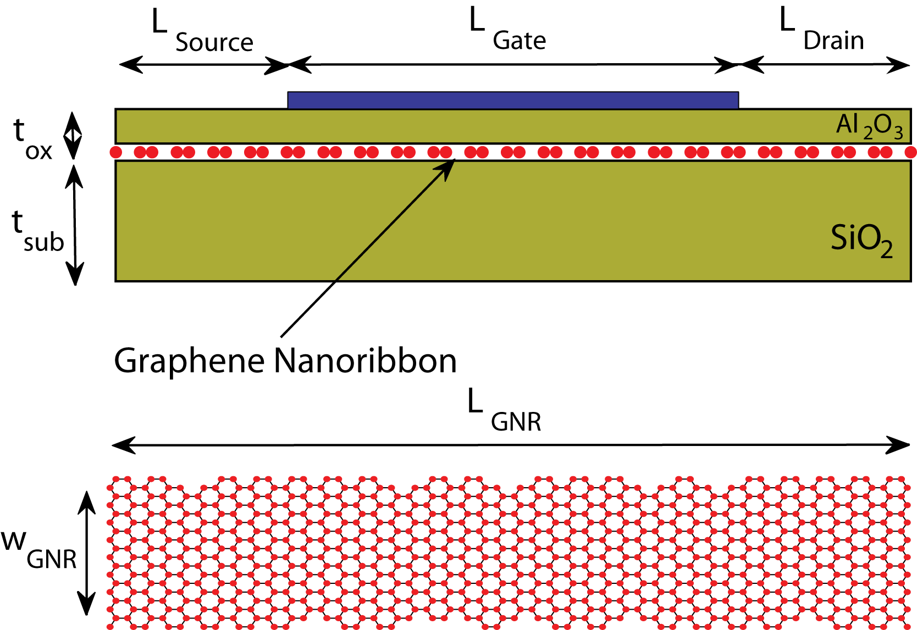
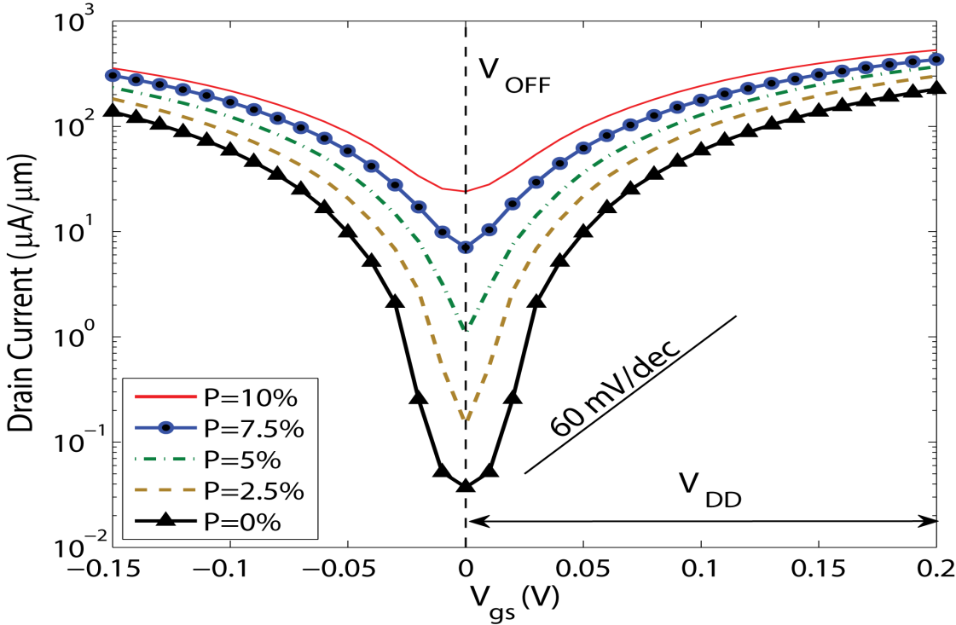
Line Edge Roughness in GNR Tunneling FETs Mathieu Luisier and Gerhard Klimeck APL 94, 223505 (2009)
Objectives:
Simulation of Graphene Nanoribbon band-to-band tunneling FETs
Study the influence of Line Edge Roughness (LER) on their performances
Approach:
Non-equilibrium quantum transport with on single orbital per carbon atom
Atomistic description of the graphene ribbon
Edge atoms randomly removed with a given probability P
Statistical sampling of LER (100 random samples per roughness probability)
Results and Impacts:
LER causes drastic increase of OFF-current and decrease of ON/OFF ratio (band gap states)
Help experimentalists design better devices, less sensitive to LER
Image Caption
Up: Single-gate graphene nanoribbon tunneling transistor and sample of a graphene nanoribbon with random LER
Down: Transfer characteristics I_{d}-V_{gs} of graphene nanoribbon tunneling FETs with different LER probabilities. Each curve represents the average of 100 different samples

