Slide 1
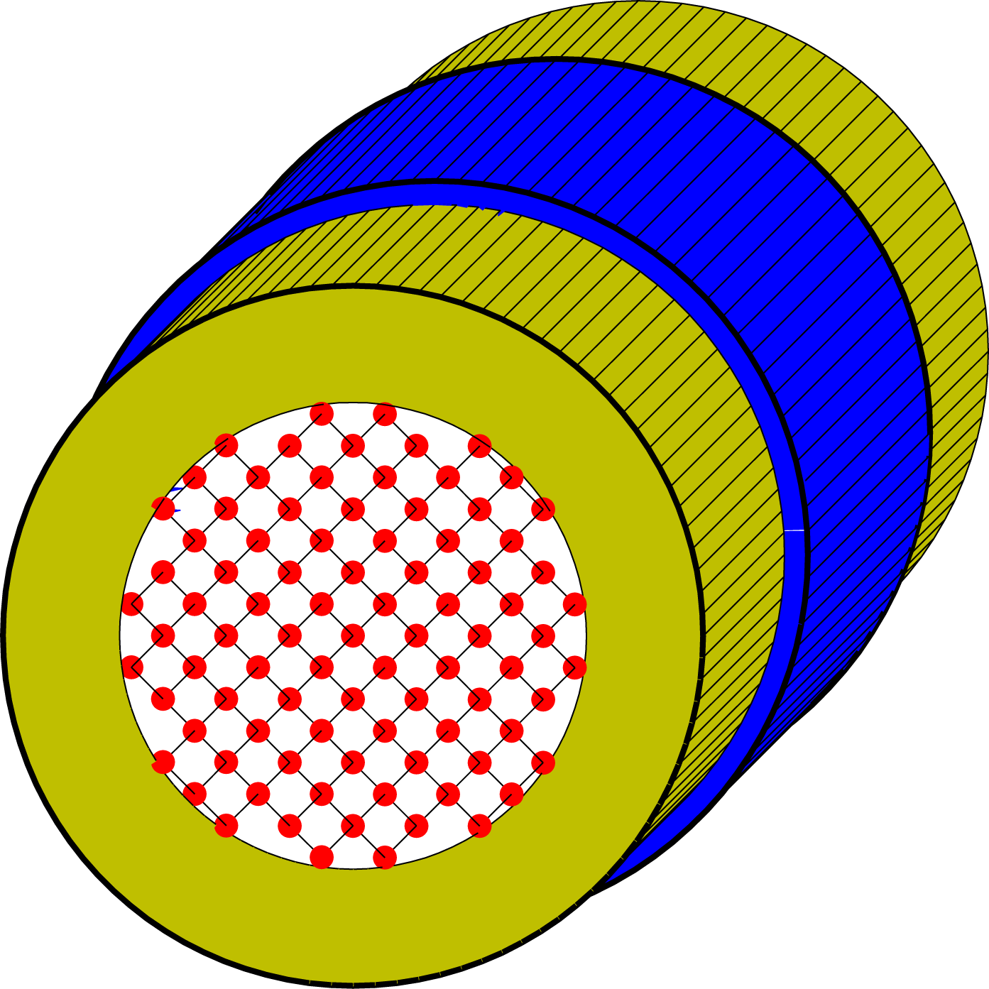
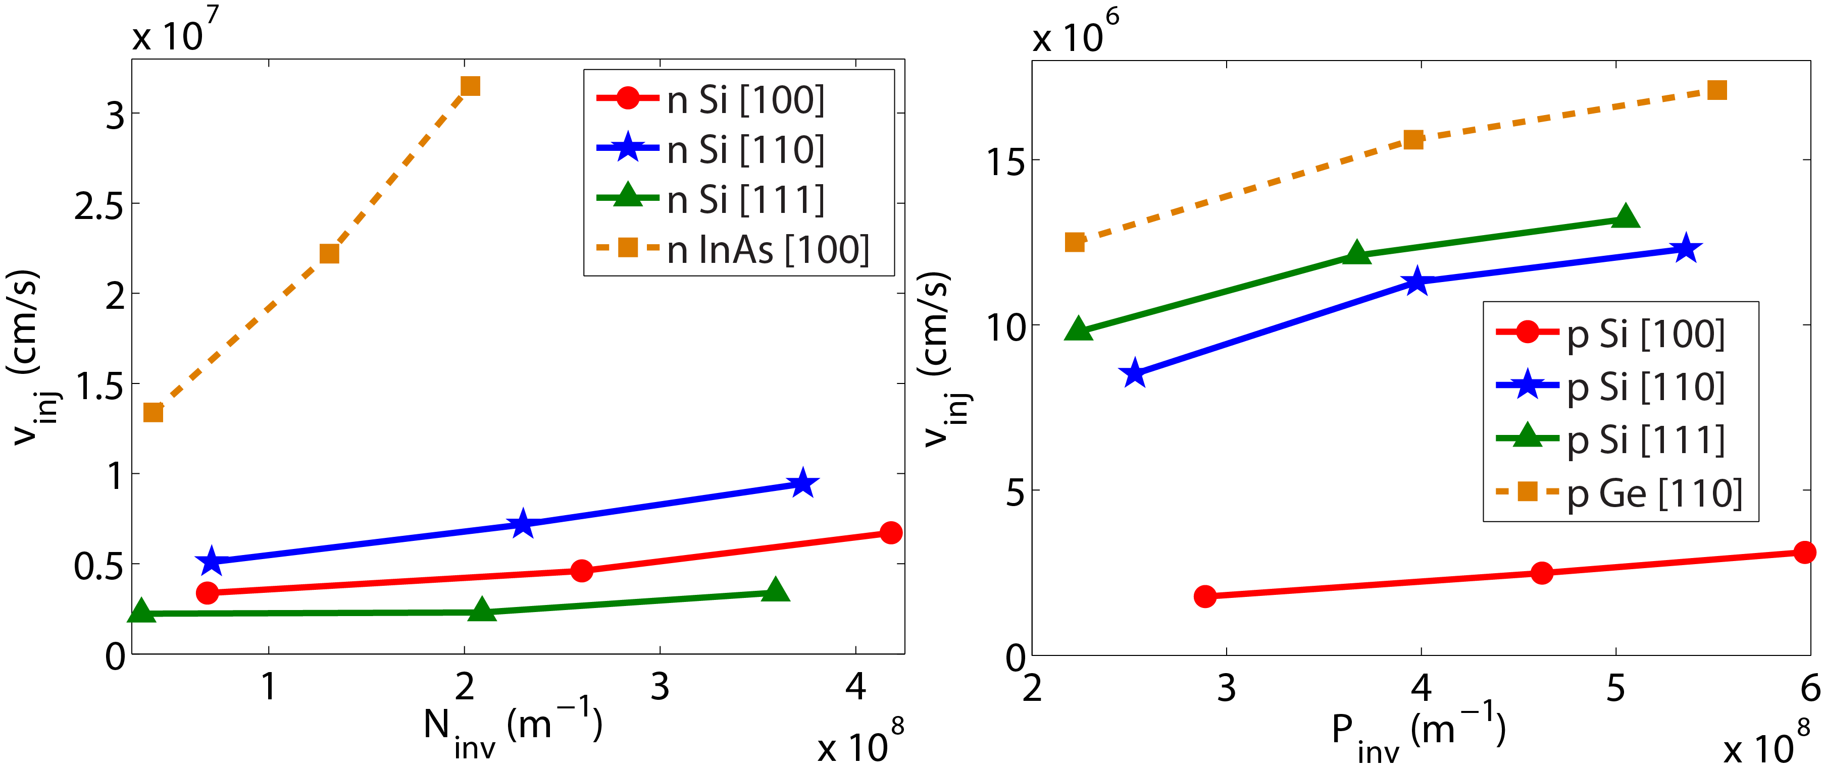
Injection Velocity in Si, Ge, and InAs NW FETs Mathieu Luisier and Gerhard Klimeck IEDM 2010
Objective:
Calculate phonon-limited injection velocity v_{inj} and ballisticity at the top-of-the barrier in n-type Si and InAs and p-type Si and Ge NW FETs with different oritentations
[100]
[110]
[111]
Approach:
Tight-binding (sp³d⁵s*) description of the electron/hole properties
Atomistic Representation of the NWs
Quantized phonon dispersion (VFF)
Quantum transport with NEGF
Si NW FET
structure
Results and Impacts:
v_{inj} as function of the charge density at the top-of-the-barrier
[100] InAs NW highest electron velocity and close to ballistic limit
[110] Ge NW highest hole velocity, but 50-60% of ballistic limit
Caption: Phonon-limited electron (left) and hole (right) injection velocity in Si, Ge, and InAs NW FETs

