Slide 1
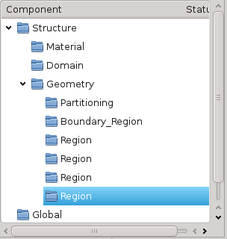
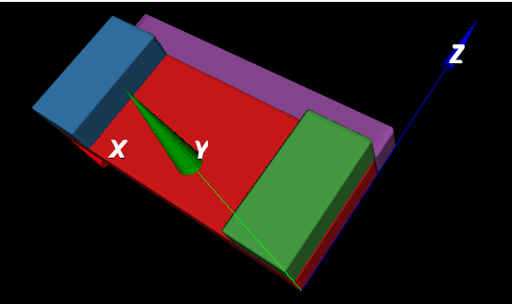
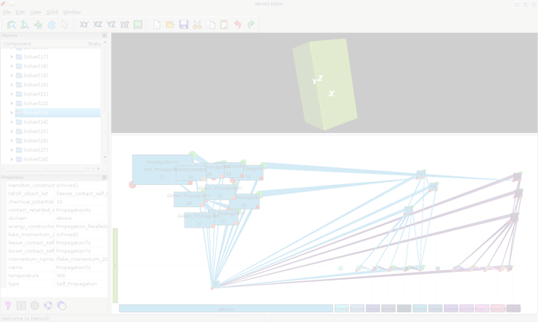
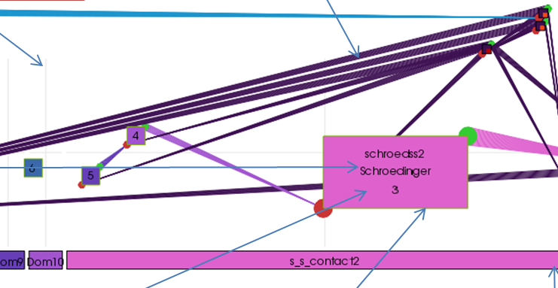
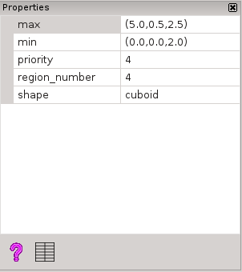
Nemo5 Graphical User Interface (GUI) Nemui
Objective: to create a Graphical User Interface for Nemo5
To visualize/interact with the device geometry
To visualize/interact with the dataflow definition
To visualize output results from the simulation.
Approach: create a framework that contains:
Tree View: Shows the tree representation of the file
Parameters: Shows the parameters of a previously selected definition
3D Device: Shows the 3D representation of the device
DataFlow: Presents the dataflow structure of the solvers
Results:
NemUI allows user to create, load and visualize input deck files
All different views are synchronized
relations between inputdeck definitions are represented graphically.
geometrical description of the device is visualized as a 3D model.
Daniel Mejia, Tillmann Kubis, Michael Povolotsky, Gerhard Klimeck

