Slide 1
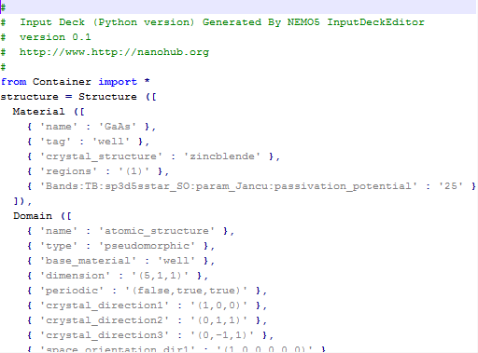
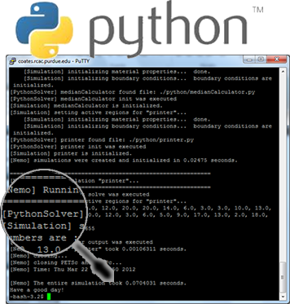
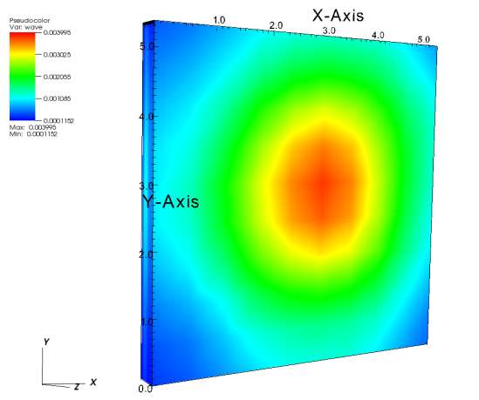
Extending Nemo5 capabilities
Objective: to allow users and developers to extend Nemo5’s capabilities.
Results:
Python input decks supported on Nemo5
Python Solvers (Nemo5 solvers wrote on python)
Python Meta Solvers (set of solvers grouped in a container Solver “Meta”)
Python-Nemo is working with both shared and static libraries
Approach:
[1] To Develop a python framework to create NEMO5 Input Decks
[2] To Create a scripting mechanism (using Phyton) to extend Nemo5’s functionality.
Daniel Mejia, Tillmann Kubis, Michael Povolotsky, Gerhard Klimeck

