Slide 1
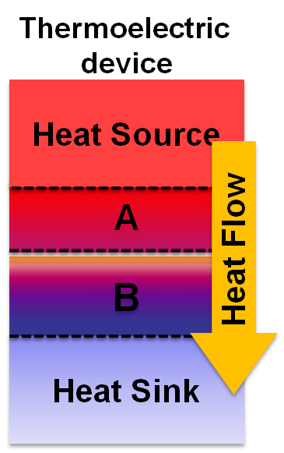
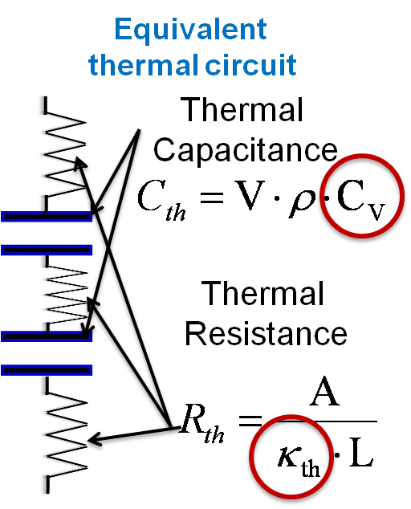
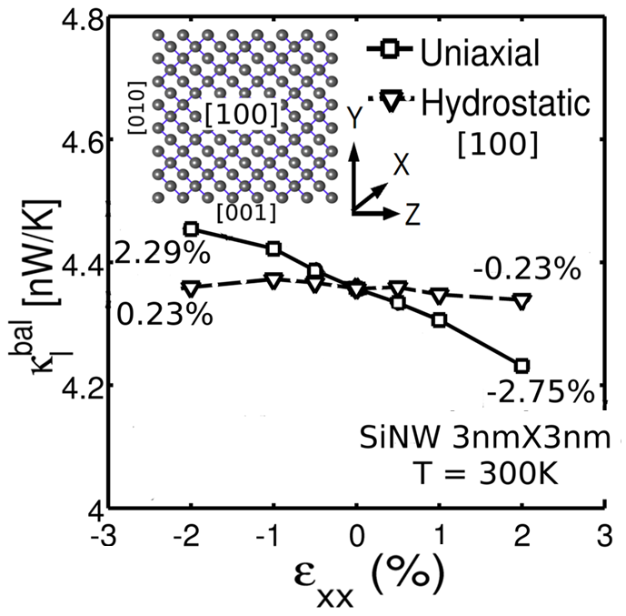
Strain Engineering of lattice thermal properties in Silicon nanowires: Abhijeet Paul & Gerhard Klimeck
Results:
Uniaxial strain effectively tunes κ_{l.}
Objective: Engineering material thermal properties using strain to improve system level performance.
Hydro-static strain tunes Cv.
Approach:
[1] Modified Valence Force Field to model phonons in strained Si nanowires.
[2] Study the effect of strain on specifc heat (Cv) and thermal conductance (k_{l}).
Impact: Published in APL, 99, 083115 (2011); doi:10.1063/1.3630228

