Slide 1
Modeling the atomic and electronic structure of Meta-Metal, Metal-Semiconductor and III-V/Oxide interfaces
Ganesh Hegde
Network for Computational Nanotechnology (NCN)
Electrical and Computer Engineering
Purdue University, West Lafayette IN, USA
{ghegde} at purdue dot edu
Committee
Prof. Gerhard Klimeck (chair)
Prof. Alejandro Strachan
Prof. Peide Ye
Prof. Timothy Fisher
1
Notes:
Good morning everyone. I can see some unfamiliar faces in the audience, so let me introduce myself. I am Ganesh Hegde and I will be talking about my thesis on modeling the electronic structure of material interfaces.

Slide 2
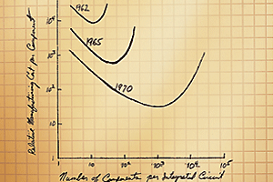
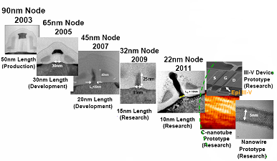
Moore’s Law and the decrease in device dimensions
Acknowledgement: Robert Chau, Intel
Figure from: http://www.manifest-tech.com/ce_products/flash_revolution.htm
Continual downward scaling according to Moore’s Law has lead to a continual decrease in device dimensions
Notes:
Almost all of the work that we do in our group is intimately related to the desire to continue Moore’s Law. It was originally formulated as an economic law that said that the cost of manufacturing a device would come down along with a two fold increase in dimensions every two years. For the most part, this has remained true. So we’ve had a continual decrease in transistor dimensions following Moore’s Law.

Slide 3
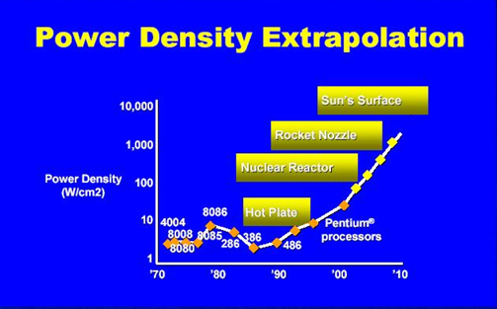
Consequence of Moore’s Law Scaling →Increase in Microprocessor Power dissipation
Continual decrease in device dimensions ➔ Increase in component power dissipation
3
  Figure - http://www.semiwiki.com/forum/content/attachments/6084d1359678676-intel-processor-power.jpg,
Notes:
But this decrease in dimensions has come at a price. Turns out that the total power dissipation in a microprocessor has also increased with an increase in device density. People have found interesting ways of communicating this fact. Here we can see an Intel graph that says that We’ve gone from having power density similar to a hot plate to one in a Nuclear reactor and the sun’s surface!! It’s important to understand that this increase is for the same chip architecture. So if we had a different architecture, the graph might look different, but we’d still see a increase due to scaling.

Slide 4
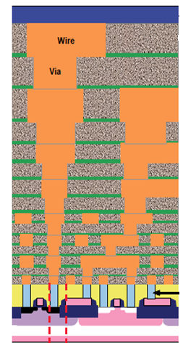
Sources of component power dissipation in microprocessors
Device dynamic power dissipation(CV²f)
Chip Metallization power dissipation (I²R)
Parasitic capacitances and resistances (CV²f, I²R)
Global and local interconnects
G
Contact plugs
S
D
Rs
RD
ITRS – 2011 edition
4
Notes:
This begs the question - why has component power dissipation increased? Let’s look at a zoomed-in cross section of a microprocessor I got from the 2010 ITRS edition. We can look at the switching device and the associated wiring as an equivalent reisistive-capacitive network. The total power dissipation can be broken down to three main components – 1) The device dynamic power dissipation. This is the power dissipated in charging and discharging the MOS transistor chip and is directly proportional to the capacitance and frequency. The Voltage decrease is overshadowed by the increase in frequency of switching and capacitance. The second is Interconnect metallization which dissiptes Ohmic power. The third is parasitic capacitances and resistances that exist in the chip.

Slide 5
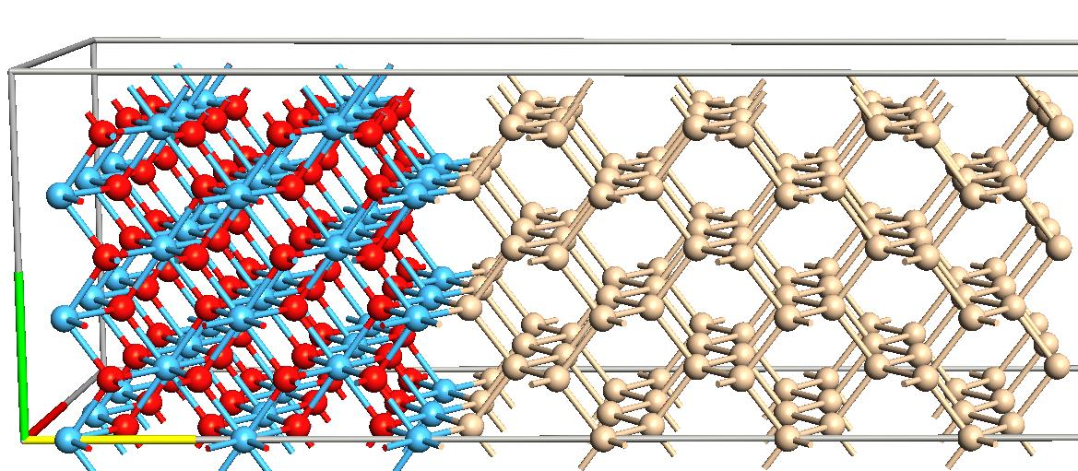
How is power dissipation related to material interfaces?
Oxide
Semiconductor
G
S
D
E_{c}
E_{f}
Oxide-Semiconductor Interface properties strongly affect electron transport and power dissipation !!
E_{v}
Notes:
From the viewpoint of this thesis – one can ask the question – How is increased power dissipation an interface issue? We can find out by having a closer look at each source of PD. For instance if we zoom into the device at the semiconductor oxide interface. When a potential is applied at the gate we have a triangular potential well forming. The electron inversion layer is less than a nm at the interface. This suggests that the properties of the oxide-semiconductor interface should strongly influence electronic transport and power dissipation in the device.

Slide 6
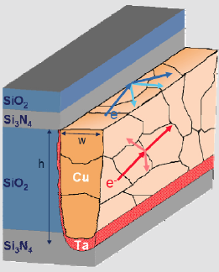
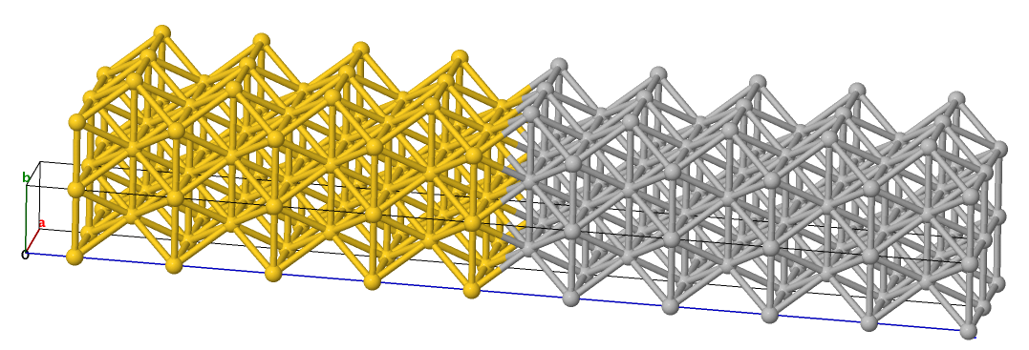
How is power dissipation related to material interfaces?
Metal-Metal Grain interface
Metal-Liner interface
Metal-dielectric interface
Contact plug – Interconnect interface
Figure from EE-311, V.K.Saraswat, Stanford University 2003
Metal interface electron scattering is a major source of power dissipation!!
Global and local interconnects
G
Contact plugs
S
D
6
Notes:
If we zoom into the second component - interconnects, it is very evident that the interconnect structure is composed of several interfaces. There are interfaces between grains formed during electrodeposition, interface between Cu and a diffusion barrier material such as Ta and interfaces between Cu and the dielectric that separates Cu from underlying Si. Electrons scatter significantly at each of these interfaces. Additionally there are metallic contact plugs that connect the source and drain to the interconnect. These are metal interfaces too. Due to significant electron scattering at interconnects, they are a major source of power dissipation.

Slide 7
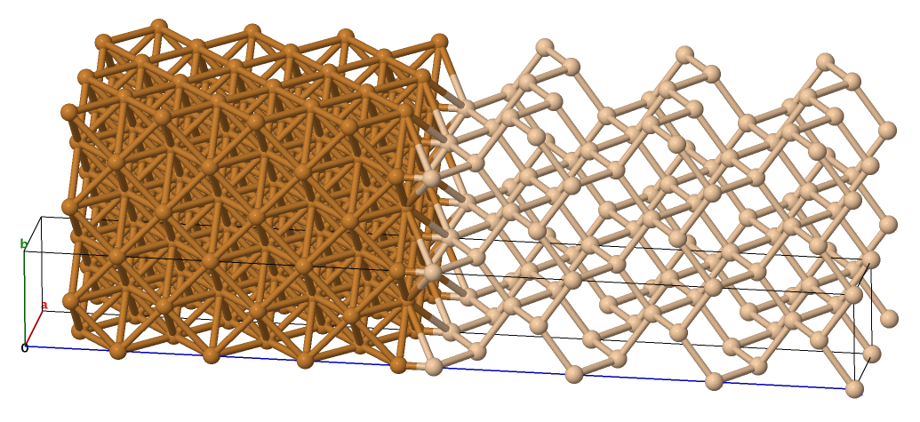
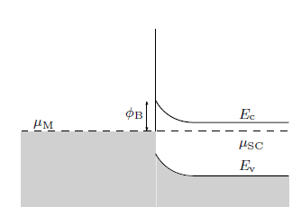
How is power dissipation related to material interfaces?
G
S
D
Rs
RD
Metal
Semiconductor
There is significant power dissipation at non-Ohmic Metal-Semiconductor interfaces!!!
Figure courtesy Kaspar Haume, DTU
7
Notes:
What about the third contribution to power dissipation. If we zoom in to the series source and drain resistances – we see another interface which is composed of a metal on one side and a semiconducting source or drain on the other. In the metals and semiconductors used in technology, we see a potential barrier – the Schottky barrier. Electrons scatter at this non-ohmic barrier while tunneling through it and can cause significant power dissipation.

Slide 8
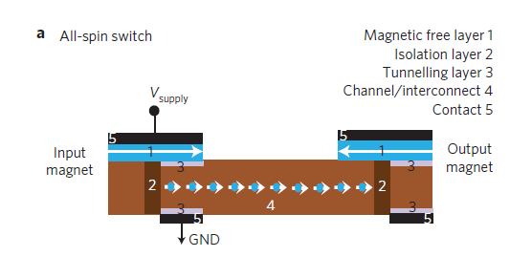
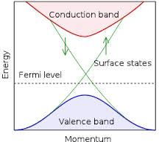
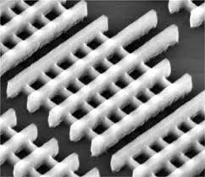
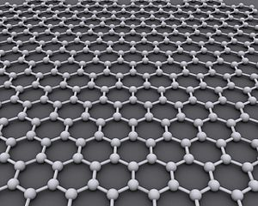
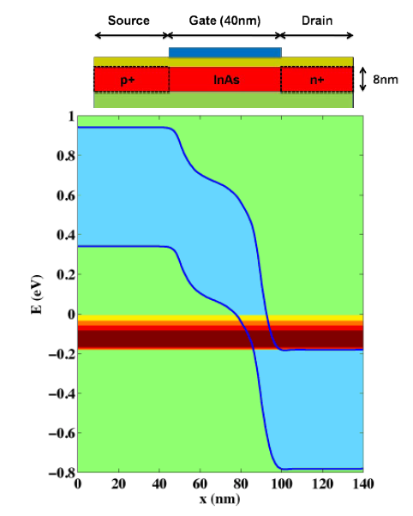
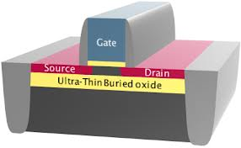
Existing/Proposed solutions to the problem
Device Perspective
New Switching mechanisms
New materials
New device geometries/architectures
Topological Insulator
ASL (Behin-Aein et al. 2010)
Tri-Gate (Intel 2011)
Graphene
FD-SOI
III-V
Figures for TI, Graphene from en.wikipedia.org, FD-SOI - stericsson.com
8
BTBT (Fig. from Luisier et al. 2009)
Notes:
Now that we’ve established that power dissipation and material interfaces are intimately related, let’s look at proposed solutions for each source of power dissipation. The Device component has perhaps attracted the most attention in research. We have had completely new switching mechanisms being proposed – ASL and the Datta-Das transistor at Purdue, BTBT to name a few. New device geometries such as Tri-gate transistors and FD-SOI are in production, while new materials such as graphene, TI’s and III-V’s are being intensely investigated. III-V’s are something that we’ve investigated as part of my thesis work, and I will come back to it later in this talk.

Slide 9
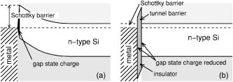
Proposed Solutions, continued…
Parasitic Resistance/Schottky Barrier Perspective
Connelly et al. (Acorn Technologies, 2006)
Insulating transition region (Acorn)
Conducting, non-reactive transition region (Intel)
Passivation using monolayer of Selenium (UT)
Chlorine ion implantation (Sematech)
Preventing direct Metal/Si contact by adding a transition layer seems to be a converging solution of choice
Notes:
From the Metal-Semiconductor Schottky barrier perspective, industry seems to have converged upon preventing a direct contact between semiconductors and metals by using a barrier – insulator, layer of selenium and non-reactive transition regions having chlorine ions implanted in them. We will come back to this topic later and see why a direct contact between Si and metal is not desirable.

Slide 10
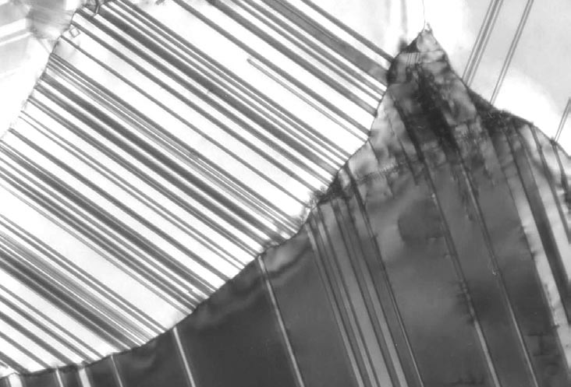
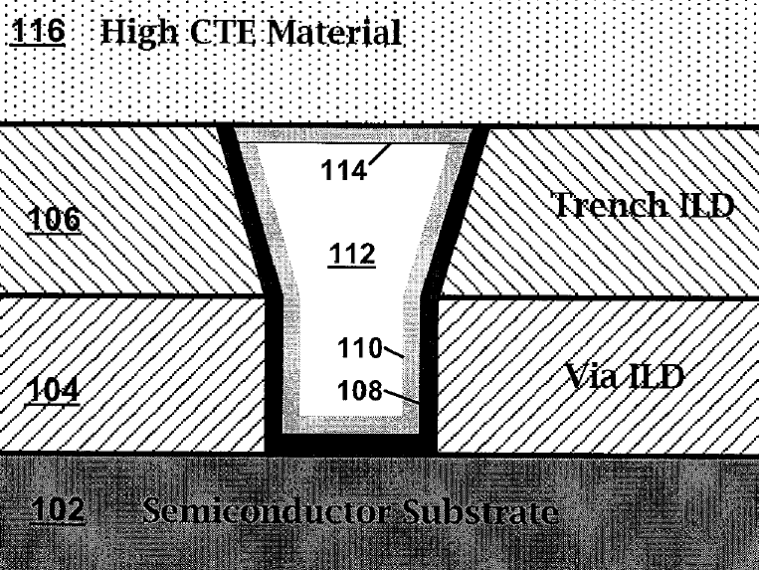
Proposed Solutions, continued…
Interconnects Perspective
Changing grain profile (??)
New materials (??)
Liner interface engineering
  Back to Al?
  Alloys of Cu?
  TI’s?
  Silicides?
(Lu et al. Science. 2004)
(Intel USPTO 2009/0001591 A1)
  Compressive Strain
  Changing liner material to modify interface DOS
  Bottomless liner
“…There is a significant contribution to the increase in resistivity from both grain boundary and interface roughness scattering. To date, research has not identified potential solutions to the problem”– ITRS 2003, 2007, 2009, 2011 Interconnect.
In comparison to research on devices and M-S interfaces, the solution space for interconnects is far smaller and less investigated
Notes:
Interconnects seem far less exposed to experimental or theoretical solutions in comparison to the previous two sources. There are a few patents by Intel that talk about using compressive strain or doing liner engineering to improve conductivity, but these patents seem written to conceal more than they reveal. In fact I try to make the case that the supposed cause of improvement in conductivity due to compressive strain – decrease in DOS, is objectively wrong. So there is far less clarity on this issue, Whether new interconnect materials are needed, if need to go back to Al, or use silicides or we can radically change deposition conditions to change grain structure in interconnects.

Slide 11
Unifying theme – Material interfaces
‘... the interface is the device.’
Herbert Kroemer (Nobel Lecture, 2000)
Metals and Metal/Metal Interfaces
Metal/Semiconductor Interfaces
Oxide/Semiconductor Interfaces
11
Notes:
The unifying theme in all of the scenarios I have just mentioned is the importance of material interfaces. I have worked in some capacity on the theoretical modeling of each of these interfaces. I came across a very interesting quote by Herb Kroemer while going through his Nobel Lecture. Here, he says that the interface is the device. While he made that statement in the context of semiconductor hetero junctions it is evident from the information I just shared that it is also true for technology in general.

Slide 12
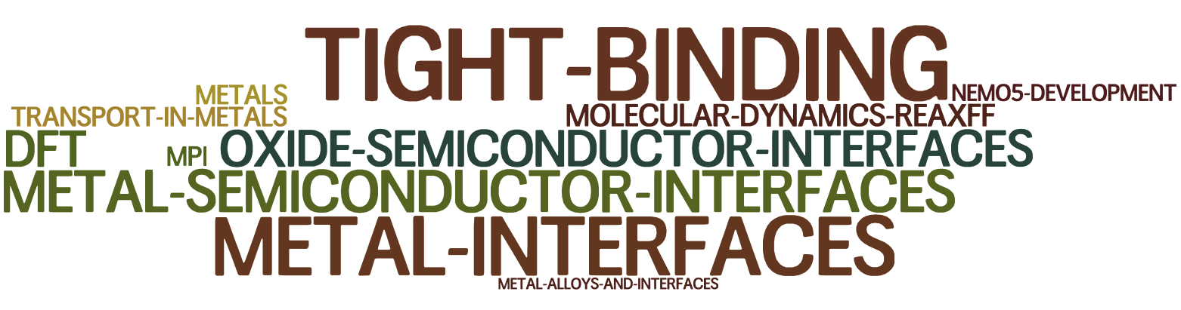
Summary of work done in PhD thesis – Word cloud
12
Notes:
In order to decide what topics to devote time to, I drew up a word cloud of the work I’ve done during the last three years. It turns out that I have worked on Tight Binding and its applications to Metals and Metal interfaces for the most part. That is what I shall be devoting a lot of time to in this presentation

Slide 13
Outline
Metal Interfaces
  Importance
  Need for atomistic modeling
  Development of environment-dependent TB framework
    Moments theorem and ←→ mapping to DFT
    On-site elements and variation with strain
    Validation versus DFT
    Application → Conductivity vs. dimensionality, orientation, strain.
Summary of work in III-V Semiconductor/Oxide Interfaces
Summary of work in atomic and electronic structure of Cu-Si interfaces
Future Work
Summary
13
Notes:
Here is the outline for the talk. I will focus on Metal Interfaces and elaborate on their importance in technology. I will discuss why a new TB model was needed to describe metal electronic structure and how I went about doing it. Then I will compare the new model with DFT calculations and apply it to relevant transport problems of interest. I will also briefly touch upon my work on Metal-Semiconductor Interfaces and III-V Oxide interfaces and summarize.

Slide 14
Metal/Metal Interfaces
Metal/Semiconductor Interfaces
Oxide/III-V Semiconductor Interfaces
14
Notes:
Let’s begin with Metal Interfaces

Slide 15
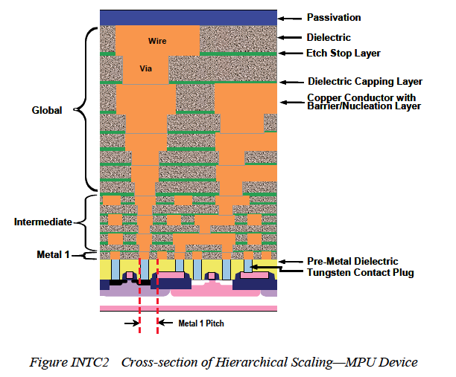
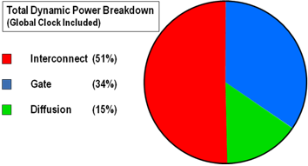
Why interconnect power dissipation is a BIG deal
Total interconnect length in Metal 1 and Intermediate wiring ~ 3km/cm² !!!
Electrons travel through far more metal than semiconductor!!!
2004, Nir Magen, Intel
http://lp-hp.com/pangrle/files/2011/09/barry1.png
ITRS 2007 Interconnect
Notes:
We are accustomed to thinking of metals as ideal conductors having a constant, very small conductivity. So why is power dissipation in interconnects a big deal? It turns out that the extent of metallization in a micrprocessor chip makes it a very big deal. The ITRS mentions that there is about 3km/cm2 of chip area. Electrons travel through far more metal than semiconductor. In a very interesting study in 2004, an Intel team estimated that more than 51% power was dissipated in interconnects and projected that it would become 75% in current generations. That is an astounding statistic. One could argue that tis difficult to dissipate heat from sc, but the fact remains that in terms of absolute power dissipation, metals outweigh sc.

Slide 16
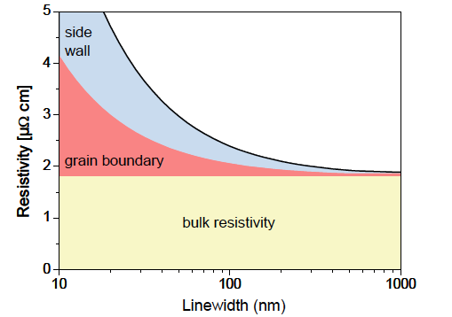
Sources of resistance in interconnects
Surface and Surface roughness scattering
(Metal-dielectric Interface)
2. Grain Boundary scattering
(Metal-Metal interface)
2
3. Barrier scattering
(Metal-Metal Interface)
1
3
Image from EE-311, V.K.Saraswat, Stanford University 2003
ITRS Interconnect (2010)
Notes:
The next question would be - why is so much power dissipated in interconnects and why is it increasing every technology node. To see this lets revisit a figure we just saw. The interconnect cross section shows distinct interfaces at which an electron can scatter. People studying this problem have estimated that grain boundary and surface scattering have increased tremendoucly with a reduction in dimensions. But there is no consensus on what dominates and how to address the problem.

Slide 17
Semi-classical models of resistivity
Fuchs-Sondheimer for surface scattering (1928), Mayadas-Shatzkes for grain-boundary scattering in thin films (1970)
d = average grain diameter
R = Average reflectivity
w
t
Graham et al. - nanowires (2010)
Notes:
Now people have studied this problem semi-classically for years. The earliest work on the topic was early 1920’s. And models based on these canonical models for surface and grain boundary scattering are being developed even today. The problem with these models is that they have averaged parameters that are fit to experimental data. Turns out they can give conflicting results.

Slide 18
Open questions
  What is the relative magnitude of grain boundary scattering and surface scattering
  Does scaling affect all grain orientations equally?
  How does geometry, aspect ratio affect resistivity?
  How does the liner layer scattering affect resistivity?
  How does strain, alloying and surface roughness affect resistivity?
  Can these insights be extended for realistic (~10’s of nm) system sizes?
  Can these insights be extended to new materials for interconnects – NiSi, NiSi₂, etc?
Scalable
Arbitrary strain
Roughness
Nanostructures
Interfaces
Alloys
Atomistic quantum-mechanical modeling can provide answers
IF
Notes:
AS a result there are several relevant questions that are unanswered even today. For instance what scattering dominates? How does geomtry affect conductivity, how does strain, alloying, roughness affect conductivity. What alternate materials can be used that perform well under confinement? Semi-classical models do not provide answers to such crucial questions. Now atomistic quantum mechnical modeling can provide answers to these importANt questions if you have a TECHNIQUE THAT SCALES, handles arbitrary strains, roughness, nanostructures, interfaces and alloys. So we need to look for a technique that can do this.

Slide 19
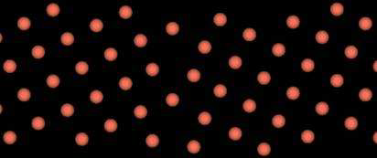
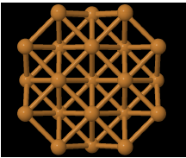
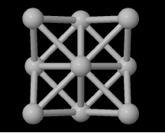
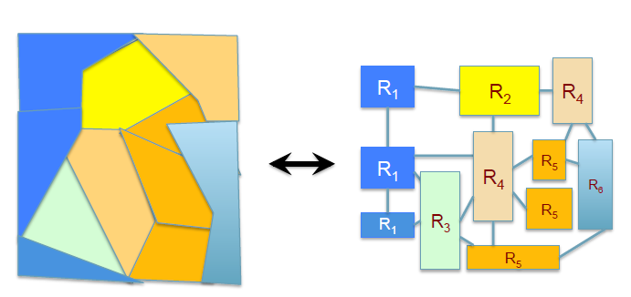
DFT is one possible candidate
Feldman et al. (DFT+NEGF)
  Single grain boundary reflectivity in bulk
  Scattering at Cu/Ta interface.
Kharche et al., Zhou et al. (DFT)
  Ballistic conductance of ideal nanowires.
  Comparison to CNT’s for interconnects.
Ke et al., Timoshevskii et al. (DFT+NEGF)
  Surface roughness in Cu nanowires.
DFT suffers from poor scaling with system size ~ order of 1000 atoms
Notes:
DFT is a possible candidate, it is ab-initio so arbitrary materials, strains, interfaces can be handled. There has been some important work done in recent years on this subject. The proble with DFT of course is that it does not scale well with system sizes. For instance, for periodic systems it can scale up to a few thousand atoms. For non-periodic systems the scaling is even worse. The problem though is that polycrystalline interconnects can be thought of as a ntwork of interconnected grains having cross sections of up to 35 nm3 in current technology nodes. That amounts to a few million atoms which is beyond what DFT can do.

Slide 20
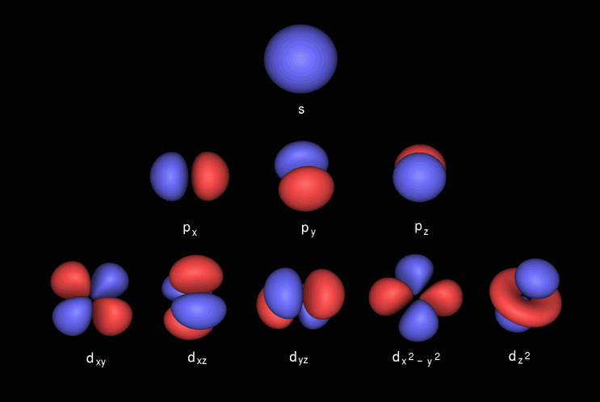
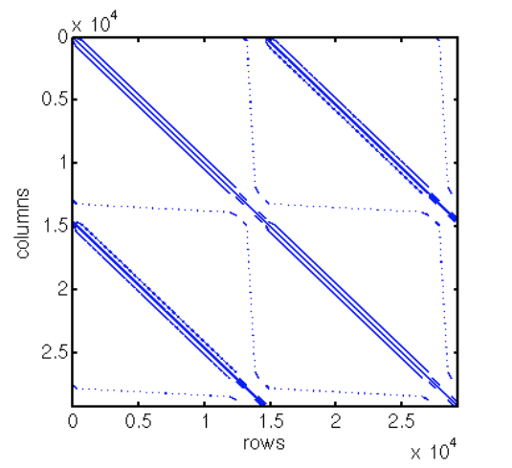
Semi-empirical, orthogonal Tight Binding (TB) – A full quantum mechanical alternative to DFT
LCAO ➔
Hamiltonian is parameterized by fitting to experiment/more accurate theoretical techniques
  No time consumed in computing interactions between orbitals
  Constrained only by time complexity of eigen-solver/inversion method.
TB ➔ Sparsity!
Image from [http://www.chemcomp.com/journal/molorbs.htm]
TB can scale to larger system sizes (~10⁵- ~10⁶) than DFT calculations
Notes:
Semi-Empirical Tight Binding is a fully quantum mechanical alternative to DFT. It is of course the core expertise of our group. It has a few special features that make it very suitable for handling large system sizes of the order of million atoms. One is that the electron wavefunction is composed of a local, atomic-orbital basis. This leads to significant sparsity in the Hamiltonian and improves computational efficiency. The second and most important is that the Hamiltonian is not computed by calculating interactions between orbitals explicitly as is done in DFT. So the Hamiltonian is created simply by pulling out numbers from a lookup table. That makes TB very efficient as compared to DFT.

Slide 21
TB as an optimization problem
m*₁ ,m*₂ ,m*₃,….m*_{n}
m*₁ ,m*₂ ,m*₃,….m*_{n}
m*₁ ,m*₂ ,m*₃,….m*_{n}
m*₁ ,m*₂ ,m*₃,….m*_{n}
m*₁ ,m*₂ ,m*₃,….m*_{n}
Eg₁ ,Eg₂ ,Eg₃,….Eg_{n}
Eg₁ ,Eg₂ ,Eg₃,….Eg_{n}
Eg₁ ,Eg₂ ,Eg₃,….Eg_{n}
Ec₁ ,Ec₂ ,Ec₃,….Ec_{n}
Vhh₁,Vhh₂,Vhh₃,….Vhh_{n}
P₁ ,P₂ ,P₃,….P_{n}
Several inputs/material, 100’s of outputs, unknown search space
21
Notes:
Let me talk a little more about the process of doing Tight Binding. The main aim of course is to solve Schrodinger’s equation for systems of interest. The idea in TB is that parameters that make the Hamiltonian are determined by fitting to experimental or other theoretical data. So this is essentially an optimization problem containing several hundred outputs and an unknown search space.

Slide 22
TB – Usual Work Flow
Fitness Extraction
Initial inputs
Masses, Band Edges, Gaps, etc (from experiment/theory)
Solve [H]{Ψ}= E{Ψ}
Inputs (Hamiltonian Terms)
Outputs (Band structure)
Modify
Evaluate
Optimization Algorithm
New Inputs
Fitness Evaluation
22
Notes:
Another way of looking at it is to treat it as is…
Once the parameters have been determined – they are used as is to form the Hamiltonian and applied to problems of interest. But in order for TB to be used as a predictive tool there are some requirements it must satisfy.

Slide 23
Key requirements for a predictive TB parameterization
Computational Efficiency – Orthogonal, neighbor interaction kept to minimum required.
Transferability – Should accommodate different materials and bonding environments – bulk/interfaces/thin films/nanowires/strain
Transparency – Variation of parameters should be captured in a model that is physically transparent
Accuracy – Should be comparable to DFT.
The central contribution of this thesis is a TB model that meets the above requirements
23
Notes:
The first is of course computational efficiency. We wouldn’t want to use it if it is not orders of magnitude more fficient thatn DFT. From a TB perspective it means that basis should be orthogonal and interaction between a very small number of neighbors needs to be computed. It needs to be transferable – i.e. parameters fitted for one atomic configuration should be able to predict what happens ina another atomic configuration. The model needs to be physically transparent i.e. one should not be using an arbitrary number of parameters without physical justification. The accuracy should be comparable to the state-of-the art, in our case DFT. Central contribution….
In the next few slides I will attempt to describe the features that make the new model unique and satisfy these key requirements

Slide 24
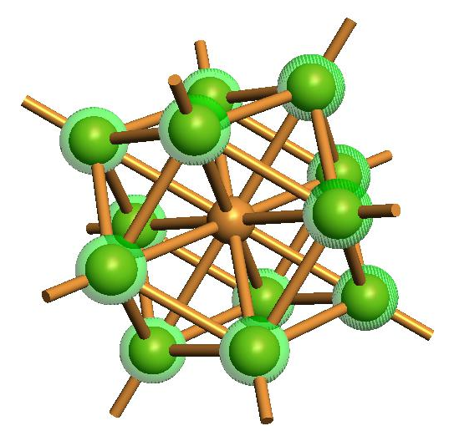
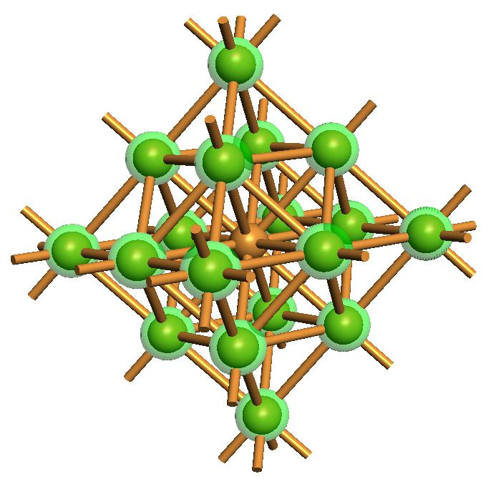


New Environment dependent TB Model - Computational Efficiency
Computational Efficiency – Orthogonal, Neighbor interaction kept to minimum required.
1st Nearest neighbor approximation for bulk, 2nd nearest neighbor approximation for nanostructures
Image from [http://www.chemcomp.com/journal/molorbs.htm]
One s, three p and 5 d
Basis of 9 orbitals
$$HΨ=ESΨ$$
Orthogonal Basis ➔$S=1\text{➔}HΨ=EΨ$
$$S^{−1}HΨ=EΨ$$
First ever orthogonal, 1st Nearest and 2nd Nearest Neighbor TB Model suitable for metals
An Environment-dependent Semi-Empirical Tight Binding Model Suitable For Electron Transport In Bulk Metals, Metal Alloys, Metallic Interfaces And Metallic Nanostructures – G. Hegde, M. Povolotskyi, T. Kubis, T. Boykin, G. Klimeck – In preparation
24
Notes:
The first criterion was computational efficiency. A key feature of this model is that it is indeed orthogonal and bulk FCC

Slide 25

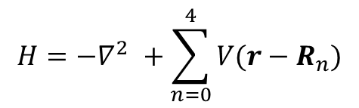




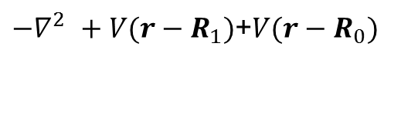



New Environment dependent TB Model - Transferability
Two center approximation
Hamiltonian elements taken between orbitals are affected only by potentials from atomic sites that the orbitals belong to
$$H={−∇}^{2 }+\sum_{n=0}^{4}{V(r−R_{n})}$$
$$H_{at,0}={−∇}^{2 }+V(r−R_{0})$$
$$e^{iθ_{1}}$$
$$e^{iθ_{2}}$$
$$e^{iθ_{4}}$$
2
$$e^{iθ_{3}}$$
1
0
sp3
3
4
s
$$H_{at,0}$$
c
s
${−∇}^{2 }+V(r−R_{1})$+$V(r−R_{0})$
s
a
s
b
p
p
d
s
$${−∇}^{2 }+V(r−R_{1})\text{+}V(r−R_{0})$$
p
$$H_{at,0}$$
25

Slide 26

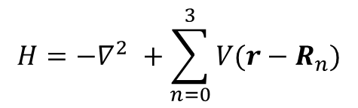




New Environment dependent TB Model - Transferability
Failure of two-center paradigm – lack of implicit self-consistency and environment awareness
$$H={−∇}^{2 }+\sum_{n=0}^{3}{V(r−R_{n})}$$
Should be non-zero when symmetry is broken
$$H_{at,0}={−∇}^{2 }+V(r−R_{0})$$
$$e^{iθ_{1}}$$
$$e^{iθ_{2}}$$
2
$$e^{iθ_{3}}$$
1
0
Diagonal terms←→ potential.
Do not change in response to environment change
3
a
s
$$H_{at,0}$$
s
A
s
$$H_{}$$
s
New Model includes these effects ➔ implicit self-consistency w.r.t change in environment
b
p
p
p
p
$$H_{at,0}$$
B
$$H_{}$$
26

Slide 27
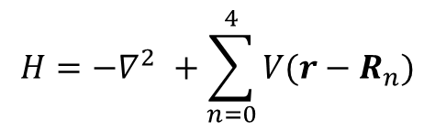


New Environment dependent TB Model - Transferability – Physical Transparency
Transparency – Variation of parameters with change in environment should be captured in a model that is physically transparent
$$H={−∇}^{2 }+\sum_{n=0}^{4}{V(r−R_{n})}$$
$$e^{iθ_{1}}$$
$$H_{at,0}={−∇}^{2 }+V(r−R_{0})$$
1
1
R₀
0
???
Strain
R
0
???
27

Slide 28
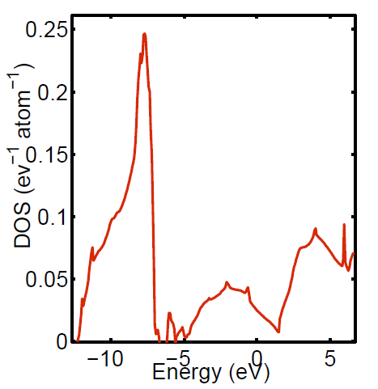
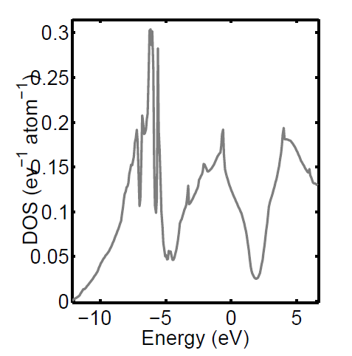
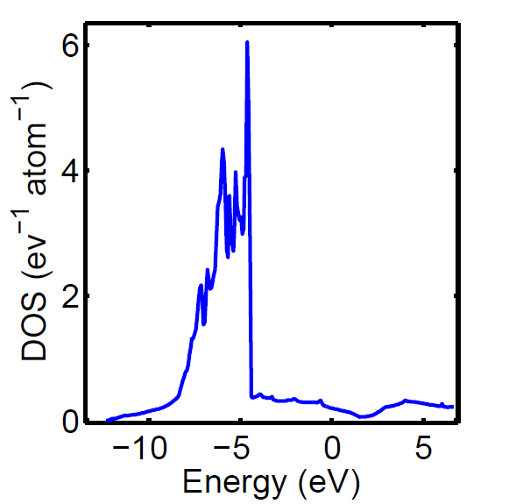
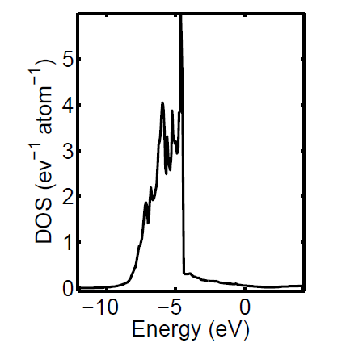
Variation in parameters – Momentum resolved LDOS and the Moments theorem
Atom projected DOS – Local DOS obtained from DFT
s-DOS
p-DOS
d-DOS
Can one use LDOS obtained from DFT calculations to find TB parameter variation??
28

Slide 29
Variation in parameters – Momentum resolved LDOS and the Moments theorem
n = 1, 2, 3,…
From Cyrot-Lackmann [J. Phys. Chem. Solids 29 (1968) 1235 ] – The ‘n’th moment of the local density of states at an atom ‘i’ is the sum of all closed electron paths of length ‘n’ hops.
Used to find LDOS without solving Schrodinger equation
Can it be used to find TB parameters if LDOS known??
α = s, p, d
1
2
Electron hops = Hamiltonian matrix elements!!!
Momentum resolved DFT LDOS ⬅➔Mathematical relationships between TB Hamiltonian elements!!!
29

Slide 30


Example – Hydrogen molecule
s orbitals on each atom interacting with each other
$$H_{}$$
On-site energy
s
s
$$H_{}$$
s
s
Two center Integral
First Moment ➔ Paths of length 1 hop
s
s
N-moments ➔ N-non-linear equations containing TB elements
Second Moment ➔ Sum of Paths of length 2 hops
Repeat for different interatomic distances
30

Slide 31
A novel mapping algorithm from DFT → TB
Obtain Orbital Resolved LDOS from DFT
DFT
Calculate ‘n’th energy moment of this DOS
No
Compute all possible closed paths of length ‘n’
TB
Mapping
Eq. sufficient?
Perform symbolic Hamiltonian parameter multiplication corresponding to path to obtain non-linear equation for nth moment
Yes
Solve ‘N’ non-linear equations to get parameters
31

Slide 32
Variation of on-site elements with strain
On-site elements = 1st moment of momentum-resolved LDOS
Find 1st moment for each lattice parameter
Cu
Instead of ad-hoc expressions assumed in literature, expression for variation is derived
Solid lines – DFT 1st moments. Dotted lines – fits
An Environment-dependent Semi-Empirical Tight Binding Model Suitable For Electron Transport In Bulk Metals, Metal Alloys, Metallic Interfaces And Metallic Nanostructures – G. Hegde, M. Povolotskyi, T. Kubis, T. Boykin, G. Klimeck – In preparation
32

Slide 33
Recap – Key features of new model
Computational Efficiency – Orthogonal, 1NN, 2NN, s,p,d basis
Transferability – Implicit self-consistency - strain, environment effects are part of model, not correction
Transparency – Variation of semi-empirical parameters obtained from moments of LDOS
Accuracy – Comparable to DFT ??
33
Notes:
The first is of course computational efficiency. We wouldn’t want to use it if it is not orders of magnitude more fficient thatn DFT. From a TB perspective it means that basis should be orthogonal and interaction between a very small number of neighbors needs to be computed. It needs to be transferable – i.e. parameters fitted for one atomic configuration should be able to predict what happens ina another atomic configuration. The model needs to be physically transparent i.e. one should not be using an arbitrary number of parameters without physical justification. The accuracy should be comparable to the state-of-the art, in our case DFT. Central contribution….
In the next few slides I will attempt to describe the features that make the new model unique and satisfy these key requirements

Slide 34
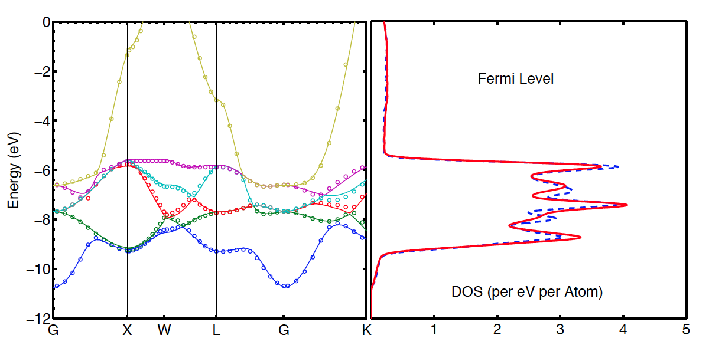
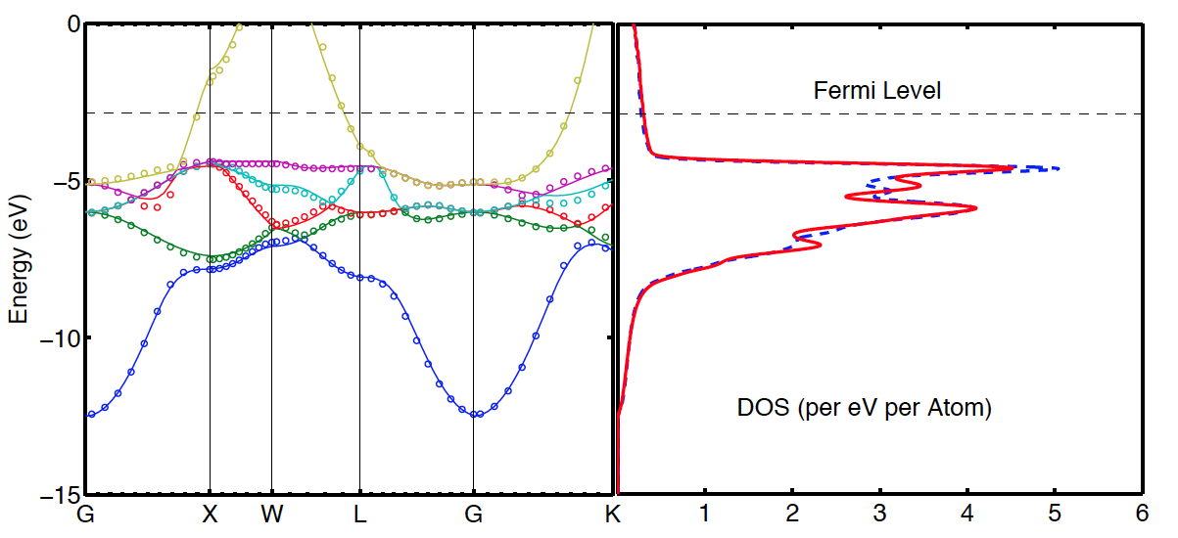
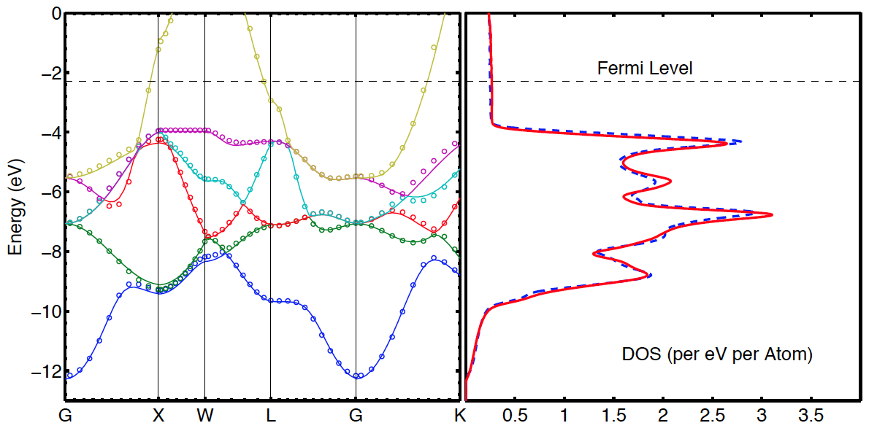
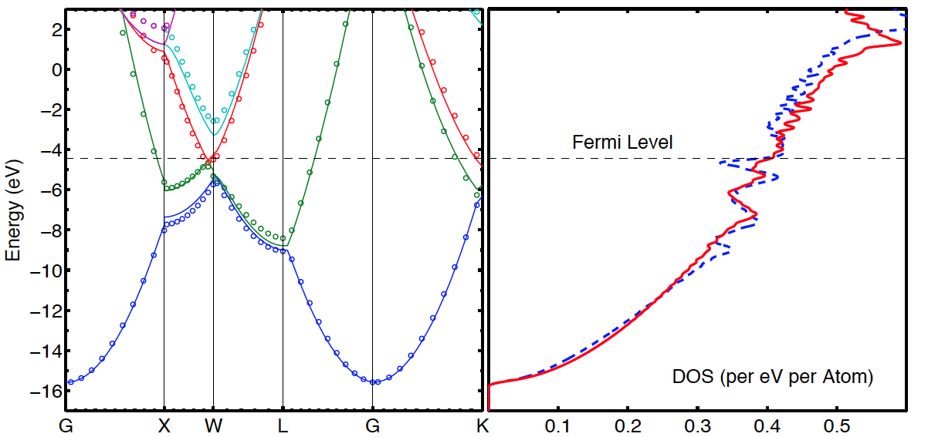
Model Validation versus DFT – bulk FCC metals
Solid Line – DFT (GGA,PBE), Dots – New TB model
RMS error up to Fermi Level ~ 5 meV
Aluminum (Al)
Gold (Au)
Silver (Ag)
Copper (Cu)
Accurate vs. DFT for ‘free-electron’ FCC metals within 1NN TB model
An Environment-dependent Semi-Empirical Tight Binding Model Suitable For Electron Transport In Bulk Metals, Metal Alloys, Metallic Interfaces And Metallic Nanostructures – G. Hegde, M. Povolotskyi, T. Kubis, T. Boykin, G. Klimeck – In preparation
34

Slide 35
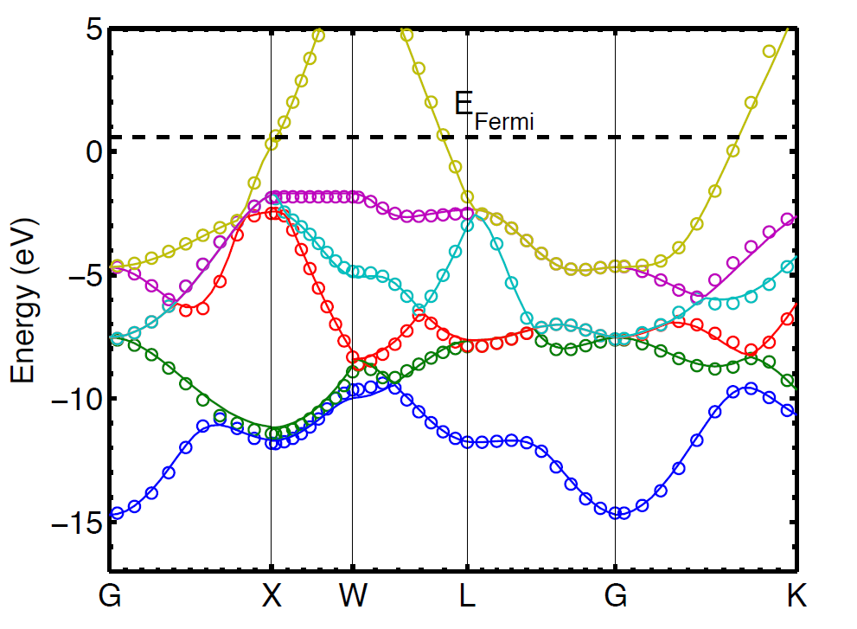
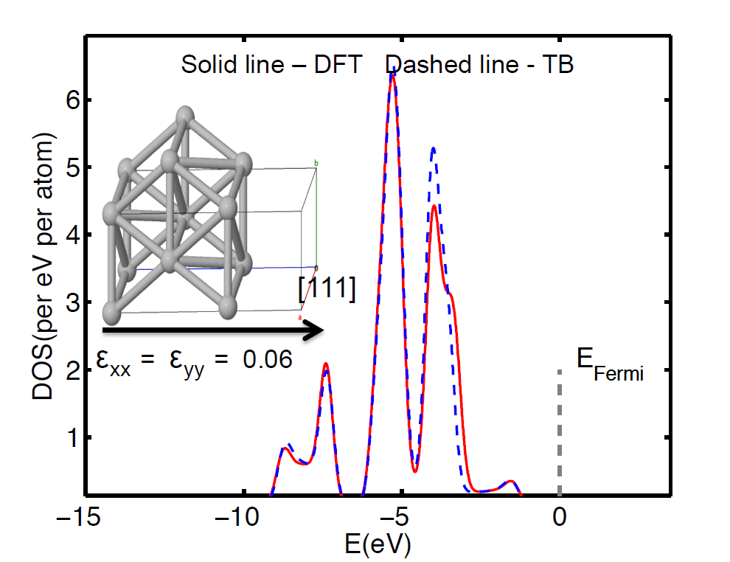
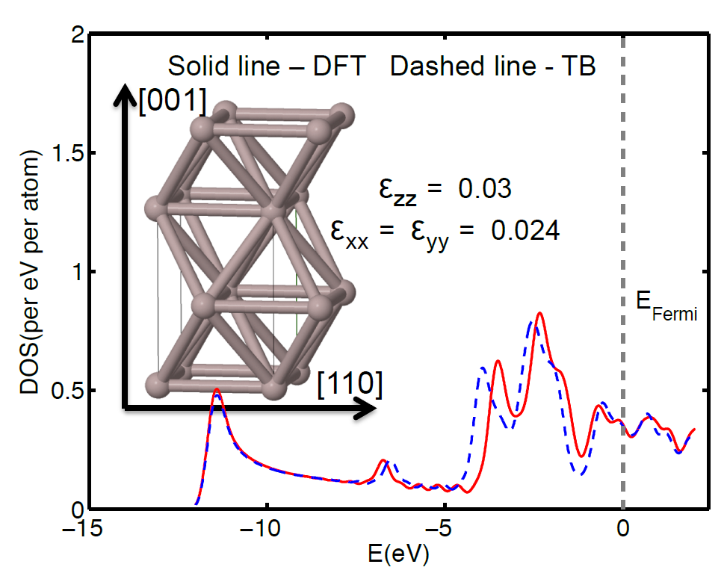
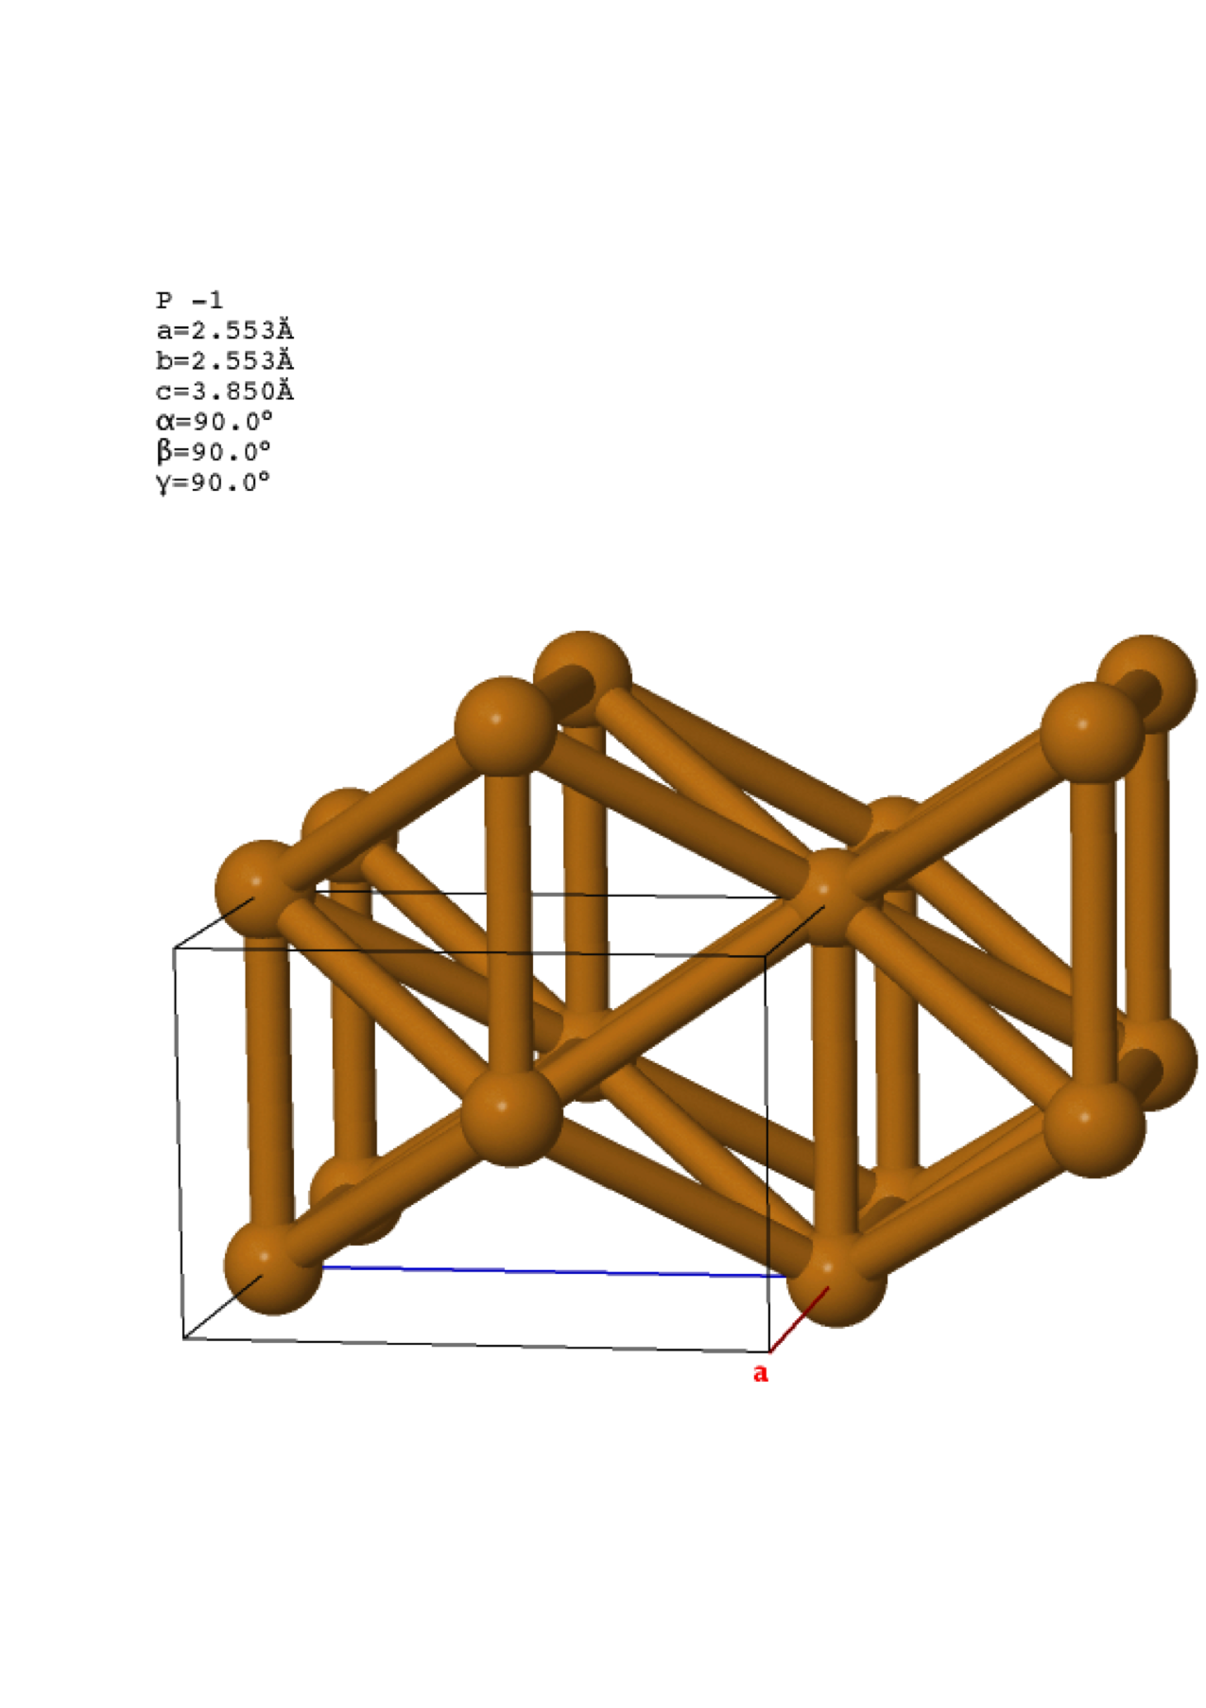
Model Validation versus DFT – Strain
Solid line – DFT Dashed line - TB
[010]
Al
Cu
Ag
[001]
ε_{zz} = 0.06
Au – 10% compressive hydrostatic strain
Same 1NN parameters also fit arbitrary strain in bulk materials!!
An Environment-dependent Semi-Empirical Tight Binding Model Suitable For Electron Transport In Bulk Metals, Metal Alloys, Metallic Interfaces And Metallic Nanostructures – G. Hegde, M. Povolotskyi, T. Kubis, T. Boykin, G. Klimeck – In preparation
35

Slide 36
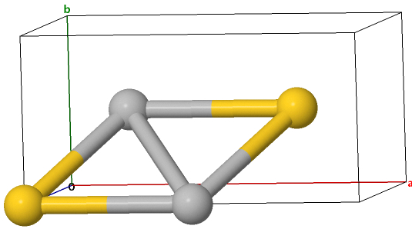
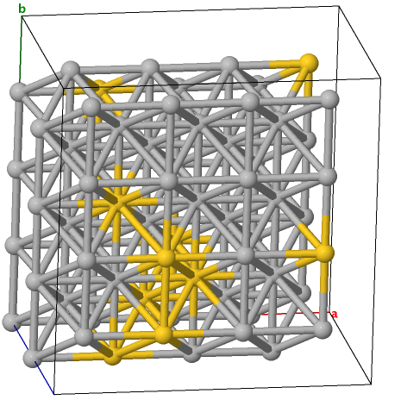
Model validation – Alloys
Solid line – DFT Dashed line - TB
[010]
Solid line – DFT Dashed line - TB
Au_{0.19}Ag_{0.81}
Au_{0.5}Ag_{0.5}
[001]
1NN parameters for individual elements also fit DFT alloy band structures well!!!
An Environment-dependent Semi-Empirical Tight Binding Model Suitable For Electron Transport In Bulk Metals, Metal Alloys, Metallic Interfaces And Metallic Nanostructures – G. Hegde, M. Povolotskyi, T. Kubis, T. Boykin, G. Klimeck – In preparation
36

Slide 37
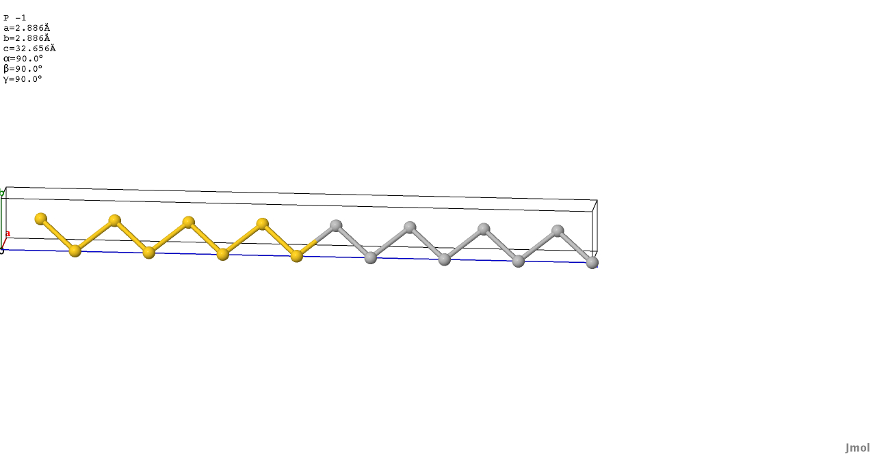
Model validation - Interfaces
Solid line – DFT Dashed line - TB
1NN parameters for individual elements also fit DFT interface band structures well!!
An Environment-dependent Semi-Empirical Tight Binding Model Suitable For Electron Transport In Bulk Metals, Metal Alloys, Metallic Interfaces And Metallic Nanostructures – G. Hegde, M. Povolotskyi, T. Kubis, T. Boykin, G. Klimeck – In preparation
37

Slide 38
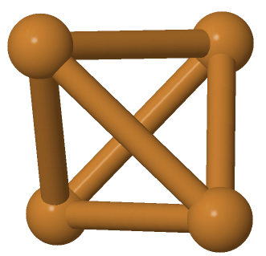


Validation - Nanostructures
Solid line – DFT Dashed line - TB
Solid line – DFT Dashed line - TB
Solid line – DFT Dashed line - TB
Cu [100] nanowire cross section
Cu [111] nanowire cross section
Cu [110] nanowire cross section
On extending to 2NN excellent fits obtained for nanostructure band structures!!
An Environment-dependent Semi-Empirical Tight Binding Model Suitable For Electron Transport In Bulk Metals, Metal Alloys, Metallic Interfaces And Metallic Nanostructures – G. Hegde, M. Povolotskyi, T. Kubis, T. Boykin, G. Klimeck – In preparation
38

Slide 39



Application – effect of dimensionality on resistivity of Cu
Aim
To determine effect of confinement on resistivity in Cu
Method
Ideal Cu cross sections along [100], [110], [111] constructed.
2 different boundary conditions used – 3D periodic (bulk), 1d periodic (nanowire)
Transmission vs. Cross sectional Area at Fermi Level computed for each orientation and dimensionality.
bulk
Confinement has anisotropic effect on resistivity in Cu nanowires!!
39

Slide 40

Application – effect of homogeneous strain on copper resistivity
Fig. from James Charles
-5%
Homogeneous strain
-5% to +5%
Steps of 1 percent
How does conductivity change?
+5%
Zero strain
Recall
Strain = (a-a₀)/a₀
Resistivity inversely proportional to slope
Compressive strain ➔ Same number of modes crammed in smaller cross section ➔ Increases slope
Compressive strain decreases nanowire resistivity!!!
40

Slide 41
Application - Si/Silicides in the new TB model
Bulk Si at experimental lattice parameter vs. DFT (MGGA)
Si in bulk Nickel Silicide (NiSi₂) vs. DFT (MGGA)
Same Si-Si interaction parameters used in both NiSi₂ and Si

Slide 42

Applications – M-S Interfaces
Solid Lines – Results from DFT Circles – TB results
Dashed Line – Fermi Level
[001]
[100]
Same Si-Si, Cu-Cu 1NN interactions, only Si-Cu interactions parameterized

Slide 43
Metal/Metal Interfaces
Metal/Semiconductor Interfaces
Oxide/III-V Semiconductor Interfaces
43

Slide 44


Metal-Semiconductor interfaces work
Aim
To study effect of interface chemistry on electrical properties of Cu-Si interface
Method
Cu and Si structures of different orientation created
Reactive Force Field used to perform MD simulations
Relaxed structures imported into ATK DFT code
Transport simulations on un-doped and doped relaxed structures carried out
Results
Insignificant Cu diffusion into Si
Insignificant change in transmission characteristics due to interface chemistry
Strong Fermi-Level Pinning seen regardless of chemistry
Cu
Si
NVT+NVE – 20 ps heat (300K->900K)
100 ps hold at 900K
20 ps cool (900K->300K), 0.5 fs time step
p-doping
n-doping
44
Simulations designed by Ganesh Hegde, performed by Kaspar Haume. Figures by Kaspar Haume.

Slide 45
Metal/Metal Interfaces
Metal/Semiconductor Interfaces
Oxide/III-V Semiconductor Interfaces

Slide 46

III-V/Oxide interfaces-Summary
Motivation
Experiments on ALD Al2O3/GaAs NMOS devices showed 10⁵ variation in ON current from (111)B -> (111)A.
Devices showed significantly different pinning behavior but cause unknown.
Need model that captures interface chemistry and electronic structure.
Approach
Compute reaction pathways for OH passivated (111)A and B substrates with Trimethylaluminum (TMA) and H₂O as precursors in each half cycle.
Result
(111)A and B interfaces are significantly different after 1st cycle of ALD reactions. (see figure)
DOS computed in DFT shows clear signature of pinning in (111)B while absent in (111)A
(111)A
(111)B
Impact
First demonstration of atomistic mechanism of ‘self-cleaning effect’ in ALD
As-Al bonding and significant strain at interface was shown to be cause of pinning and poor NMOS performance
46

Slide 47
Other research completed/publications
MPI-parallel MATLAB code at Intel Corporation (2011)
  Tight Binding (TB) electronic structure
  NEGF+TB transport in semiconductors, metals, metal nanostructures
  Created from ground up in 3 Months
  Currently used for studying transport in metals at Intel Corp.
Incorporating new features into NEMO5 – C++ Software Development
  Metals in NEMO5
  NRL Tight Binding method implemented in NEMO5
“Role of surface orientation on atomic layer deposited Al2O3/GaAs interface structure and Fermi level pinning: A density functional theory study” – G. Hegde, G. Klimeck, A. Strachan, Appl. Phys. Lett. 99, 093508 (2011)
“An Environment-dependent Semi-Empirical Tight Binding Model Suitable For Electron Transport In Bulk Metals, Metal Alloys, Metallic Interfaces And Metallic Nanostructures” – G. Hegde, M. Povolotskyi, T. Kubis, T. Boykin, G. Klimeck – In preparation
“The effect of quantum mechanical confinement , transport orientation and strain on electronic transport in Cu”, G. Hegde, M. Povolotskyi, T. Kubis, J. Charles, G. Klimeck - In preparation
47

Slide 48
Summary of key messages/achievements in thesis
A environment-dependent TB model that enables scalable atomistic modeling of metals, metal alloys, , metal-metal, metal-semiconductor interfaces has been developed
  Comparable accuracy vs. DFT
  Transferable
  Computationally Efficient
  Physically Transparent
Confinement has anisotropic effect on conductivity of Cu, compressive strain can improve copper conductivity.
MD and transport simulations on M-S interfaces showed insignificant effect of interface chemistry on electronic transport
DFT Reaction pathway simulations on III-V/ALD Oxide interfaces showed
  Strong influence of interface chemistry on eventual electronic structure
  Pinning arising from As-Al and strain at the interfaces
Modeling interface chemistry and studying electronic structure atomistically can enable significant insight into mechanisms governing electron transport at interfaces.

Slide 49
Future Work – Throwing the gauntlet
  Full polycrystalline transport
  How does geometry, aspect ratio affect resistivity?
  How does the liner layer scattering affect resistivity?
  Effect of non-homogeneous strain on conductivity
  Effect of alloying on conductivity
  Material parameterization – Ru, Ta-Cu, Ru-Cu and so on…
  M-S interfaces
    Parameters needed for silicide-Si interactions
    Poisson at M-S interfaces
    Reactive Force Field parameterization for silicides, metals

Slide 50
Acknowledgments
NSF/NCN, SRC/Intel, MSD for funding support
Purdue
Profs. Klimeck, Ye, Strachan, Fisher, Kubis, Datta, Lundstrom, Boykin (UAH)
All Klimeck group and DLR members for help and interesting discussions.
Intel
Sadasivan Shankar, Michael Haverty, Roksana Golizadeh Mojarad
Others
Friends who made life in West Lafayette infinitely more interesting than it would have been without them!
Vicki Johnson, Cheryl Haines

Slide 51
Thank You

Slide 52
Questions

Slide 53
Onsite intra-atomic elements in the TB model
On-site block (diagonal elements)
Additional terms
Reference - Mercer et al. Phys. Rev. B, 49, 8506–8509 (1994) - Intra-atomic terms in the Tight Binding model
Similar expressions can be written for on-site, off-diagonal elements.
Following Mercer et al. Intra-atomic integrals will be referred to using syntax I_{ll’m} similar to V_{ll’m} in the Slater-Koster two-center integral table.

Slide 54
Differences between Slater-Koster tables for on-site terms and two-center terms
Under simultaneous interchange of angular momentum indices, the elements retain their signs
On-site integrals
Two-center integrals

Slide 55
On-site Hamiltonian block for bulk Cu in FCC lattice in sp3d5 basis
On-site elements now contain contributions from all neighbors, thus introducing environment dependence into the usual SETB model
Under in-homegenous strain, direction cosines between pairs of atoms change, breaking symmetry and this will lead to off-diagonal terms in the diagonal block

Slide 56


Interface Chemistry dependent transport at Cu-Si interfaces using ReaxFF and DFT/TB
ReaxFF – Reactive Force Fields for Molecular Dynamics
Solve Newton’s equations using total energy fitted to a variety of bonding arrangements
Heat up/cool down system to simulate annealing – global minimum
Empirical method. Parameters available with corrections for
  Over/Under Coordination
  Bond Angle distortion
  Van Der Waals interaction
  Screening interaction
Parameterized vs. total energy QC calculations of small clusters and molecules
Pt/Methanol interface
Water/Metal Oxide interface
ReaxFF can be used to study interface chemistry
One can compute effect of interface chemistry on electronic transport
Figures from http://www.engr.psu.edu/adri/Home.aspx

Slide 58





Against this backdrop, interesting experiment
Gate (Metal)
Gate (Metal)
Gate (Metal)
Al₂O₃
Al₂O₃
Al₂O₃
[111]
[110]
[001]
(111)A – Ga rich surface, (111)B – As rich surface
As
Ga

Slide 59
Key Result
X 85,000
I = Q.v Q ~ (m_{eff})^{3/2}, v ~ 1/m_{eff} , m_{eff} – Isotropic for GaAs
Additionally, (111)B showed ~ zero current ➔ FLP not an intrinsic property
Figures courtesy of Min Xu
Notes:
59

Slide 60
Our approach – unbiased DFT study of energetics of ALD reactions
Chemical Reaction
A + B ➔ C + D↑
Semiconductor Slab (111)A/B
ALD precursors
Slab + complex
CH₄
Energy
A*+B*
C + D
Unfavorable
A + B
Favorable
C + D

Slide 61

(111)A/B-OH surfaces → starting point
(111)B
(111)A
2(As*-OH) → As*-O-As* + H₂O
2(Ga*-OH) ← Ga*-O-Ga* + H₂O
(111)A is more hydrophilic than (111)B – matches experiment!

Slide 62
(111)B – ALD half reactions
  As*-O- As* + (AlCH₃)₃ → As*-Al(CH₃)-As* + CH₃-O-CH₃ ↑(dimethyl ether)
  As*-Al(CH₃)-As* + H₂O → As*-Al(OH)-As* +CH₄ ↑
Preferential Self-Cleaning of As species in ALD!!

Slide 63
Atomic and electronic structure - comparison
(111)A – Max current – good unpinning, (111)B – zero current – heavy pinning
(111)A
(111)B

Slide 64
States in band gap - Fermi Level Pinning
Ideally
In reality
Inversion layer of free carriers
M
O
S
No inversion!
E_{C}
E_{C}
E_{F}
E_{F}
E_{V}
E_{V}
Allowed states in band gap ➔ occupied by electrons/holes at all times ➔ No/partial gate control ➔ Poor transistor!!!
Some figures in this slide are courtesy of Min Xu
Notes:
64

