Slide 1
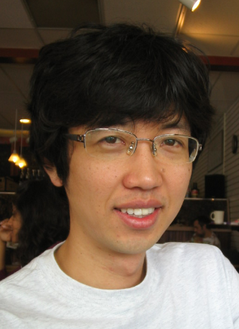
Theoretical and Experimental Study on Graphene Nanoribbon Tunneling Transistor
SungGeun Kim
Advisor: Prof. Gerhard Klimeck
Electrical and Computer Engineering
Purdue University
Please do not distribute.
1

Slide 2
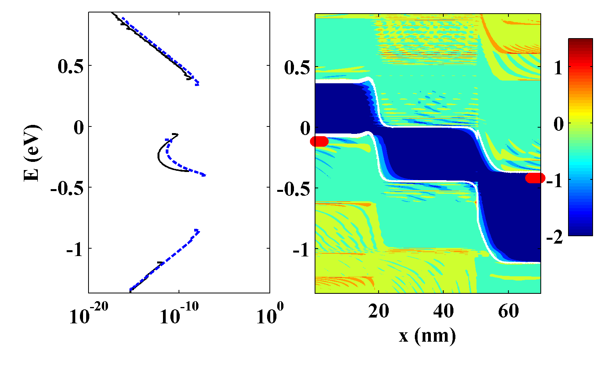
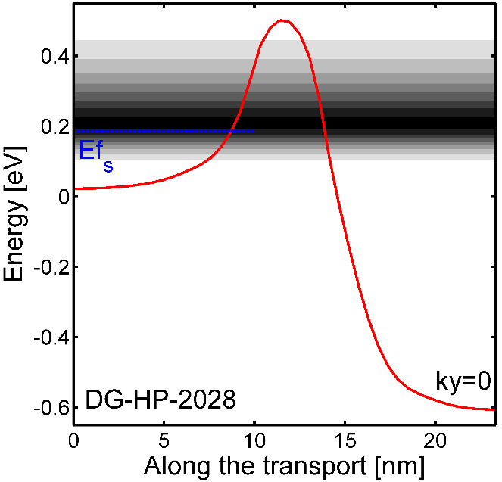
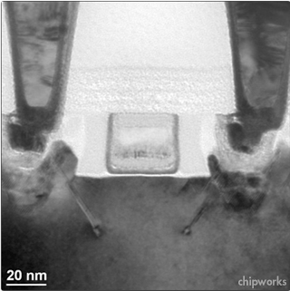
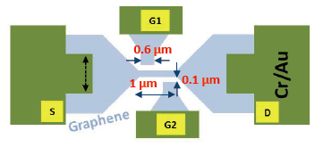
Outline
Challenges for conventional transistor
Size scaling
Supply voltage scaling
G
S
D
Therm.
Edge roughness effects
V_{d}
Metal
Vdd
TFET as a solution for low power operation
Why GNR TFET?
Tunn.
S
Oxide
D
i
p+
n+
I_{d}
C
98% tunneling current
→SS degradation
Therm.
H
Challenges to GNR TFET
Doping
ON/OFF current
Edge-roughness
L_{G}
log₁₀DOS
Credit: Mehdi Salmani
Electrostatic Doping
Summary/Conclusion
Notes:
geometrical scaling

Slide 3
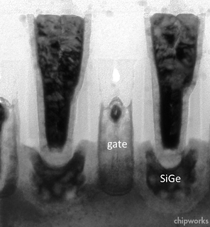
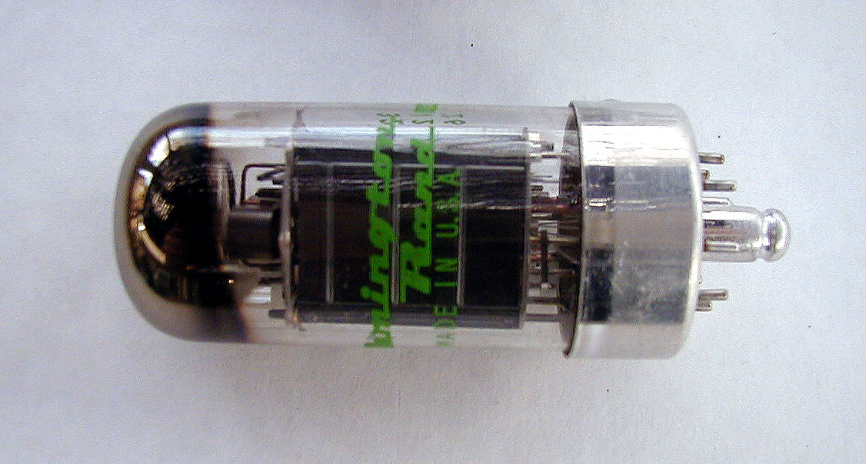
Transistor Scaling
2013
CPU
1946
intel.com
computermuseum.li
Vacuum tube (Eniac)
Transistor
www.goldstardsimulations.com
Size scaling ~cm→~nm
Size Scaling
Power Scaling
www.nokiainnovation.com
intel.com
Voltage scaling 240V→1.6V
Transistor is driving the size and power scaling of electronic devices.
microsoftstore.com

Slide 4
Future Projection for Transistor Scaling
25%↓
Short channel effects
Vdd
DIBL increase
S-to-D tunneling
L_{G}
75%↓
Vth shift
SS degradation
ON-current reduction
ITRS 2012
chipworks
ITRS projects that size/supply voltage scales significantly in the future.
Notes:
conduction band edge profile

Slide 5
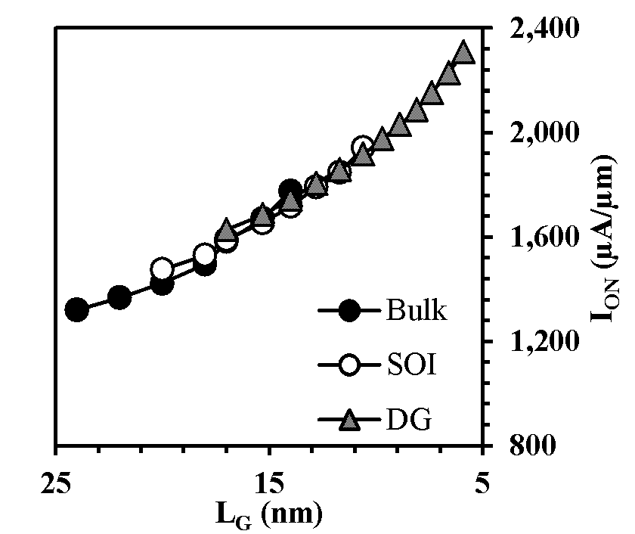
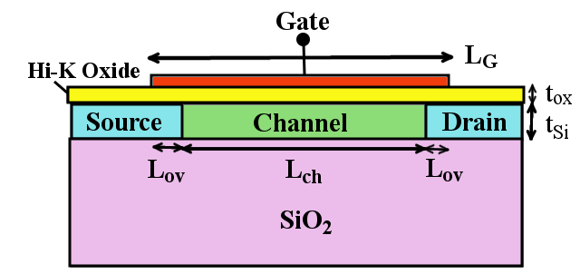
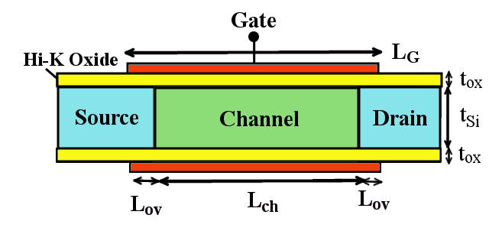
Transistor Performance Projection of ITRS
Bulk
Gate
ITRS2012
S
D
I_{OFF}=0.1 μA/μm
Oxide
Channel
Source
Drain
ITRS 2012 (MASTAR)
Analytical model based on drift-diffusion
No 2D electrostatic
No realistic quantum effects
Mobility/v_{sat} fitting
I_{on} as a target
SOI
DG
ON-current increase as L_{G}↓

Slide 6
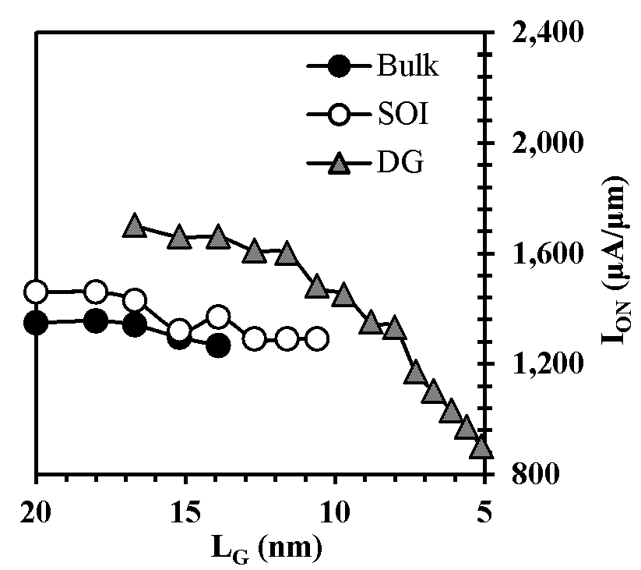
Analytical Modeling vs. Quantum Transport
Drift diffusion with quantum corrections (IEEE, TED, submitted)
confinement (calibrated with 1D Schroe.-Poisson)
ballistic mobility (good match with exp.)
quasi-ballistic transport (calibrated with M.C.)
Calibrated with exp. (Samsung 20 nm/Intel 32 nm)
DD/QT Simulation Results-ITRS2014
ITRS2012
I_{OFF}=0.1 μA/μm
QCDD
Ballistic
+Scattering
Ballistic+Scattering
Quantum transport: ballistic
$T=\frac{λ}{λ+l}, B=\frac{T}{2−T}=\frac{Iscatt}{Iball}$
$λ$: mean free path calculated from experimental mobility
SOI/DG Data: Mehdi Salmani
I_{OFF}=0.1 μA/μm
ON-current increase as L_{G}↓
ON-current decrease as L_{G}↓
Series Resistance: I_{ON} reduction by 33% (same as previous ITRS)
Reducing channel length of Bulk/SOI/DGFET degrades ON-current.
Notes:
Ioff=0.1uA/um

Slide 7
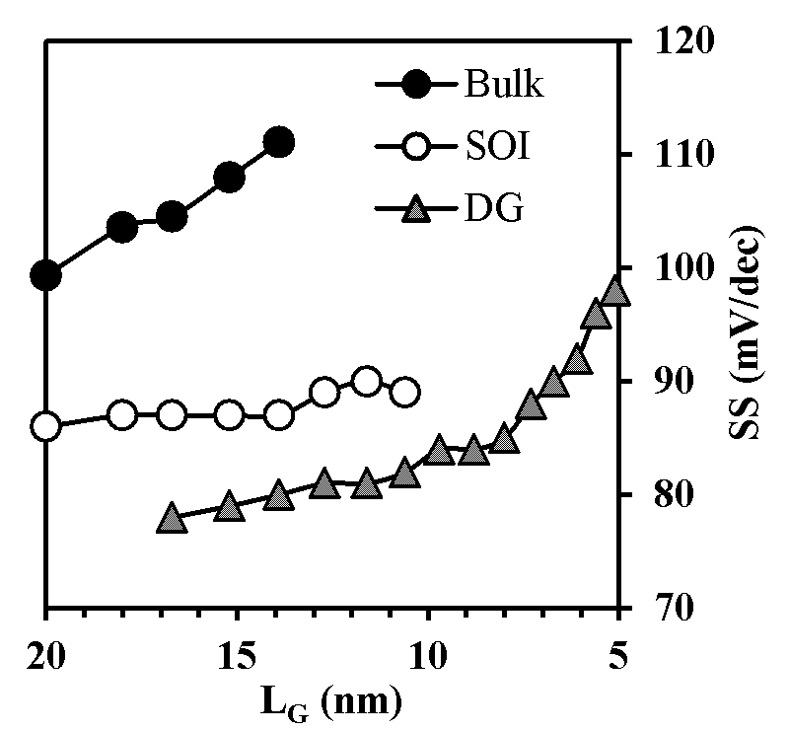
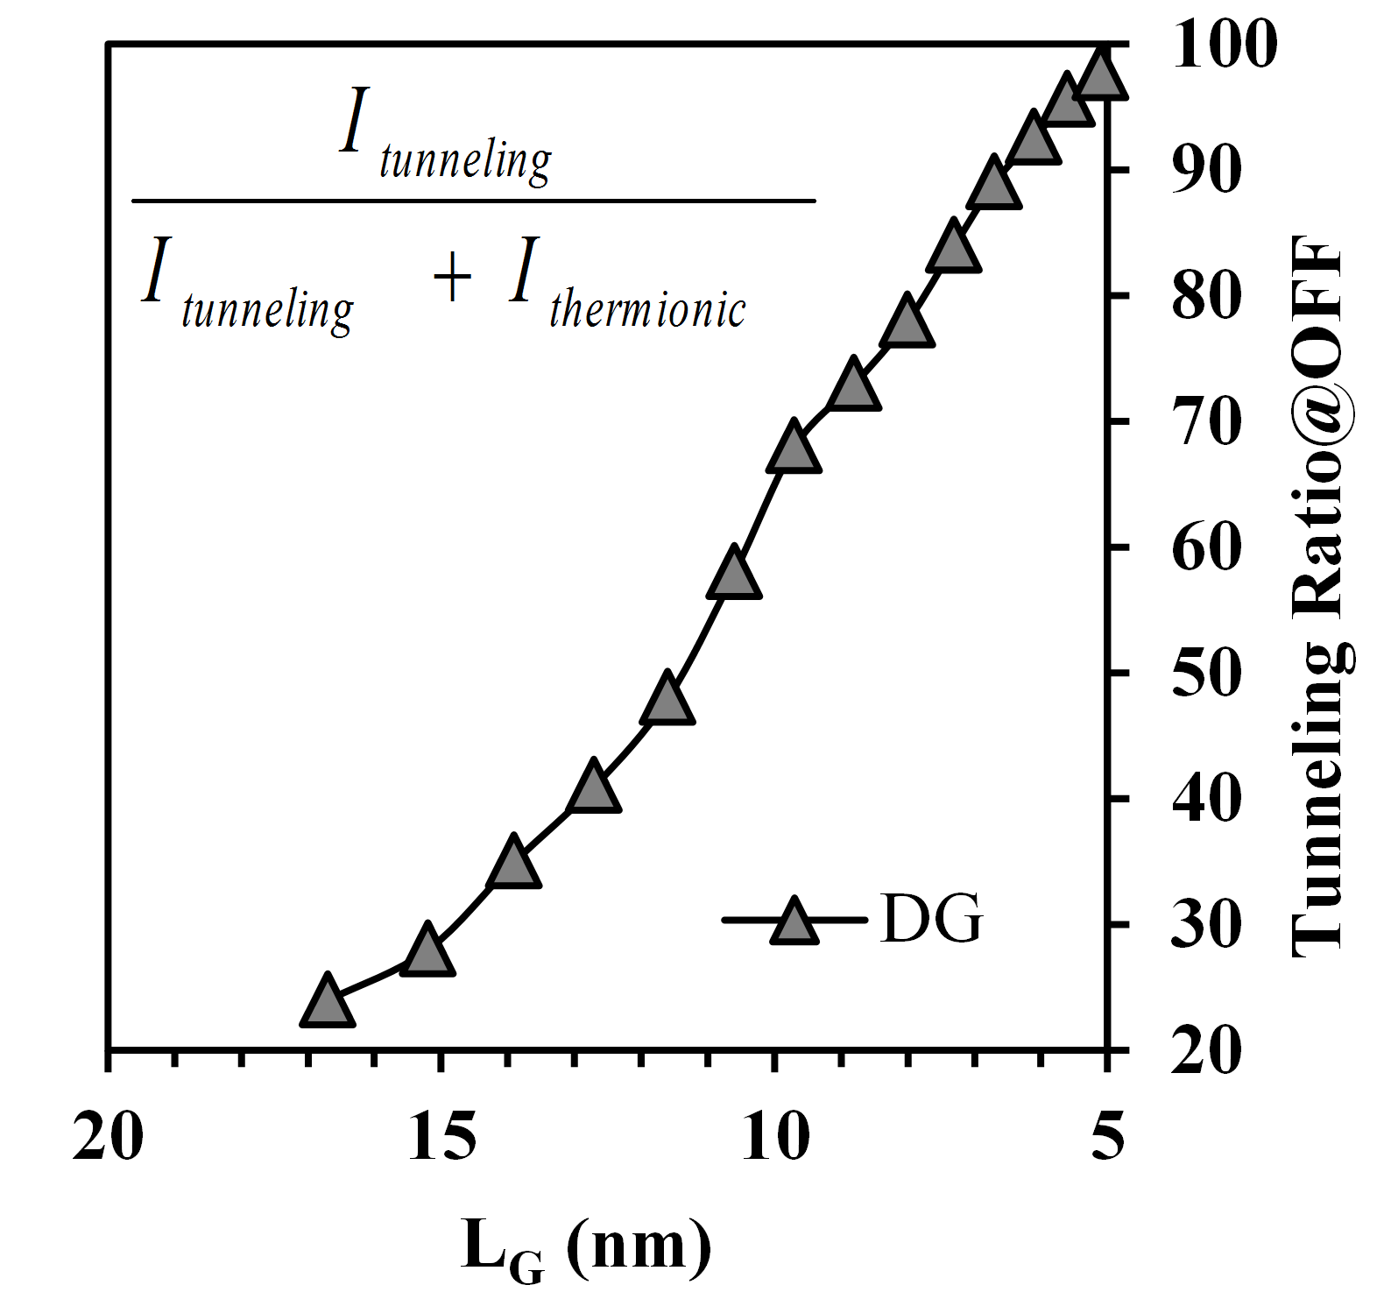
Short Channel Effects/S-D tunneling
Significant short channel effects (DIBL, S-to-D tunneling effects)
Barrier Controlled Device has NO Barrier??
SOI/DG Data: Mehdi Salmani
(%)
@OFF
98% tunneling current
→SS degradation
We may need a fundamentally different device structure
that can utilize tunneling!
Notes:
Itunneling/Ioff
Put arrows correctly

Slide 8
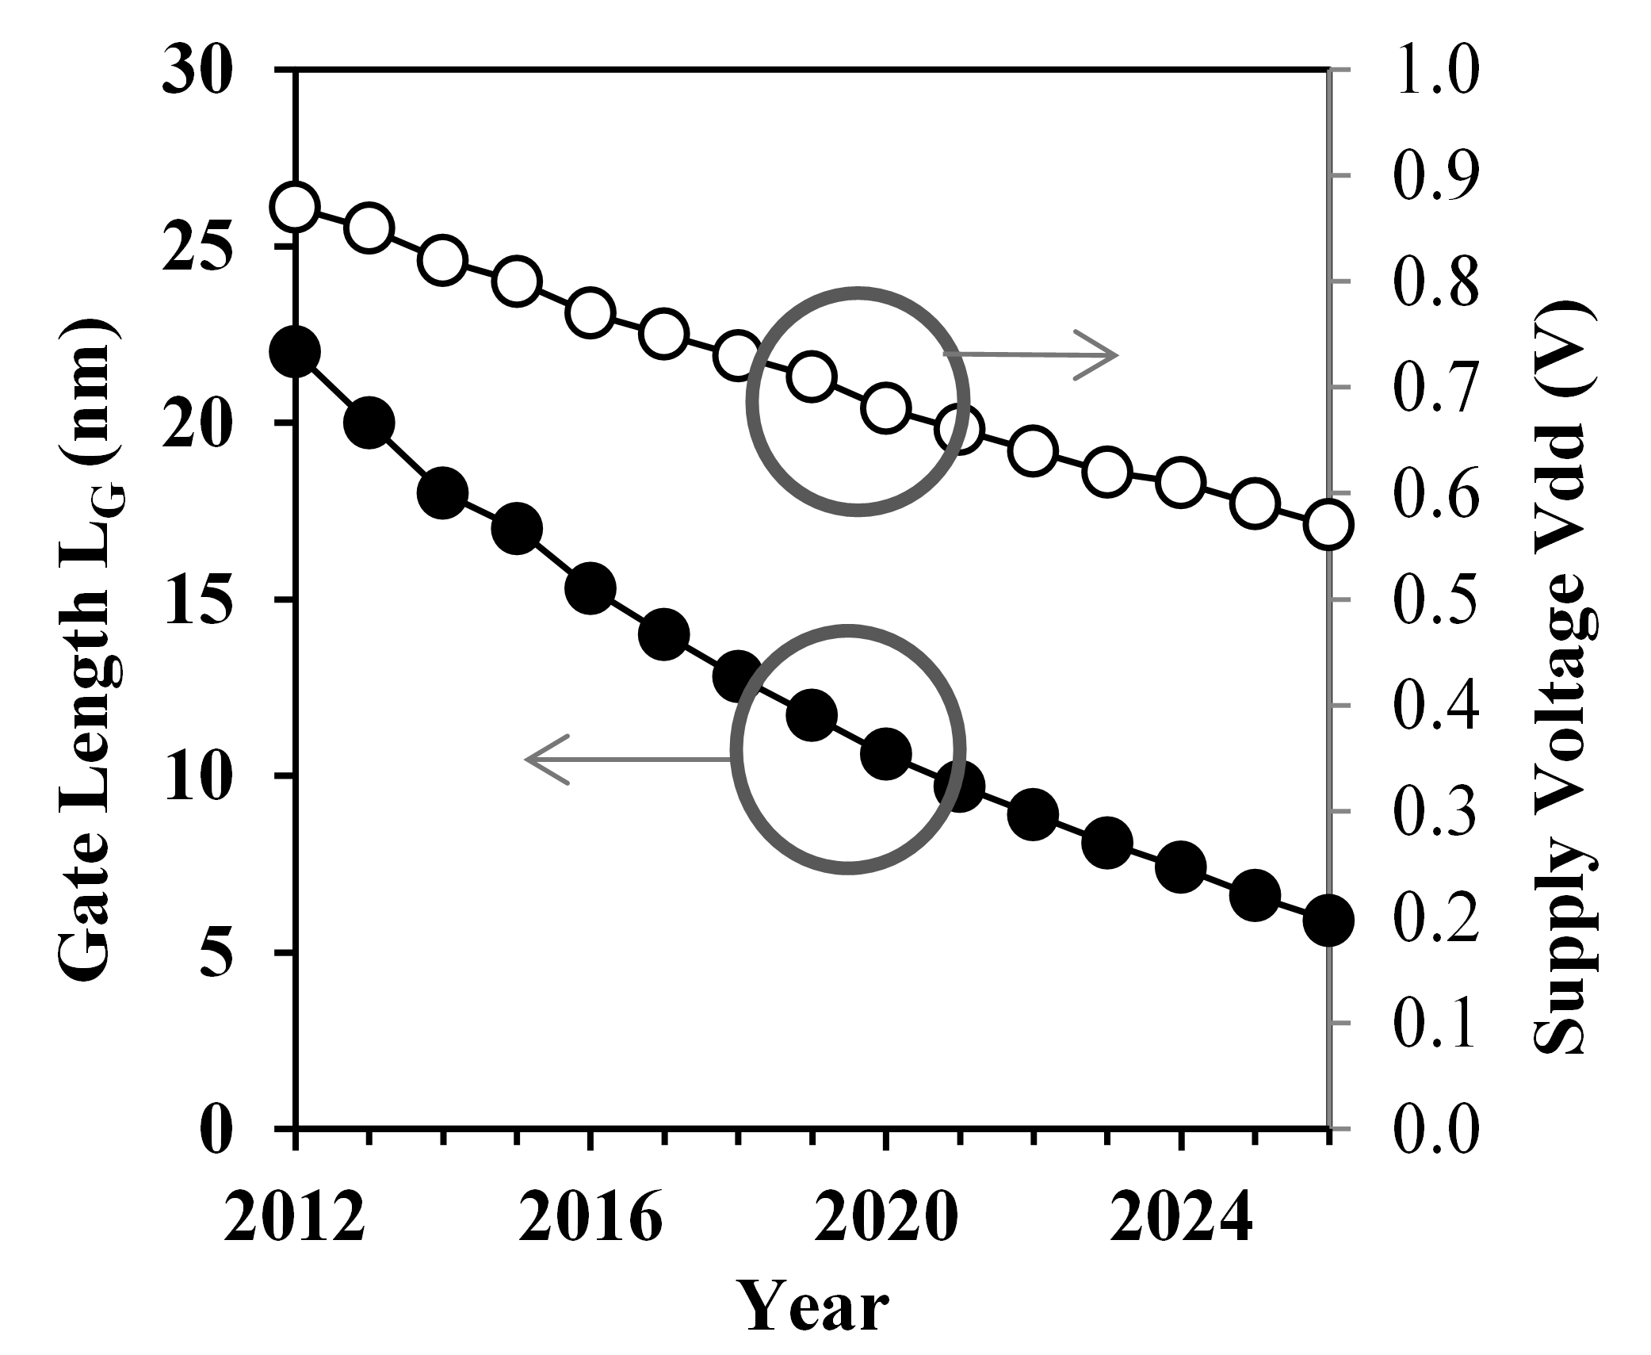
Slow Supply Voltage Scaling
Much slow supply voltage scaling? Why?
ITRS 2012
25%↓
75%↓
Obstacle: short channel effects
Notes:
put the arrows opposite direction

Slide 9
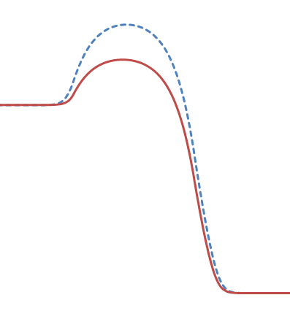
Fundamental Limit of Conventional Transistor
Need completely different structure/material
Vg
S
D
log I_{d}
Metal
Oxide
n+
p
Id
n+
log f(E)
SS≥60 mV/dec
Hot injection
Vg↑
Ef
0
V_{dd}
V_{g}
E
Reducing supply voltage has big impacts on on-current
because of SS>60 mV/dec limit.
x
Hot injection limits the SS of conventional transistors.

Slide 10
Tunneling Transistor for Low Power
Structure
Solve the power problem!
log I_{d}
P=fCV_{dd}²
G
S
D
TFET
Metal
Conv.
Oxide
p+
i
n+
log f(E)
SS=60 mV/dec
T(E)
Ef
0
V_{dd}
V_{g}
Cold injection
Cold injection is necessary for sub-60mV/dec operation.
V_{dd} can be scaled more aggresively
10

Slide 11
Choice of Material/Structure for Good TFET
Material
G
Metal
Oxide
p+
i
n+
E_{g}
log f(E)
T(E)
Ef
λ
Cold injection
A. Seabaugh, Proceedings of the IEEE, 2010
Low bandgap
Low effective mass
better gate control (1D)→ small screening length
Good TFET
Graphene nanoribbon
11

Slide 12
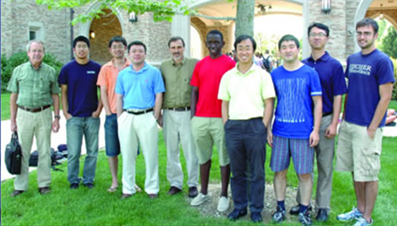
GNRTFET Experiment
Many theoretical studies have been presented, but no actual experimental realization of GNRTFET before.
Collaboration with University of NotreDame
Challenges in doping GNR
Challenges in creating p-n junction
Dr. Wansik Hwang, Dr. Susan Fullerton
GNRTFET experiment
Notes:
before

Slide 13
Challenge in Doping GNRs
Gate
Metal
Oxide
i
p+
n+

Slide 14
Challenge in Doping GNRs
Gate
Metal
Oxide
Chemical doping: D. B. Farmer et al., APL, 2009
Metallization: B. Huard, et al., PRB, 2008
Substrate doping: H. E. Romero, ACS Nano, 2008
Difficult in controlling at nano-scale
Not easy to reproduce

Slide 15
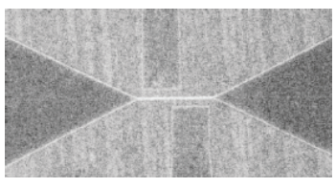
GNRTFET Structure with Electro-static doping
PEO: Polymer Electrolyte
W. Hwang, et al., ND
Electrostatic doping with PEO: easy to control in nanoscale
Very efficient doping method: high charge density (Philip Kim, 2007)
n/p>10¹⁴cm⁻²

Slide 16
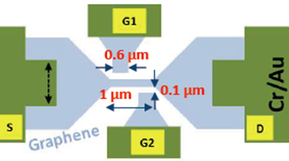
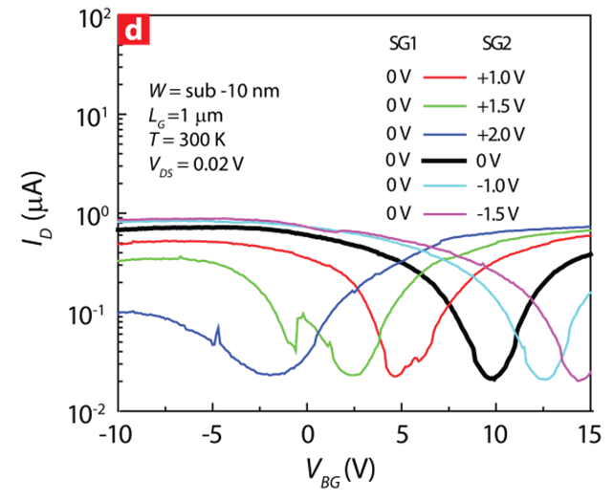
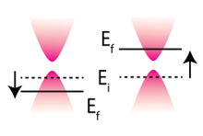
I_{D}-V_{BG} Characteristics
V_{G1}
V_{G2}
W=10 nm
P
N
Efficiency of doping in GNR with side gates
GNR is originally p-type.

Slide 17
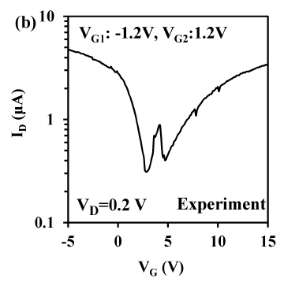
I_{D}-V_{BG} Characteristics
P
N
Efficiency of doping in GNR with side gates
GNR is originally p-type (on SiO₂).
Double dips in Id-Vg shows p-n junction characteristics.
E_{fD}
E_{fS}

Slide 18
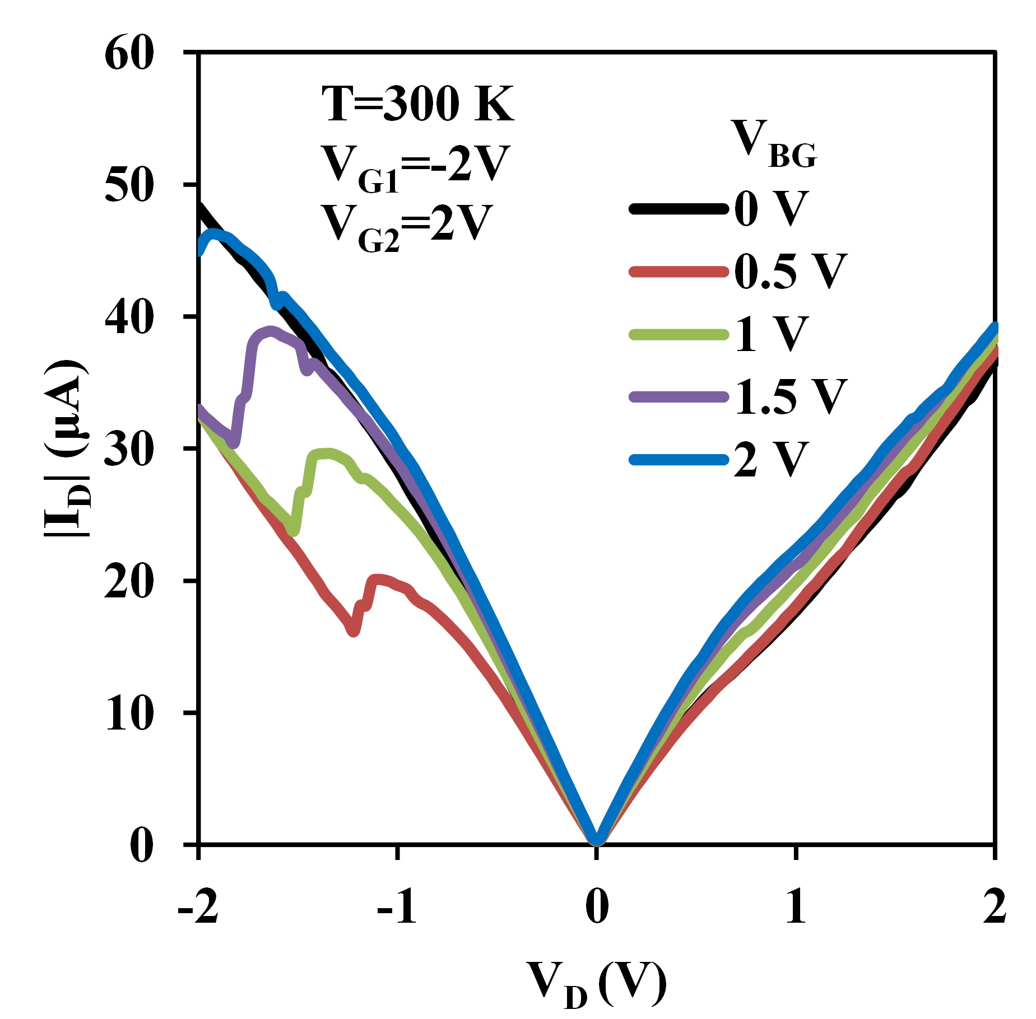
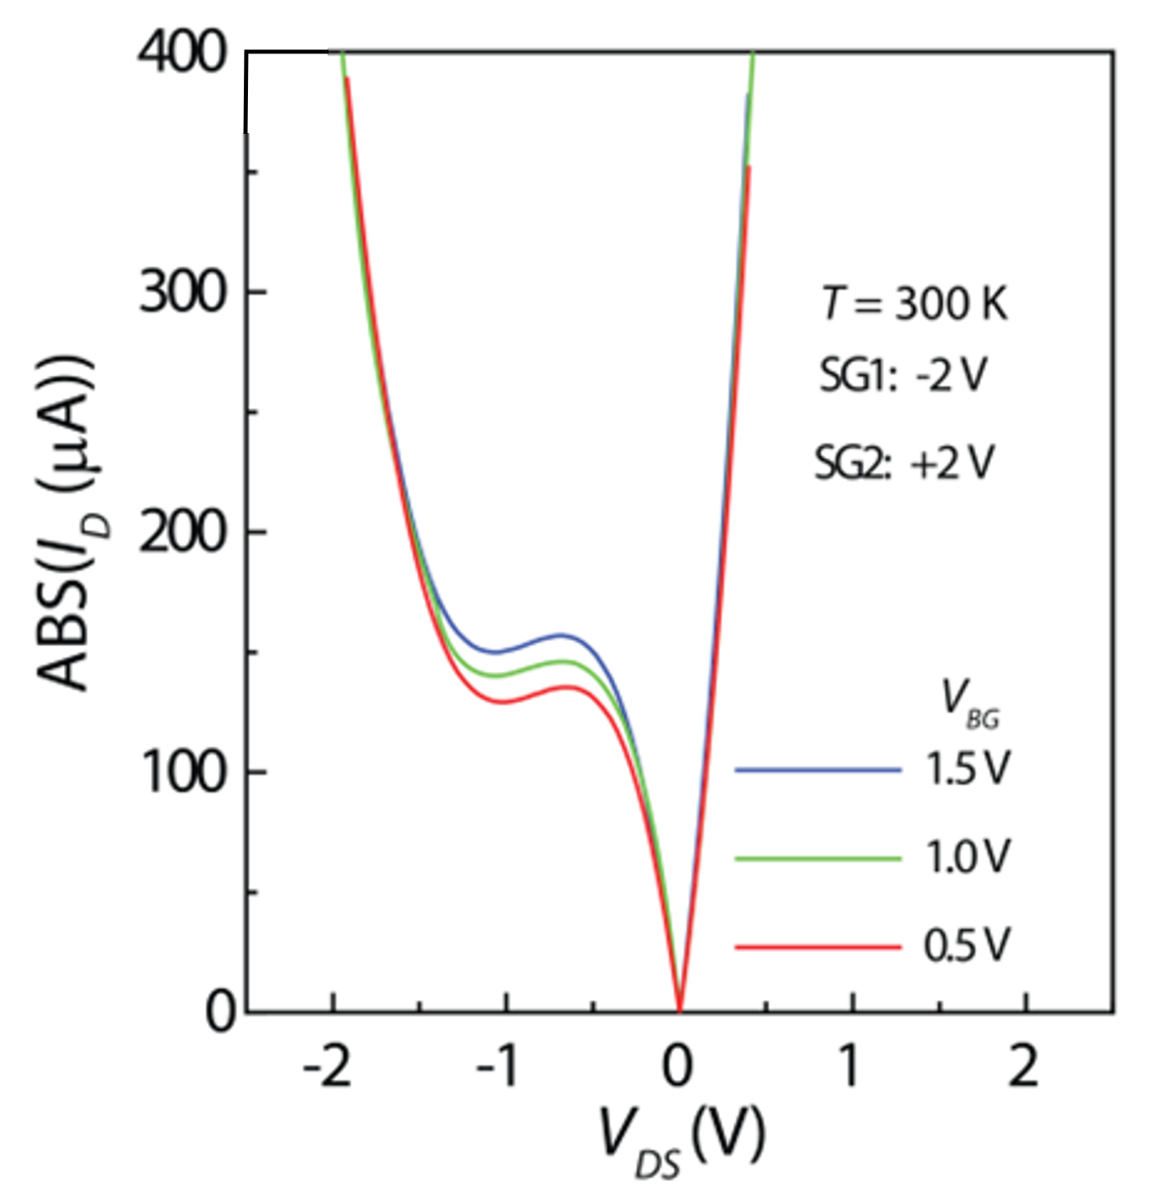
Experiment vs. Drift-diffusion (NotreDame)
Experiment
Drift-diffusion (ND)
First experimental data that shows NDR in GNRTFET.
NDR tells that there is a p-n junction with very high doping concentrations.
Drift-diffusion simulation gives a qualitative picture, but not quantitative one: quantum transport simulation needed.

Slide 19
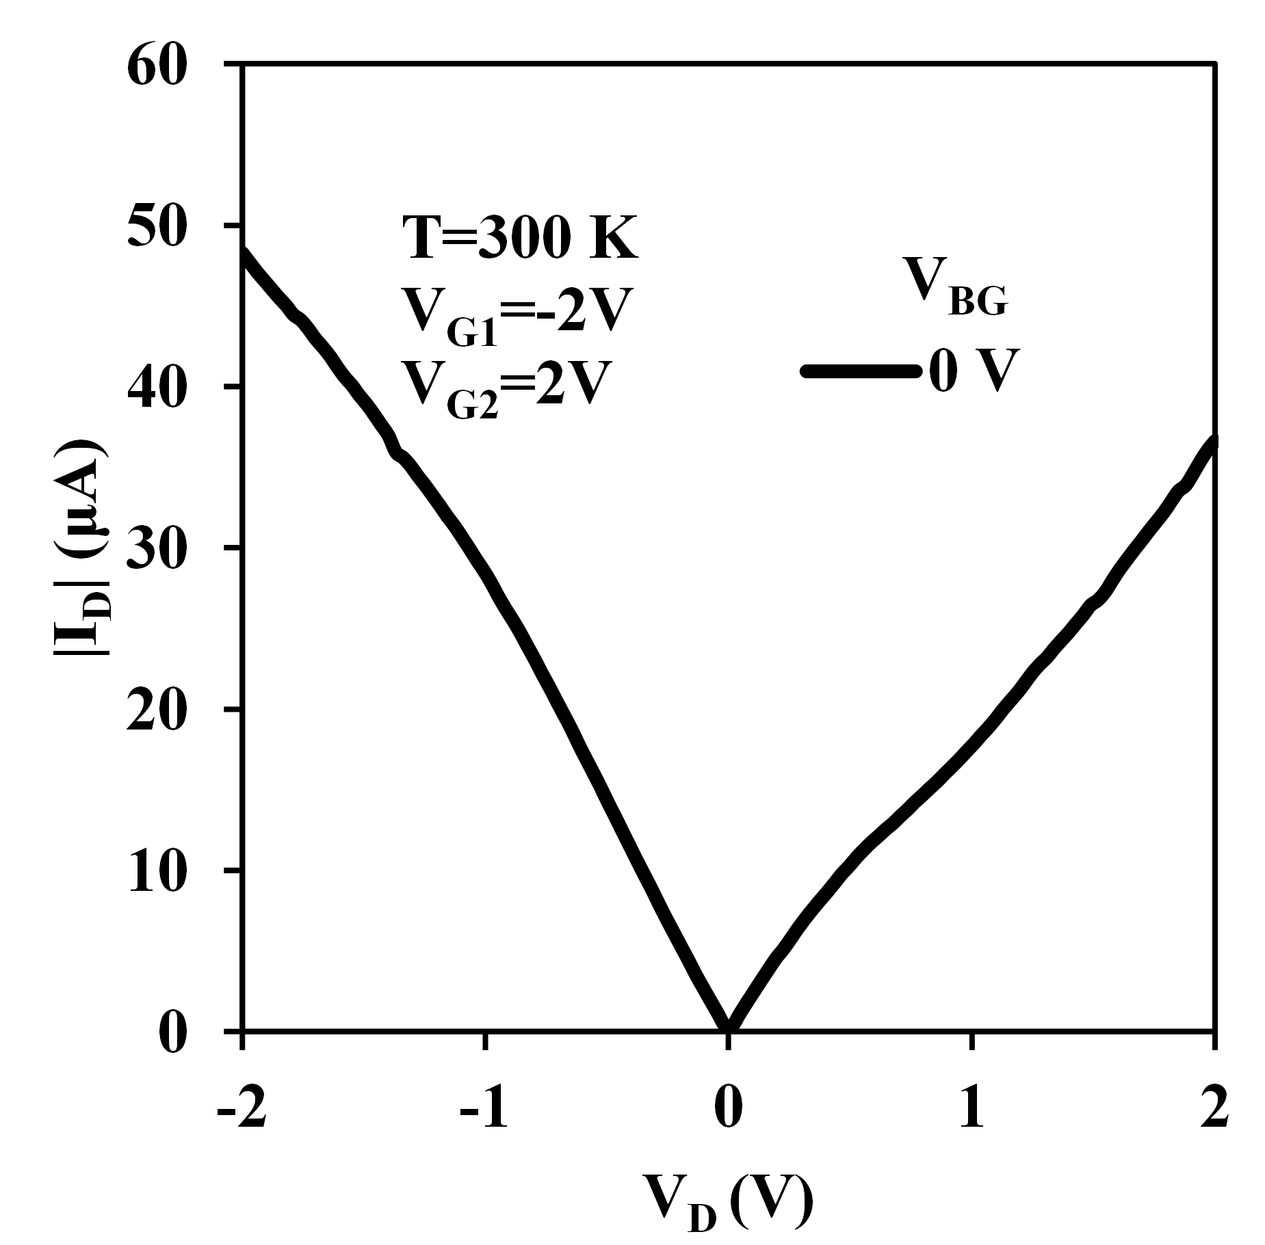
I_{D}-V_{D} at V_{BG}=0 V
Experiment
V_{DS}=0 V
E_{fD}
V_{BG}=0 V
E_{fS}
P++++
N
Tunneling branch
V_{DS}=1 V
E_{fS}
E_{fD}
V_{BG}=0 V
GNR on SiO₂ is p-type doped.
Asymmetric doping explains “non”-NDR behavior

Slide 20
Experimental Id-Vd Characteristics with NDR
Experiment
V_{DS}=0 V
E_{fD}
V_{G}=0 V
E_{fS}
hole
P++++
N
Thermionic branch
Asymmetric doping explains “non”-NDR behavior

Slide 21
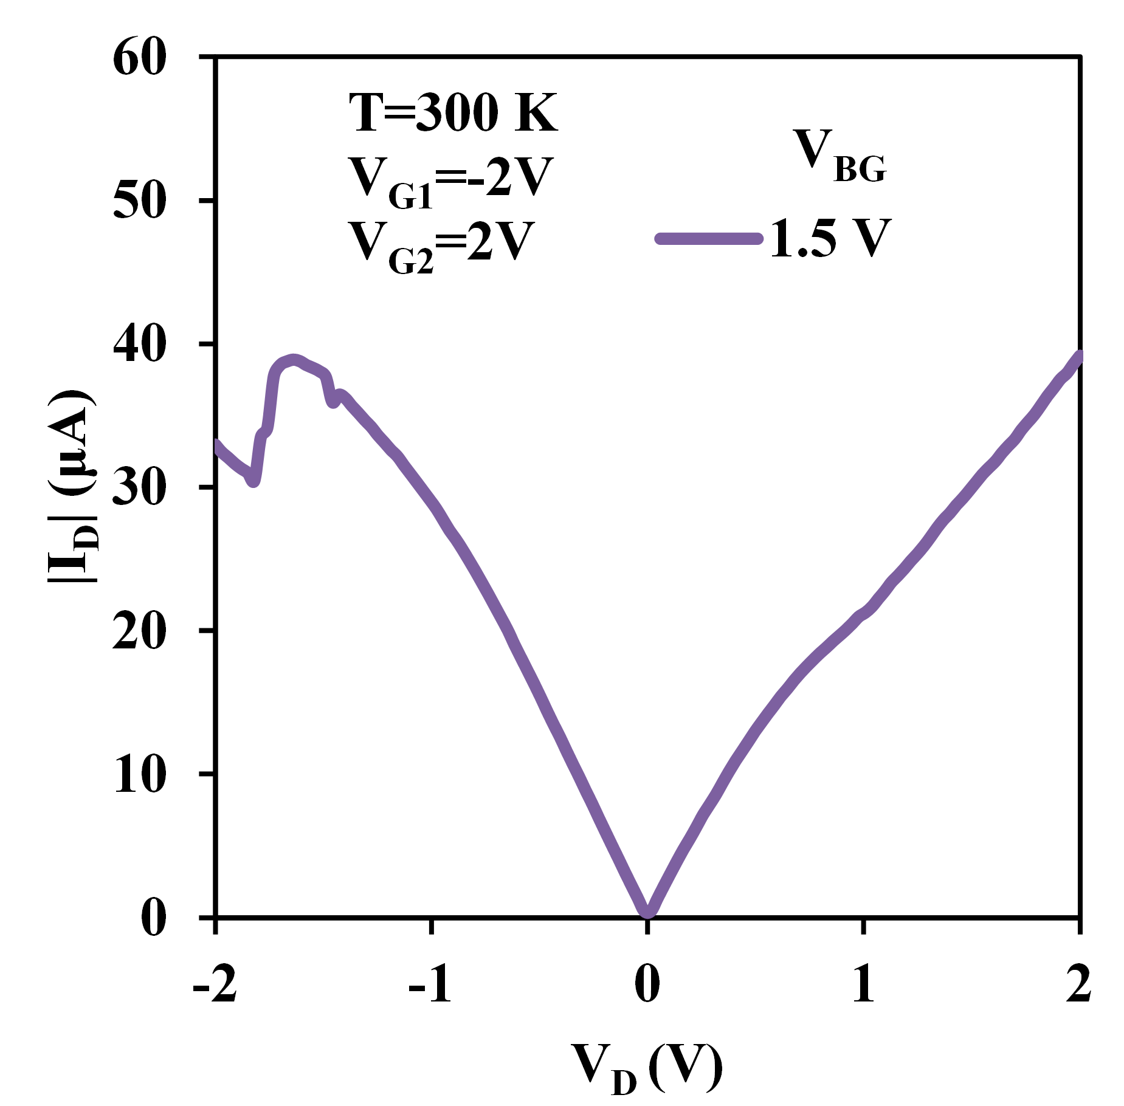
Experimental Id-Vd Characteristics with NDR
Experiment
V_{DS}=0 V
E_{fD}
E_{fS}
P++++
P++
N++
N
V_{BG}=0 V
V_{BG}=1.5 V
Maximum NDR peak occurs when effective doping is symmetric.
NDR due to Esaki-diode like behavior.

Slide 22
Experimental Id-Vd Characteristics with NDR
Experiment
Esaki-diode
V_{DS}=0 V
E_{fD}
E_{fS}
V_{G}=1.5 V
P++
N++
V_{DS}>0 V
E_{fD}
E_{fS}
Maximum NDR peak occurs when the doping is symmetric.
NDR due to Esaki-diode like behavior.

Slide 23
Id-Vd Characteristics: NDR
Experiment
E_{fD}
E_{fS}
E_{fD}
E_{fS}
E_{fD}
E_{fS}
Maximum NDR peak occurs when the doping is symmetric.
NDR due to Esaki-diode like behavior.

Slide 24
Quantum Transport Simulation vs Experiment
V_{G}
P++
E_{fD}
E_{fS}
N++
Open questions
Can quantum transport model capture Id-Vd quantitatively?
G1
30 nm
P
N
30 nm
G2

Slide 25
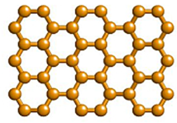
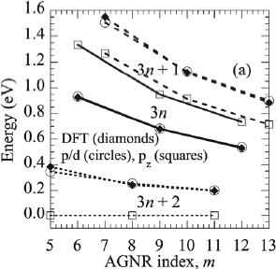
Graphene Modeling (p_{z} vs p/d tight binding)
Bandgap
m=3n+1=7
p/d
Better match with DFT than simple p_{z}.
Explicit treatment of hydrogen atoms
T. Boykin, M. Luisier, G. Klimeck, et al., JAP2011

Slide 26
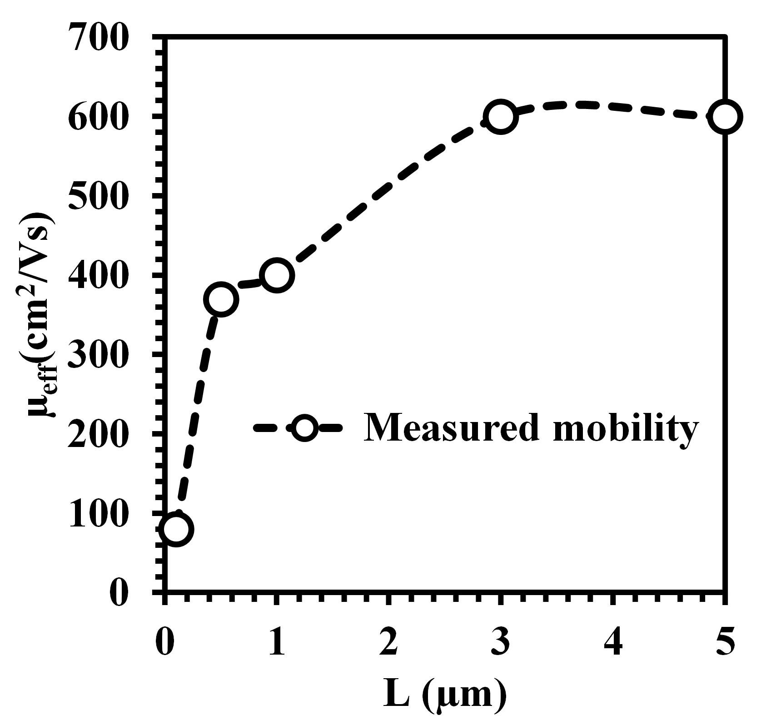
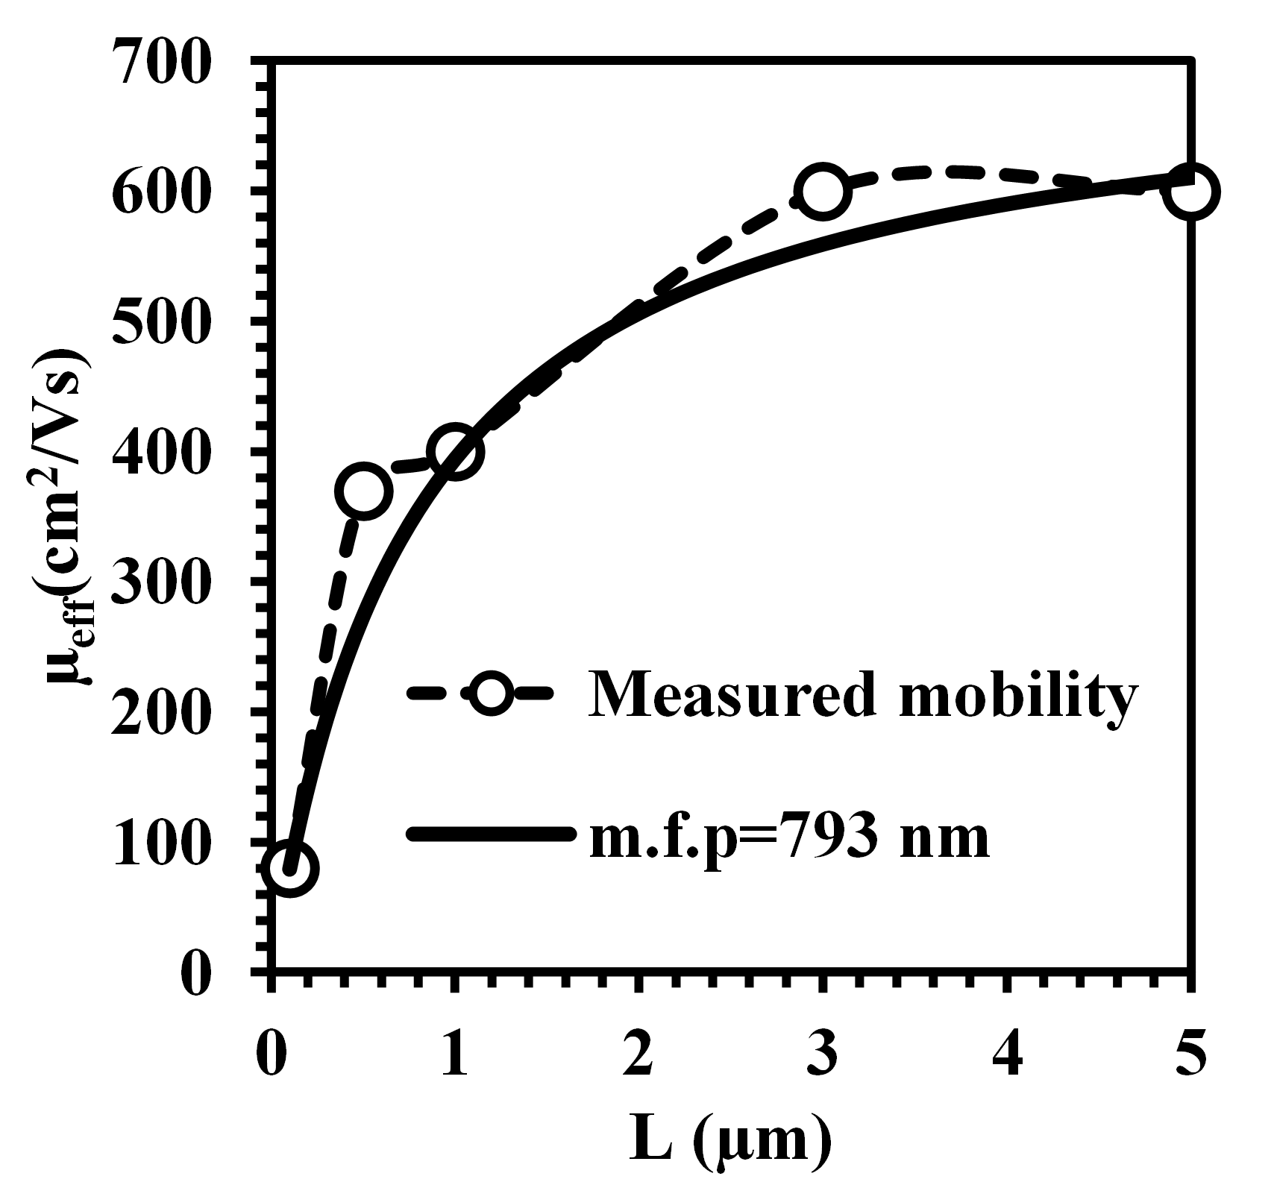
Scattering Theory
Scattering theory is needed for quantitative approach
Experiment | Simulation
1μm | Ballistic
Ballistic simulation→ scattering theory
=0.3
S. Kim, W.Hwang, et al. (unpublished)
1 μm
LSQ fit
Calculate mean free path λ and B from experiment by fitting
Notes:
=Iscatt/Iball

Slide 27
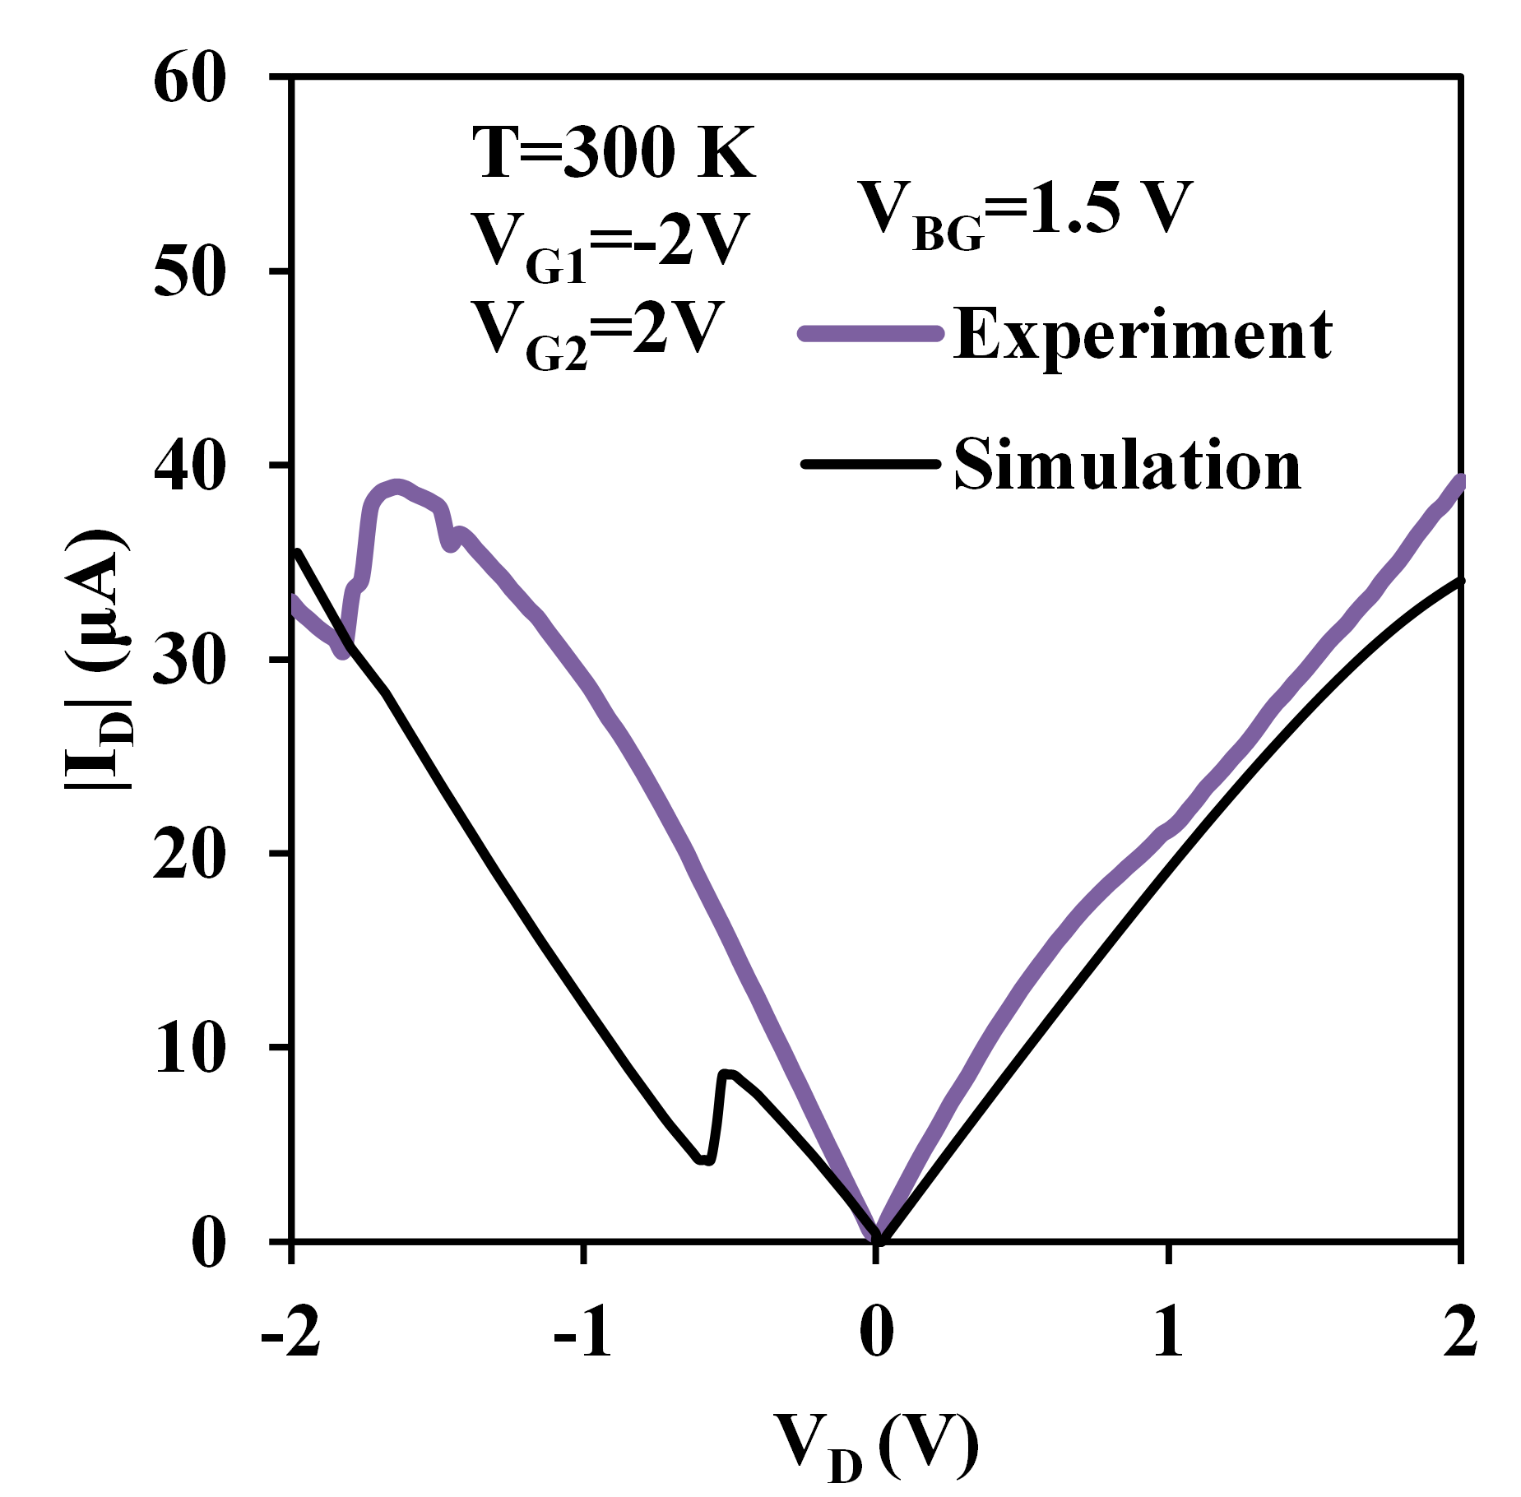
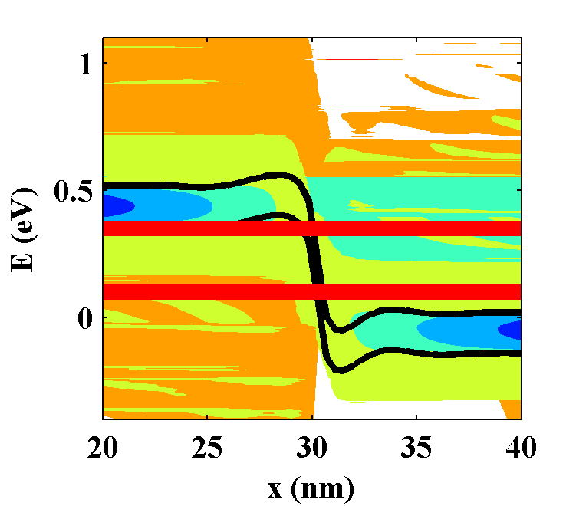
Quantum Transport Simulation vs Experiment
V_{G}
P++
E_{fD}
E_{fS}
N++
N_{A}/N_{D}=1.1x10¹³/cm²
E_{fD}
R_{SD}=300 Ωμm
E_{fS}

Slide 28
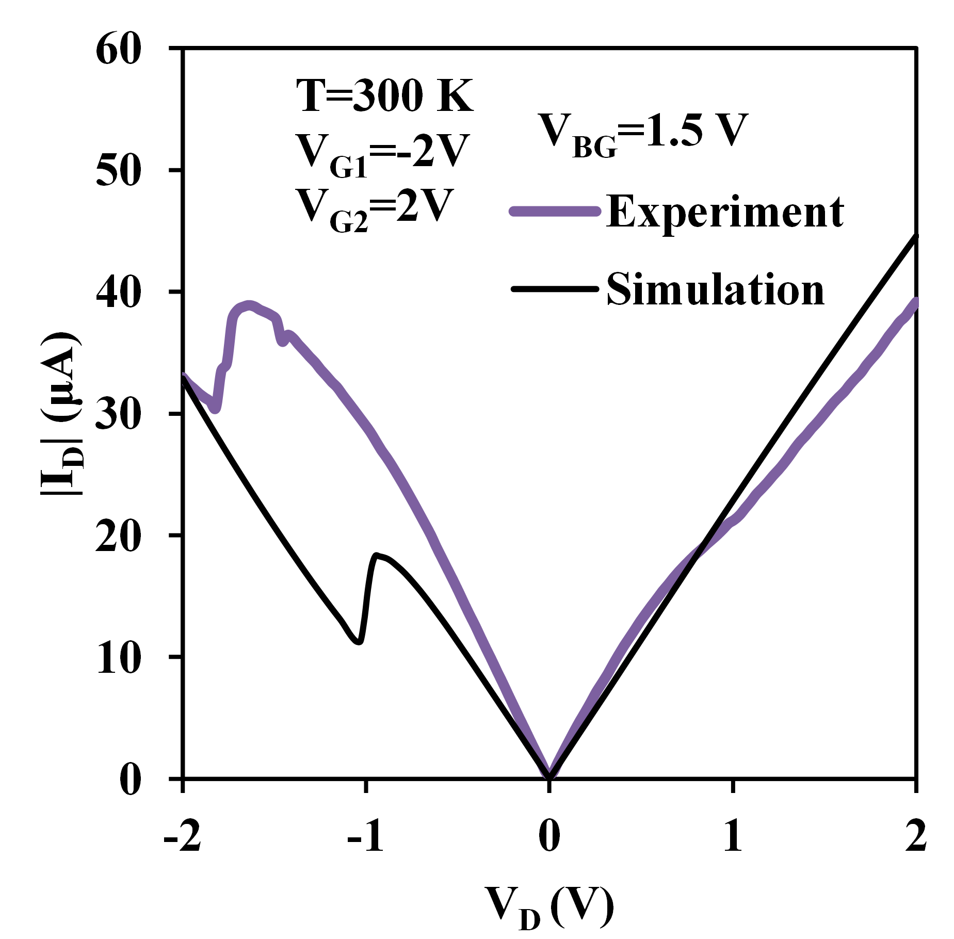
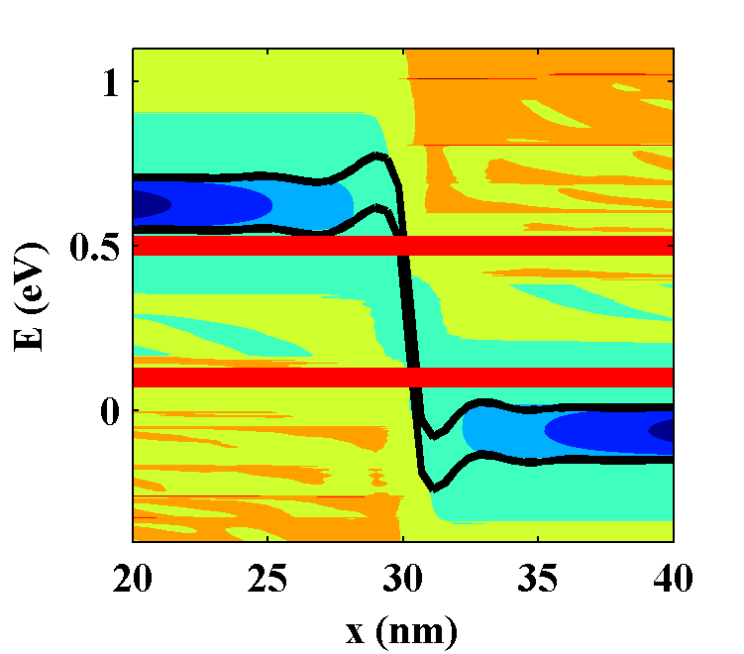
Quantum Transport Simulation vs Experiment
V_{G}
P++
E_{fD}
E_{fS}
N++
N_{A}/N_{D}=2.2x10¹³/cm²
E_{fD}
R_{SD}=300 Ωμm
E_{fS}

Slide 29
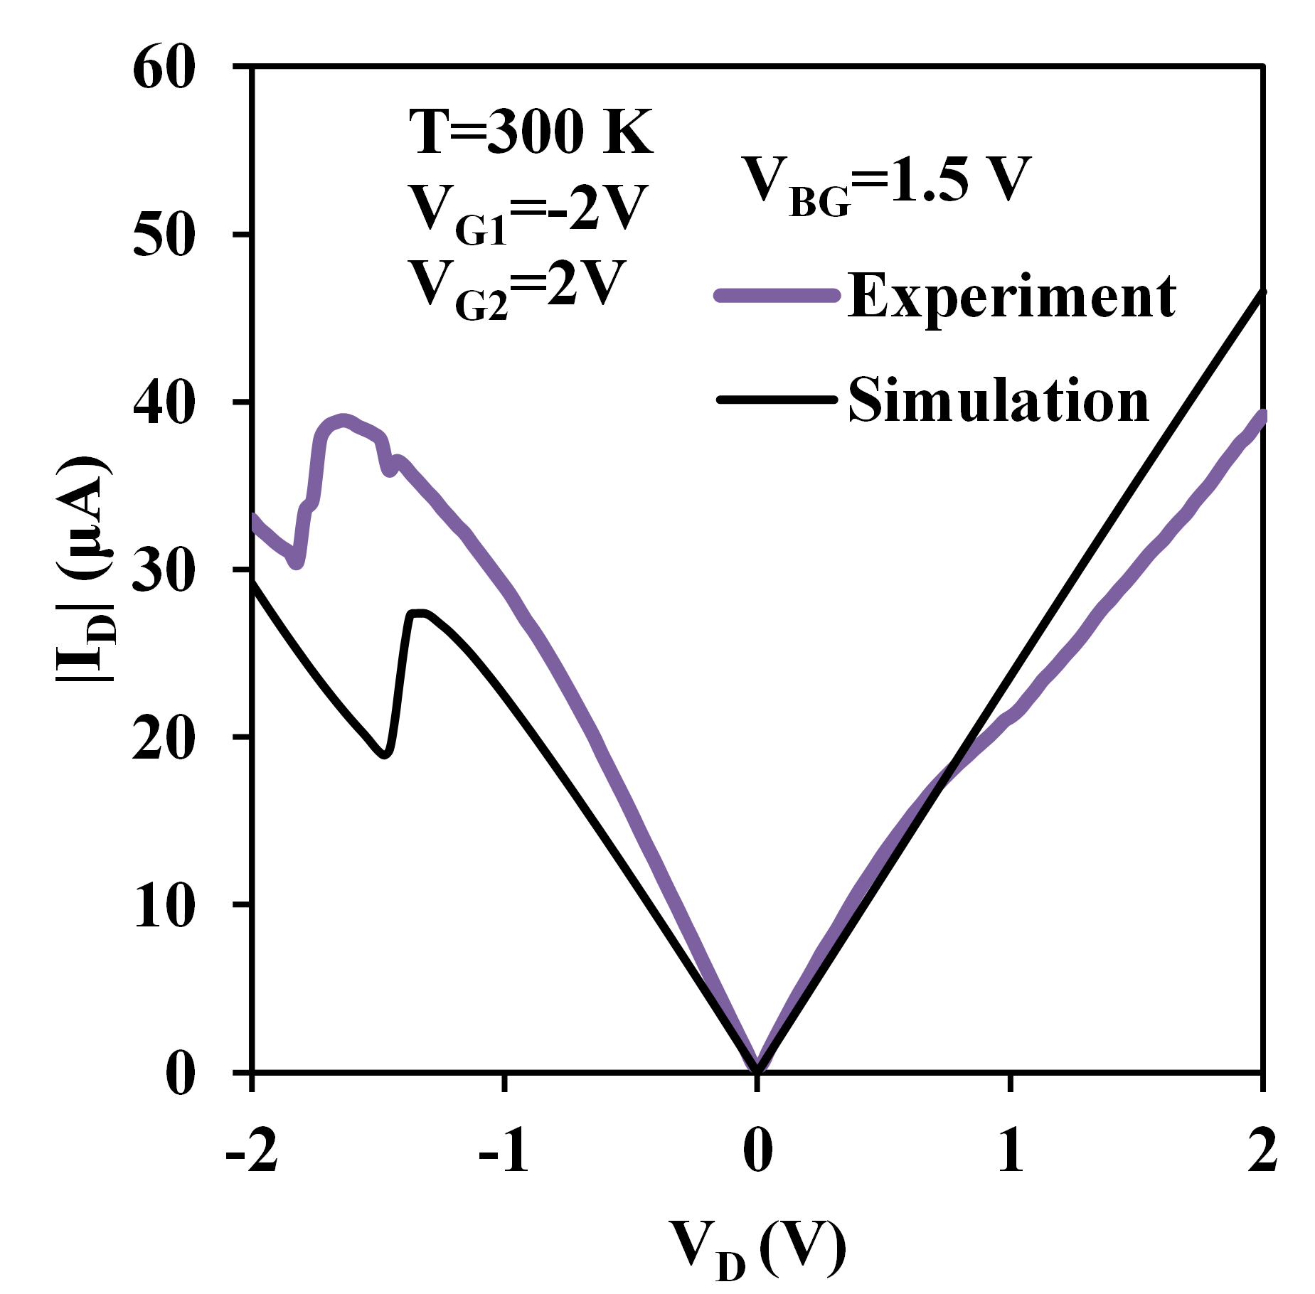
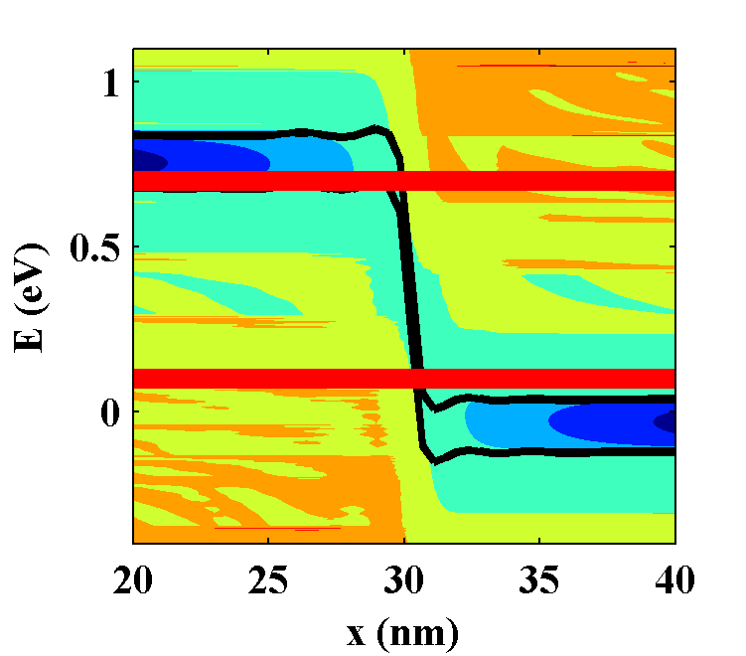
Quantum Transport Simulation vs Experiment
V_{G}
P++
E_{fD}
E_{fS}
N++
N_{A}/N_{D}=4.4x10¹³/cm²
E_{fD}
R_{SD}=300 Ωμm
E_{fS}

Slide 30
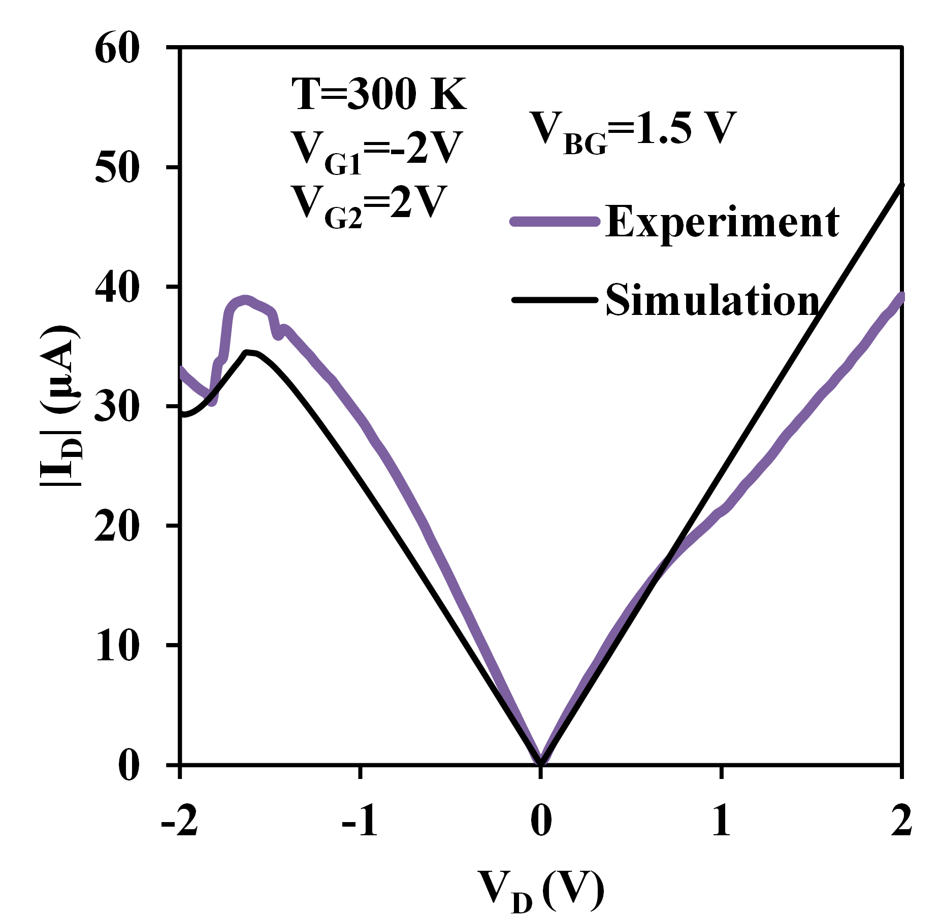
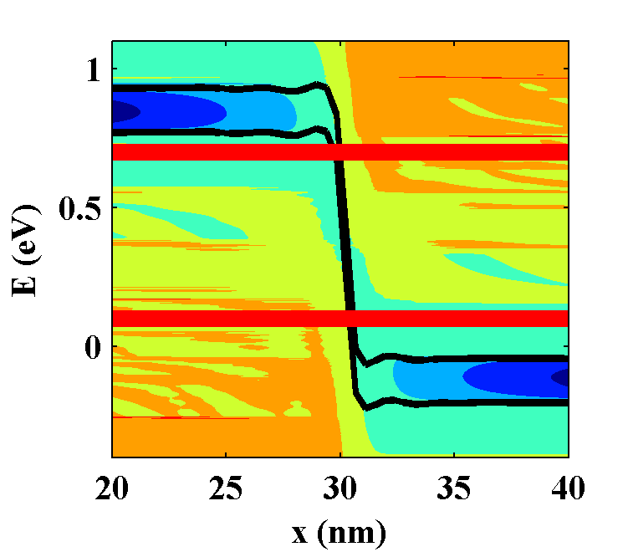
Quantum Transport Simulation vs Experiment
V_{G}
P++
E_{fD}
E_{fS}
N++
`
N_{A}/N_{D}=5.5x10¹³/cm²
E_{fD}
Experimental data is quantitatively captured.
R_{SD}=300 Ωμm
E_{fS}

Slide 31
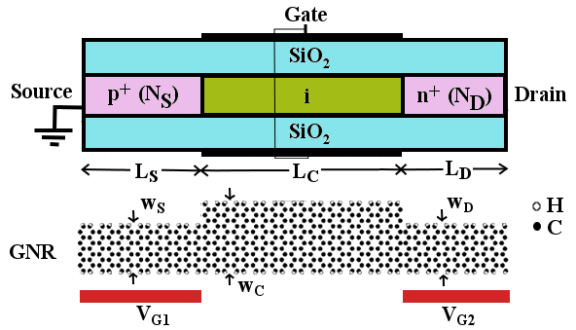
Graphene Nanoribbon Tunneling Transistor
EOT= 1nm
Vdd= 0.3 V
= 30 nm
Electrostatic doping opens a door way to easy band-engineering
p-i-n structure with varying doping concentrations
Varying width from source to drain
31
Notes:
Electrostatic doping opens…

Slide 32
Optimizing GNRTFETs
Band-engineering for low OFF-current and high ON-current
2008, Q. Zhang, A. Seabaugh, et al., IEDL (WKB): SS<60 mV/dec
2009, P. Zhao, J. Guo, et al., Nano Letters. (p_{z} TB): assymetric doping effects - reduction of ambipolar characteristics
2010, J. Chauhan, J. Guo, INEC. (p_{z} TB): underlap - reduction of ambipolar characteristics
2010, P. Michetti, et al., APL (p_{z} TB): thermionic current/V_{DS} effects
2010, Y, Kathami et al., DRC (p_{z} TB): heterostructure-varying width to increase ON-current
Theory
Almost all the study have been done with p_{z} TB model. What if p/d TB?
Can GNRTFET compete with silicon FET?
What are the combined effects of doping/width on thermionic/tunneling current in heterostructure GNRTFET?

Slide 33
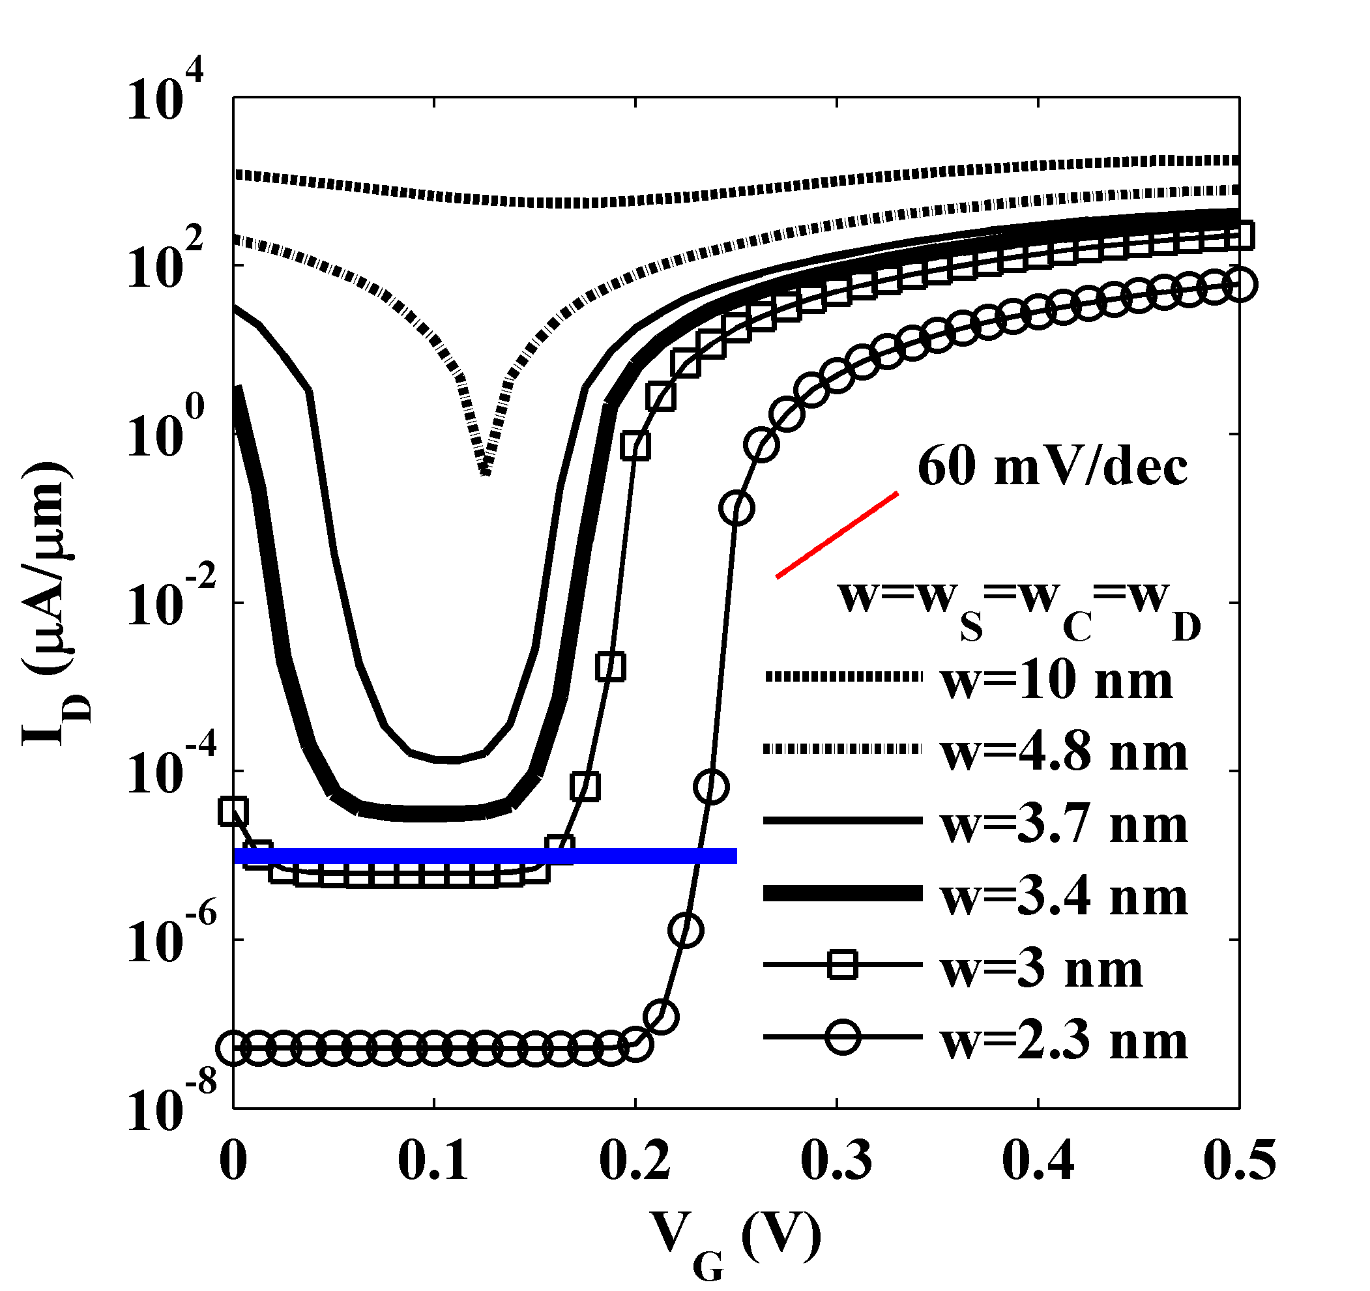
GNRTFET Id-Vg (Ballistic)
There is trade off between I_{ON} and I_{OFF} when the width is changed.
w↓
# of modes↓
E_{G}↑
ITRS LP off-current
requirement
norm. by width
33
Notes:
Add pz vs p/d IV comparison
p-i-n structure

Slide 34
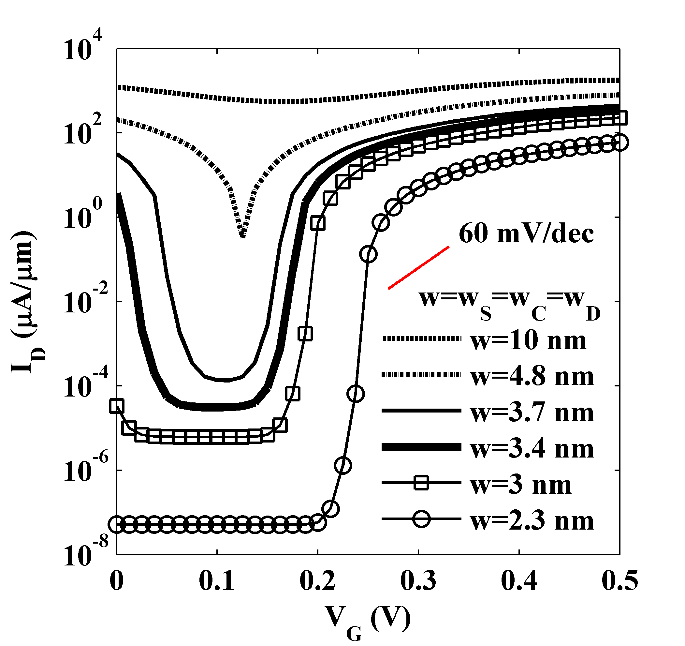
GNRTFET Id-Vg (Ballistic)
Different shape of I-V curve due to different current mechanism.
Sharp
Flat
norm. by width
34
Notes:
Add pz vs p/d IV comparison
p-i-n structure

Slide 35
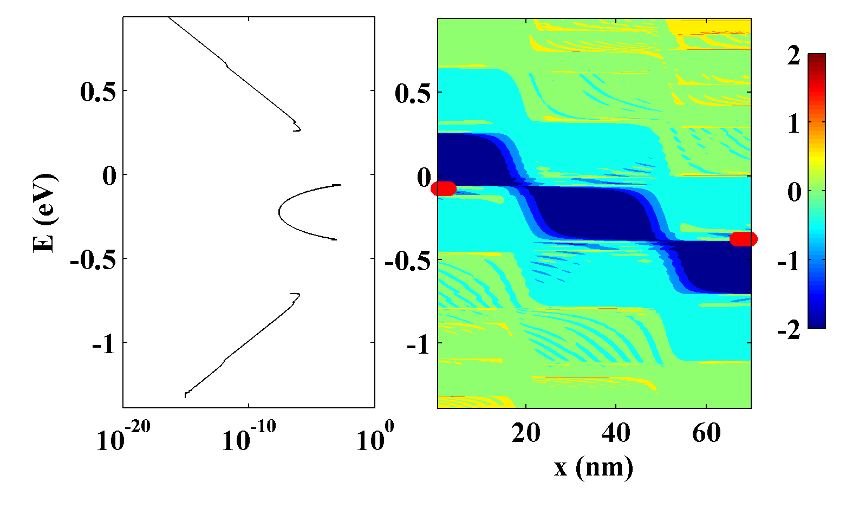
Current Mechanism in GNRTFET with w>3.4 nm
Sharp: width>3.7 nm
4.8 nm
2.2x10¹²cm⁻²
2.2x10¹²cm⁻²
Thermionic
E_{FD}
Tunneling
E_{FS}
Thermionic
log(DOS)
OFF-state, V_{G}=0 .1 V
J(E)=T(E)×(f_{S}(E)-f_{D}(E))
I_{tunneling} dominates the I_{off} for GNRTFETs with small width (w>3.4 nm).
35
Notes:
Show the decision making steps

Slide 36
GNRTFET Id-Vg (Ballistic)
Different shape of I-V curve due to different current mechanism.
Flat
norm. by width
36
Notes:
Add pz vs p/d IV comparison
p-i-n structure

Slide 37
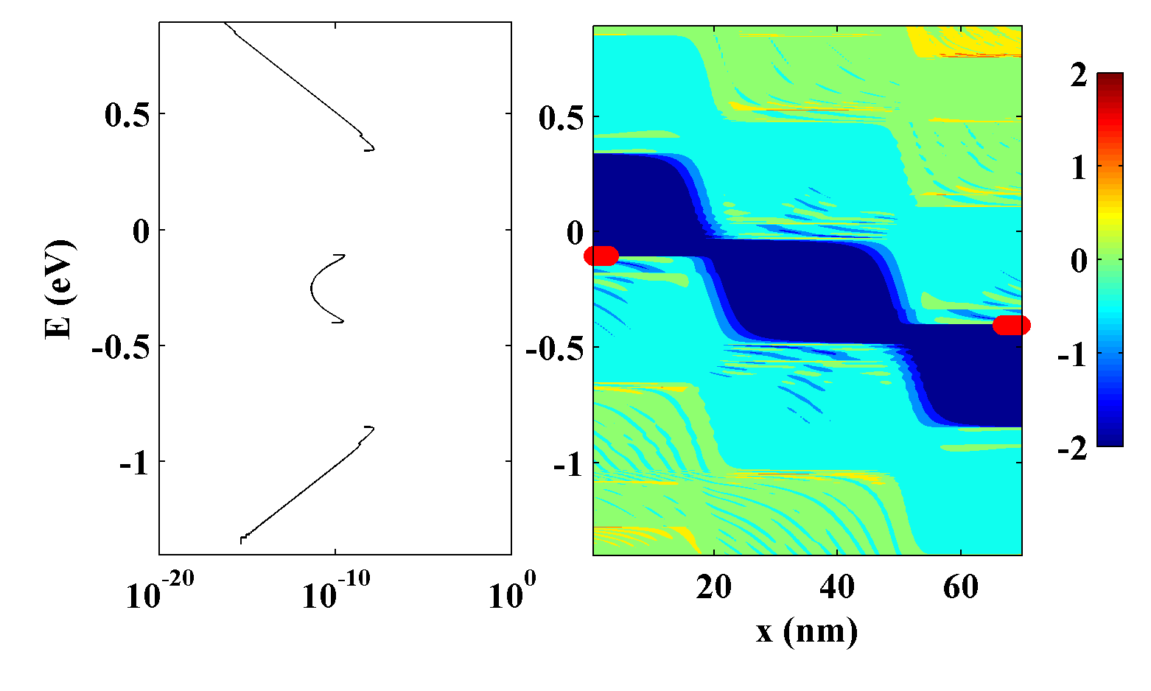
Current Mechanism in GNRTFET with w<3.4 nm
Flat: width<3.7 nm
3.4 nm
Thermionic
2.2x10¹²cm⁻²
2.2x10¹²cm⁻²
Tunneling
E_{FD}
E_{FS}
Thermionic
log(DOS)
OFF-state, V_{G}=0 .1V
J(E)=T(E)×(f_{S}(E)-f_{D}(E))
I_{thermal} dominates the I_{off} for GNRTFETs with small width (w<3.4 nm).
37
Notes:
Show the decision making steps

Slide 38
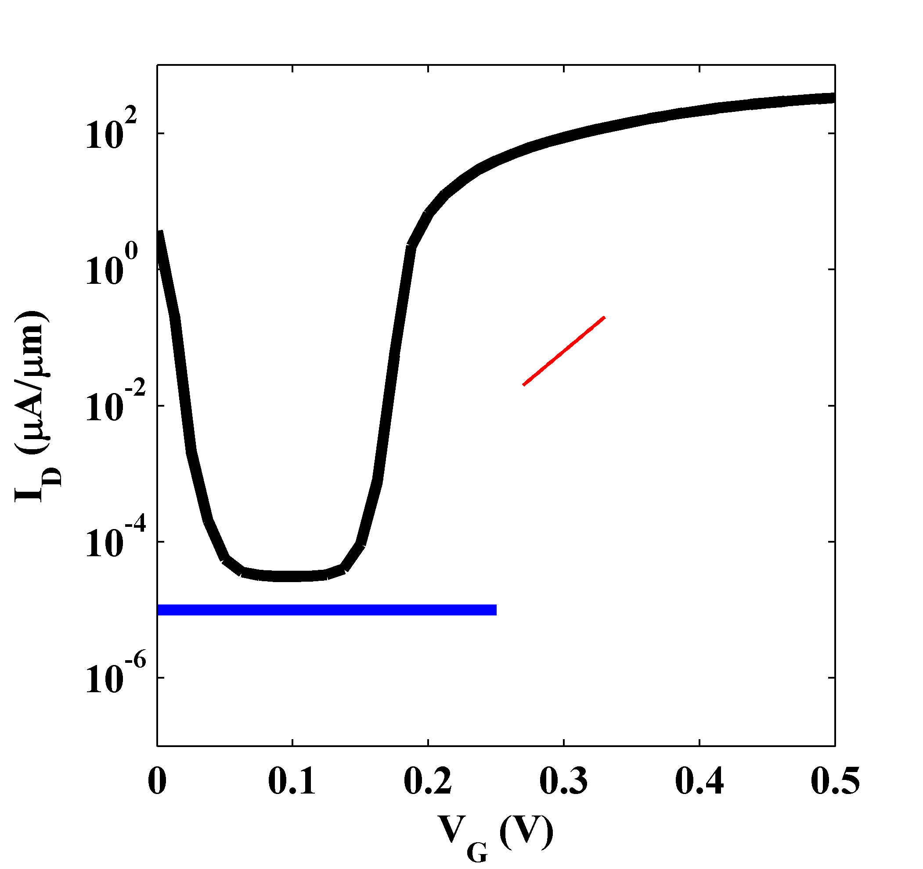
Id-Vg Characteristics Comparison
GNR: L_{g}=30 nm, V_{DS}=0.3 V
3.4 nm
2.2x10¹²cm⁻²
2.2x10¹²cm⁻²
60 mV/dec
I_{OFF} slightly larger than ITRS requirement
Band-engineering
ITRS LP off-current
Minimize I_{OFF}
Maximize I_{ON}
norm. by width
38
Notes:
Put two lines for ITRS off/on current

Slide 39
Reducing OFF current with Heteronegous/Assymmetric Structure
Thermionic current can be reduced with changing size or doping.
Width variation
Asymmetric doping
3.4 nm
1.9 nm
Thermionic
N_{S}↑6.6x10¹²cm⁻²→n↓
N_{D}↓1.1x10¹²cm⁻²→λ↑
J.Knoch,VLSITech. (2009)
P.Zhao,, NanoLett. (2009)
Lam et al., JJAP (2010)
J.Knoch,VLSITech. (2009)
N_{S}↑ → SS↑
width↓
Eg↑
λ
Tunneling
Bad for ON-current
E_{FD}
E_{FS}
width↓
Eg↑
p↓
log₁₀DOS
Thermionic
J(E)=T(E)×(f_{S}(E)-f_{D}(E))
39
Notes:
Add J(E) for original homo junction

Slide 40
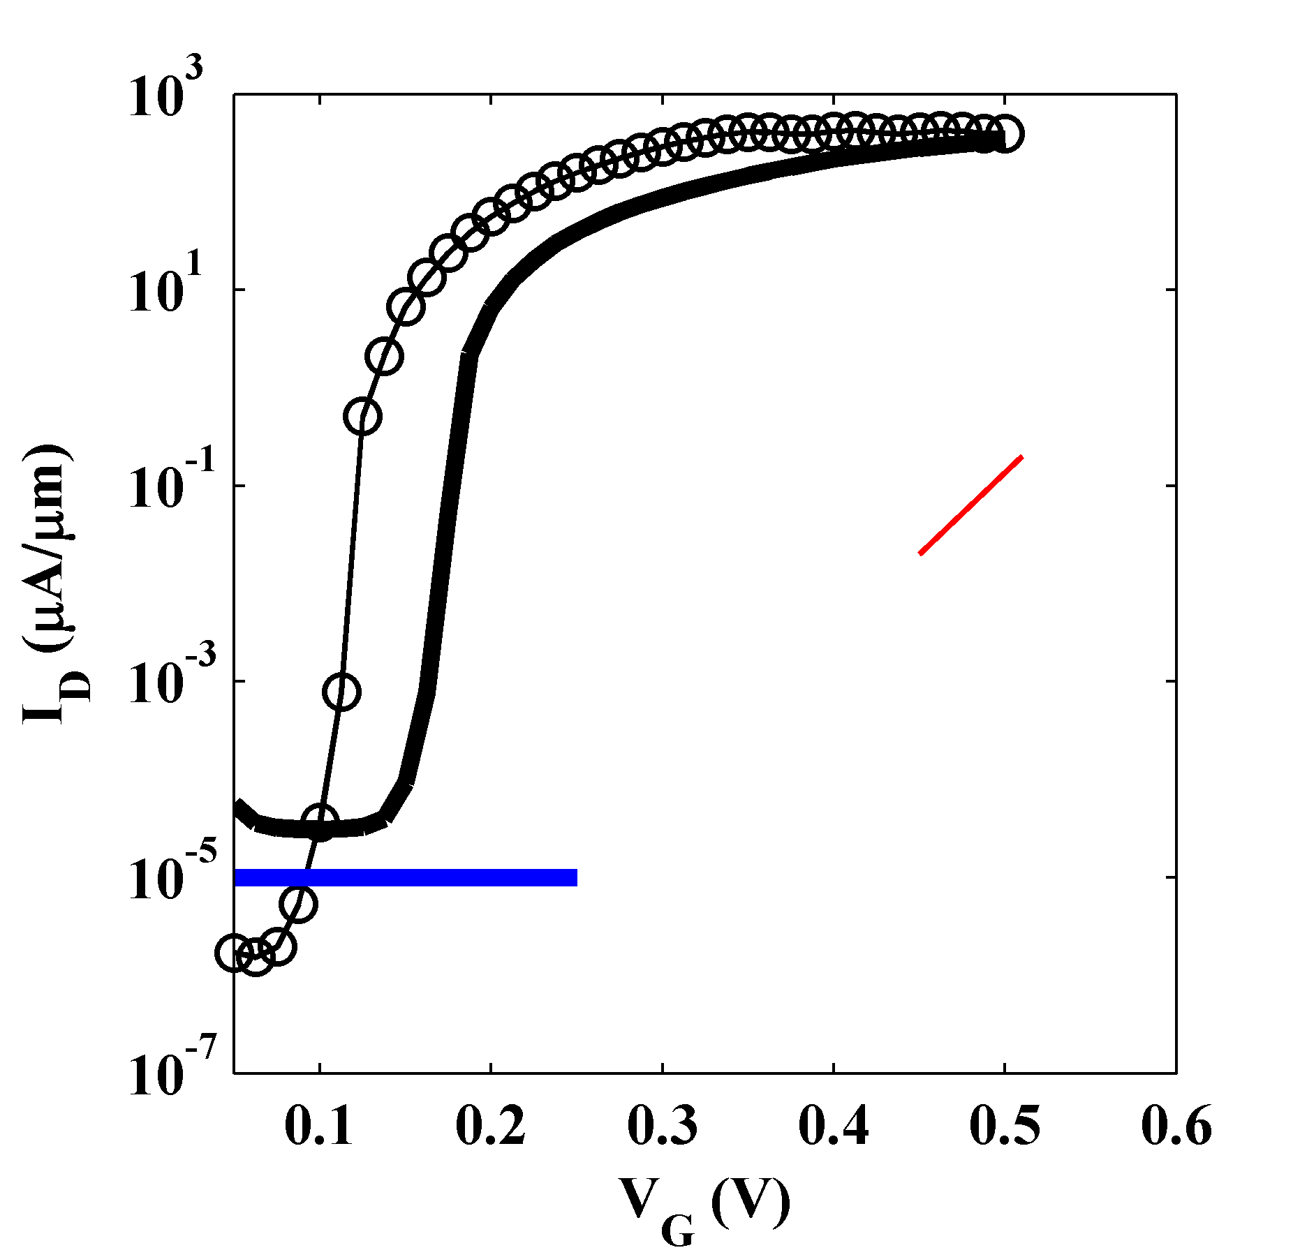
Id-Vg Characteristics Comparison
Through band-engineering off-current can be reduced significantly.
asymmetric, heterojunction
GNRTFET
symmetric, homojunction
60 mV/dec
ITRS LP off-current
×~1/40
norm. by width
40
Notes:
Put two lines for ITRS off/on current

Slide 41
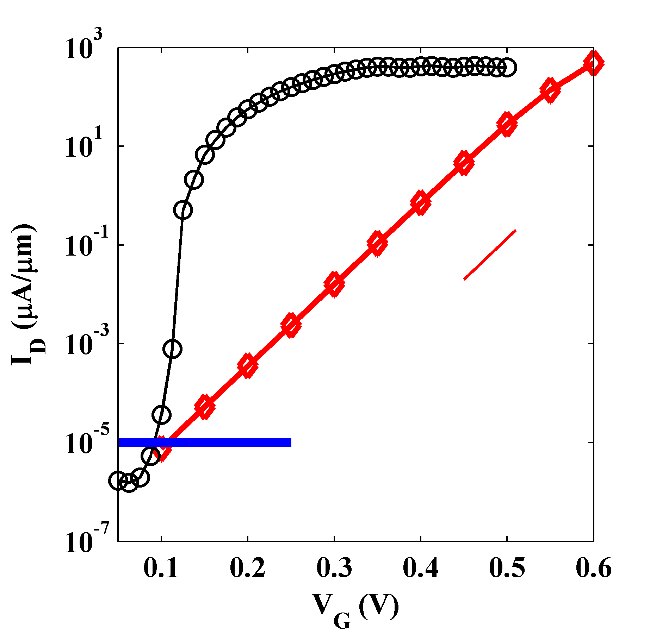
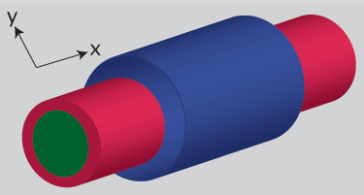
Id-Vg Characteristics Comparison
GNR: L_{g}=30 nm
1.1x10¹²cm⁻²
LP2012 (ITRS): 0.9 V
3.4 nm
GNRTFET
~400 μA/μm
1.9 nm
6.6x10¹²cm⁻²
0.25 V
0.5 V
Significant reduction of power consumption with optimized GNRTFET
60 mV/dec
SiNWFET
D=3 nm
ITRS LP off-current
V_{dd}×1/2
P=fCV_{dd}²×1/4
L_{g}=10 nm
V_{dd}×1/4
P=fCV_{dd}²×1/16
norm. by width/dia
41
Notes:
different fonts for equation. new template, light color.

Slide 42
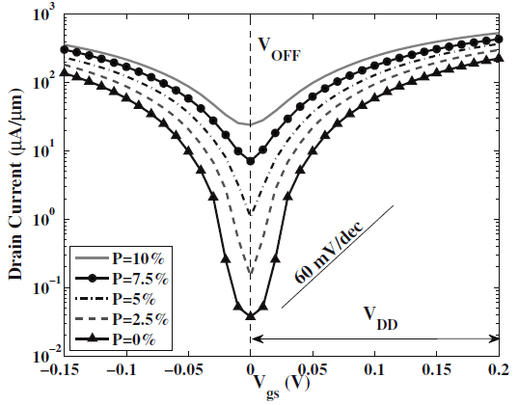
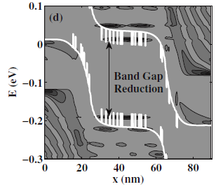
Edge Roughness Effects on GNRTFET w=5.1 nm
p_{z} TB
How much edge roughness affect GNRTFETs with a small width (w<3.4 nm) and p/d TB model?
w=5.1 nm
Edge roughness limited mobility compared with experimental data → Edge roughness quantitative description?
DOS/band diagram
M.Luisier, G. Klimeck, APL2009
Edge roughness is known to degrade the off-current of GNRTFETs
Tunneling current is dominant compared to thermionic current

Slide 43
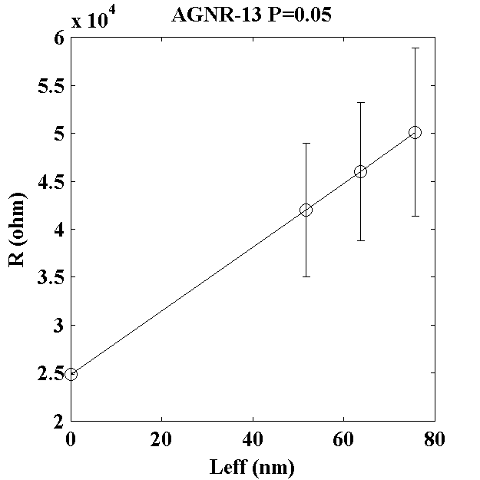
Edge Roughness Limited Mobility
Edge roughness generation procedure
Generate random variable v
from 0 to 1 for each edge C atom.
Compare v with P (e.g. 0.05)
If v<P remove the atom, if not do not.
Edge roughness effects
V_{d}
S
250 samples each
D
I_{d}
C
H
The effects of edge roughness on mobility is calculated through the slope of R vs L
43

Slide 44
Edge Roughness Limited Mobility
Edge roughness generation procedure
Generate random variable v
from 0 to 1 for each edge H atom.
Compare v with P (e.g. 0.05)
If v<P remove the H atom, if not do not.
Hydrogen passivation effects
V_{d}
S
D
250 samples each
I_{d}
C
H
The effects of edge roughness on mobility is calculated through the slope of R vs L
44

Slide 45
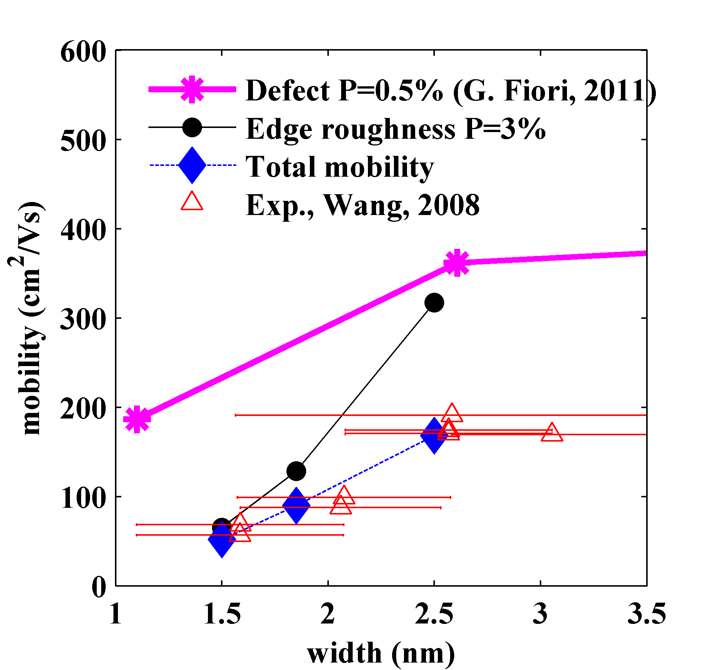
Width-dependent Mobility
Hydrogen roughness limited mobility is 2 order of magnitude larger than edge roughness limited mobility
Edge roughness P=3 % describes experimentally fabricated GNRs mobility.
Hydrogen roughness
(This work)
Exp. Wang, PRL2008
Edge roughness
n~0.95x10¹³/cm²
45

Slide 46
Edge Roughness Effects in GNRTFET w=3.4 nm
Vth,shift
I_{ON(ball)} =424 μA/μm
=18.4 mV
I_{ON(rough)}=270 μA/μm
B=63 %
∆Vth=9mV
3.4 nm
1.9 nm
N_{A}=6.6x10¹²cm⁻²
N_{D}=1.1x10¹²cm⁻²
x1/4
P=3 %
30 samples
OFF-current decrease/Vth shift: edge-roughness effects on I_{thermal}
ON-current decrease: edge-roughness scattering (B~63%)
46

Slide 47
Edge Roughness Effects on Current Spectrum
Edge-roughness mainly reduces OFF-current for small width.
E_{FS}
E_{FD}
log₁₀DOS
Edge roughness scattering reduces thermionic current.
Tunneling current increases at some resonant states, but overall decreases due to scattering.
47

Slide 48
Summary/Conclusion
Power problems can be overcome by TFETs.
GNRs satisfy requirements for good TFETs.
GNRTFETs can be next generation devices if the following obstacles are overcome
Easily realizable doping/p-n junction
OFF-state current is minimized
Edge roughness is controlled.
This study has shown that
Electrostatic doping is possible and p-n junction with NDR is demonstrated and quantitatively analyzed.
OFF-state current can be minimized through engineering bandstructure with doping/width - importance of thermionic current.
Edge-roughness with small probability (P=3%) degrades electron mobility significantly - good edge quality is required.
Edge roughness can decrease off-current in GNRTFET, but can degrade the on-current at the same time.

Slide 49
Acknowledgement
Overall guidance and direction (committee members)
Prof. Gerhard Klimeck
Prof. Mathieu Luisier
Prof. Mark Lundstrom
Prof. Supriyo Datta
Post-Doc/Research Faculty team (Purdue)
Prof. M. Povolotskyi, Prof. T. Kubis, Prof J. Fonseca
Collaboration/Discussion
Prof. T. Boykin (U. of Alabama)
Dr. Kwok (SRC), Prof. D. Antoniadis (MIT)
Prof. A. Seabaugh, Prof. W. Hwang, Prof. D. Jena (ND)
49

Slide 50
Acknowledgement

Slide 51
Thank you!

Slide 52
Quantum Confinement in Si Inversion Layer
Metal
Oxide
Silicon
~0.9 nm*ε_{Si}/ ε _{SiO2}~0.3 nm
SC-CV matched QM-CV with increasing tox by 0.3 nm.

Slide 53
DD for bulk callibrated with MC
Monte Carlo Simulation (Bulk)
µ: mobility, E: longitudinal electric field, v_{sat}: saturation velocity
Bulk: Bude, SISPAD, 2000 Lg>40 nm

Slide 54
How to determin v_{sat}?
Granzner, 2006
β=1
Assump.:Monte-Carlo simulation captures the ballistic transport correctly, the ballistic transport in SOI is similar to bulk

Slide 55
Impacts of the ballistic mobility
Low Vds
Experimental data
Unstrained: A. Cros et al., IEDM, 2006
Strained: F. Andrieu et al., VLSI Tech. Dig., 2005

Slide 56
Intel 32 nm (Id-Vg)
Experimental data: Natarajan et al., IEDM, 2008
Benchmarked with experimental data at L_{G}=32 nm and 20 nm

Slide 57
Nanowire Transistors
N.Singh, IEDL, 2006
Y. Cui, NanoLetters, 2003
Diameter: 5 nm
(Hole) Mobility: average 560 cm²/Vs
Projected SS~60 mV/dec @ Lg=50 nm
Promising SS/Mobility
Lg=180 nm

Slide 58
Scaled Nanowire FETs
IEEE spectrum
IBM,2010
S. Suk, IEDM, 2007 (Samsung)
J. W. Sleights, IEDM, 2011
Diameter: down to 2 nm @Lg=30 nm
Ion~1100 µA/µm (normalized with circ.)
Mobility ~125 cm²/Vs
SS ~ 78 mV/dec
Diameter: down to 3 nm @Lg=234 nm
Mobility ~40 cm²/Vs
Very small nanowires with a short channel
Still not clear what will happen at a channel length 4.1 nm.

Slide 59
MOSFET Electrostatics
log Id
image:http://en.wikipedia.org/wiki/MOSFET
Vg
Conduction-band edge profile

Slide 60
Short Channel Effects
log Id
image:http://en.wikipedia.org/wiki/MOSFET
DIBL increase
Vth shift
SS degradation
Vg
Conduction-band edge profile

Slide 61
Short Channel Effects
Tox
log Id
image:http://en.wikipedia.org/wiki/MOSFET
DIBL increase
Vth shift
SS degradation
Vg
Reduce Tox-utilizing high-K
Halo doping
Conduction-band edge profile

Slide 62
Nanowire Transistors
Year | Author /Journal | Diameter (nm) | Lg (nm) | EOT (nm) | SS (mV/dec) | Mobility (cm2/Vs) | Ion (µA/µm)
2003 | Y.Cui,N.Lett. | 5 | 800 | 600 | >174 | 560 | 200
2006 | Singh,IEDL | 5 | 180 | 9 | 63 | 750 | 1500 (dia.)
2006 | K.Yeo,IEDM | 4 | 15 |  | 71 |  | ~1440 (dia.)
2007 | S.Suk,IEDM | >2 | 30 | 1 | 80 | 190 | ~1100 (cir.)
2011 | J.S.Sleights, IEDM | >3 | 234 |  |  | ~50
Drain
Source
Gate

Slide 63
Bandstructure Effects
Hydrogen Passivation
Edge Roughness
AGNR-13
AGNR-12
2nd subband
2nd subband
1st subband
AGNR 13
1st subband
AGNR 12

Slide 64
Mobility vs Experiment
n~ 0.95x10¹³/cm²
Hydro. Pass.
Experiment: Wang, PRL2008
Edge roughness
Edge roughness dominates the experimental mobility at even small probability!!
Hydrogen passivation less effective than edge roughness

Slide 65
Fundamental Limit of Conventional Transistor
Vg
S
D
log I_{d}
Metal
Oxide
n+
p
Id
n+
Threshold
log f(E), DOS(E)
`
SS≥60 mV/dec
Hot injection
Vg↑
Ef
0
V_{dd}
V_{g}
E
Subthreshold Swing = 1/Subthreshold Slope
x
Hot injection limits the SS of conventional transistors.

Slide 66
SiNW vs. DG
Ballistic Simulation Results
 | I_{ON}(µA/µm)
NW | 3068
DG | 1766
x1.7
NW
DG
DG Data: Mehdi Salmani

Slide 67
SiNW/GNR FET (quasi-1D)
Drain
SiNWFET
Source
Gate
GNR FET

Slide 68
Scaling Transistors
ITRS2012
DD/QT Simulation Results
L_{ch} can be scaled very aggressively with quasi-1D structure.
V_{dd} is not easy to scale. WHY?

Slide 69
CPU clock scaling blocked
Free lunch is over, Herb Sutter,
Dr. Dobb’s Journal, 2005
Size scaling!
$$P=fCV^{2}$$
Power problem becomes very serious.
→Frequency stopped increasing

Slide 70
MOSFET vs TFET: Injection Mechanism
Problem with V_{DD} Scaling:
Subthreshold Swing (SS) limited to 60 mV/dec
Large I_{ON}/I_{OFF} ratio => large V_{DD}
High Power Consumption
V_{DD} scaling not possible:
either increase of I_{OFF}
or decreases of I_{ON}
Solution: BTB Tunneling
No lower limit on the SS
Low Power Consumption
Various designs and materials
Less heat generation
Biggest Challenges:
High I_{ON}
Steep SS
Low I_{OFF}
Mathieu Lusier, OMEN
ON
V_{DD}
Hot Injection
Heat Problem
OFF
ON
ON
Heat Problem
Reduced
V_{DD}
Cold Injection
Material Characteristics
OFF
Inherent in TFET, but caused by external factors:IR,IT
From Gerhard Klimeck’s Physics Seminar 2010
9

Slide 71
Eniac vs. Intel Core Duo
10⁶
10³
10⁵
10⁴

Slide 72
Derivation of effective mobility

Slide 73
Quantitative Analysis: Simulation
chipworks
Simulate intrinsic device characteristics assuming series resistance reduces on-current by ~1/3
2D electrostatics: must
IEEE TED, 2013 submitted
Drift diffusion with quantum corrections
confinement (calibrated with 1D Schroe.-Poisson)
ballistic mobility (good match with exp.)
qausi-ballistic transport (calibrated with M.C.)
Calibrated with exp. (Samsung 20 nm/Intel 32 nm)
Quantum Transport for SOI/DG
:Ballistic+Scattering

Slide 74
Fundamental Problem with Bulk MOSFET
Increasing??
Anlaytical model with arbitrary(?) parameters
Realistic simulation: 2D electrostatics
Decreasing!
ITRS 2012 (MASTAR) | QCDD (new ITRS)
No geometry input | 2D electrostatics
SS as a input | SS as an output
No SCE | SCE captured
I_{on} as a target | I_{on} as an output
2D electrostatic captured: intrinsic performance degradation of Bulk in shorter channel

Slide 75
Fundamental Problem with Bulk MOSFET
Increasing??
Lg (nm) | Literature | Year
32 | S. Natarajan (Intel) | 2009
30 | H.Ohta (Fujitsu) | 2005
30 | E. Morifuji (Toshiba) | 2002
27 | Uejima (NEC) | 2007
20 | Cho (Samsung) | 2011
15 | B. Doyle (Intel) | 2002
15 | Bin Yu (AMD) | 2001
14 | A. Hokazono (Toshiba) | 2002
10 | B. Doyle (intel) | 2007
5 | H. Wakabayashi (NEC) | 2003
Decreasing!
2D electrostatic captured: intrinsic performance degradation of Bulk in shorter channel

Slide 76
SOI/FinFET (quasi-2D)
SOI/DG FinFET better electrostatics → reduced short channel effects
Quantum Transport
=1/4×L_{G}
SOIFET
FinFET
=1/2×L_{G}

Slide 77
How to calculate mobility or mean free path
µ₀ is long channel mobility:
1. Experiment
2. Calculations
a) Benchmark with experiment like what we did for IBM 22nm SOI (lack of experiments)
b) Atomistic modeling (very expensive) c) Simple available mobility models for bulk (it wont work well for ultra scaled devices)

Slide 78
Difficult Supply Voltage Scaling
Stop scaling Vdd/L_{G}
or at least slow down scaling
log I_{d}
2026 (Old ITRS)
2012
2026 simulation
SS≥60 mV/dec
ITRS2012
0
V_{dd}
V_{g}
Subthreshold Swing = 1/Subthreshold Slope
Supply voltage scaling is hampered by unscalable SS
Short channel effects make it even worse.

Slide 79
Tunneling Current/Thermionic Current
OFF | N_{S}↑ | N_{D}↑ | S/D Width↑
I_{th} | ↓ | ↓ | ↑
I_{tunneling} | N/A | ↓ | ↑
SS | ↑ | N/A | ↑
ON | N_{S}↑ | N_{D}↑ | Width↑
I_{tunneling} | ↑ | N/A | ↓

Slide 80
Fabrication of GNRs (ND)
Wafer scale multiple GNRs
Picture: Wansik Hwang

Slide 81
Id-Vg Characteristics
EOT=90 nm
Back-gate
Poor SS

Slide 82
Electrostatic dopiong
SG2=2 V
D. Efetov, P. Kim, 2010, PRL
W. Hwang (unpublished)

Slide 83
Ballistic Simulation Result
Ballistic simulation

Slide 84
Graphene Nanoribbon for Tunneling Transistors
Material
3n+1 group
Graphene nanoribbon:
Low bandgap/effective mass compared to other material
Small screening length (1D)
84

Slide 85
Closer Look at I_{D}-V_{D}
V_{G}
P++
E_{fD}
E_{fS}
N++
P+++
E_{fD}
E_{fS}
N+
V_{G}
P
E_{fD}
E_{fS}
N++++

Slide 86
Bandstructure Effects
Hydrogen Passivation
Edge Roughness
AGNR-13
AGNR-12
2nd subband
2nd subband
1st subband
AGNR 13
1st subband
AGNR 12

Slide 87
Edge roughness effects on p/d vs pz model
P=3 %
P=3 %
p/d
w=4.7 nm
pz
w=4.7 nm
p/d vs pz: current increases when w=4.7 nm.

